Slide 1
AWS Storage Design
1

Slide 2
3
Selecting the Storage Service
Simple Storage Service (S3)
Glacier
CloudFront
Elastic Block Store (EBS)
Storage Gateway
Snow family
Databases

Slide 3








Block, Object and File Storage
Amazon S3
http://s3.aws-region.amazonaws.com/bucket/object
Amazon Elastic Block Store (EBS)
Amazon Elastic File System
Corporate data center
Availability Zone
HDD/SSD
Volume
/dev/xvdf EC2 Instance
REST API: GET, PUT, POST, SELECT, DELETE
File system
On-premises client
NFS v1
Note: Linux only
Object
Availability Zone
/efs-mnt
EC2 Instance
Availability Zone
/efs-mnt
EC2 Instance
Internet Client

Slide 4
4
Block Storage
Used on local networks
iSCSI
Fibre Channel
AWS can use block storage with virtual machines within the AWS cloud using EBS

Slide 5
5
File Storage
AWS uses similar, called object storage in S3
Used with NAS devices locally

Slide 6
6
Selecting Storage
Size
Performance
Cost

Slide 7
S3 Storage Class
7

Slide 8

Amazon S3 Storage Classes
There are six S3 storage classes.
S3 Standard (durable, immediately available, frequently accessed).
S3 Intelligent-Tiering (automatically moves data to the most cost-effective tier).
S3 Standard-IA (durable, immediately available, infrequently accessed).
S3 One Zone-IA (lower cost for infrequently accessed data with less resilience).
S3 Glacier (archived data, retrieval times in minutes or hours).
S3 Glacier Deep Archive (lowest cost storage class for long term retention).

Slide 9
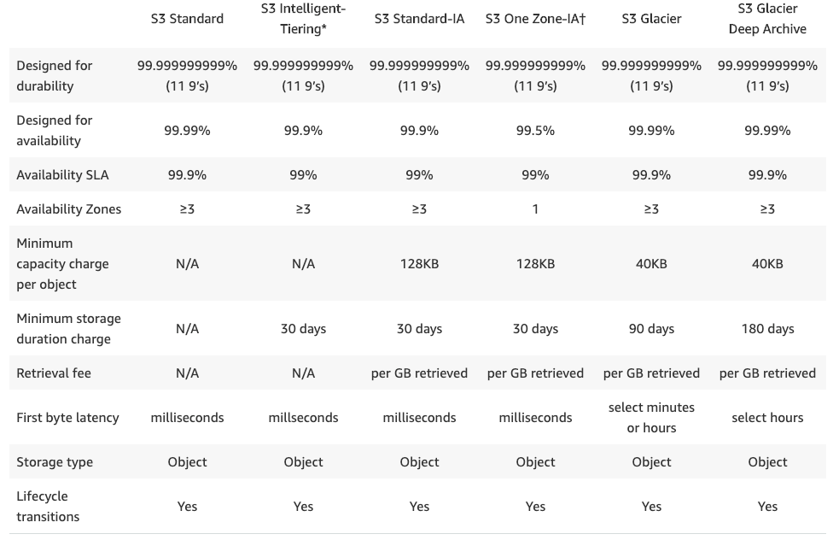
Amazon S3 Storage Classes

Slide 10
8
S3 Storage Overview
Object storage
Distributes across at least three Availability Zones
Except: 1A (1 zone, least expensive)

Slide 11







Amazon S3 Overview
Bucket
http://bucket.s3.aws-region.amazonaws.com
Amazon S3
Private Connection
http://s3.aws-region.amazonaws.com/bucket
VPC
S3 Gateway Endpoint
Public subnet
EC2 Instance
Object
Public Internet
Key
Version ID
Value
Metadata
Subresources
Access control information
Internet gateway
Private subnet
EC2 Instance
Internet Client

Slide 12
9
S3 Storage Overview
Supports encryption and automatic data classification
Big data analytics can run directly against stored data

Slide 13
10
Getting Data into S3
API (Application Programming Interface)
Amazon Direct Connect
Storage Gateway
Kinesis Firehose
Transfer Acceleration

Slide 14
11
Getting Data into S3
Snow family
Snowball
Snowball Edge
Snowmobile

Slide 15
S3 Terminology
12

Slide 16
13
S3 Concepts
Buckets
Regions
Objects
Keys
Object URLs
Eventual consistency
Works great for static website hosting

Slide 17
14
S3 Concepts
Works great for static website hosting

Slide 18
15
Common S3 Operations
Creating and deleting buckets
Writing objects
Reading objects
Deleting objects
Managing object properties
Listing keys in buckets

Slide 19
16
REST Interface
Representational State Transfer (REST)
S3 API
Maps HTTP methods to CRUD operations
Create uses PUT or POST
Read uses GET
Update uses POST or PUT
Delete uses DELETE

Slide 20
S3 Advanced Features
17

Slide 21
18
S3 Features
Prefixes and delimiters
Storage classes
Object lifecycle management
Encryption
Versioning

Slide 22


S3 Encryption
Server-side encryption with S3 managed keys (SSE-S3)
Server-side encryption with AWS KMS managed keys (SSE-KMS)
Server-side encryption with client provided keys (SSE-C)
Client side encryption
S3 managed keys
Unique object keys
Master key
AES 256
KMS managed keys
Customer master keys
CMK can be customer generated
Encryption / decryption
Encryption / decryption
Encryption / decryption
Encryption / decryption
Client managed keys
Not stored on AWS
Client managed keys
Not stored on AWS

Slide 23
19
S3 Features
Multi‐Factor Authentication (MFA) Delete
Multi‐part upload
Range GETs
Cross‐Region replication
Logging
Event notifications

Slide 24
Glacier
26

Slide 25
27
Glacier Overview
Archival data storage
Fractions of a penny per GB/month
Three access methods
Expedited (3‐5 minutes)
Standard (3‐5 hours)
Bulk (5‐12 hours)

Slide 26
28
Glacier Overview
You define the Region for data storage
Data stored with AES 256‐bit encryption

Slide 27
29
Glacier Integration
S3 cold data can be automatically moved into Glacier
Snow devices can be used to import data
Storage Gateway can connect to Glacier

Slide 28
30
Glacier Concepts
Archives
Vaults
Vault locks
Data retrieval
Up to 5% retrieved at no charge, no rollover
Vault can be configured to limit costs

Slide 29
Elastic Block Store (EBS)
37

Slide 30
38
EBS Overview
Used for durable storage in EC2 instances
Block‐level storage from one AWS service to another

Slide 31
39
EBS Volume Types
Magnetic
SSD (solid‐state drive)
General purpose
Provisioned IOPS
PIOPS (provisioned input/output operations per second)
EBS‐optimized instance should be used

Slide 32
40
Protecting EBS Data
Snapshots
Volume recovery
Attaching volumes from one instance to another
Encryption methods

Slide 33


EBS Snapshots
Region
Availability Zone A
Amazon S3
EC2 Instance
Volume
Snap A
Snap B
Snap CB
Availability Zone B
EC2 Instance
Volume

Slide 34
Elastic File System (EFS)
43

Slide 35
44
EFS Overview
Shareable
Hierarchical
Can be accessed through NFSv4
EBS volumes are dedicated to an instance

Slide 36


EFS Overview
Region
VPC
Availability Zone
VPC
Peering
Corporate data center
EFS File system
VPN or Direct Connect connection
On-premises client
NFS v1
Note: Linux only
Availability Zone
/efs-mnt
EC2 Instance
Availability Zone
/efs-mnt
EC2 Instance

Slide 37
45
EFS Overview
EC2 instances can use EFS shares
EFS is not supported on Windows instances

Slide 38
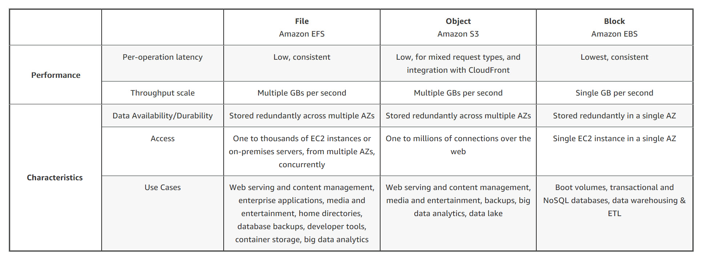
46
Storage Comparison
https://aws.amazon.com/efs/when‐to‐choose‐efs/

Slide 39
49
AWS Storage Gateway
Uses a software appliance to implement the gateway
Provides three types of storage solutions:
File‐based
Volume‐based
Tape‐based

Slide 40



Intro to Amazon FSx
52

Slide 41



Amazon FSx for Windows File Server
Support for native Windows file system features:
Region
ACLs, shadow copies, user quotas
NTFS file systems
SMB protocol
VPC
Availability Zone
Public subnet
Corporate data center
EC2 Instance (Windows)
Amazon FSx
VPN or Direct Connect connection
On-premises client (Windows)
Public subnet
Availability Zone
AWS Managed Microsoft AD
With multi-AZ a standby can be created in another AZ
EC2 Instance (Windows)

Slide 42
Integrating On-Premises Storage
56

Slide 43








AWS Storage Gateway – File Gateway
Corporate data center
The file system is mounted using NFS or SMB
AWS Cloud
Can store data in multiple S3 storage classes
S3 Standard
Server
AWS Storage Gateway
S3 Standard IA
Files are stored as objects in S3, a local cache provides low latency access to recently used data
Virtual gateway appliance
runs on Hyper-V, VMware, or EC2
S3 One Zone IA

Slide 44
57
AWS Storage Gateway
Software appliance creates the gateway
Provides three types of storage solutions:
File‐based
Volume‐based
Tape‐based

Slide 45
58
Utilization Process
https://docs.aws.amazon.com/storagegateway/l atest/userguide/WhatIsStorageGateway.html

Slide 46
Storage Performance
62

Slide 47
63
Storage Performance
EBS volume types
https://docs.aws.amazon.com/AWSEC2/latest/User Guide/EBSVolumeTypes.html
S3 storage classes
https://aws.amazon.com/s3/storage‐ classes/?nc=sn&loc=3

