Slide 1
CloudWatch CloudTrail

Slide 2







Amazon CloudWatch – Examples of Functionality
Dashboard
Metrics:
Logs:
Application logs System logs
ConsumedReadCapacityUnits, ConsumedWriteCapacityUnits
Amazon DynamoDB
Amazon EC2
Events:
ECS Task State Change ECS Container Instance State Change
Metrics:
CPU Utilization
Amazon CloudWatch
Alarms:
Initiate scaling event
Event triggers function
Amazon Elastic Container Service
AWS Auto Scaling
Lambda function

Slide 3





VPC Flow Logs
VPC
Public subnet
Flow logs
Private subnet
Flow logs
EC2 Instance
Flow logs

Slide 4
Amazon CloudWatch Overview
Amazon CloudWatch monitors AWS resources and applications in real-time.
CloudWatch collects and tracks metrics.
Metrics are data points that are published to CloudWatch.
CloudWatch alarms monitor metrics and automatically initiate actions.
CloudWatch Logs centralizes logs from systems, applications and AWS services.
CloudWatch Events delivers a stream of system events that describe changes in AWS resources.

Slide 5
Amazon CloudWatch – Key Terminology and Concepts
Namespace:
A namespace is a container for CloudWatch metrics.
Metrics in different namespaces are isolated from each other, so that metrics from different applications are not mistakenly aggregated into the same statistics.

Slide 6
Amazon CloudWatch – Namespaces
Service | Namespace
Amazon API Gateway | AWS/ApiGateway
Amazon CloudFront | AWS/CloudFront
AWS CloudHSM | AWS/CloudHSM
Amazon CloudWatch Logs | AWS/Logs
AWS CodeBuild | AWS/CodeBuild
Amazon Cognito | AWS/Cognito
Amazon DynamoDB | AWS/DynamoDB
Amazon EC2 | AWS/EC2
AWS Elastic Beanstalk | AWS/ElasticBeanstalk

Slide 7
Amazon CloudWatch – Key Terminology and Concepts
Metrics:
Metrics are the fundamental concept in CloudWatch.
A metric represents a time-ordered set of data points that are published to CloudWatch.
AWS services send metrics to CloudWatch.
You can also send your own custom metrics to CloudWatch.
Metrics exist within a region.
Metrics cannot be deleted but automatically expire after 15 months.
Metrics are uniquely defined by a name, a namespace, and zero or more dimensions.

Slide 8


Amazon CloudWatch - Metrics
ConsumedReadCapacityUnits, ConsumedWriteCapacityUnits
CPUUtilization, DiskReadOps, NetworkIn, StatusCheckFailed
Amazon DynamoDB
Amazon EC2
ReadLatency, FreeStorageSpace, WriteIOPS, WriteLatency
BucketSizeBytes, NumberOfObjects, GetRequests, PutRequests
Amazon CloudWatch
Amazon Simple Storage Service (S3)
Amazon RDS

Slide 9
Amazon CloudWatch – Key Terminology and Concepts
Dimensions:
A dimension is a name/value pair that is part of the identity of a metric.
You can assign up to 10 dimensions to a metric.
Dimensions are categories for the characteristics of each metric.

Slide 10
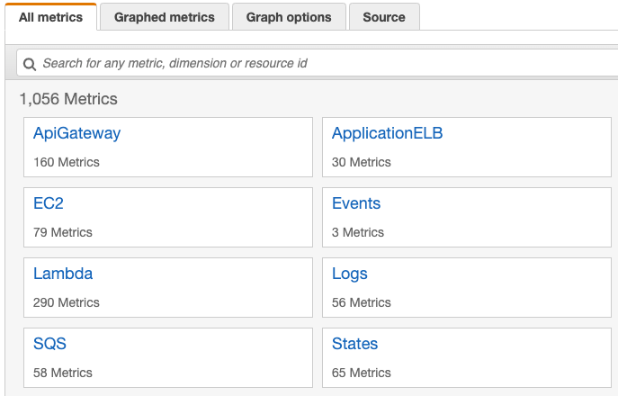
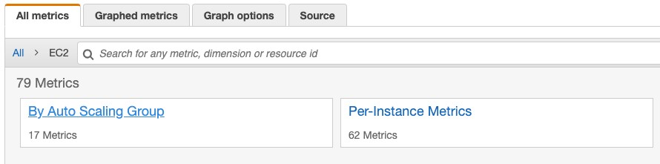
Amazon CloudWatch – Dimensions
These are namespaces
These are dimensions

Slide 11
Amazon CloudWatch – Key Terminology and Concepts
Statistics:
Statistics are metric data aggregations over specified periods of time.
CloudWatch provides statistics based on the metric data points provided by your custom data or provided by other AWS services to CloudWatch.

Slide 12
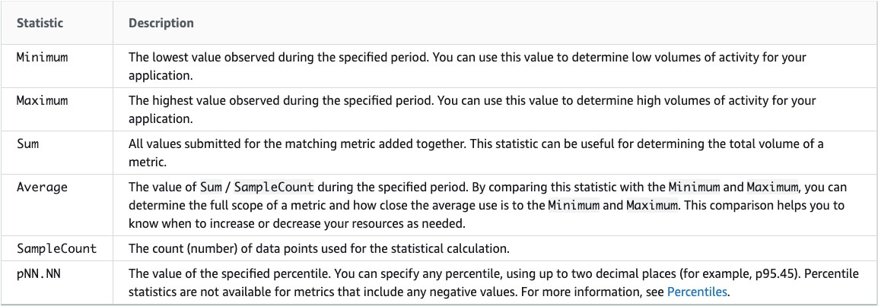
Amazon CloudWatch – Statistics

Slide 13
Amazon CloudWatch – Key Terminology and Concepts
Alarms:
You can use an alarm to automatically initiate actions on your behalf.
An alarm watches a single metric over a specified time period, and performs one or more specified actions, based on the value of the metric relative to a threshold over time.
The action is a notification sent to an Amazon SNS topic or an Auto Scaling policy.
You can also add alarms to dashboards.
Alarms invoke actions for sustained state changes only.
CloudWatch alarms do not invoke actions simply because they are in a particular state.
The state must have changed and been maintained for a specified number of periods.

Slide 14
Amazon CloudWatch – Custom Metrics and Resolution
You can publish your own metrics to CloudWatch using the AWS CLI or an API.
Each metric is one of the following:
Standard resolution, with data having a one-minute granularity.
High resolution, with data at a granularity of one second.
Metrics produced by AWS services are standard resolution by default.
When you publish a custom metric, you can define it as either standard resolution or high resolution.
When you publish a high-resolution metric, CloudWatch stores it with a resolution of 1 second, and you can read and retrieve it with a period of 1 second, 5 seconds, 10 seconds, 30 seconds, or any multiple of 60 seconds.

Slide 15


Amazon CloudWatch Logs
Dashboard
CloudWatch Agent installed
CloudWatch Agent installed
Application logs System logs
Application logs System logs
Amazon EC2
Amazon CloudWatch
On-premises servers
AWS Lambda

Slide 16
Amazon CloudWatch Logs
CloudWatch Logs enables you to centralize the logs from all of your systems, applications, and AWS services.
Features:
Monitor logs from Amazon EC2 instances - monitors application and system logs and can trigger notifications.
Monitor CloudTrail Logged Events – alarms can be created in CloudWatch based on API activity captured by CloudTrail.
Log retention – by default, logs are retained indefinitely. Configurable per log group from 1 day to 10 years.

Slide 17
Amazon CloudWatch Logs Agent
The CloudWatch Logs agent provides an automated way to send log data to CloudWatch Logs from Amazon EC2 instances.
There is now a unified CloudWatch agent that collects both logs and metrics.
The unified CloudWatch agent includes metrics such as memory and disk utilization.

Slide 18

Amazon CloudWatch Agent
The unified CloudWatch agent enables you to do the following:
Collect more system-level metrics from Amazon EC2 instances across operating systems. The metrics can include in-guest metrics, in addition to the metrics for EC2 instances.
Collect system-level metrics from on-premises servers. These can include servers in a hybrid environment as well as servers not managed by AWS.
Retrieve custom metrics from your applications or services using the StatsD and collectd protocols.

Slide 19


Amazon CloudWatch Events
Dashboard
Events:
EC2 Instance State- change Notification
EBS Volume Notification
Events:
ECS Task State Change ECS Container Instance State Change
Amazon EC2
Amazon CloudWatch
Amazon Elastic Container Service
Events:
EC2 Instance Launch Successful
EC2 Instance Terminate Successful
Amazon EC2 Auto Scaling

Slide 20
Amazon CloudWatch Events
Amazon CloudWatch Events delivers a near real-time stream of system events that describe changes in AWS resources.
Can use CloudWatch Events to schedule automated actions that self-trigger at certain times using cron or rate expressions
Can match events and route them to one or more target functions or streams.

Slide 21




Amazon CloudWatch Events Example
Event source:
EC2 Instance State- change Notification
Event target
EC2 Instance
SQS Queue
Amazon CloudWatch
Polls queue for messages
EC2 Instance

Slide 22




Auditing with Amazon CloudTrail
RunInstances TerminateInstances
SetQueueAttributes DeleteQueue
Amazon EC2
Amazon Simple Queue Service
CreateFunction UpdateFunctionCode
DeleteTable UpdateTable
AWS CloudTrail
Amazon DynamoDB
AWS Lambda

Slide 23
Amazon CloudTrail
AWS CloudTrail is a web service that records activity made on your account.
A CloudTrail trail can be created which delivers log files to an Amazon S3 bucket.
Enables governance, compliance, and operational and risk auditing of your AWS account.
Events include actions taken in the AWS Management Console, AWS Command Line Interface, and AWS SDKs and APIs.
CloudTrail is enabled on your AWS account when you create it.
You can create two types of trails for an AWS account:
A trail that applies to all regions - records events in all regions and delivers to an S3 bucket.
A trail that applies to a single region – records events in a single region and delivers to an S3 bucket. Additional single trails can use the same or different bucket.

Slide 24
Amazon CloudTrail
Management events provide information about management operations that are performed on resources in your AWS account. These are also known as control plane operations.
Example management events include:
Configuring security (for example, IAM AttachRolePolicy API operations).
Registering devices (for example, Amazon EC2 CreateDefaultVpc API operations).
Configuring rules for routing data (for example, Amazon EC2 CreateSubnet API operations).
Setting up logging (for example, AWS CloudTrail CreateTrail API operations).

Slide 25
Amazon CloudTrail
Data events provide information about the resource operations performed on or in a resource. These are also known as data plane operations. Data events are often high-volume activities. Example data events include:
Amazon S3 object-level API activity (for example, GetObject, DeleteObject, and PutObject
API operations).
AWS Lambda function execution activity (the Invoke API).

Slide 26
CloudWatch vs CloudTrail
CloudWatch | CloudTrail
Performance monitoring (operations) | Auditing (security)
Log events across AWS services – think operations | Log API activity across AWS services – think activities
Higher-level comprehensive monitoring and eventing | More low-level granular
Log from multiple accounts | Log from multiple accounts
Logs stored indefinitely | Logs stored to S3 or CloudWatch indefinitely
Alarms history for 14 days | No native alarming; can use CloudWatch alarms

