Slide 1
Virtual Private Cloud (VPC)

Slide 2

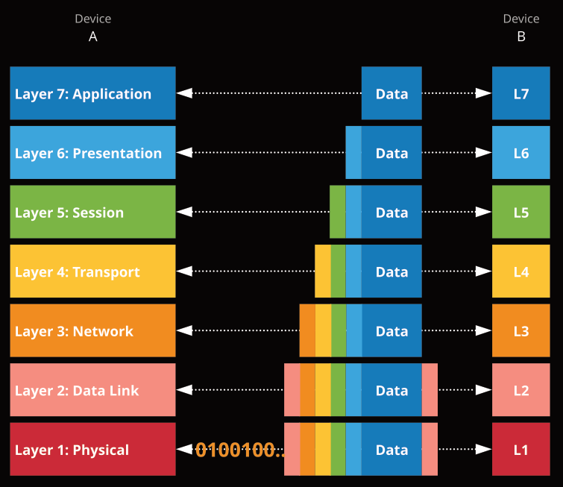
OSI Model

Slide 3
VPC
A Virtual Private Cloud (VPC) is logically isolated from other VPCs on AWS.
VPCs are region wide.
A default VPC is created in each region with a subnet in each AZ.
You can define dedicated tenancy for a VPC to ensure instances are launched on dedicated hardware (overrides the configuration specified at launch).
The default VPC has all-public subnets.

Slide 4
VPC
Public subnets are subnets that have:
“Auto-assign public IPv4 address” set to “Yes”.
The subnet route table has an attached Internet Gateway.
Instances in the default VPC always have both a public and private IP address.
AZs names are mapped to different zones for different users (i.e. the AZ “ap- southeast-2a” may map to a different physical zone for a different user).

Slide 5





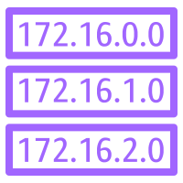

Creating a Custom VPC
Region
Public Route Table
VPC
Destination | Target
10.0.0.0/16 | Local
0.0.0.0/0 | igw-id
Availability Zone
Private subnet
Public subnet
NAT gateway
Availability Zone
Private subnet
Public subnet
Route table
Internet gateway
Route table
Private Route Table
Destination | Target
10.0.0.0/16 | Local
0.0.0.0/0 | nat-gateway-id
Availability Zone
Private subnet
Public subnet

Slide 6
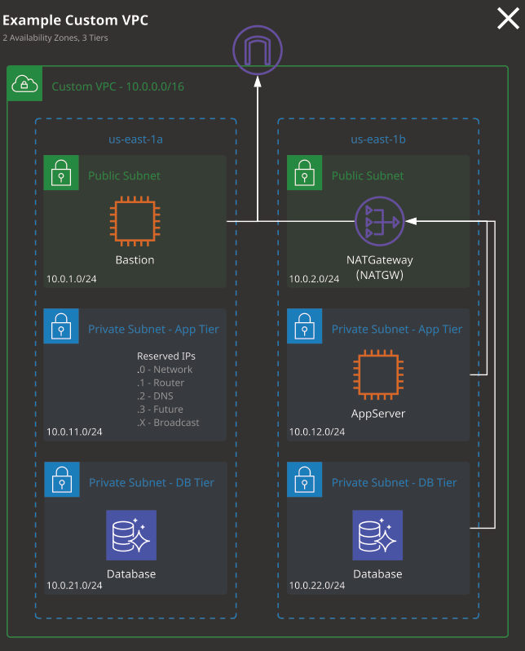
Creating a Custom VPC

Slide 7
Amazon VPC – Components
A Virtual Private Cloud: A logically isolated virtual network in the AWS cloud. You define a VPC’s IP address space from ranges you select.
Subnet: A segment of a VPC’s IP address range where you can place groups of isolated resources (maps to a single AZ).
Internet Gateway: The Amazon VPC side of a connection to the public Internet.
NAT Gateway: A highly available, managed Network Address Translation (NAT) service for your resources in a private subnet to access the Internet.
Hardware VPN Connection: A hardware-based VPN connection between your Amazon VPC and your datacenter, home network, or co-location facility.
Virtual Private Gateway: The Amazon VPC side of a VPN connection.
Customer Gateway: Your side of a VPN connection.

Slide 8
Amazon VPC – Components
Router: Routers interconnect subnets and direct traffic between Internet gateways, virtual private gateways, NAT gateways, and subnets.
Peering Connection: A peering connection enables you to route traffic via private IP addresses between two peered VPCs.
VPC Endpoints: Enables private connectivity to services hosted in AWS, from within your VPC without using an an Internet Gateway, VPN, Network Address Translation (NAT) devices, or firewall proxies.
Egress-only Internet Gateway: A stateful gateway to provide egress only access for IPv6 traffic from the VPC to the Internet.

Slide 9
VPC – Routing
The VPC router performs routing between AZs within a region.
The VPC router connects different AZs together and connects the VPC to the Internet Gateway.
Each subnet has a route table the router uses to forward traffic within the VPC.
Route tables also have entries to external destinations.
Public Route Table
Private Route Table
Destination | Target
10.0.0.0/16 | Local
0.0.0.0/0 | igw-id
Destination | Target
10.0.0.0/16 | Local
0.0.0.0/0 | nat-gateway-id

Slide 10
Subnets
Types of subnet:
If a subnet’s traffic is routed to an internet gateway, the subnet is known as a public subnet.
If a subnet doesn’t have a route to the internet gateway, the subnet is known as a private subnet.
If a subnet doesn’t have a route to the internet gateway, but has its traffic routed to a virtual private gateway for a VPN connection, the subnet is known as a VPN- only subnet.

Slide 11
Amazon VPC – Subnets and Addressing
The VPC is created with a master address range (CIDR block, can be anywhere from 16-28 bits), and subnet ranges are created within that range.
New subnets are always associated with the default route table.
Once the VPC is created you cannot change the CIDR block.
You cannot create additional CIDR blocks that overlap with existing CIDR blocks.
You cannot create additional CIDR blocks in a different RFC 1918 range.
Subnets with overlapping IP address ranges cannot be created.
The first 4 and last 1 IP addresses in a subnet are reserved.
Subnets are created within availability zones (AZs).
Subnets map 1:1 to AZs and cannot span AZs.

Slide 12
Amazon VPC – Internet Gateways
An Internet Gateway serves two purposes: .
To provide a target in your VPC route tables for internet-routable traffic.
To perform network address translation (NAT) for instances that have been assigned public IPv4 addresses.
Internet Gateways (IGW) must be created and then attached to a VPC, be added to a
route table, and then associated with the relevant subnet(s).
No availability risk or bandwidth constraints.
You cannot have multiple Internet Gateways in a VPC.
Egress-only Internet Gateway provides outbound Internet access for IPv6 addressed instances.

Slide 13
Amazon VPC – Security Groups
Security groups act like a firewall at the instance (network interface) level.
Can only assign permit rules in a security group, cannot assign deny rules.
All rules are evaluated until a permit is encountered or continues until the implicit deny.
Can control ingress and egress traffic.
Security groups are stateful.
By default, custom security groups do not have inbound allow rules (all inbound traffic is denied by default).
By default, default security groups do have inbound allow rules (allowing traffic from
within the group).

Slide 14


Security Groups
VPC
Default Security Group
Inbound:
Security group – PublicALB
Inbound: Protocol/Port HTTP/80 Source: 0.0.0.0/0 Outbound: Protocol/Port HTTPS:80 Destination: PublicEC2
Source | Protocol | Port
Security Group ID | All | All
Internet-facing ALB
Outbound:
Security group – PublicEC2
Inbound: Protocol/Port HTTP/80 Source: PublicALB Outbound: Protocol/Port HTTPS/80 Destination: PrivateALB
Destination | Protocol | Port
0.0.0.0/0 | All | All
::/0 | All | All
Web Front-End
Custom Security Group
Inbound:
Security group – PrivateALB
Inbound: Protocol/Port HTTP/80 Source: PublicEC2 Outbound: Protocol/Port HTTPS/80 Destination: PrivateEC2
Source | Protocol | Port
Internal ALB
Outbound:
Destination | Protocol | Port
0.0.0.0/0 | All | All
::/0 | All | All
Security group – PrivateEC2 Inbound: Protocol/Port HTTP/80 Source: PrivateALB
Application Layer

Slide 15


Network Access Control Lists (NACLs)
Default NACL
VPC
Inbound:
Protocol | Port | Source | Action
All | All | 0.0.0.0/0 | ALLOW
All | All | ::/0 | ALLOW
Availability Zone
Private subnet
Security Group B
Public subnet
Security Group A
Outbound:
Protocol | Port | Source | Action
All | All | 0.0.0.0/0 | ALLOW
All | All | ::/0 | ALLOW
Network ACL
Network ACL
Custom NACL
Inbound:
Availability Zone
Protocol | Port | Source | Action
All | All | 0.0.0.0/0 | DENY
All | All | ::/0 | DENY
Router
Private subnet
Security Group B
Public subnet
Security Group A
Security Group A
Outbound:
Protocol | Port | Source | Action
All | All | 0.0.0.0/0 | DENY
All | All | ::/0 | DENY
Network ACL
Network ACL

Slide 16
Amazon VPC – Security Groups
All outbound traffic is allowed by default in custom and default security groups.
You cannot delete the security group that’s created by default within a VPC.
You can use security group names as the source or destination in other security groups.
You can use the security group name as a source in its own inbound rules.
Security group membership can be changed whilst instances are running.
Any changes made will take effect immediately.
You cannot block specific IP addresses using security groups, use NACLs instead.

Slide 17
Amazon VPC – Network ACLs
Network ACL’s function at the subnet level.
With NACLs you can have permit and deny rules.
Network ACLs contain a numbered list of rules that are evaluated in order from the lowest number until the explicit deny.
Network ACLs have separate inbound and outbound rules and each rule can allow or
deny traffic.
Network ACLs are stateless so responses are subject to the rules for the direction of traffic.
NACLs only apply to traffic that is ingress or egress to the subnet not to traffic within the subnet.

Slide 18
Amazon VPC – Network ACLs
A VPC automatically comes with a default network ACL which allows all inbound/outbound traffic.
A custom NACL denies all traffic both inbound and outbound by default.
All subnets must be associated with a network ACL.
You can create custom network ACL’s. By default, each custom network ACL denies all inbound and outbound traffic until you add rules.
You can associate a network ACL with multiple subnets; however a subnet can only be associated with one network ACL at a time.
Network ACLs do not filter traffic between instances in the same subnet.

Slide 19
Amazon VPC – Network ACLs
NACLs are the preferred option for blocking specific IPs or ranges.
Security groups cannot be used to block specific ranges of IPs.
NACL is the first line of defence, the security group is
the second line.
Changes to NACLs take effect immediately.
Default NACL
Inbound:
Protocol | Port | Source | Action
All | All | 0.0.0.0/0 | ALLOW
All | All | ::/0 | ALLOW
Outbound:
Protocol | Port | Source | Action
All | All | 0.0.0.0/0 | ALLOW
All | All | ::/0 | ALLOW
Custom NACL
Inbound:
Protocol | Port | Source | Action
All | All | 0.0.0.0/0 | DENY
All | All | ::/0 | DENY
Outbound:
Protocol | Port | Source | Action
All | All | 0.0.0.0/0 | DENY
All | All | ::/0 | DENY

Slide 20
Security Group vs Network ACL
Security Group | Network ACL
Operates at the instance level | Operates at the subnet level
Supports allow rules only | Supports allow and deny rules
Stateful | Stateless
Evaluates all rules | Processes rules in order
Applies to an instance only if associated with a group | Automatically applies to all instances in the subnets its associated with

Slide 21
Amazon VPC – Connectivity
There are several methods of connecting to a VPC. These include:
AWS Managed VPN.
AWS Direct Connect.
AWS Direct Connect plus a VPN.
AWS VPN CloudHub.
Software VPN.
Transit VPC.
VPC Peering.
AWS PrivateLink.
VPC Endpoints.

Slide 22




Virtual Private Networks (VPN)
VPC
CIDR: 10.0.0.0/16
Public subnet
Corporate data center
CIDR: 192.168.0.0/16
Private subnet
VPN gateway
VPN connection
Customer gateway
Route Table
Destination | Target
192.168.0.0/16 | vgw-id

Slide 23
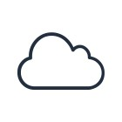


AWS Direct Connect
AWS Cloud
Region
VPC
Corporate data center
Public subnet
AWS Direct Connect location
Private VIF
AWS cage
Customer / partner cage
VPN gateway
Private subnet
Public VIF
AWS Direct Connect
Customer / partner router
Customer Router
endpoint
Amazon EC2
Amazon Simple Storage Service (S3)

Slide 24
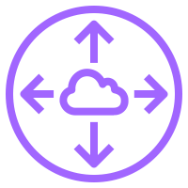
AWS Direct Connect Gateway
Region
VPC
Public subnet
Corporate data center
AWS Direct Connect location
Private VIF
Private subnet
VPN gateway
AWS cage
Customer / partner cage
Private VIF
Direct Connect Gateway
AWS Direct Connect
Customer / partner router
Customer Router
Region
endpoint
VPC
Private VIF
Public subnet
Private subnet
VPN gateway

Slide 25
AWS Managed VPN
What AWS Managed IPSec VPN Connection over your existing Internet
When Quick and usually simple way to establish a secure tunnelled connection to a VPC; redundant link for Direct Connect or other VPC VPN
Pros Supports static routes or BGP peering and routing
Cons Dependent on your Internet connection
How Create a Virtual Private Gateway (VPG) on AWS, and a Customer Gateway on the on-premises side

Slide 26
AWS Direct Connect
What | Dedicated network connection over private lines straight into the AWS backbone
When | Requires a large network link into AWS; lots of resources and services being provided on AWS to your corporate users
Pros | More predictable network performance; potential bandwidth cost reduction; up to 10 Gbps provisioned connections; supports BGP peering and routing
Cons | May require additional telecom and hosting provider relationships and/or network circuits; costly; takes time to provision
How | Work with your existing data networking provider; create Virtual Interfaces (VIFs) to connect to VPCs (private VIFs) or other AWS services like S3 or Glacier (public VIFs)

Slide 27
AWS Direct Connect Plus VPN
What IPSec VPN connection over private lines (Direct Connect)
When Need the added security of encrypted tunnels over Direct Connect
Pros More secure (in theory) than Direct Connect alone
Cons More complexity introduced by VPN layer
How Work with your existing data networking provider

Slide 28
AWS VPN CloudHub
What Connect locations in a hub and spoke manner using AWSs Virtual Private Gateway
When Link remote offices for backup or primary WAN access to AWS resources and each other
Pros Reuses existing Internet connections; supports BGP routes to direct traffic
Cons Dependent on Internet connection; no inherent redundancy
How Assign multiple Customer Gateways to a Virtual Private Gateway, each with their own BGP ASN and unique IP ranges

Slide 29
Software VPN
What You provide your own VPN endpoint and software
When You must manage both ends of the VPN connection for compliance reasons or you want to use a VPN option not supported by AWS
Pros Ultimate flexibility and manageability
Cons You must design for any needed redundancy across the whole chain
How Install VPN software via Marketplace appliance of on an EC2 instance

Slide 30
Transit VPC
What | Common strategy for connecting geographically dispersed VPCs and locations in order to create a global network transit center
When | Locations and VPC-deployed assets across multiple regions that need to communicate with one another
Pros | Ultimate flexibility and manageability but also AWS-managed VPN hub-and-spoke between VPCs
Cons | You must design for any needed redundancy across the whole chain
How | Providers like Cisco, Juniper Networks, and Riverbed have offerings which work with their equipment and AWS VPC

Slide 31
VPC Peering
What AWS-provided network connectivity between two VPCs
When Multiple VPCs need to communicate or access each other’s resources
Pros Uses AWS backbone without traversing the Internet
Cons Transitive peering is not supported
How VPC peering request made; accepter accepts request (either within or across accounts)

Slide 32
VPC Peering
Account 1
Account 2
VPC
CIDR: 10.1.0.0/16
VPC
CIDR: 10.0.0.0/16
Public subnet
Public subnet
Private subnet
Peering
Private subnet
Security Group
Inbound:
Security Group
Inbound:
Source | Protocol | Port
Security Group ID | All ICMP v4 | All
Source | Protocol | Port
0.0.0.0/0 | TCP | 22
Route Table
Route Table
Destination | Target
10.0.0.0/16 | peering-connection-id
Destination | Target
10.1.0.0/16 | peering-connection-id

Slide 33

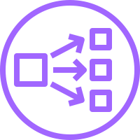
VPC Endpoint Services
Default VPC
Custom VPC – Provider
VPC
VPC
Public subnet
Public subnet
EC2 Instance
Endpoint
Private subnet
Private subnet
Network Load
Web Server
Balancer
Endpoint Service

Slide 34
AWS PrivateLink
What | AWS-provided network connectivity between VPCs and/or AWS services using interface endpoints
When | Keep Private Subnets truly private by using the AWS backbone to reach other AWS or Marketplace services rather than the public Internet
Pros | Redundant; uses the AWS backbone
Cons
How | Create endpoint for required AWS or Marketplace service in all required subnets; access via the provided DNS hostname

Slide 35
VPC Endpoints
Interface Endpoint Gateway Endpoint
What Elastic Network Interface with a A gateway that is a target for a Private IP specific route
How Uses DNS entries to redirect traffic Uses prefix lists in the route table to redirect traffic
Which API Gateway, CloudFormation, Amazon S3, DynamoDB services CloudWatch etc.
Security Security Groups VPC Endpoint Policies

Slide 36
VPC Sharing
You can allow other AWS accounts to create their application resources, such as EC2 instances, Relational Database Service (RDS) databases, Redshift clusters, and Lambda functions, into shared, centrally-managed Amazon Virtual Private Clouds (VPCs).
VPC sharing enables subnets to be shared with other AWS accounts within the same AWS Organization. Benefits include:
Separation of duties: centrally controlled VPC structure, routing, IP address allocation.
Application owners continue to own resources, accounts, and security groups.
VPC sharing participants can reference security group IDs of each other.
Efficiencies: higher density in subnets, efficient use of VPNs and AWS Direct Connect.
Hard limits can be avoided, for example, 50 VIFs per AWS Direct Connect connection through simplified network architecture.
Costs can be optimized through reuse of NAT gateways, VPC interface endpoints, and intra-Availability Zone traffic.

Slide 37
VPC Flow Logs
Flow Logs capture information about the IP traffic going to and from network interfaces in a VPC.
Flow log data is stored using Amazon CloudWatch Logs.
Flow logs can be created at the following levels:
VPC.
Subnet.
Network interface.

Slide 38

VPC Flow Logs
VPC
Public subnet
Flow logs
Private subnet
Flow logs
EC2 Instance
Flow logs

Slide 39
Guidance on High Availability for Networking in AWS
Create subnets in the available AZs, to create Multi-AZ presence for your VPC.
Best practice is to create at least two VPN tunnels into your Virtual Private Gateway.
Direct Connect is not HA by default, so you need to establish a secondary connection via another Direct Connect (ideally with another provider) or use a VPN.
For Multi-AZ redundancy of NAT Gateways, create gateways in each AZ with routes for
private subnets to use the local gateway.

Slide 40
Amazon Route 53

Slide 41
AWS Route 53
Route 53 offers the following functions:
Domain name registry.
DNS resolution.
Health checking of resources.
Route 53 is located alongside all edge locations.
When you register a domain with Route 53 it becomes the authoritative DNS server for that domain and creates a public hosted zone.
You can transfer domains to Route 53 only if the Top Level Domain (TLD) is supported.
You can transfer a domain from Route 53 to another registrar by contacting AWS support.

Slide 42



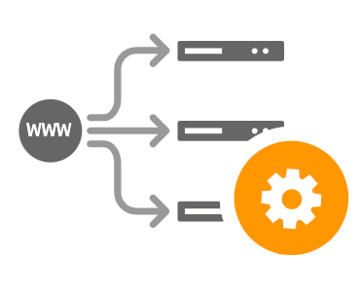
Route 53 Overview
Amazon Route 53
Domain Registration
.net
.com
.org
Hosted zone
example.com dctlabs.com
Health Checks
EC2 Instances
Traffic Flow

Slide 43
AWS Route 53
You can transfer a domain to another account in AWS however it does not migrate the hosted zone by default (optional).
It is possible to have the domain registered in one AWS account and the hosted zone in another AWS account.
Private DNS is a Route 53 feature that lets you have authoritative DNS within your
VPCs without exposing your DNS records (including the name of the resource and its IP address(es) to the Internet.
You can use the AWS Management Console or API to register new domain names
with Route 53.

Slide 44
AWS Route 53 Hosted Zones
A hosted zone is a collection of records for a specified domain.
A hosted zone is analogous to a traditional DNS zone file; it represents a collection of records that can be managed together.
There are two types of zones:
Public host zone – determines how traffic is routed on the Internet.
Private hosted zone for VPC – determines how traffic is routed within VPC (resources are not accessible outside the VPC).
For private hosted zones you must set the following VPC settings to “true”:
enableDnsHostname.
enableDnsSupport.
You also need to create a DHCP options set.

Slide 45
AWS Route 53 Health Checks
Health checks check the instance health by connecting to it.
Health checks can be pointed at:
Endpoints.
Status of other health checks.
Status of a CloudWatch alarm.
Endpoints can be IP addresses or domain names.

Slide 46
AWS Route 53 Records
Amazon Route 53 currently supports the following DNS record types:
A (address record).
AAAA (IPv6 address record).
CNAME (canonical name record).
CAA (certification authority authorization).
MX (mail exchange record).
NAPTR (name authority pointer record).
NS (name server record).
PTR (pointer record).
SOA (start of authority record).
SPF (sender policy framework).
SRV (service locator).
TXT (text record).
Alias (an Amazon Route 53-specific virtual record).

Slide 47
Route 53 DNS Record Types
Supported DNS records
A (address record)
AAAA (IPv6 address record)
CNAME (canonical name record)
Alias (an Amazon Route 53-specific virtual record)
CAA (certification authority authorization)
MX (mail exchange record)
NAPTR (name authority pointer record)
NS (name server record)
PTR (pointer record)
SOA (start of authority record)
SPF (sender policy framework)
SRV (service locator)
TXT (text record)
CNAME | Alias
Route 53 charges for CNAME queries | Route 53 doesn’t charge for alias queries to AWS resources
You can’t create a CNAME record at the top node of a DNS namespace (zone apex) | You can create an alias record at the zone apex (however you can’t route to a CNAME at the zone apex)
A CNAME can point to any DNS record that is hosted anywhere | An alias record can only point to a CloudFront distribution, Elastic Beanstalk environment, ELB, S3 bucket as a static website, or to another record in the same hosted zone that you’re creating the alias record in

Slide 48
AWS Route 53 Records
The Alias record is a Route 53 specific record type.
The Alias is pointed to the DNS name of the service.

Slide 49
AWS Route 53 CNAME vs Alias
CNAME Alias
Route 53 charges for CNAME queries Route 53 doesn’t charge for alias queries to AWS resources
You can’t create a CNAME record at You can create an alias record at the the top node of a DNS namespace zone apex (however you can’t route to (zone apex) a CNAME at the zone apex)
A CNAME can point to any DNS An alias record can only point to a record that is hosted anywhere CloudFront distribution, Elastic Beanstalk environment, ELB, S3 bucket as a static website, or to another record in the same hosted zone that you’re creating the alias record in

Slide 50
AWS Route 53 Routing Policies
Policy What it Does
Simple Simple DNS response providing the IP address associated with a name
Failover If primary is down (based on health checks), routes to secondary destination
Geolocation Uses geographic location you’re in (e.g. Europe) to route you to the closest region
Geoproximity Routes you to the closest region within a geographic area
Latency Directs you based on the lowest latency route to resources
Multivalue answer Returns several IP addresses and functions as a basic load balancer
Weighted Uses the relative weights assigned to resources to determine which to route to

Slide 51
AWS Route 53 Routing Policies
Simple:
An A record is associated with one or more IP addresses.
Uses round robin.
Does not support health checks.
Failover:
Failover to a secondary IP address.
Associated with a health check.
Used for active-passive.
Can be used with ELB.

Slide 52
AWS Route 53 Routing Policies
Geo-location:
Caters to different users in different countries and different languages.
Contains users within a particular geography and offers them a customized version of the workload based on their specific needs.
Geolocation can be used for localizing content and presenting some or all of your website in the language of your users.
Can also protect distribution rights.
Can be used for spreading load evenly between regions.
If you have multiple records for overlapping regions, Route 53 will route to the smallest geographic region.

Slide 53
AWS Route 53 Routing Policies
Geo-proximity routing policy (requires Route Flow):
Use for routing traffic based on the location of resources and, optionally, shift traffic from resources in one location to resources in another.
Latency based routing:
AWS maintains a database of latency from different parts of the world.
Focussed on improving performance by routing to the region with the lowest latency.
You create latency records for your resources in multiple EC2 locations.

Slide 54
AWS Route 53 Routing Policies
Multi-value answer routing policy:
Use for responding to DNS queries with up to eight healthy records selected at random.
Weighted:
Similar to simple but you can specify a weight per IP address.
You create records that have the same name and type and assign each record a relative weight.
Numerical value that favours one IP over another.
To stop sending traffic to a resource you can change the weight of the record to 0.

Slide 55

Route 53 - Simple Routing Policy
Name | Type | Value | TTL
simple.dctlabs.com | A | 1.1.1.1 2.2.2.2 | 60
simpler.dctlabs.com | A | 3.3.3.3 | 60
Amazon Route 53
1
2
Region
3
DNS query

Slide 56
Route 53 - Weighted Routing Policy
Name | Type | Value | Health | Weight
weighted.dctlabs.com | A | 1.1.1.1 | ID | 60
weighted.dctlabs.com | A | 2.2.2.2 | ID | 20
weighted.dctlabs.com | A | 3.3.3.3 | ID | 20
Optional Health Checks
Region
Amazon Route 53
1.1.1.1
1
60%
2
Region
3
20%
2.2.2.2
20%
DNS query
3.3.3.3

Slide 57
Route 53 - Latency Routing Policy
Region – ap-southeast-1
Optional Health Checks
Name | Type | Value | Health | Region
latency.dctlabs.com | A | 1.1.1.1 | ID | ap-southeast-1
latency.dctlabs.com | A | 2.2.2.2 | ID | us-east-1
latency.dctlabs.com | A | alb-id | ID | ap-southeast-2
1.1.1.1
Amazon Route 53
Singapore
DNS query
Region – us-east-1
2.2.2.2
New York
DNS query
Region – ap-southeast-2
Sydney
DNS query
ALB

Slide 58

Route 53 - Failover Routing Policy
Corporate data center
Traditional server
Name | Type | Value | Health | Record Type
failover.dctlabs.com | A | 1.1.1.1 | ID | Primary
failover.dctlabs.com | A | alb-id |  | Secondary
Health Check required on Primary
Amazon Route 53
Region – us-east-1
1.1.1.1
Region – ap-southeast-2
DNS query
ALB

Slide 59
Route 53 - Geolocation Routing Policy
Region – ap-southeast-1
Optional Health Checks
Name | Type | Value | Health | Geolocation
geolocation.dctlabs.com | A | 1.1.1.1 | ID | Singapore
geolocation.dctlabs.com | A | 2.2.2.2 | ID | Default
geolocation.dctlabs.com | A | alb-id | ID | Oceania
1.1.1.1
Amazon Route 53
Singapore
DNS query
Region – us-east-1
2.2.2.2
Mexico
DNS query
Region – ap-southeast-2
New Zealand
DNS query
ALB

Slide 60
Route 53 - Multivalue Routing Policy
Name | Type | Value | Health | Multi Value
multivalue.dctlabs.com | A | 1.1.1.1 | ID | Yes
multivalue.dctlabs.com | A | 2.2.2.2 | ID | Yes
multivalue.dctlabs.com | A | 3.3.3.3 | ID | Yes
Amazon Route 53
Health Checks: returns healthy records only
1
2
Region
3
DNS query

Slide 61
AWS Route 53 Traffic Flow
Route 53 Traffic Flow provides Global Traffic Management (GTM) services.
Traffic flow policies allow you to create routing configurations for resources using routing types such as failover and geolocation.
Create policies that route traffic based on specific constraints, including latency, endpoint health, load, geo-proximity and geography.
Scenarios include:
Adding a simple backup page in Amazon S3 for a website.
Building sophisticated routing policies that consider an end user’s geographic location, proximity to an AWS region, and the health of each of your endpoints.

Slide 62
Exam Cram AWS Route 53 Resolver
Route 53 Resolver is a set of features that enable bi-directional querying between on- premises and AWS over private connections.
Used for enabling DNS resolution for hybrid clouds.
Route 53 Resolver Endpoints.
Inbound query capability is provided by Route 53 Resolver Endpoints, allowing DNS queries that originate on-premises to resolve AWS hosted domains.
Connectivity needs to be established between your on-premises DNS infrastructure and AWS through a Direct Connect (DX) or a Virtual Private
Network (VPN).
Endpoints are configured through IP address assignment in each subnet for which you would like to provide a resolver.

Slide 63

Route 53 Resolver – Inbound Endpoints
VPC
Amazon Route 53
Public subnet
3
2
Corporate data center
EC2 Instance
Inbound Endpoint
1
DNS server
Private subnet
VPN gateway
VPN connection
Customer gateway
EC2 Instance
Inbound Endpoint
Client

Slide 64
AWS Route 53 Resolver
Conditional forwarding rules:
Outbound DNS queries are enabled through the use of Conditional Forwarding Rules.
Domains hosted within your on-premises DNS infrastructure can be configured as forwarding rules in Route 53 Resolver.
Rules will trigger when a query is made to one of those domains and will attempt to forward DNS requests to your DNS servers that were configured along with the rules.
Like the inbound queries, this requires a private connection over DX or VPN.

Slide 65
Route 53 Resolver – Outbound Endpoints
VPC
1
Amazon Route 53
Public subnet
2
3
Corporate data center
EC2 Instance
Outbound Endpoint
DNS server
Private subnet
VPN gateway
VPN connection
Customer gateway
EC2 Instance
Outbound Endpoint

Slide 66
AWS Global Accelerator (SAA-C02 exam only)
AWS Global Accelerator is a service that improves the availability and performance of applications with local or global users.
It provides static IP addresses that act as a fixed entry point to application endpoints
in a single or multiple AWS Regions, such as Application Load Balancers, Network Load Balancers or EC2 instances.
Uses the AWS global network to optimize the path from users to applications, improving the performance of TCP and UDP traffic.
AWS Global Accelerator continually monitors the health of application endpoints and
will detect an unhealthy endpoint and redirect traffic to healthy endpoints in less than 1 minute.

Slide 67
AWS Global Accelerator (SAA-C02 exam only)
Uses redundant (two) static anycast IP addresses in different network zones (A and B).
The redundant pair are globally advertized.
Uses AWS Edge Locations – addresses are announced from multiple edge locations at the same time.
Addresses are associated to regional AWS resources or endpoints.
AWS Global Accelerator’s IP addresses serve as the frontend interface of applications.
Intelligent traffic distribution: Routes connections to the closest point of presence for applications.
Targets can be Amazon EC2 instances or Elastic Load Balancers (ALB and NLB).

Slide 68
AWS Global Accelerator (SAA-C02 exam only)
By using the static IP addresses, you don’t need to make any client-facing changes or update DNS records as you modify or replace endpoints.
The addresses are assigned to your accelerator for as long as it exists, even if you disable the accelerator and it no longer accepts or routes traffic.
Uses the vast, congestion-free AWS global network to route TCP and UDP traffic to a
healthy application endpoint in the closest AWS Region to the user.
If there’s an application failure, AWS Global Accelerator provides instant failover to the next best endpoint.

Slide 69




AWS Global Accelerator
Uses the AWS global network
Addresses: 51.45.2.12
53.58.31.89
Edge location
dctlabs.com in us-east-1
Addresses: 51.45.2.12
53.58.31.89
dctlabs.com in eu-central-1
Resolve dctlabs.com
Answer: 51.45.2.12
53.58.31.89
Users in US
Amazon Route 53
Static anycast IP addresses

