Slide 1
EECE237 Introduction to Embedded System
Sukgi Choi, Ph.D.
Week 1-c, Spring 2016

Slide 2
Review of Week 1-b
Micro-processor vs. Micro-controller (MCU)
Segmentation of MCU industry
ARM Cortex-M4

Slide 3
Today’s topic
STM32F303 Layout (No textbook)
Processor
Core
Core peripherals
System peripherals
External I/O ports
Internal I/O ports
Buses
Memory blocks and registers

Slide 4
Assignment for Week 2-a
Reading assignment: Chapter 4.1~4.2.

Slide 5
STM32F303
ST Microelectronics(www.st.com) is a European semiconductor company. Her HQ is in Germany.
STM32F303 is a ST version of ARM Coretex-M4 for mainstream general purpose applications.
Other licensees have their own version of ARM Coretex-M4. (Example, TI TM4C123GXL) They are not compatible (i.e. interchangeable) to each other.

Slide 6
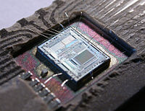
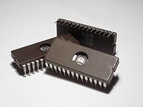
IC, Chip, Package
What is a chip? A chip is a piece of Silicon crystal on which integrated circuit is built. It is hidden inside a package, thus not usually visible.
What is a package? A package a mechanical encapsulation of a chip. It is usually made of plastic or ceramic and has metal pins for interconnection. A chip is mounted inside the package. A package comes in many different types.

Slide 7
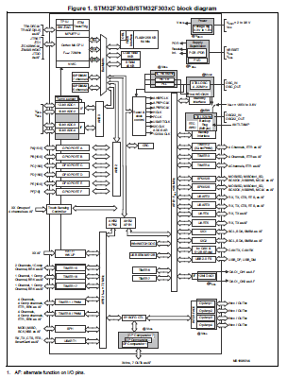
SSTM32F303 Layout
Processor
Core
Core peripherals
Buses
System peripherals
External I/O ports
Internal I/O ports (functional blocks)
Memory blocks
STM32F303xC Datasheet (DM00058181) P12

Slide 8
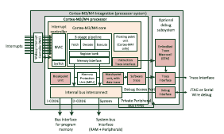
Processor (ARM)
The processor has a core and core peripherals (NVIC, MPU, SysTick, MPU, FPU etc.)
Figure 3.3 p62

Slide 9
Core and Core Peripherals (ARM)
The processor is identical among all licensees.
Other than that, all other blocks are different among the licensees.
A processor has a core and core peripherals.
The core is the central place where all instruction execution occurs.
As far as the core is concerned, it treats core peripherals exactly in the same way as the system peripherals.

Slide 10
System Peripherals(STM)
External I/O ports- the ports which have pin connection to the external.
GPIO (General Purpose I/O)
I2C
Timer
Internal I/O ports – the ports which do not have pin connection to the external.
RCC

Slide 11
Buses (STM)
STM uses AMBA (Advanced Microcontroller Bus Architecture) for bus structure.
The processor interacts with the system via 3 AHB (high speed) buses and 2 APB (low speed) buses.
High speed I/O’s (GPIO, DMA etc.) are connected to AHB buses. Low speed I/O’s (I2C, Timer, DAC etc.) are connected to APB buses.

Slide 12
Memory blocks
Memory can be grouped by its function
instruction memory block
Data memory block
Registers (Peripheral registers, core registers)
Memory can be grouped by its physical property.
Volatile – SRAM, DRAM
Nonvolatile (NVM) – ROM, EEPROM, Flash

Slide 13
Memory by function
Instruction memory - Memory block to store instruction codes. Usually made of ROM.
Data memory - Memory block to store instruction codes. Made of SRAM.
Registers
A register is a memory with multiple bits (usually 32 bits) on which data can be written (i.e. stored) or read.
The core and each I/O port, either external or internal, has multiple registers within.
Core registers, peripheral registers

Slide 14
Memory by Physical Structure-1
SRAM: static random access memory. Any memory address can be accessed randomly (not sequentially). Memory stays static but gets lost when power goes off (volatile). Fast and expensive.
DRAM: dynamic random access memory. Any memory address can be accessed randomly (not sequentially). The memory decays in time, thus requires refreshing periodically (dynamically). Memory is lost when power goes off (volatile). Cheaper but slower than SRAM. CPU does not use DRAM internally.

Slide 15
Memory by Physical Structure-2
ROM: Read only memory. Memory designed for mainly reading rather than writing. However, an initial writing is necessary. How to make the initial writing and how to rewrite make various types of ROM. ROM’s are non-volatile. Fast reading, slow writing.
NVM: non-volatile memory. Flash memory (Thumb drive) is quasi- RAM NVM.

