Slide 1
EECE237 Introduction to Embedded System
Sukgi Choi, Ph.D.
Week 2-a, Spring 2016

Slide 2
Review of Week1-c
STM32F303 Layout
Processor
Core
Core peripherals
System peripherals
External I/O ports
Internal I/O ports
Buses
Memory blocks and registers

Slide 3
Today’s Topics
Processor core architecture (4.1~4.2)
Major components of a core
Program counter
Instruction register
Instruction decoder
ALU
Core Registers
Special registers

Slide 4
Assignments
Reading assignment: Chapter 4.3-4.4

Slide 5
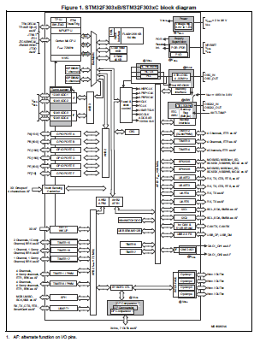
SSTM32F303 Layout
Processor
Core
Core peripherals
Buses
System peripherals
External I/O ports
Internal I/O ports (functional blocks)
Memory blocks
STM32F303xC Datasheet (DM00058181) P12

Slide 6
Core Structure
***Remember this diagram***
Program Counter (PC)
Register Bank
Instruction Register (IR)
ALU
Instruction Decoder
Special Registers
Core
ROM
(Instruction Code)
RAM
(Data)
Data Bus
Instruction Bus
Control Bus

Slide 7
5 Major Components of a core
Program Counter (PC)
Instruction register
Instruction decoder
Register bank (SRAM)
ALU

Slide 8
Register Bank
A register is a memory array of 32 bits.
A register is made of SRAM and is designed for easy and fast access of data.
A register has a name (R0, R1 etc.) but no address.
A collection of 16 registers is called a register bank. (R0~R15)
Designated function registers
R13: Stack pointer (SP)
R14:The link register (LR)
R15: The program counter (PC)

Slide 9
Program Counter (PC)
PC contains the address of the next instruction to be executed.
PC holds an address, not an instruction code.
PC is updated right after the next instruction is fetched and stored in IR (instruction register).
PC is R15 in the register bank.

Slide 10
Instruction Register (IR)
Instruction register (IR) holds the currently executing instruction code.
IR feeds the instruction to the instruction decoder.

Slide 11
Instruction decoder
Instruction decoder decodes the instruction into a series of micro-codes and feeds the control bus.
This series of micro-codes operates and executes the instruction in multiple clock cycles.
The design of the instruction decoder is highly protected

Slide 12
ALU
The Arithmetic and Logical Unit (ALU) performs arithmetic operations (+,-, *,/) and logic operations (AND, OR, NOT, shift).
ADD R2, R0, R1 (R2=R0+R1)
SUB Rd, Rn, Rm (Rd=Rn-Rm)
AND Rd, Rn (Rd=Rd&Rn)
ALU symbol
In Cortex M4, ALU cannot be read directly.

Slide 13
Special (Function) Registers
Special (function) registers perform only very specific functions only
Special registers in Cortex-M4
Program Status registers
Interrupt Mask registers
Control register: will be discussed later.
FPU registers: will be discussed later.
Special registers are accessible by special instructions only.
MSR: Move from general register to special register.
MRS: Move from special register to general register.

Slide 14
Program Status Registers
PSR is also called PSW (program status word).
Cortex M4 processor has three program status registers (APSR, IPSR and EPSR). APSR has the most significance for application. (Ch 4.3/Ch 3.2.1)
APSR holds the flags (N,Z,C,V,Q) which indicate the status of ALU.
N: negative
Z: zero
C: carry/borrow
V: overflow
Q saturation
An instruction has S-suffix to set PSR flags.
ADDS R0, R1, R2

