Slide 1
EECE237 Introduction to Embedded System
Sukgi Choi, Ph.D.
Week 5-a, Spring, 2016

Slide 2
Review of Week-4c
Barrel shifter (5.8)
EQU
NOP
Assembly coding exercises

Slide 3
Today’s Topics
Assembly coding exercise
Memory map
Memory and peripherals
Refer to STM32F3 Data sheet. (posted on BB)

Slide 4
Announcement
Reading assignment: Chapter 6.
Skip 6.7.4, 6.8-6.12
Rgt LCD panel for the Discovery Kit.
Quiz 1 on 2/26 (Fri)
Homework 1 due on 2/28(Sun)

Slide 5
Instruction code summary
Data transfer | mov, mvn, neg, ldr, str, push, pop
Arithmetic | add, adc, sub, umul,
Logic | and, orr, bic, eor, asr, lsl, lsr, ror, rol, rrx
Branching | b, bx, bl, blx, it, cmp, cbz, cbnz
Suffix | (eq, ne, gt, lt, ge, le, mi, pl),(s, b, h, w)

Slide 6
Assembly coding exercise
Self study answer sheet.
Homework 1 discussion
Keil μVision Demonstration
Debug-breakpoint, single run
SRAM
Get the average of 10 numbers stored in 0x20002000~0x2000200A.
Read the keyboard and store the data 10 times to 0x20002000~0x2000200A.

Slide 7
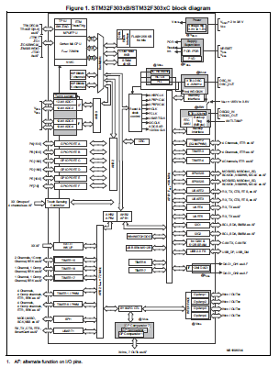
SSTM32F303 Layout
Processor
Core
Core peripherals
Memory blocks
System peripherals
External I/O ports
Internal I/O ports (functional blocks)
Buses
STM32F303xC Datasheet (DM00058181) P12

Slide 8
Memory Map
As far as PC is concerned, all memory have addresses and content (data), thus are treated in the same way.
The entire memory space that PC sees is drawn in the memory map.
The continuous memory addresses are not necessarily located adjacent physically.
The memories in the map are made of various devices such as SRAM, ROM, Flash, hard disk etc.

Slide 9
Memory regions
The entire memory space in the map is divided into several regions.
Code region(0x00000000~1FFF FFFF),
SRAM region(i.e. memory 0x2000 0000~0x3FFF FFFF),
Peripheral region(0x4000 0000~5FFF FFFF),
Other regions: Internal peripherals.

Slide 10
Internal Buses (outside of Core)
Multi bus allows multi tasking in interrupt and stack handling. It also improves system bandwidth.
Three AHB’s (AMBA High Performance Bus) for Code, SRAM regions and high speed I/O’s.
Two APB’s for other peripherals (ex. USART, Timer).
The separation of AHB from APB is not in bus width but in the way of the bus interfaces with peripheral devices.

Slide 11
Peripheral I/O-to-Bus connection
Each I/O interfaces with either AHB or APB bus.
All peripheral I/O’s are disconnected from the processor by default. RCC (reset and clock control) block controls the connection by feeding clock signal to the peripheral.
Each I/O has peripheral registers that store data and control bits. The number of registers varies from a peripheral to a peripheral.

Slide 12
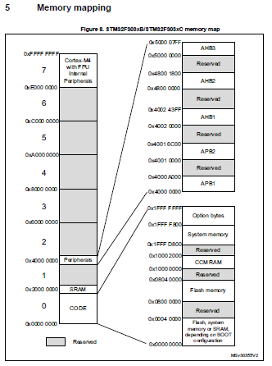
Memory Mapping of peripheral region
The peripheral region starts from 0x4000 0000.
The region is divided into different I/O devices by bus. (ex. APB1 devices, AHB1 devices, etc.)

Slide 13
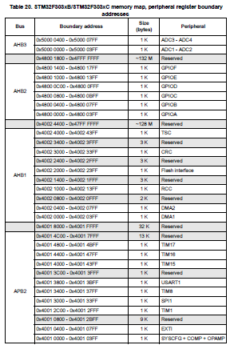
I/O, registers and Bus
GPIOE is a AHB device and has register addresses in 0x4800 1000~ 0x4800 13ff.
I2C1 is a APB device and has register addresses in 0x4000 5400~0x4000 57ff.

