Slide 1
EECE237 Introduction to Embedded System
Sukgi Choi, Ph.D.
Week 6a, Spring 2016

Slide 2
Review W5-c
Bit-band operation
Quiz 1

Slide 3
Today’s Topics
STM32F303 Device pins
STM32F3 Discovery kit I/O pins
GPIO ports

Slide 4
Announcement
Reading Assignment
STM32F303xC Data Sheet (Rev 8)
Chapter 4 Pin outs and pin description
Chapter 5 Memory mapping
Emphasis on p32, 47, 49 and 50.
STM32F3 Reference manual (V.6)
Chapter 9 Reset and Clock Control (RCC)
Chapter 11 General Purpose I/Os (GPIO)
Lab work #1 (due 3/13).
LCD panels are coming on Wednesday (3/2).

Slide 5
Code Exercise
Time Delay
Sort the 5 data stored in the memory (0x20002000~0x20002014) in ascending order and store them in the memory (0x20002200~0x20002214).

Slide 6
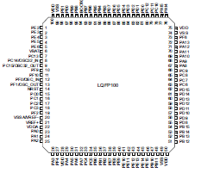

Slide 7
STM32F303xC Device
STM32F303xC has 5 I/O ports
PA, PB, PC, PD and PE
Each port has 16 pins.
Each port can work as an input or output port.
Each I/O port has 10 (peripheral) registers to control the port’s function.
Each pin of a port has multiple functions besides GPIO.
GPIO is a general purpose parallel input/output.

Slide 8
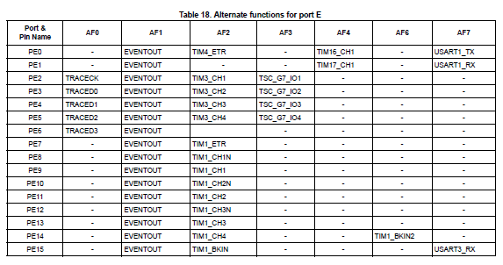

Slide 9
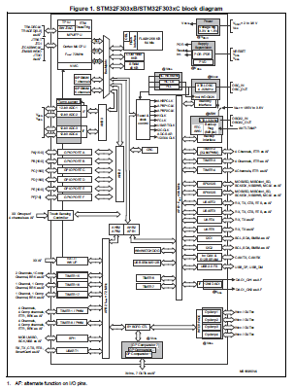
SSTM32F303 Layout
Processor
Core
Core peripherals
Memory blocks
System peripherals
External I/O ports
Internal I/O ports (functional blocks)
Buses
STM32F303xC Datasheet (DM00058181) P12

Slide 10
STM32F Discovery Kit
Reset button is connected to NRST (pin 14)
User button is connect to PA0 (pin 23)
8 LED are connected to PE8~PE15 (pins 39~46)
USB1 is connected to PA11 (pin 70)
USB2 is connected to PA12 (pin 71)
L3GD20 (Gyroscope) is connected to PA5~7.
LSM303DLHC (e-compass) is connected to PB6&7.

Slide 11
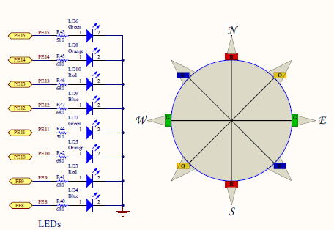
Discovery Kit PCB Schematic

Slide 12
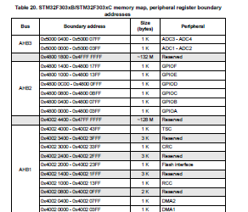
Memory Map of AHB2 devices
Base addresses
GPIOA:0x4800 0000
GPIOB:0x4800 0400
GPIOC: 0x4800 0800
GPIOD:0x4800 0C00
GPIOE: 0x4800 100
(p50 Datasheet)

