Slide 1
EECE237 Introduction to Embedded System
Sukgi Choi, Ph.D.
Week 6b, Spring 2016

Slide 2
Review W6-a
Code exercise – bcc, movt, bne, rrx, bl, bx
Lab work #2
STM32F3 Discovery kit
STM32F303 VC device GPIO port

Slide 3
Today’s Topics
Quiz 1 review
Homework 1 review
RCC configuration
GPIO registers
Lab Work #1 Announcement

Slide 4
Announcements
Reading Assignment
STM32F3 Reference manual (V.6)
Chapter 9 Reset and Clock Control (RCC)
Chapter 11 General Purpose I/Os (GPIO)
Lab work 1 announcement

Slide 5
Bit writing techniques
LDR instruction to set bits R0[15:8]
Example: ldr r0, =0x00005500
ORR instruction
What if R0[31:16] and R0[7:0] have valid bits?
LDR R3, =0x00005500 ;set a pattern
ORR R0, R3, R0 ;ORR the pattern to R0
BIC and BFC instructions
What if R0[15:8] has non-zero bits?
Clear R0[15:7] with BIC or BFC instruction.

Slide 6
RCC (Reset and Clock Control) port
RCC is an internal peripheral I/O. It is not connected to any pins.
All peripheral I/O are disabled (disconnected from CPU) at reset.
RCC does,
Resets the system
Controls internal/external clocks
Connect/disconnect a peripheral to CPU by enable/disable the bus clock to the peripheral.
Unless RCC sets a particular I/O peripheral, the core cannot access the peripheral registers of the I/O.

Slide 7
RCC configuration
RCC has total 13 (peripheral) registers.
Out of these, RCC_AHBENR controls AHB peripheral devices.
GPIO’s are AHB devices.
RCC base address is 0x40021000.
RCC_AHBENR has offset of 0x14
GPIO_F~A are set by bit [22:17]

Slide 8
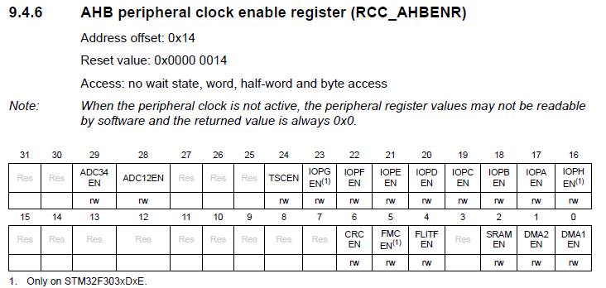
RCC_AHBENR register

Slide 9
RCC configuration example
; Configure GPIO_E port (LED port)
RCC_BASE EQU 0x40021000
AHBENR_OFFSET EQU 0x14
AHBENR_GPIOEEN EQU 0x0200000 ;bit[21]
LDR R0, =RCC_BASE ; load base address for RCC
LDR R1, =AHBENR_OFFSET ; load offset for AHBENR
LDR R2, =AHBENR_GPIOEEN ; load GPIOE enable
LDR R3, [R0, R1] ; Read current AHBENR value
ORR R2, R2, R3 ; Modify AHBENR value to enable E
STR R2, [R0, R1] ; Write new AHBENR value to register

Slide 10
GPIO Peripheral Registers
A GPIO port has 16 pins.
Each pin of a GPIO operates in either an input mode or output mode or alternate-function (AF) mode. ModeR (mode register) sets the mode of each pin. (00:input, 01:output, 10:AF )
In an output mode, the processor sends a data to ODR (output data register, 16 bit) Then the internal circuitry places this data to the port pins.
In an input mode, a signal at the port pin is stored at IDR (input data register, 16 bit). Then the processor reads this data.
GPIO is AF0 (Alternate function).

Slide 11
GPIO Register Addresses
GPIOA Base Address 0x4800 0000
GPIOE Base Address 0x4800 1000
GPIO_ModeR Offset 0x00
GPIO_IDR Offset 0x10
GPIO_ODR Offset 0x14

Slide 12
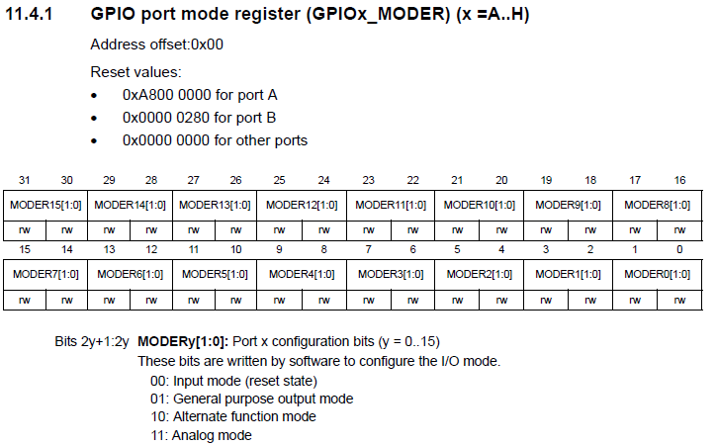
GPIOE ModeR

Slide 13
Two steps of GPIO port operation
Step I: Configure the port registers.
Set the base address and offset addresses
Set ModeR.
Step II
If output port, write a data to ODR.
If input port, read the data in IDR.

