Slide 1

daA
PRESENTATION
Faculty advisor:-
d.Balakotaiah sir

Slide 2
Batch:-5
231FA04934-S.H.V.S Aditya Sekhar
231FA04966-J.Devendra
231FA04A15- L.Hasikkha
231FA04G95- B.Harshitha

Slide 3
Agenda
Problem Statement
Problem Description
Algorithm
Test Cases
Time Complexity

Slide 4

Four people need to cross a bridge with one flashlight in 17 minutes using the Greedy Two-Fastest Method, where at most two can cross at a time, the crossing time is determined by the slower person, and individual crossing times are 1, 2, 5, and 10 minutes, with a generalization for n people with crossing times t1,t2,…,tn.
Problem statement:-

Slide 5
Problem description
There are four people who need to cross a rickety bridge at night. The constraints are:
A maximum of two people can cross the bridge at the same time.
They must carry the only available flashlight while crossing.
The speed of crossing is determined by the slower person.
The goal is to get everyone across in the shortest possible time.
Each person takes the following time to cross individually:
Person 1: 1 minute
Person 2: 2 minutes
Person 3: 5 minutes
Person 4: 10 minutes
The total time limit is 17 minutes.
Additionally, we consider the general case with n > 1 people whose crossing times are given as t1, t2, ..., tn.

Slide 6
The
Greedy Method

Slide 7
Question solving using algorithm &tracing
Step | Action | Time Taken | Side A (Start) | Side B (Across)
1️⃣ | (1,2) cross | 2 min | 5, 10 | 1, 2
2️⃣ | (1 returns) | 1 min | 1,5,10 | 2
3️⃣ | (5,10) cross | 10 min | 1 | 2,5,10
4️⃣ | (2 returns) | 2 min | 1,2 | 5,10
5️⃣ | (1,2) cross again | 2 min | - | 1, 2,5,10
Consider any schedule that does not follow SJF.
Suppose jobs i and j are scheduled in the order i → j but t → i > t → j.
Swapping them reduces the waiting time because a shorter job j executes earlier, reducing total waiting time.
By repeating this process, we arrive at the sorted order, which is optimal.

Slide 8
Code implementation
#include <stdio.h>
void bridgecrossing(int people[], int n) {
printf("bridge crossing order:\n");
if (n == 2) {
printf("(%d, %d) -> %d minutes\n", people[0], people[1], people[1]);
return;
}
int total_time = 0;
printf("(%d, %d) -> %d minutes\n", people[0], people[1], people[1]);
total_time += people[1];
printf("(%d) <- %d minutes\n", people[0], people[0]);
total_time += people[0];
printf("(%d, %d) -> %d minutes\n", people[n - 2], people[n - 1], people[n - 1]);
total_time += people[n - 1];
printf("(%d) <- %d minutes\n", people[1], people[1]);
total_time += people[1];
printf("(%d, %d) -> %d minutes\n", people[0], people[1], people[1]);
total_time += people[1];
printf("total time taken: %d minutes\n", total_time);}
int main() {
int n;
printf("Enter the number of people: ");
scanf("%d", &n);
if (n < 2) {
printf("At least two people are needed to cross the bridge.\n");
return 1; }
int people[n];
printf("Enter the crossing times of %d people (space-separated): ", n);
for (int i = 0; i < n; i++) {
scanf("%d", &people[i]);
}
for (int i = 0; i < n - 1; i++) {
for (int j = 0; j < n - i - 1; j++) {
if (people[j] > people[j + 1]) {
int temp = people[j];
people[j] = people[j + 1];
people[j + 1] = temp;}}}
bridgeCrossing(people, n);
return 0;}

Slide 9
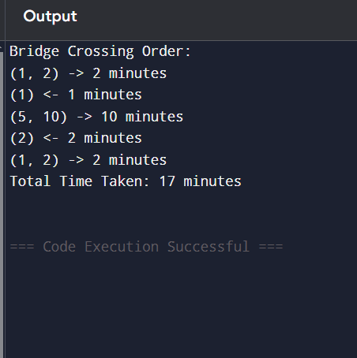
The output:-

Slide 10
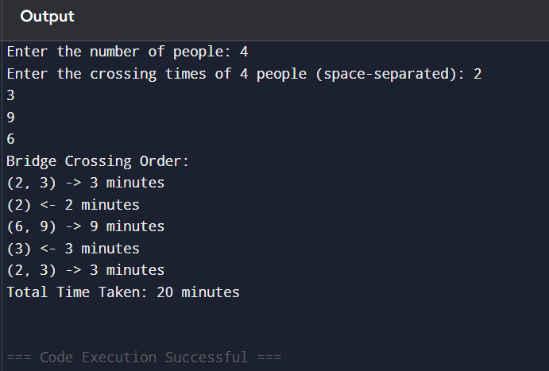
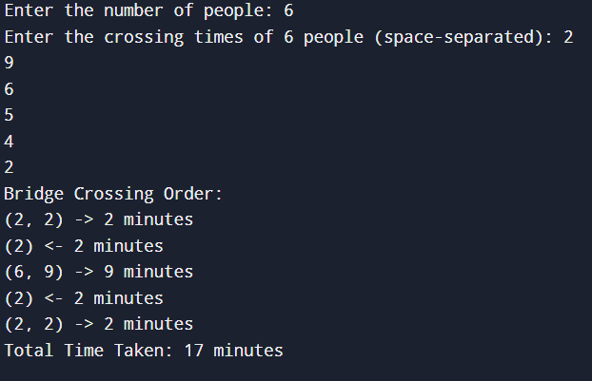
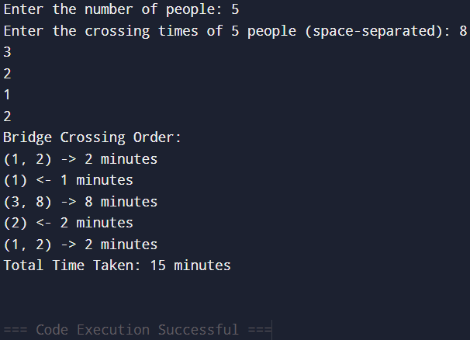
Test cases
(1)
(2)
(3)

Slide 11
extension
What happens if one additional person joins the group and has a crossing time of 15 minutes? How does this affect the total crossing time in your greedy algorithm? Show the step-by-step crossing sequence.

Slide 12
Extension description
The bridge crossing puzzle involves a group of people needing to cross a bridge at night with only one flashlight. At most two people can cross at a time, moving at the slower person's speed. The goal is to minimize the total crossing time.
Initially, we have four people with crossing times of 1, 2, 5, and 10 minutes. The greedy algorithm typically follows these steps:
The two fastest people cross first.
The fastest returns with the flashlight.
The two slowest cross together.
The second-fastest returns with the flashlight.
The two fastest cross again.
When adding a fifth person with 15 minutes crossing time, the strategy might change, increasing the total crossing time. The revised sequence would involve:
Ensuring optimal pairing to minimize waiting time.
Adjusting the return of the flashlight strategically.

Slide 13
Extension implementation
#include<stdio.h>
void bridgeCrossing(int people[],int n){
printf("Bridge Crossing Sequence:\n");
int total_time=0;
printf("(%d,%d)->%d minutes\n",people[0],people[1],
people[1]);
total_time+=people[1];
printf("(%d)<-%d minutes\n",people[0],people[0]);
total_time+=people[0];
printf("(%d,%d)->%d minutes\n",people[n-2],people[n-1],people[n-1]);
total_time+=people[n-1];
printf("(%d)<-%d minutes\n",people[1],people[1]);
total_time+=people[1];
printf("(%d,%d)->%d minutes\n",people[0],people[1],people[1]);
total_time+=people[1];
printf("Total Crossing Time:%d minutes\n",total_time);
}
int main(){
int people[]={1,2,5,10,15};
int n=sizeof(people)/sizeof(people[0]);
bridgeCrossing(people,n);
return 0;
}

Slide 14
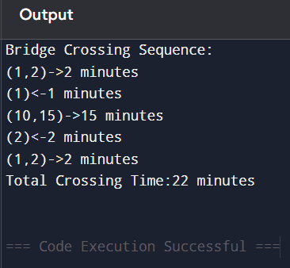
Extension output

Slide 15
Time complexity
The question:-
Sorting Step: O(n log n) (if needed)
Greedy Execution Steps: O(n)
Total Complexity: O(n log n)
The extension question:-
Sorting Step: O(n log n) (if needed)
Greedy Execution Steps: O(n)
Total Complexity: O(n log n)

Slide 16
Thank you

