Slide 1
Mini Project
Project Title : Appointment Booking System
Developed By : AVULA MADHAVI(23AK1A05A3)
Department : Computer science and engineering.
College Name : Annamacharya institute of technology and
sciences ,Tirupati .

Slide 2
Problem Statement
Traditional appointment booking methods are manual and time-consuming.
Problems:
Data loss
Human errors
Time-consuming process
Difficult record management
Solution:
Develop an Appointment Booking System using JSP,JDBC,MySQL, and Tomcat.

Slide 3
Methodology/Technology Used
Technology used:
Frontend:- JSP,HTML,CSS
Backend:-Java(JDBC)
Database:-MySQL
Server:Apache Tomcat
IDE:-Eclipse
Workflow:
User enters details.
Form submits data.
JDBC connects to MySQL.
Data stored in database.
Success message displayed.

Slide 4
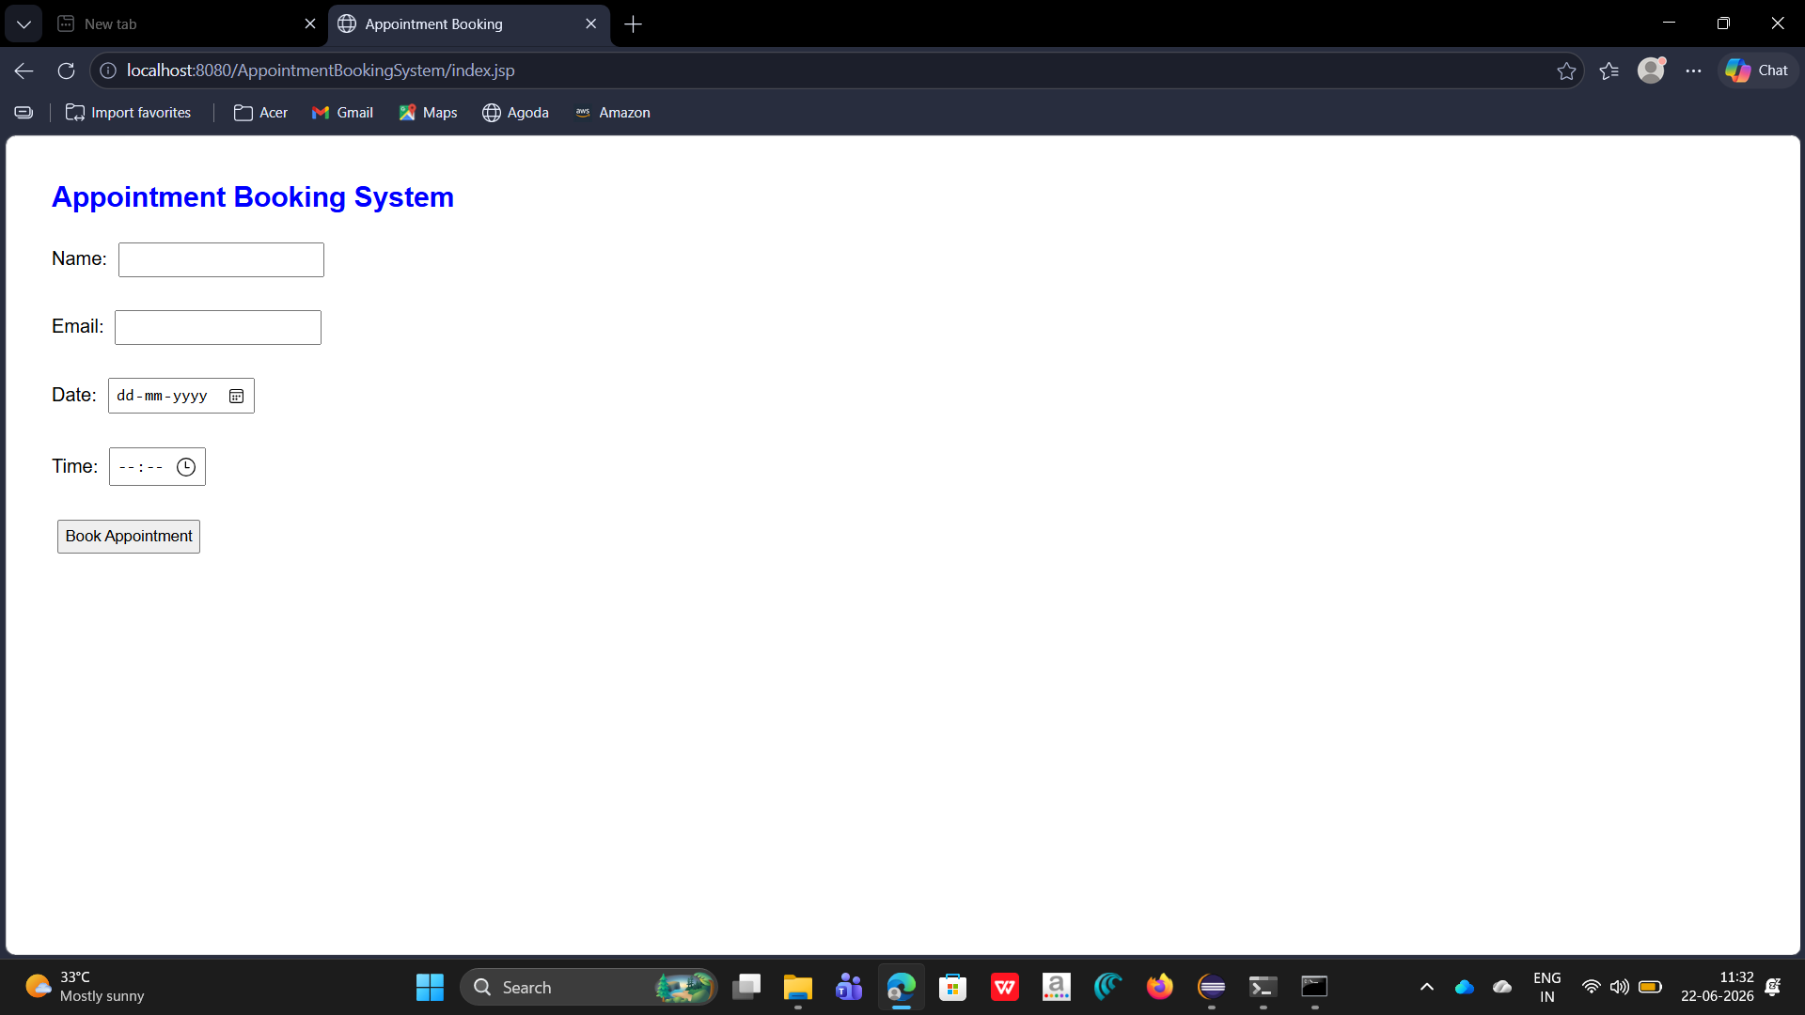
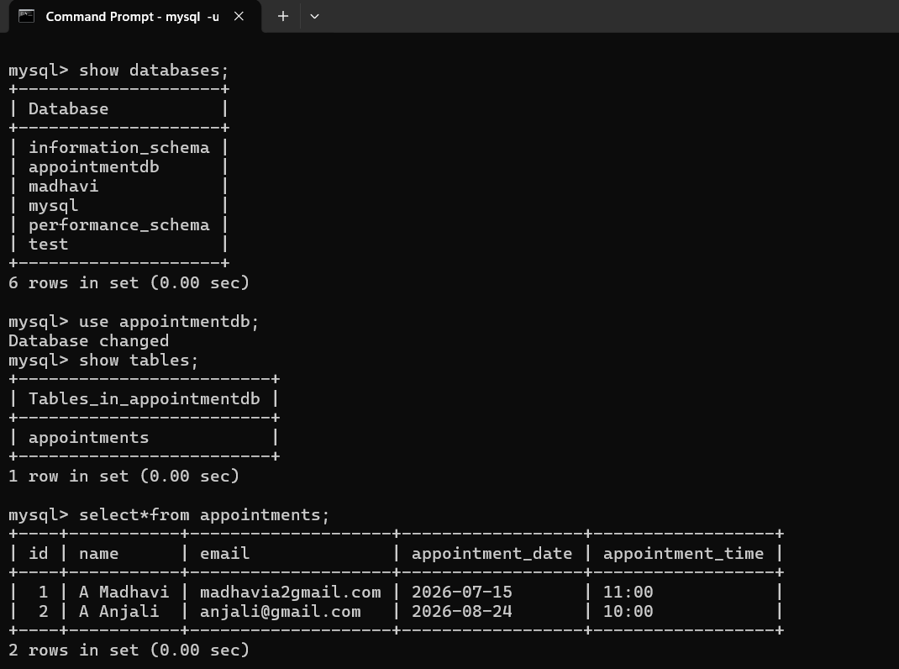
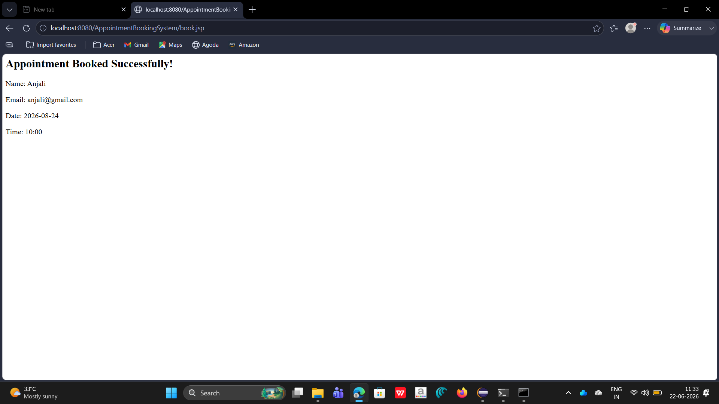
Project Output
User can book appointments online.
Appointment details are stored in MySQL.
Success confirmation is displayed.

Slide 5
Conclusion
The Appointment Booking System successfully automates the appointment booking process and stores records in a database.
Future Enhancements:
Admin login
Appointment Cancellation
Email notification
Mobile application support

