Slide 1
PageRank
Alexander Ulanov

Slide 2
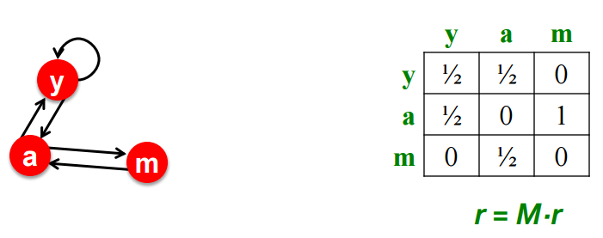
PageRank
Given:
adjacency matrix with 1s: rows – inbound links, columns – outbound
each column divide by the sum of its elements, so it sum to one
as probability to jump from one to the other
PageRank is a flow of influence
Issues
no outbound links – dead end (flow leaks)
column has only zeroes, replace with 1/n
cycles – spider trap (flow cycles)
column has some zeroes, jump with (1-d) anywhere (even if no zeroes)

Slide 3
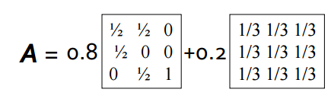
PageRank
Power iteration
r:=M*r
M has to be stochastic (columns sum to one), acyclic and irreducible
Then M will be dense, which is hard to manage
A=d*M+(1-d)*[1/n]^{nxn}
r:=d*M*r+[(1-d)/n]^{n}
Algorithm
r:=[1/n] ^{n}
Loop while r |r_{j}(t)-r_{j}(t-1)|>epsilon
r_{j}:=sum(d*r_{i}/outdegree_{i}) (:=0 if indegree of j is 0)
r_{j}:=r_{j}+(1-sum(r_{j})/n)

