Slide 1

Analysis of Adult dataset Professor – Dr. Lindi Liao AIT614 - #005: Big Data Essentials April 26, 2023 Pravallika Avula – G01388664 Saipriya Bethi – G01389650 Sai Roopesh Diddi – G01353614 Snehita Moturu – G01388464 Sameeksha Muralidhar Gupta – G01380844

Slide 2

Functional Requirements
In this project, we will use Pyspark and the required libraries for data analysis and model building.
We will also use SQL queries to find the income earned by the people with different variables.

Slide 3
Introduction
The economic success of a nation relies on multiple factors beyond income, such as employment opportunities and the overall welfare of its people. These aspects are influenced not only by financial status but also by other variables, including age, gender, race, education, and family background.
To obtain an accurate projection of an individual's income, these factors must be considered. Census income data is a valuable resource for big data analysis, providing essential insights into a population's demographic and economic characteristics.
By examining census income data, we can gain valuable information about consumer behavior, market trends, and economic patterns, leading to improved predictions of income and enhancing overall economic well-being.

Slide 4

Project Goals
The main goal of the project is to find out the following:
Analyzing the features contributing to the highest income.
Which age group, working class, occupation, and sex have the highest income?
How are the attributes dependent on each other and identify if there are any similarities.

Slide 5

Project Timeline
Week 1: DATA COLLECTION (Collected raw data.)
Week 2: DATA PRE-PROCESSING (Data cleaning)
Week 3: DATA STORAGE and VISUALIZATION (Set-up and load database, data analysis and visualization)
Week 4: MODEL DEVELOPMENT (model building and testing)
Week 5: Report and Presentation

Slide 6
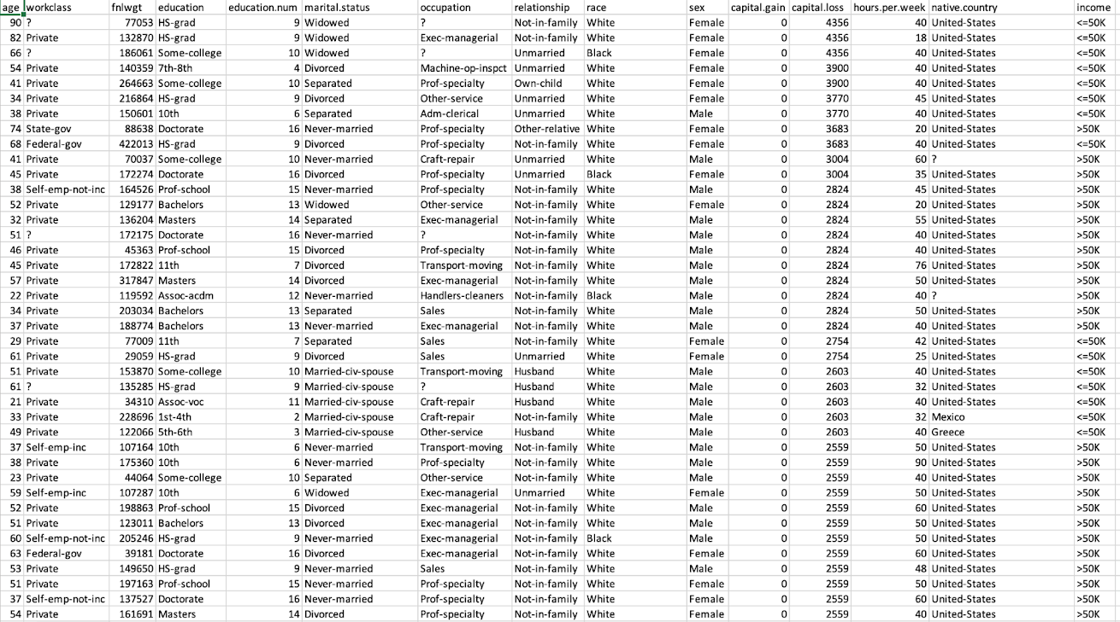
Dataset
The adult dataset is a fairly large set, consisting of 48,842 instances.
There are 14 attributes prescribed to each person.
The dataset contains missing values that are marked with a question mark character (?).

Slide 7
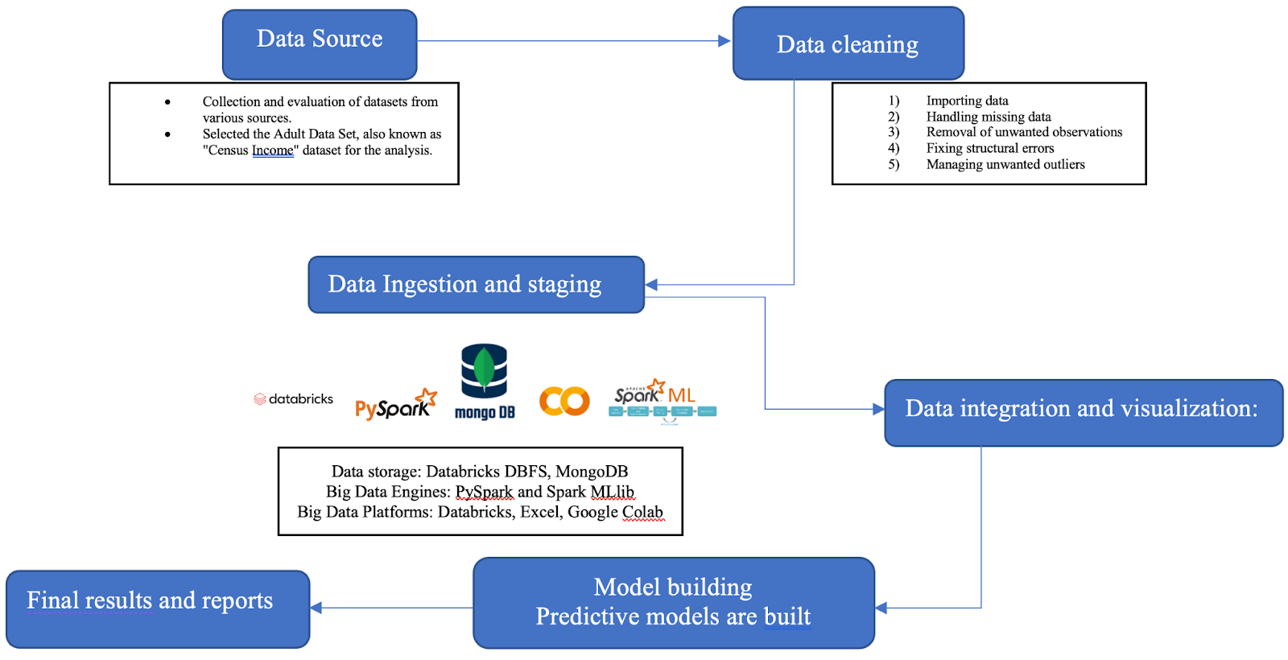
Distribution of proposed system

Slide 8
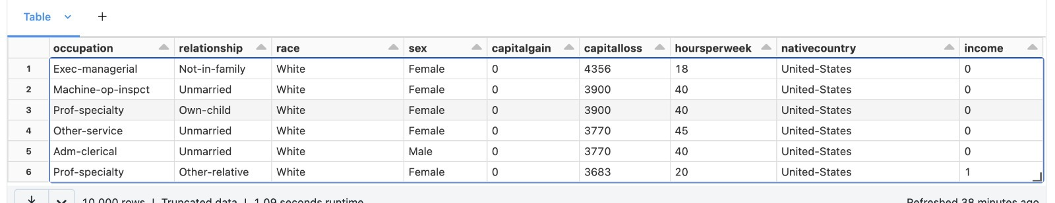
Encoded data of the Target variable where “<=50K” and “>50K” are changed to 0 and 1 respectively.

Slide 9
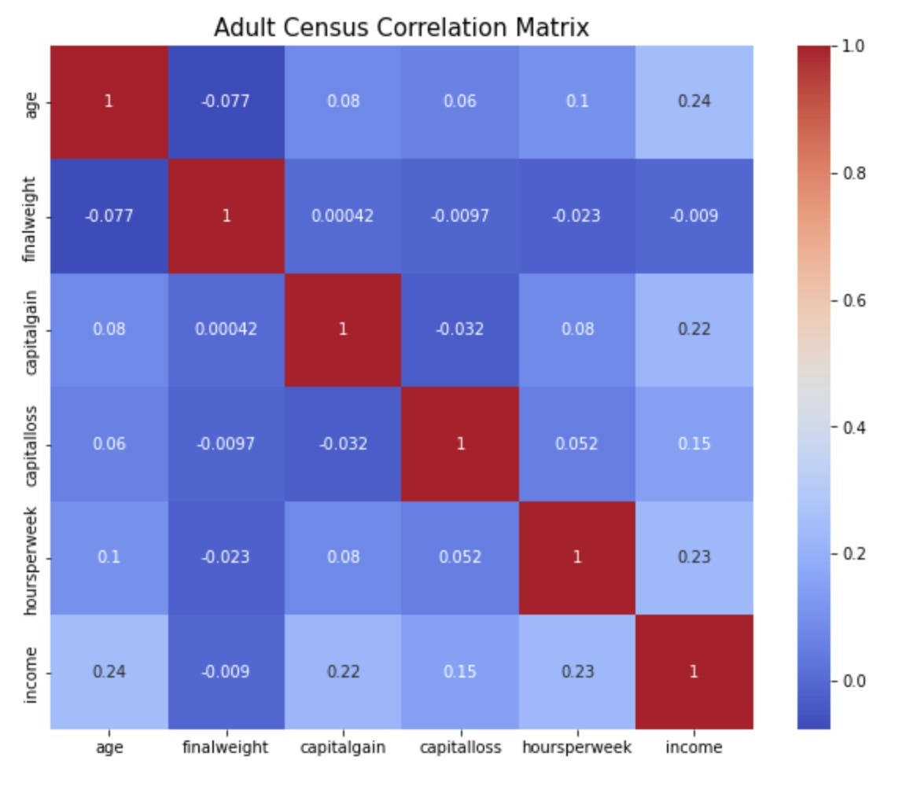
Correlation Matrix
The correlation matrix shows that income, age, hours per week, and capital gain are the main variables that have a positive relationship with income.
Furthermore, we observe a positive correlation between age and the average number of hours worked per week, while the relationship between hours per week and capital gain/loss is not as strong.
Additionally, there is a negative correlation between capital gain and capital loss.

Slide 10
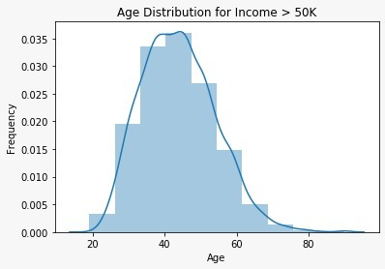
Data Visualization
Visualization for different age groups where income is greater than 50K.

Slide 11
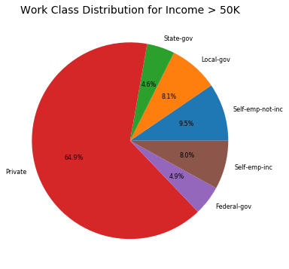
Data Visualization
Visualization of Work Class Distribution for Income > 50K

Slide 12
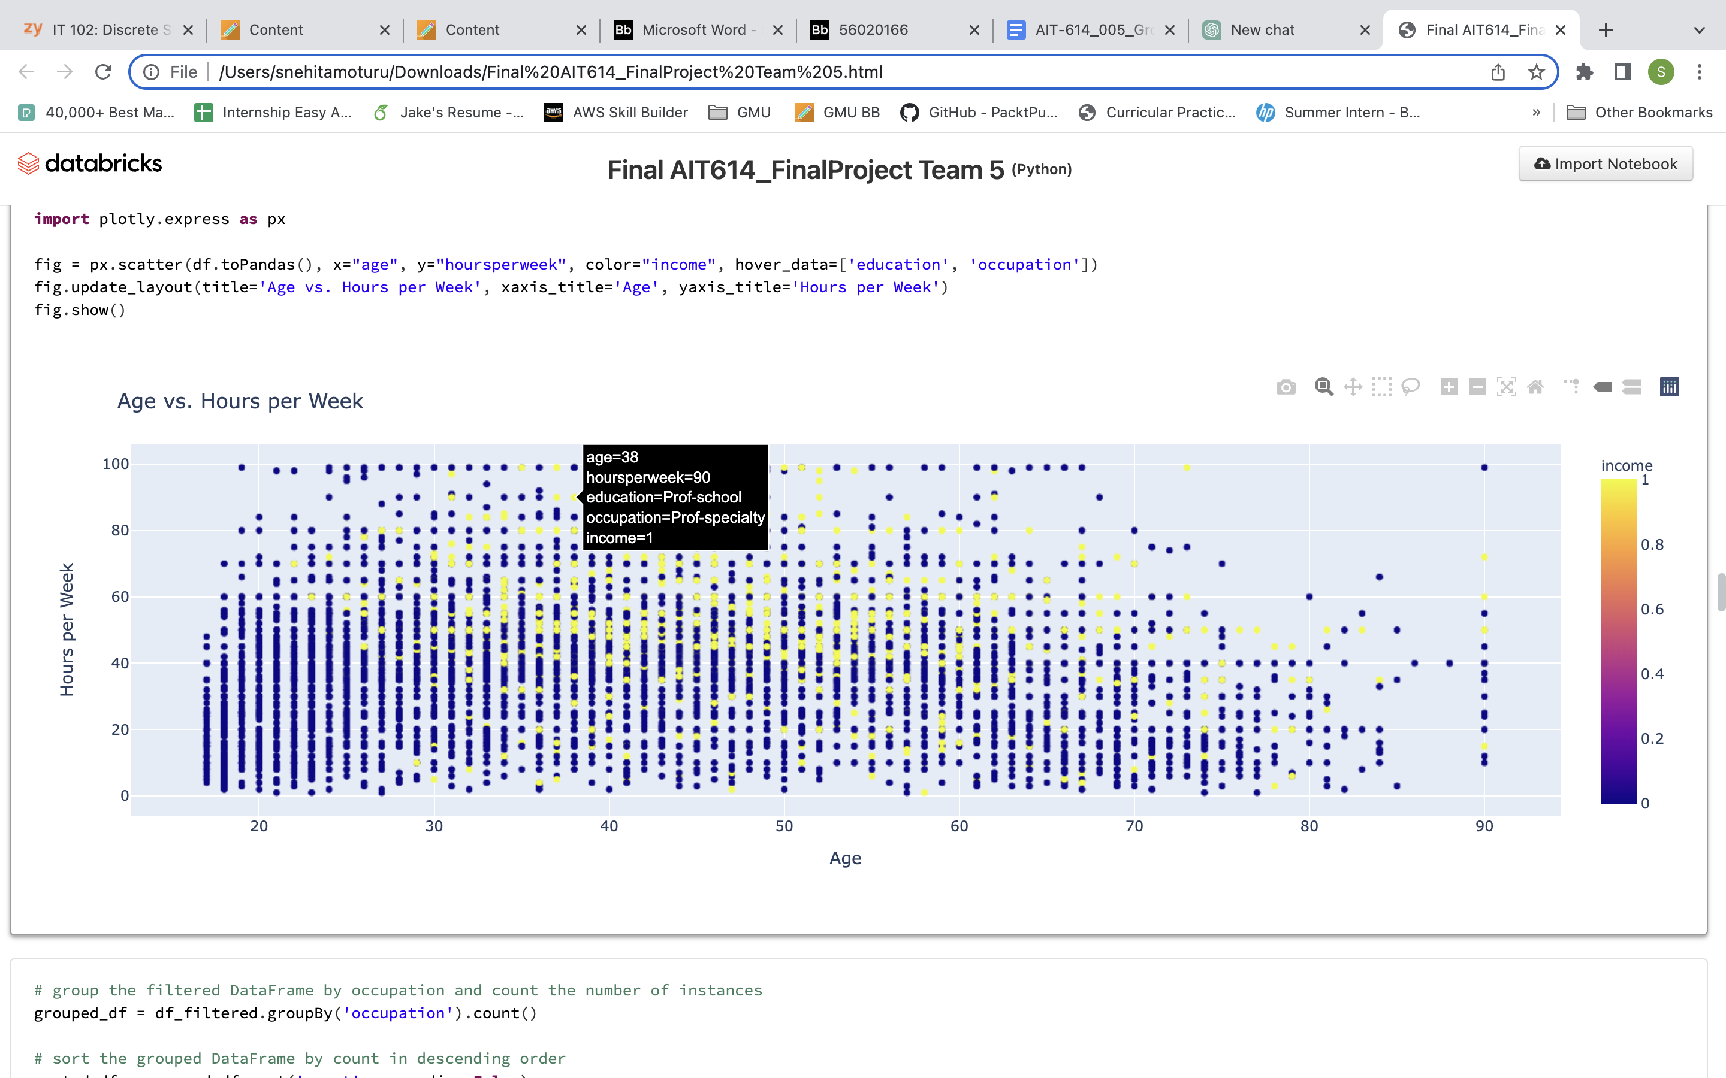
Data Visualization
Exploring Variations through Scatterplot Visualization: Age and Hours per week showing income variation.

Slide 13
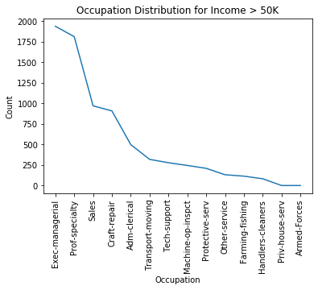
Data Visualization
Occupation Distribution for Income > 50K: A Visualization using Line Graph

Slide 14
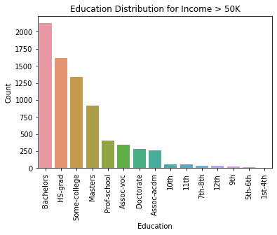
Data Visualization
Education Distribution for High-Income Individuals (>50K) in the Dataset

Slide 15
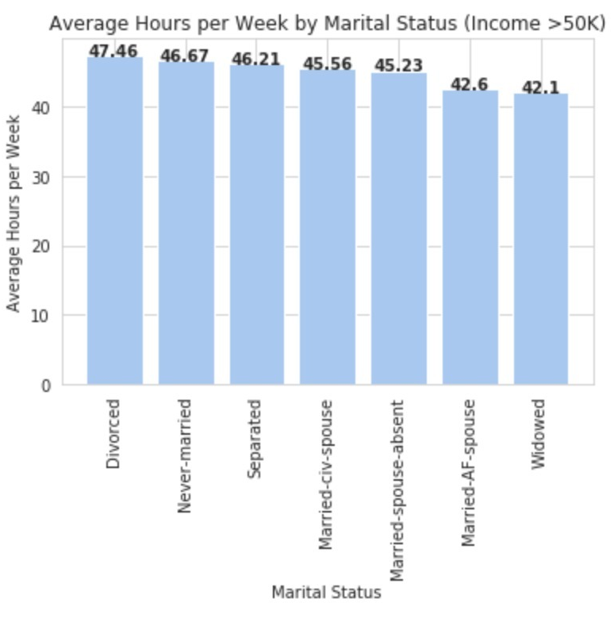
Data Visualization
Average Weekly Work Hours by Marital Status for High Income Individuals

Slide 16
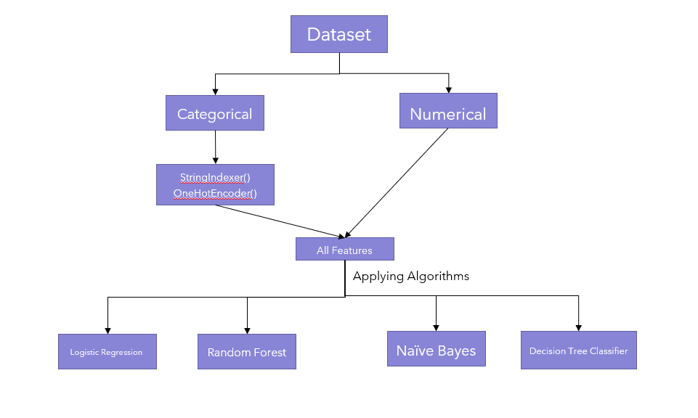
Feature Preprocessing
Model Building

Slide 17
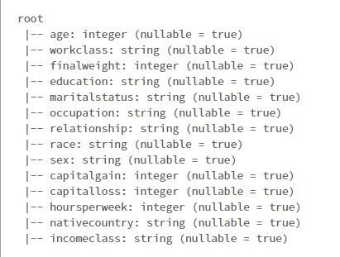
Features of the Dataset

Slide 18
We created train and test dataset by splitting the
data into: - 70% for training -30% for test data set
-Databricks runtime (7.3 ml(10.4 LTS (includes apache spark 3.2.1, scala 2.12))
-Machine learning algorithms using pyspark.
Analysis Setup
and
Runtime Environment

Slide 19
Results
Below are the results and scores of the models
Scores | Logistic Regression | Random Forest | Naïve Bayes | Decision Tree Classifier
Area under ROC Curve | 0.898265838 | 0.887970954 | 0.233155472 | 0.682357909
Accuracy | 0.847064027 | 0.836337499 | 0.775406392 | 0.837885657

Slide 20

Conclusion
Through data visualization, we identified patterns and relationships within the data.
Based on the Modelling results, the best predictive model is Logistic Regression with the best accuracy rate.
Through modelling we can predict about future income levels and the factors affecting it.
For instance, the factors determining the income the most include age, education, and working hours.

Slide 21

Lessons learned
How to work with Big data tools like Databricks, Pyspark etc.
How to handle huge datasets.
Data visualizations techniques
Building Predictive Models

Slide 22
References
[1] Dataset link: UCI Machine Learning Repository: Adult Data Set. (n.d.). Retrieved March 18,2023, from https://archive.ics.uci.edu/ml/datasets/Adult
[2] Great Learning Team. (2022, September 2). Data Visualization Techniques, Tools andConcepts. Great Learning Blog: Free Resources What Matters to Shape Your Career! https://www.mygreatlearning.com/blog/understanding-data-visualization-techniques/
[3] Stevens, E. (2023, January 4). The 7 Most Useful Data Analysis Methods and Techniques.CareerFoundry. https://careerfoundry.com/en/blog/data-analytics/data-analysis-techniques/

Slide 23

Thank you!

