Slide 1
Ensembl migration
The great (WTSI) e!scape
Alessandro Vullo
Ensembl Data Review
Oct 17 2016
EMBL – European Bioinformatics Institute
Wellcome Trust Genome Campus
Hinxton, Cambridge, CB10 1SD, UK

Slide 2
Objective(s)
assert(e_sanger_footprint == 0) if date =~ /Mar 2017/
  maintenance of public face is of paramount importance: public web sites (HX/AWS), MySQL access, mailing lists
  production processes are important as well

Slide 3
The Plan (Summary)
Migrate 3 groups in turn
  public archive services (archives, FTP/MySQL)/web presence (HX)
  release production processes
  processes outside of release cycle
Notes:
Expertise from Ensembl Genomes, who run many Ensembl pipelines already at EBI, will be leveraged. Early migration of non-release linked resources such as our archive and FTP site will ensure EBI is aware of our requirements and expose issues early. Maintenance of our public face is of paramount importance.

Slide 4
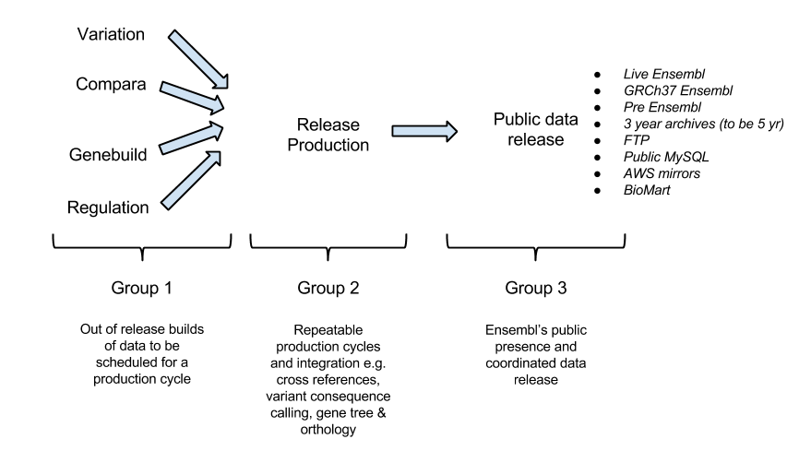
Ensembl Flow
Notes:
How to think about e!? At the simplest level you distinguish two major areas: production/data release (web/FTP/MySQL) + helpdesk
Ensembl operates a 4/5 release policy per year resulting in 9 releases over 2 years. This roughly means a production cycle and data release once every 11 weeks. During this production cycle (represented by Group 2 in Figure 1) data is delivered from content teams, processed by other content teams and then finally delivered to a staging database and file system depending on the data format. Once fully collated this data is delivered to our public distribution channels (represented by Group 3 in Figure 1) and mostly takes the form of 19 websites: one delivering the latest release and 16 delivering an archive release.
The final Group represents data that is produced out of cycle and awaits the next Ensembl release to schedule further processing. For example a gene build, the process of annotating a genome with transcription models, is rarely released publicly without the addition of cross references and mappings between genome versions.
The Vega website and data production tasks are the responsibility of the Ensembl webteam. This is generally done on a much smaller scale than, and at different times to, Ensembl. It does present a particular challenge in the need for frequent updates to data outside of the release cycle.

Slide 5
Sanger Footprint
~330TB storage (production, web live/archive servers)
  DDN SAN 103TB
  Nexsan 228TB
125 servers: ~1300 Cores/~3.2TB RAM
  29 DB production
  33 DB web & public services
  63 web sites/search (incl. archives) + tools
Farm processing
  ~500 CPU yrs (2015)
  ~45 TB clustered filesystem (lustre)
  ~200TB NFS storage areas (warehouse)
Notes:
The majority of Ensembl servers are bare metal. The exception are our archive web servers, search engines and private data (data sets which cannot be released externally) database servers which are VM based.

Slide 6
3, 2, 1 go!
September 2015: commence
<February 2016: Ok-ish, slow pace
  initial discussions with EBI/Sanger groups
  AV takes on PM role (Jan)
  identify tech requirements in more details
    benchmarking Sanger machines: mainly storage
    DB meetings (move data across, back ups, MySQL versions)
Feb 2016: shutdown in HX, bang!

Slide 7
Hinxton Data Centre Shutdown
26-30 Aug 2016, power cycle (every 5 yrs), electrical maintenance
Impact: internal/external services HX hosted
Major consequences for e!

Slide 8
Oh no, suicidal!
Some production/web db servers on potentially faulty IBM blades (50% chance to recover)
No strategy other than Sanger/IBM try to fix them
Sanger suggests to migrate away from this HW ASAP!
Main concerns:
  managing release
  guarantee public services

Slide 9
We need HW soon!
Cope with shutdown, provision in time to advance plan implementation
Need ~£400K hypervisors/storage
Have ~£250K (e! overhang budget)
Will:
  buy in on e! budget (£150K shortfall)
  EBI pre-award push shortfall into
  WT award in Oct charged EMBL pre-award

Slide 10
Strategy (web)
user/tools/hive DBs migrate to EBI asap
shadowland(?!) connects web/archives to DBs
EBI-AWS VPN for mirrors
Sanger blades:
  web servers OK
  species/mart/other DBs are suicidal, use Solr servers as fallback

Slide 11
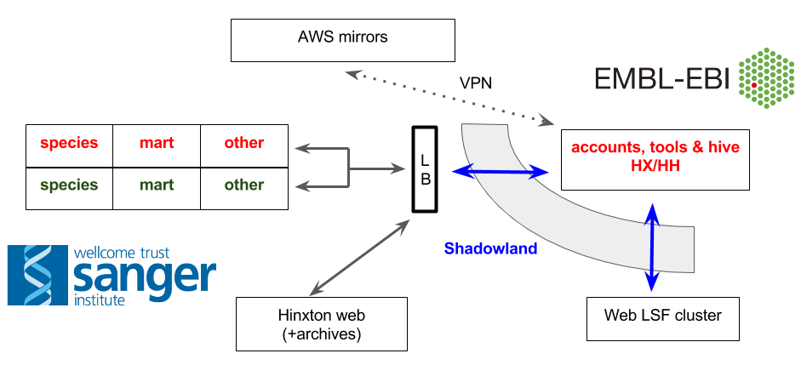
Web & VPN/shadowland

Slide 12
Strategy (production)
production remains at Sanger
  e!86 processes finish before (Aug 22)
staging servers backed up
teams make sure not to use suicidal HW
suicidal servers flagged for attention
  source suitable replacements if pbs

Slide 13
What Happened
A number of VMWare VMs have come back with different IPs
Pb with new Solr servers, java process stopping e! tomcat
A number of the IBM blades have not come back and some others had trouble with their storage
  new system board and more memory
  all blades back and serviceable (Aug 31 evening)

Slide 14
Public Archive Services
e! maintains archive of past releases (3ys)
  past 13 (includes NCBI36 e!54), e.g. may2009.archive.ensembl.org
  2 key species archive: NCBI m37 (e67), Zv8 (e59)?
Objective: migrate autumn/fall 2016
Notes:
In the next WT funding cycle this will grow to 5 years of archives.
We will aim to migrate our public archive services first followed by our public web presence (group 3).
Early migration of non-release linked resources such as our archive and FTP site will ensure EBI is aware of our requirements and expose issues early.

Slide 15
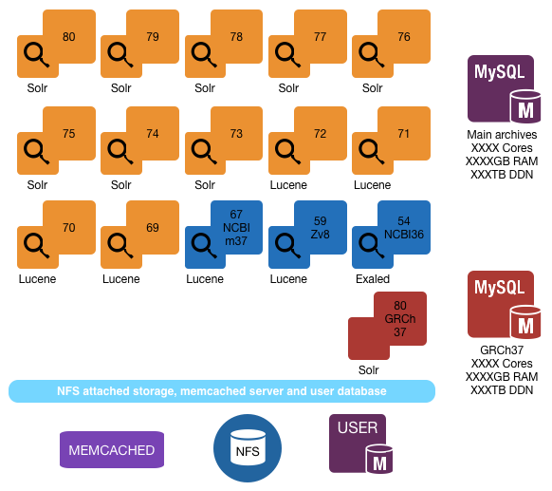

WTSI set up

Slide 16
WTSI set up (2)
28 servers: ? Cores/? RAM/? storage
  15 releases archive (past 13 releases plus 2 key species plus GRCh37): 18 VMs, ? Cores/? GB RAM/Storage?
  Each archive site accompanied by search server: 15VMs, ? Cores /225GB RAM/7TB DDN
    8 Solr e!>=73
    5 Lucene
    1 exalead
  Archives/GRCh37 DB-Solr servers: ? Cores/? RAM/? Storage (BM)
  NFS? Web data
  Shared user DB with live web
  Hosted on VMWare virtualisation platform

Slide 17
Archives Migration Plan
Spring 2016 – Migrate 82 archive (WP1) (not full fledge migration, need completion of WP2 before run)
  request image
  requisition DB servers (data hosting, user sessions, mart)/NFS server
  copy release data from EBI mirror
  upload WTSI images (web/solr search) – critical

Slide 18
Archives Migration Plan (2)
Autumn 2016 – Host all archives on Embassy (why?) (WP2)
  transfer all images
  EBI-Embassy VPN (shared accounts DB)
  deploy service monitoring infrastructure
  control procedures/load balancer
  transfer stats
  switch DNS

Slide 19
Milestones
State: 60% done
Jan 2016: 1%
  request 82 VMs, set up Embassy space
March-May 2016: 12%
  upload 82 images (ovftool from Sanger farm) and data (EBI mirror)
  main DB/Mart/NFS servers set up, (temp accounts DB replacement)
July 2016: 25%
  infrastructure developments: networking (route trafficking), security
  shadowland ready for data transferring
  upload/testing e54/67 images (proof of concept)
August 2016: 40%
  requisition enough compute/storage: 90GHz/200GB RAM/80TB
  data migration (archive Dbs/Mart/NFS)
September 2016: 60%
Notes:
Current rate: 5%/month, will end July 2016, but most of remaining are repeatable steps, infrastructure is in place, data transfer in place (need to fix couple of glitches and should be ok)

Slide 20
FTP
32TB disk hosted on FTP, HTTP(S) and Rsync
  mirrors depends on FTP (flat-files)
require to be able to sync, on a per release basis, all data held in the Ensembl FTP site onto a co-mirror hosted in HH
EBI set up
  2 LB mirrored servers HH + HX (semi-auto) fail over, 75TB storage
  covered by extra purchase
Objective: migrate by end 2016

Slide 21
FTP Migration Plan
Requisition server/storage
Test FTP/FUSE fs access
Data transfer
Release deployment procedures
Switch DNS

Slide 22
Milestones
State: 70%
Sep 2015: 0%
  pilot study into move
January 2016: 1%
  request space (not available, need money)
April 2016: 5%
  data transfer access point/ftp test server available
  test transfer e!82-83
July 2016: 25%
  FTP layout agreement, requisition server/storage
August 2016: 40%
  internal beta testing available
September 2016: 70%?
  data migration (shadowland)

Slide 23
Public MySQL
Two servers cover all releases back to 24 (MySQL 4/5.1)
  note on MySQL versions?
GRCh37 set up?
Objective: migrate autumn 2016

Slide 24
Migration Plan
Copy DBs:
  1. 24-47, then host
  2. 48-present, then host
  3. GRCh37 79-present, then host
Requisition HW/storage
Develop SOP to push DBs to server per release
Sync/Switch DNS

Slide 25
Milestones
State: 70% done
May 2016: 5%
  HW procurement order
July 2016: 15%
  warehouse available
August 2016: 50%
  HW available
  investigate failover of public services on HH
  copy all releases to warehouse (shadowland)
September 2016: 70%
  layout agreement
  HW request

Slide 26
Production (including genebuild)
Filesystems/storage:
  45 TB clustered (HX farm) + 200TB NFS long-term warehouse (lustre backup)
Compute:
  500 CPU yrs (2015) LSF farm
  run genebuild/production Hive pipelines etc.
Objective: migrate after web (Q1 2017)

Slide 27
Migration Plan
Migrate CVS
Requisition compute/storage
Test pipelines EBI
Release build process survives shutdown
Migrate pipelines/warehouse

Slide 28
Milestones
State: 70% done
Feb 2016: 1%
  Clustered storage options/e! shared user
April 2016: 5%
  software installations (perl, pipeline dependencies)
  EBI cluster update to RH7!
June 2016: 15%
  EBI farm minicourse
  work on RH7 software environment (Andy)
July 2016: 50%
  farm storage/compute ready
August 2016: 65%
  production HW ready (after shutdown)
  shutdown?
  RH7 software env/area ready

Slide 29
Live e! Websites
Dialogue with Steve to figure out the whole infrastructure and describe it in a simple but detailed way
Storage, compute (web/farm nodes), filesystems
Objectives: should have some kind of live site running on EBI hardware by the end of 2016 to ensure any remaining kinks can be resolved quickly (especially if those kinks require additional hardware purchasing)

Slide 30
Migration Plan

Slide 31
Milestones

Slide 32
Overall
State: ~60%?
(Gracefully) survived shutdown (?)
Infrastructure:
  HW resources purchased/partly allocated (budget employed, accountancy wizardry)
  Networking infrastructure to support data transfer
Public distribution:
  Archives/FTP/public MySQL on the go (thanks to shadowland)
  Web infrastructure work started (moved user/tools)
Production:
  HW requisitioned (DB servers, Farm, data storage)
  CVS migrated
  software environment installed (almost stabilised), pipelines tested
Outreach
  RT migrated?

Slide 33
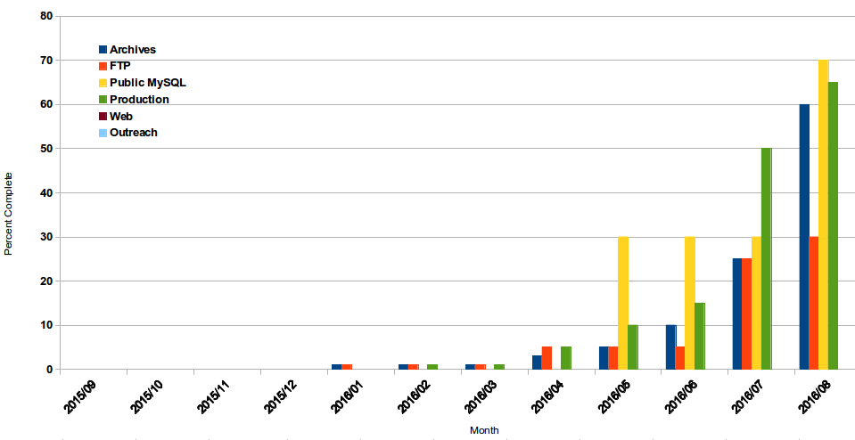

Slide 34
Acknowledgements
Mag, Daniel
  supportive and guiding in difficult moments
Andy, Steve, Dan Ss
  the underlying heroes, competent gentlemen
Migration champions
Group leaders
Everybody in e!

