Slide 1
Ensembl Migration to EBI

Slide 2
Background: 8 work packages
WP1/2: Migration of Ensembl 82 Archive and all other archives
WP3: Ensembl FTP
WP4: Ensembl Public MySQL
WP5/6: Production: All content teams
WP7: Live Ensembl Websites and services
WP8: External communications

Slide 3
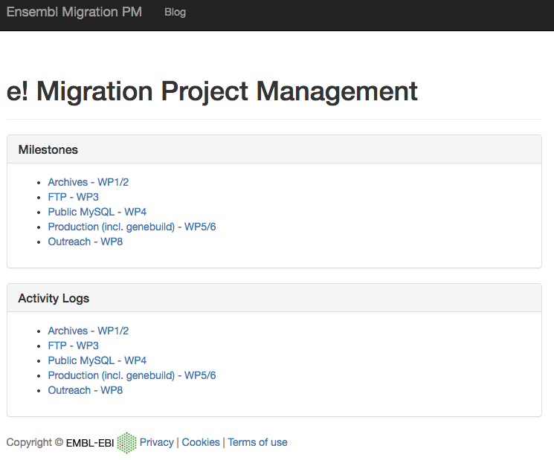
https://avullo.github.io/ensembl-migration-pm

Slide 4
Migration Timeline: Q1 2017
To be capable of running all public services and production processes at EBI by release 88
Sept 16
e86
Oct 16
Dec16
e87
Mar 17
e88

Slide 5
Migration Timeline: Q4 2016
Archives at EBI, web infrastructure ready for live site, production run confirmed
Sept 16
e86
Oct 16
Dec16
e87
Mar 17
e88

Slide 6
Migration Timeline: Oct 2016
Migration of Ensembl DB, Ensembl FTP, RT, production environment ready
Sept 16
e86
Oct 16
Dec16
e87
Mar 17
e88

Slide 7
Migration Timeline: Sept 2016
Production environment ready for use, hardware available, MySQL servers ready
Sept 16
e86
Oct 16
Dec16
e87
Mar 17
e88

Slide 8
Progress
WP1-2: Archives
Hosting archives on HX Embassy
All archives have been uploaded using shadowland
e82 successfully deployed
e54 and e67 images hosted as proof of concept
WP3: FTP
All FTP transferred to EBI warehouse
Server being setup
WP4: Public MySQL
Transfer done an awaiting hardware (MySQL 4 issues)

Slide 9
Progress
WP5-6: Production
Software environment deployed for testing RHEL7
/nfs/software/ensembl
RHEL6 testing aborted
MySQL servers requested (32GB 4 cores and 64GB 8 cores for staging)
Lustre available at EBI for use
WP7: Services
Hardware on site for web; awaiting TSC meeting to define topology
Investigating co-hosting REST with EBI based websites
CVS at Sanger turned off with archive at EBI available
Notes:
EG web have requested a read only git migration of a CVS repo

Slide 10
Progress
WP8: External communication
Bought in external consultancy to migrate RT from Best Practical
Migration slated for Mid-October (17th-21st)
Downtime expected to be minimal
Delayed due to numbers of reasons including data centre shutdown
Dev and announce lists being discussed with Sanger systems

Slide 11
Next Steps
Get hardware to everyone
Decide on the website topology
Get running as many processes/services/tools at EBI as possible

