Slide 1
Paths to EBI Migration
Core Meeting Feb 2 2016
EMBL – European Bioinformatics Institute
Wellcome Trust Genome Campus
Hinxton, Cambridge, CB10 1SD, UK
Notes:
I would like to talk about things I've been doing in the recent past concerning the integration of remote genome annotation data using recent genome browser technology

Slide 2
We need to migrate
Openstack 6 → 9 in 4 months
  REST server
  Trackhub Registry
  GenomeStats server
  a bunch of test servers
Alternative (EBI VMs) being investigated for REST/THR
  coherently part of e! production ecosystem
  set the stage for the Versioning/Mongoose service

Slide 3
EBI Environment
Hinxton data center (HX, hx-wp)
  testing new data
  delivering to HH
  serving data
    failover from HH
    from HX/HH depending on LB rules
Hemel Hempstead (HH, hh-wp)
  purely for running services

Slide 4
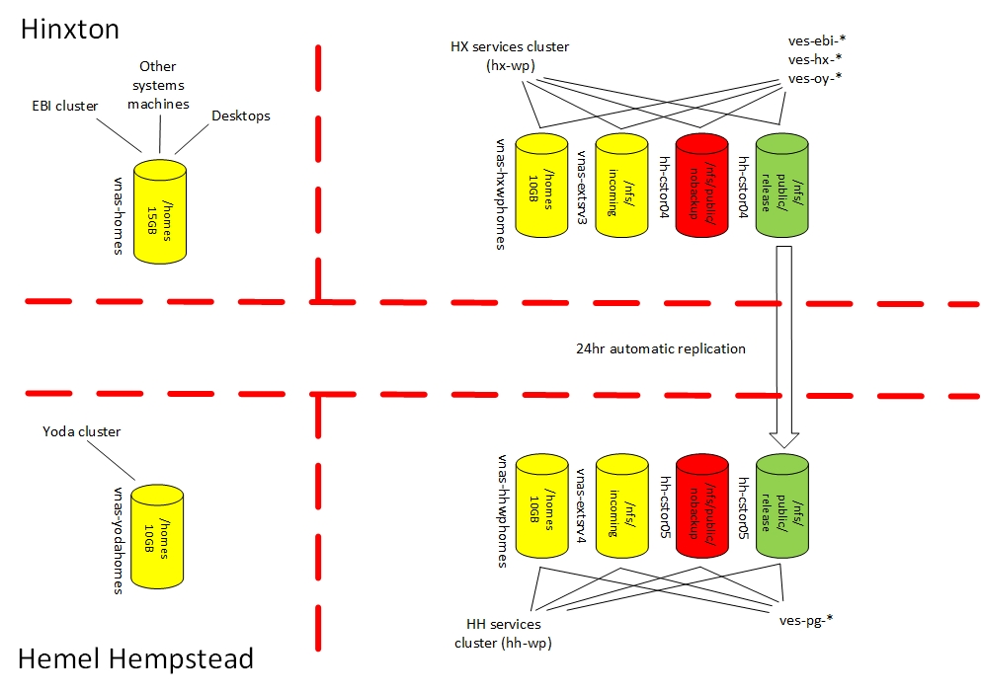
Clusters
Yellow
  NetApp/NFS
  local snapshots/offsite replication
Red
  Clusterstor/GPFS
Green
  Clusterstor/GPFS
    HX→ HH scheduled/user replication

Slide 5
User Home Directories
Intentionally separate
  copying data across is user’s responsibility
Virtual user accounts (EBI services)
  vnas-hxwphomes:/homes (HX)
  vnas-hhwphomes:/homes (HH)

Slide 6
New Storage Architecture
/homes (rw)
  storing login scripts etc.
  10GB quota
  7 days snapshots
  should not be used by application
/nfs/public/release (ro)
  actual project data (static, not changed by application)
  sync to HH
/nfs/public/nobackup (rw)
  should be treated as scratch area
  no snapshot/replication
/nfs/public/(hx|hh)-incoming (rw)
  2TB quota per project
  store incoming data for services receiving data

Slide 7
Creating/Migrating a Service
Service ↔ Project
Talk to your Sponsor/Trustee
Sponsor/Trustee ask (sysinf)
  create new project directory
  help sync data from the old system
Sponsor/Trustee ask (Desktop)
  create new virtual user(s), include list of becomers
Ask VMs! (Web prod)
  ready after mountpoints/users

Slide 8
Virtual User Policy
name includes team acronym <= 3 chars (ens)
best practice (security)
  one user owns the file and another runs the application
  tc_<acronym>_<number> (Java services)
  w3_<acronym>_<number> (Apache)
project team creates users owning project files: <acronym>_<project>_<number>
users must be part of a group (allow service team virtual users to reach each other data)

Slide 9
Virtual User Policy (2)
Web-prod only install official RH software
Do not allow users with root priviliges
  other software installed wo root
VMs with root permissions available on request (Cloud team)
  no access to NFS filers

Slide 10
THR (Openstack)
5 VMs (application)
  Catalyst front-end (2)
  Elasticsearch cluster (2)
  Staging/testing server (1)
Load balancer
  sticky sessions
  HTTPs access

Slide 11


HAProxy
Production
Staging/Testing
beta.trackhubregistry.org
test.trackhubregistry.org
Web Node 0
Web Node 1
Web Node
ES
Cluster
ES
Cluster

Slide 12
New Architecture
~10 VMs, (first service on RH7)
  2 front-end/2 back-end HH
  2 front-end/2 back-end HX (failover)
  2/3 staging/testing
New GPFS storage architecture
Load balancing with Traffic Manager
  sticky sessions
  handle HTTPs or direct to the nodes
Monitoring/Healthcheck
  Nagios check
  access to Ganglia

Slide 13
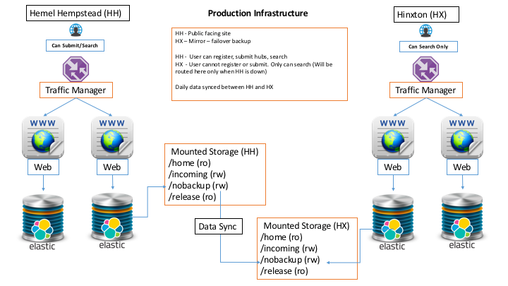

Slide 14
Timeline
Meeting witb web-prod (Dec 12 ‘16)
RH7 VMs/GPFS available (Jan 18)
Request for virtual users/project directories (Mag, Jan 25)
  ens_thrdev01, ens_thrprd01, w3_ens20 (core team)
  ens_thr proj dir in release, incoming, nobackup
Virtual users created (Jan 27)
Project dir, VMs?

