Slide 1
MS-data TrackHubs

Slide 2
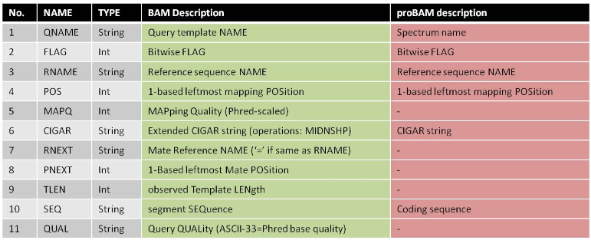
MS big data format?
proBAM (PSI, U. Vanderbilt)
  maps identified PSMs to the genome (BAM)
  build peptide-genomic location connections
  maintains spectra count info

Slide 3
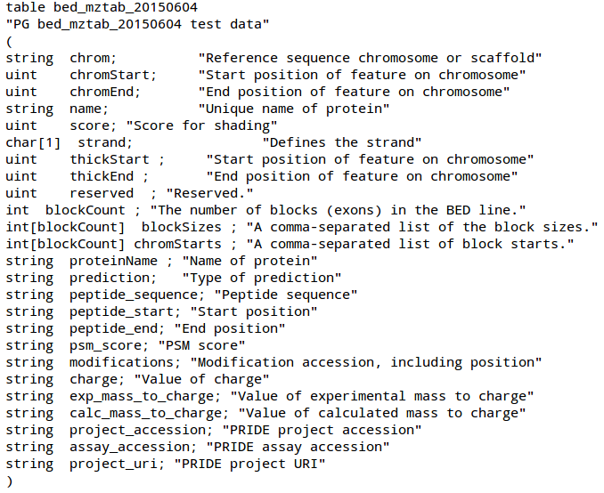
BigBED is good (temporary) fit

Slide 4
Prototype Proteomics TrackHub
Tracks refer to combined assay results at project level in custom bigBED
  overlapping features displayed in different lines
Generic “PRIDE” hub
  merge proteomics information in different projects (useful for most users)
  different colour per project
  TODO: feature colour scaled on PSM score, working with Anne
  http://www.ebi.ac.uk/~avullo/proteogenomics/example_hubs/20150728/hub.txt

Slide 5
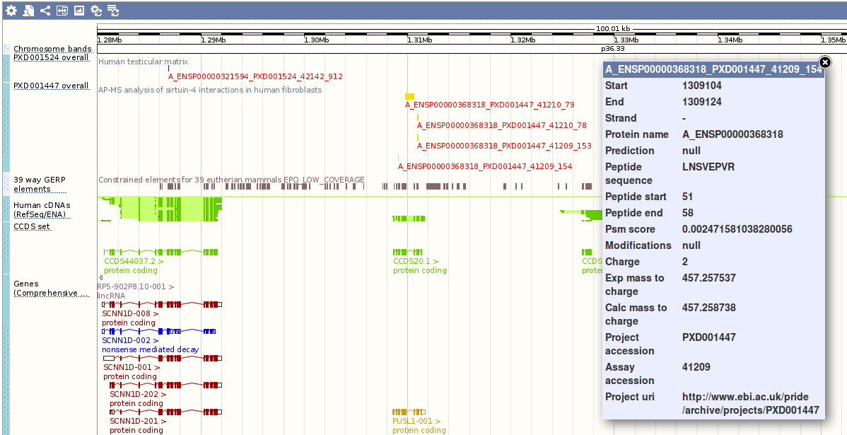

Slide 6
Future directions
Peptide with PTMs
  highlighted in different colors
  different colour per modification
Hubs for different projects available in separate hubs
  could be selected by users on-the-fly (i.e. ENCODE DCC (tailored BAM)
  similar idea to select ambiguous peptide-genome mappings

