Slide 1
Catching up on the TrackHub Registry
Ensembl Data Review
EMBL – European Bioinformatics Institute
Wellcome Trust Genome Campus
Hinxton, Cambridge, CB10 1SD, UK

Slide 2




ProteoGenomics
Dynamic linkage of genomes/proteomes
through Ensembl and ProteomeXchange

Slide 3
The Plan
Extension of TrackHub support in Ensembl
  integration of MS data sets (protein views)
  development of TrackHub Registry
Integration of (PRIDE/PX) data into Ensembl
  map protein accessions to e! IDs, peptide to genome coords
  massively parallel re-analysis of MS data (ProteoAnnotator)
  pipelines to update the TrackHubs (registry)

Slide 4



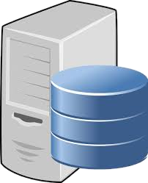
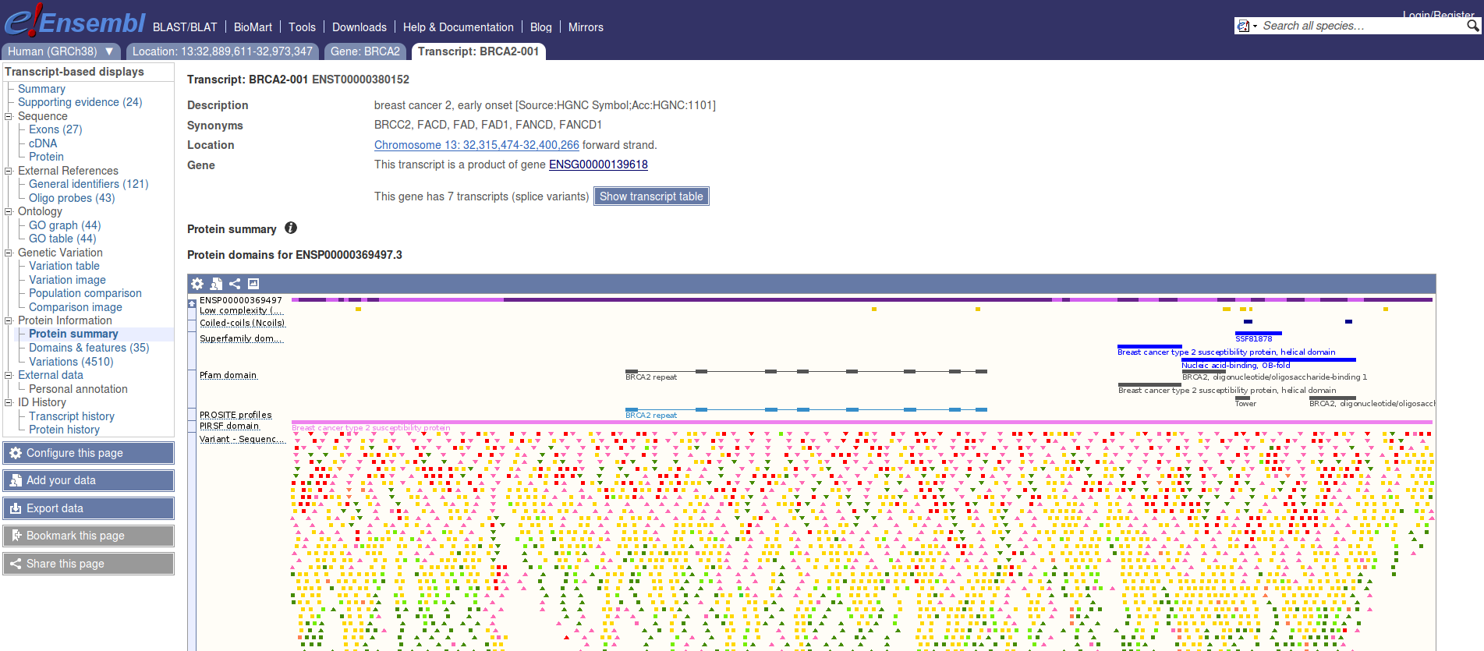


Improved TrackHub Support
BigBed
BigWig
TrackHub Server
BAM
VCF
MS-data
?
Protein View

Slide 5
TrackHubs: cons
Current specs
  UCSC proprietary format
  browser can struggle
Browser integration
  copy-paste of known URLs
Discovery:
  word of mouth
  manually curated pages

Slide 6
TrackHub Registry
Global collection of publicly available TrackHubs
  external parties advertise/publish their THs
  users discover interesting data
Services:
  programmatic registration/update (validation)
  Search
    automatic integration into genome browsers
  TrackHub still available?

Slide 7
Modelling Track Hubs
Convenient representation
  support search
  easily consumable by browsers
trackDb is the unit of information
  enough for the user/browser
TrackDB JSON
  metadata attributes
  simple tree-based structure
  versioned schema validation

Slide 8
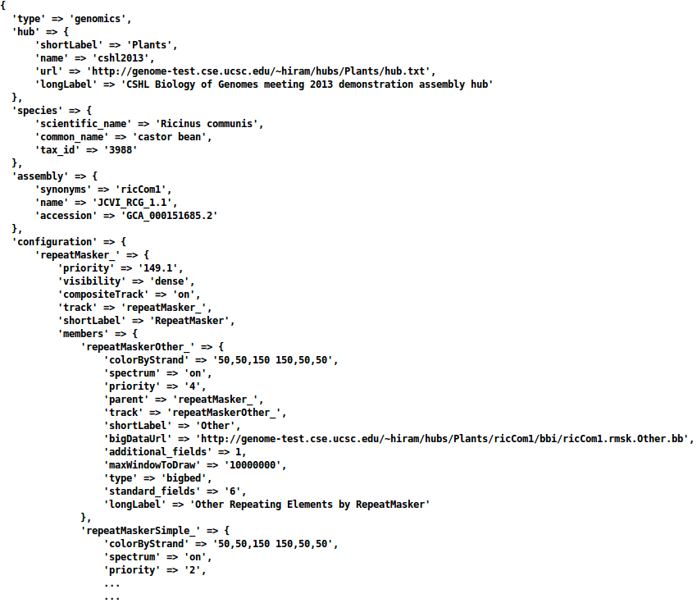

Slide 9
RESTful APIs
Info API
  basic service info
Search API
  support for genome browsers
Registration API
  TH registration/management

Slide 10
Info API
GET
  /api/info/version
  /api/info/ping – check service is alive
  /api/info/species – species in track hubs
  /api/info/assemblies – assemblies in trackDbs
  /api/info/trackhubs – retrieve all registered track hubs

Slide 11
Search API
POST /api/search
  search track hubs using query and filters
  filters: species/assembly/hub
  parameters: page/entries_per_page
GET /api/search/trackdb/:id
  retrieve trackDb with the given ID

Slide 12
Search API
POST /api/search
  search track hubs using query and filters
  filters: species/assembly/hub
  parameters: page/entries_per_page
GET /api/search/trackdb/:id
  retrieve trackDb with the given ID

Slide 13
Registration API
Security model
  HTTP communications secured with SSL
  Basic HTTP authentication, RFC 2617 (Authentication header)
    clients login and obtain auth token
  Token-based authorisation (Auth-Token header)
Many endpoints, most notably
POST /api/trackhub: register/update public data hub
  body:
    url
    type (i.e. genomics/epigenomics/transcriptomics/proteomics)
    assemblies: assembly names → INSDC accessions
    public: available for search?

Slide 14
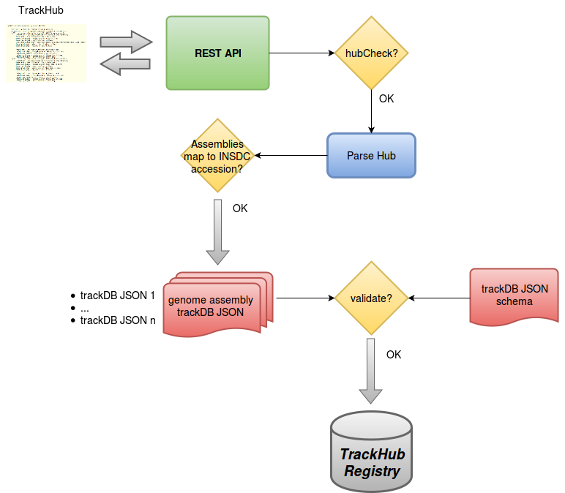

Slide 15
Web interface
Openstack prototype: http://193.62.54.43:5000
  ~600 plant track hubs from Ensembl Plants RNAseq pipeline
Users can search track hubs
  free-text/advanced
  faceted search (species/assembly/hub/type)
  track hub status report
Restricted access for TH providers
  update profile/monitoring control
  view/delete trackDbs

Slide 16
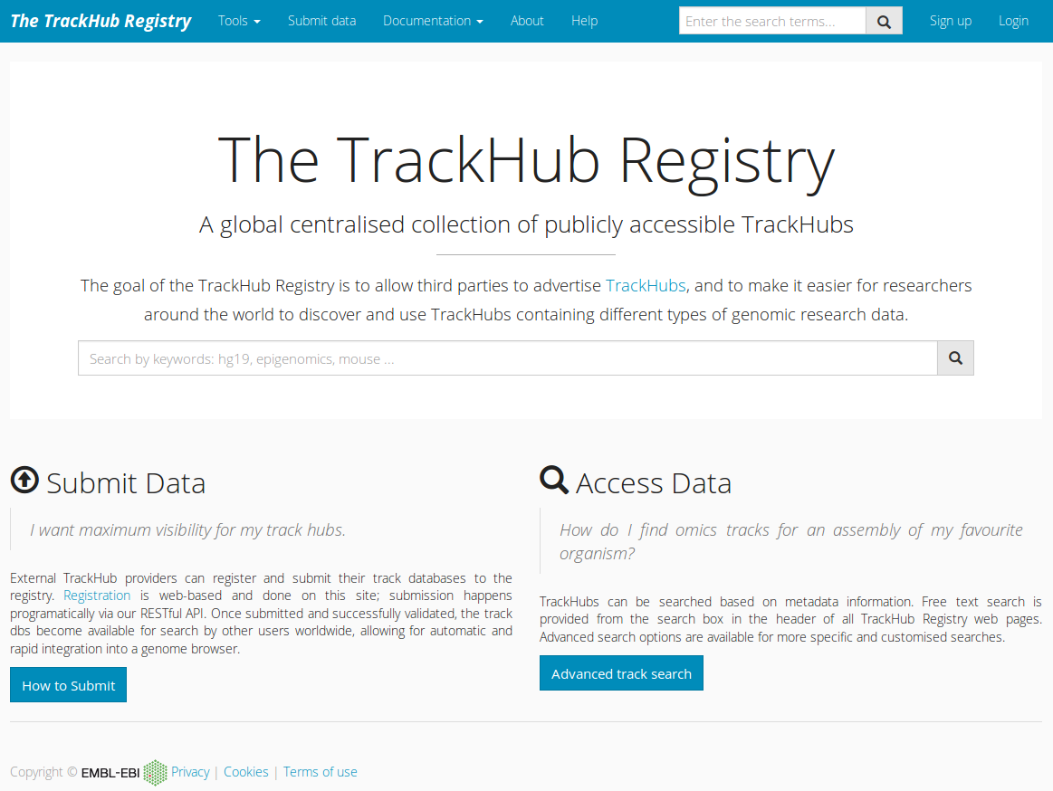

Slide 17
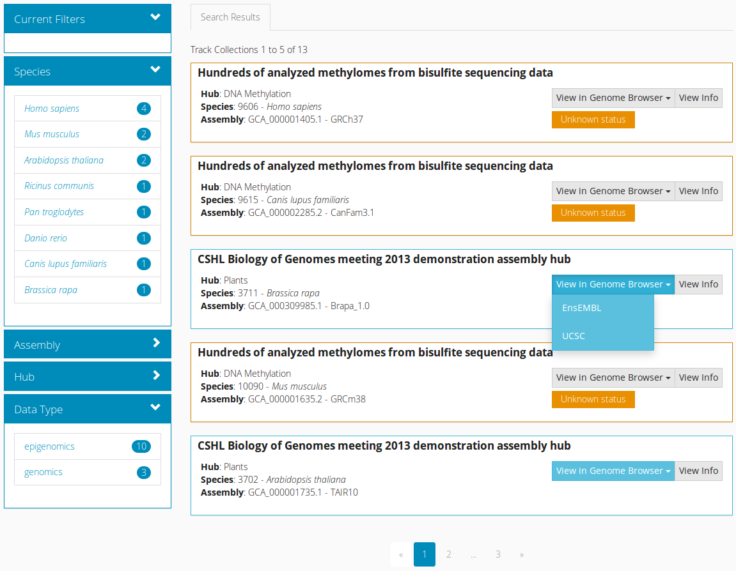

Slide 18
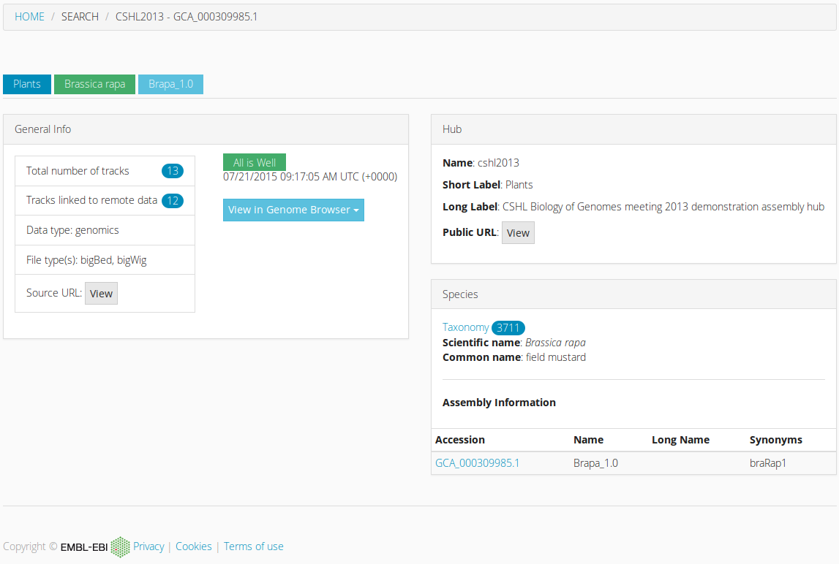

Slide 19
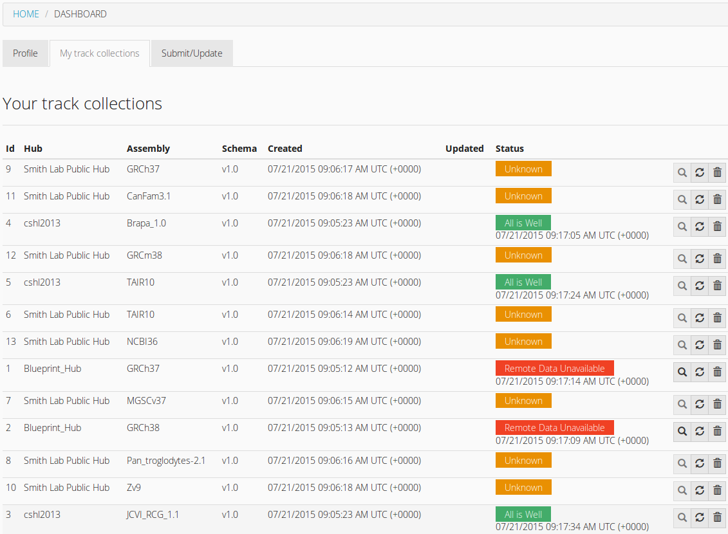

Slide 20
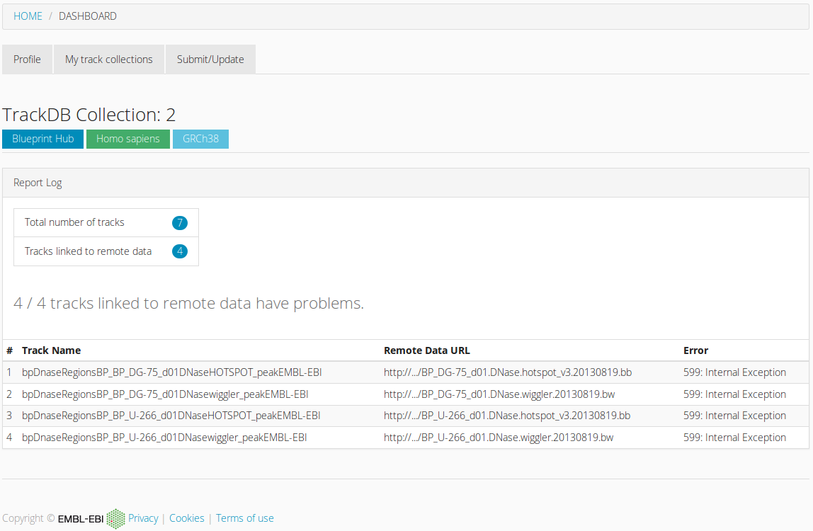

Slide 21
Current Directions
Web interface
  support e! browser th search interface (prototype: e!84)
  autocomplete search
Testing APIs
  complete Ensembl Plants pipeline
  involve other testers, e.g. Annosoft
  automate integration with proteomics pipeline (PRIDE)
Setting up production ready instances
  Beta release: start 2016

