Slide 1
Towards an eIO based RDF Dump Pipeline
An attempt to use the unified IO system

Slide 2
RDF
Resource Description Framework
Originally described as metadata data model
General method for description/modeling of information implemented in web resources
Basic idea:
  make statements (triples) about (web) resources
  subject-predicate-object
Uses a variety of syntax notations/data serialisation formats
  e.g. RDF/XML, SPARQL, Turtle, N-Triples etc.
Notes:
The subject denotes the resource, the predicate denotes traits or aspects of the resource and expresses a relationship between the subject and the object.

Slide 3
Current RDF Dump System
eHive pipeline (production)
  e! features and xrefs for each species in Turtle
fetch-all-the-things-and-dump model
  gene-transcript-exon-translation(-protein features)
  Bio::EnsEMBL::Production::DBSQL::BulkFetcher
Mongoose libs
  Bio::EnsEMBL::RDF::EnsemblToTripleConverter
  a couple of other ones

Slide 4
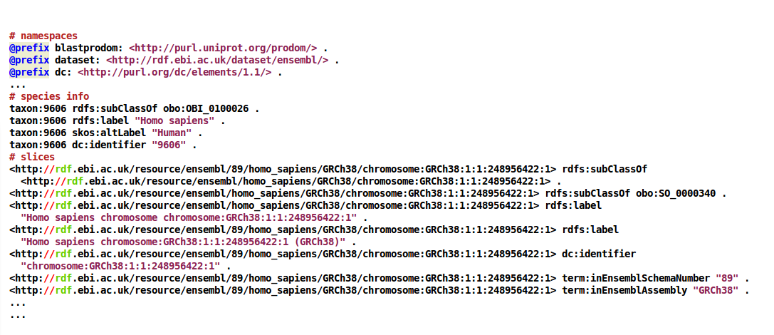

Slide 5
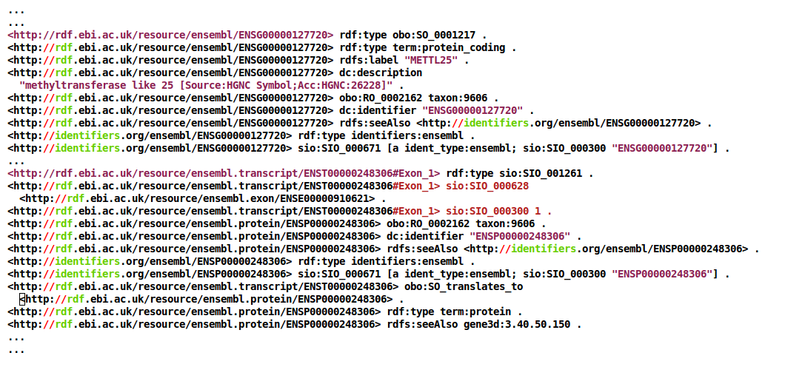

Slide 6
Fetch-all-the-things
BulkFetcher
‘quickly’ fetches all gene-transcript-exon-translation(-protein features)
no API, direct SQL
returns unorthodox “features”
  i.e. array of recursive hashes
not the focus, but has to be taken into account

Slide 7
Dump-all-the-things
Bio::EnsEMBL::RDF::EnsemblToTripleConverter
specialised methods to dump different things:
  name spaces (prefixes)
  species info
  slices
  BulkFetcher-derived “features”

Slide 8
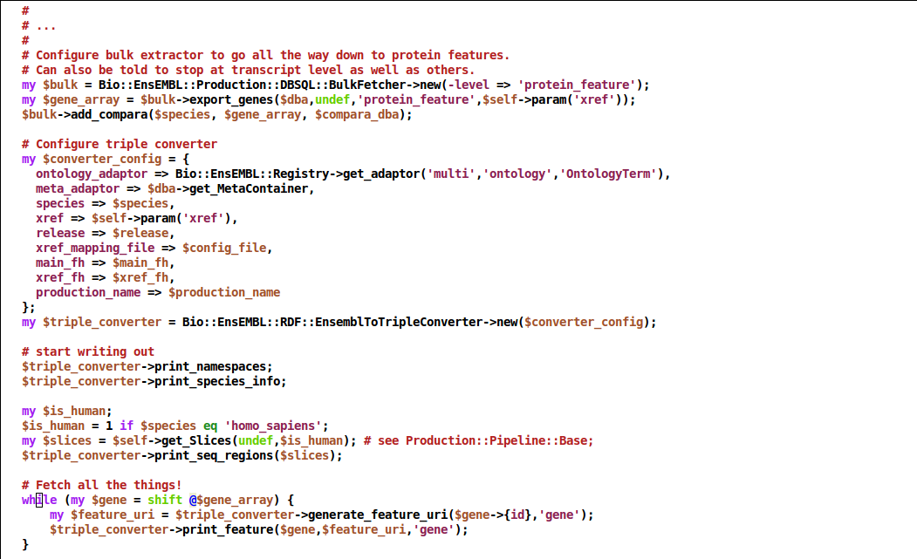

Slide 9
The Task
RDF pipeline to use ensembl-io writer model
retain fetch-all-the-things approach
writer object consumes things and emits records
  namespaces
  seq regions
  “features”

Slide 10
eIO Writer Flow
Ensembl
Persistent, can establish DB connections at creation
Knows how to fetch details from object or an external source
queries
Translator
interrogates the object
Features
Writer
Records out
has a
Object
(format)
Holds details on the file format
(ie. fields/columns for GXF formats)

Slide 11
The issue
Fragmented readers, serialized across code bases
Presentation layer properties in writers
Tightly tied to Ensembl objects

Slide 12
Writer
Writer is subclassed by format (GTF, GFF3, Fasta)
Writer knows needed fields, how to format a record
Writer sets up any format specific needs in Translator
  ie GFF3 Writer tells Feature translator how to convert a strand

Slide 13
Writer
new()
open(filename)
close()
write(object[, translator_ref])
translator(translator_ref) # if not in new()

Slide 14
Writer
my $translator = Bio::EnsEMBL::IO::Translator::Feature->new();
my $serializer = Bio::EnsEMBL::IO::Writer::GFF3->new($translator);
$serializer->open('/tmp/outfile.gff');
$serializer->write($feature);

Slide 15
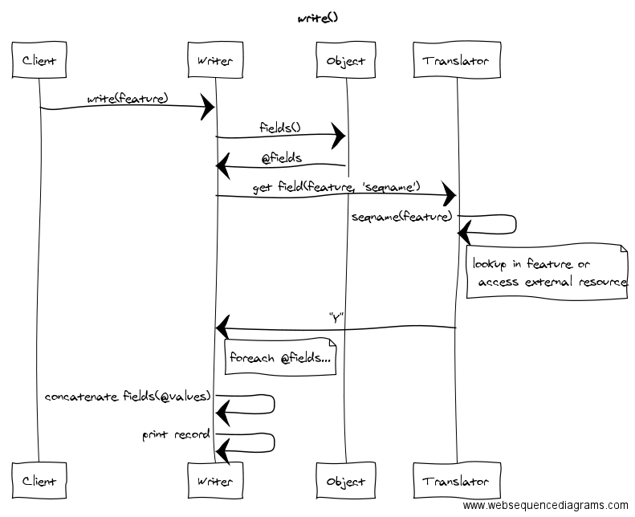
Example
(GXF formats)

Slide 16
Translator
get_field(object, field)
Args[1] : ref, object to query
Args[2] : scalar, field name
Returntype: string, hashref, or undef
Fetch a single field from the object or external source(s)
batch_fields(object, fields)
Args[1] : ref, object to query
Args[2] : listref, field values to return, in this order
Returntype: array
Fetch one or more fields from the object or external source(s)

Slide 17
Translator (callbacks)
my %ens_field_callbacks = (seqname => 'seqname',
source => 'source',
type => 'type',
start => 'start',
attribute => sub { $other_translator->get_attribute(@_) }
… );
sub start {
my $self = shift;
my $object = shift;
return $object->start();
}

Slide 18
Translator (callbacks)
add_callbacks(callbacks)
Args[1] : hashref, list of fields and callbacks
Sub-classing isn’t always necessary
IO users can override callbacks to add custom functionality
fetch_callback(field)
Args[1] : string, field to retrieve callback for
Returntype: string

Slide 19
Your task (serializer)
For each format and data source, derive classes from:
Bio::EnsEMBL::IO::Writer
Bio::EnsEMBL::IO::Object (if needed)
Bio::EnsEMBL::IO::Translator
Eg. GFF3 chromosome dumps:
Bio::EnsEMBL::IO::Writer::GFF3 (via Bio::EnsEMBL::IO::Writer::ColumnBasedGeneric)
Bio::EnsEMBL::IO::Object::GFF3
Bio::EnsEMBL::IO::Translator::Feature

Slide 20
Case Study: Column Based Formats
GTF, GFF3, VCF4 etc.
Writers inherit from Bio::EnsEMBL::IO::Writer::ColumnBasedGeneric
  define common write method
  Object::Metadata/Writer subclasses implement method to create format specific header/record

Slide 21
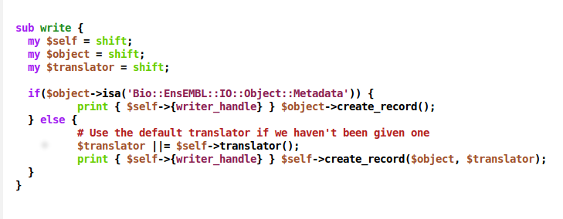
ColumnBasedGeneric Writer

Slide 22
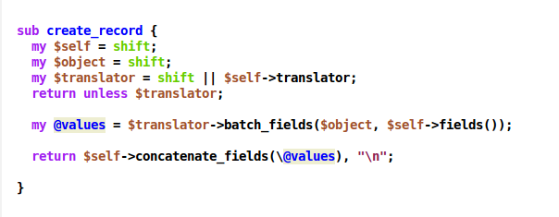

Slide 23
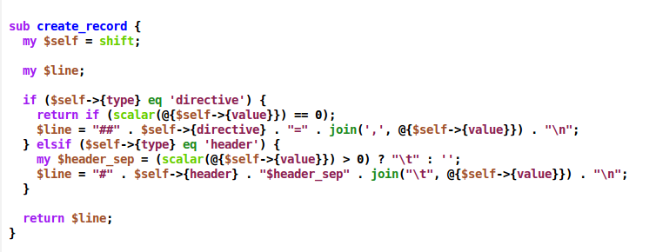
Object::VCF4Metadata

Slide 24
Dumping RDF: Considerations
pipeline dumps features/xrefs separately
  two writers?
namespaces/species info: file prelude, metadata header?
different things need different translators
  seq regions
  BulkFetcher items

Slide 25
Issues
don’t deal with classic e! features, not even objects!
eIO model relies on the concept of record
what is a record?
  definitively not just a triple (though is the atomic unit of information)
  set of predicates associated to the same subject?
no fixed format record, dynamic set of triples
  different things translates to different sets of triples/predicates, even if of the same ‘type’
  no collate-format-dump beautiful simplicity

Slide 26
Interface Design
my $strans = Bio::EnsEMBL::IO::Translator::Slice->new(%sargs);
my $ftrans = Bio::EnsEMBL::IO::Translator::BulkFetcherFeature->new(%fargs);
my $writer = Bio::EnsEMBL::IO::Writer::RDF->new();
$writer->open('outfile.ttl');
$writer->write($namespaces);
$writer->write($species);
for $slice in (@slices) { $writer->write($slice, $strans); }
for $feature in (@features) { $writer->write($feature, $ftrans); }

Slide 27
Borrowing from Mongoose
Bio::EnsEMBL::Utils::RDF
utility functions, common shortcuts for formatting RDF
common namespace definitions
Bio::EnsEMBL::Utils::RDF::Mapper
convert Ensembl internal names for things into:
  identifiers.org URIs
  specific host org namespace for the data type (if known)

Slide 28
Seq Regions
my %field_callbacks = (version => 'version',
production_name => 'production_name',
taxon_id => 'taxon_id',
scientific_name => 'scientific_name',
name => 'name',
cs_name => 'cs_name',
cs_version => 'cs_version',
uri => 'uri');
my $translator = Bio::EnsEMBL::IO::Translator::Slice->new($meta_adaptor);

Slide 29
BulkFetcher Features
my %field_callbacks = (type => 'type',
id => 'id',
name => 'name',
...
start => 'start',
...
transcripts => 'transcripts',
...
uri => 'uri');
my $translator =
Bio::EnsEMBL::IO::Translator::BulkFetcherFeature->new($xref_mapping_file,
$ontology_adaptor
$meta_adaptor);

Slide 30
RDF Header
Follow the GTF/GFF3/VCF approach
Define self-reflective class
  methods to create object special cases
  create_record handles the details, used by writer

Slide 31
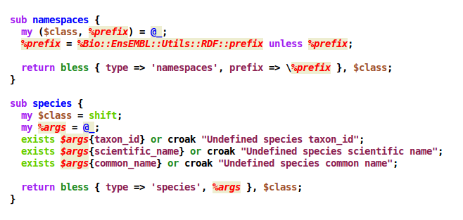
Bio::EnsEMBL::IO::Object::RDF

Slide 32
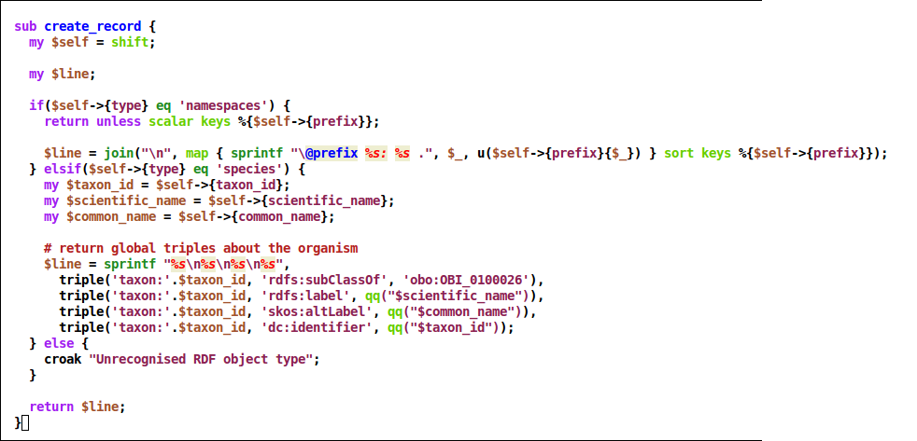
Bio::EnsEMBL::IO::Object::RDF

Slide 33
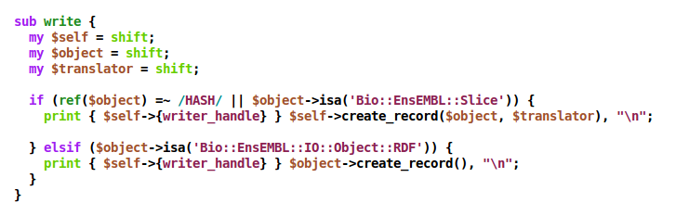
Bio::EnsEMBL::IO::Writer::RDF

Slide 34
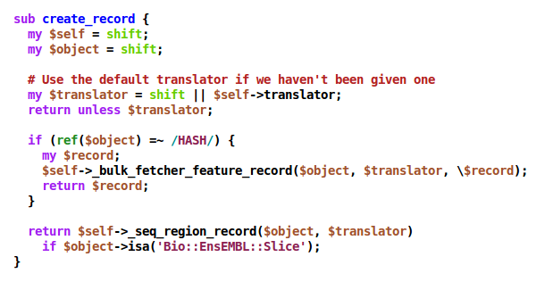

Slide 35
Altogether
my $strans = Bio::EnsEMBL::IO::Translator::Slice->new(%sargs);
my $ftrans = Bio::EnsEMBL::IO::Translator::BulkFetcherFeature->new(%fargs);
my $writer = Bio::EnsEMBL::IO::Writer::RDF->new();
$writer->open('outfile.ttl');
# namespaces and species prelude
$writer->write(Bio::EnsEMBL::IO::Object::RDF->namespaces());
$writer->write(Bio::EnsEMBL::IO::Object::RDF->species(taxon_id => 9606, ...));
# seq regions and bulkfetcher items
for $slice in (@slices) { $writer->write($slice, $strans); }
for $feature in (@bfeatures) { $writer->write($feature, $ftrans); }

Slide 36
TODO - RDF Xrefs
Bio::EnsEMBL::IO::Writer::RDF::Xrefs
acts on BulkFetcher items
can use the same translator
‘write’ invoke xrefs focused callbacks
my $ftrans = Bio::EnsEMBL::IO::Translator::BulkFetcherFeature->new(%fargs);
my $writer = Bio::EnsEMBL::IO::Writer::RDF::Xrefs->new();
$writer->open('xrefs.ttl');
for $feature in (@bfeatures) { $writer->write($feature, $ftrans); }

Slide 37
Open Issues
No e! features
  would need to extend existing translator (callbacks/adaptors)
Design flaw?!
  writing involves lots of type-checking, can we improve?
  can it be used in other contexts, REST/Web?

