Slide 1
ProteoGenomics and
The TrackHub Registry
Ensembl Data Review
EMBL – European Bioinformatics Institute
Wellcome Trust Genome Campus
Hinxton, Cambridge, CB10 1SD, UK

Slide 2
Outline
ProteoGenomics
Proteomics and Ensembl
  extending TrackHub tech
  data integration
Development of a TrackHub registry

Slide 3
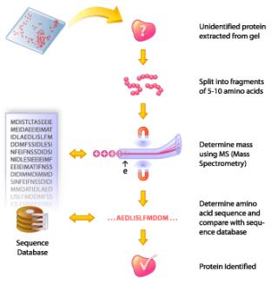
Proteomics - Proteogenomics
MS-based proteomics
  identifies, quantify, characterize: proteins, peptides, PTMs
  protein expression and functional states
Help define:
  correct gene structures
  alternative splicing
  discover new/support weakly defined gene annotations
Proteogenomics

Slide 4
Challenges
Peptides identified comparing experimental/theoretical spectra
  virtual digest of protein sequence DB → genome annotation
Search engines use 1 version/DB, not regularly updated
  results comparable with same version/DB
  asynch with most recent genome version
Data benefits from regular re-analysis
  genome assembly/annotation updates

Slide 5




ProteoGenomics
Dynamic linkage of genomes/proteomes
through Ensembl and ProteomeXchange

Slide 6
The Plan
Extension of TrackHub support in Ensembl
  integration of MS data sets (protein views)
  development of TrackHub Registry
Integration of (PRIDE/PX) data into Ensembl
  map protein accessions to e! IDs, peptide to genome coords
  massively parallel re-analysis of MS data (ProteoAnnotator)
  pipelines to update the TrackHubs (registry)

Slide 7



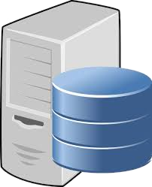
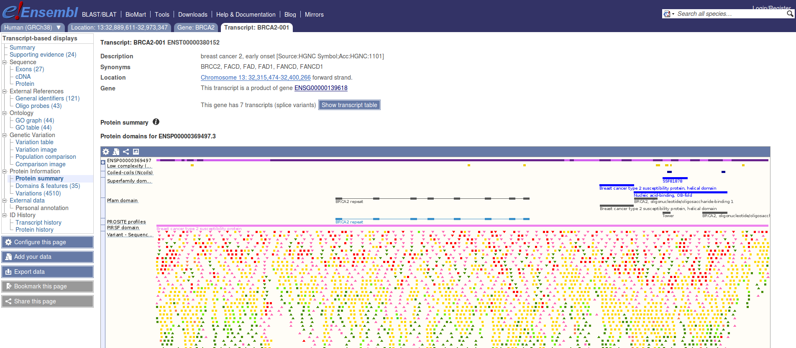


Improved TrackHub Support
BigBed
BigWig
TrackHub Server
BAM
VCF
MS-data
?
Protein View

Slide 8
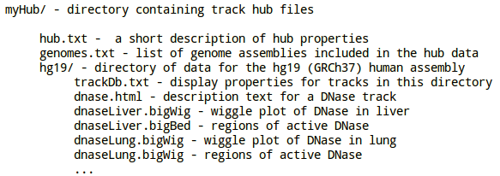
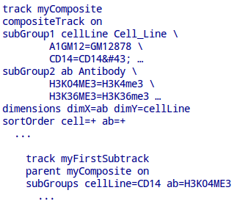
TrackHubs: cons
“Proprietary”, rigid format
  moving target
  parsing headaches
UCSC metadata extraction deprecated
Notes:
The TrackHub specification is sort of copyrighted
By UCSC. Other organisations do not have control
The way it's designed and specified.
Textual format is a sort of moving target. You write
Your parser, and then UCSC introduces another
Feature which you happen to discover a lot later.
This can give a lot of headaches during parsing
But also when trying to support display features on
The browser.

Slide 9

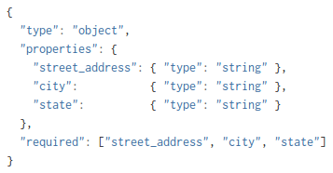
TrackHub
Single file, well structured/readable
Use schema to enforce constraints
http://json-schema.org (IETF draft 04)
Metadata describes components/relationships
Complete structural validation

Slide 10
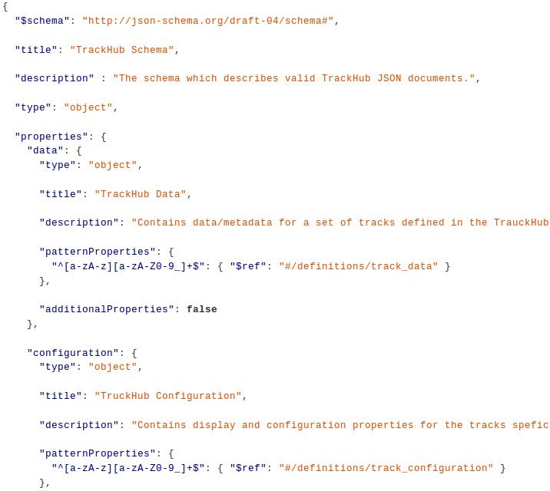
Draft v2
Notes:
Draft version 2 is ready, where we provide
Support for aggregate trucks and epigenomics
Metadata.
This is the prologue ...

Slide 11
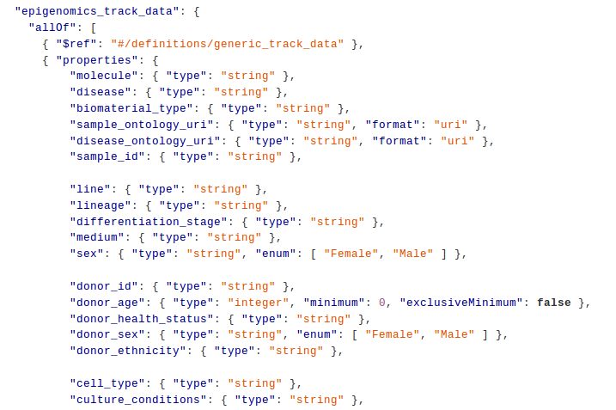

Slide 12
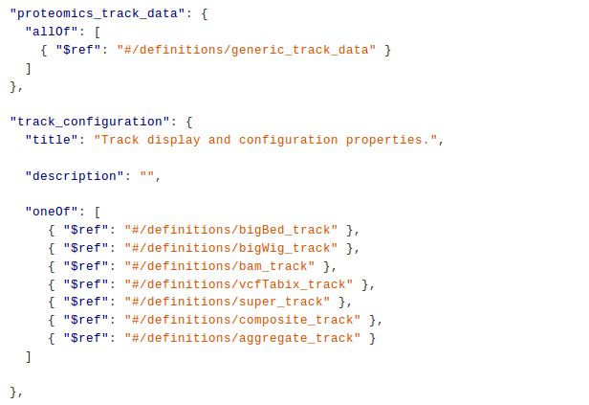

Slide 13
TrackHubs: cons (2)
Browser integration
  copy-paste of known URLs
Discovery:
  word of mouth
  manually curated pages

Slide 14
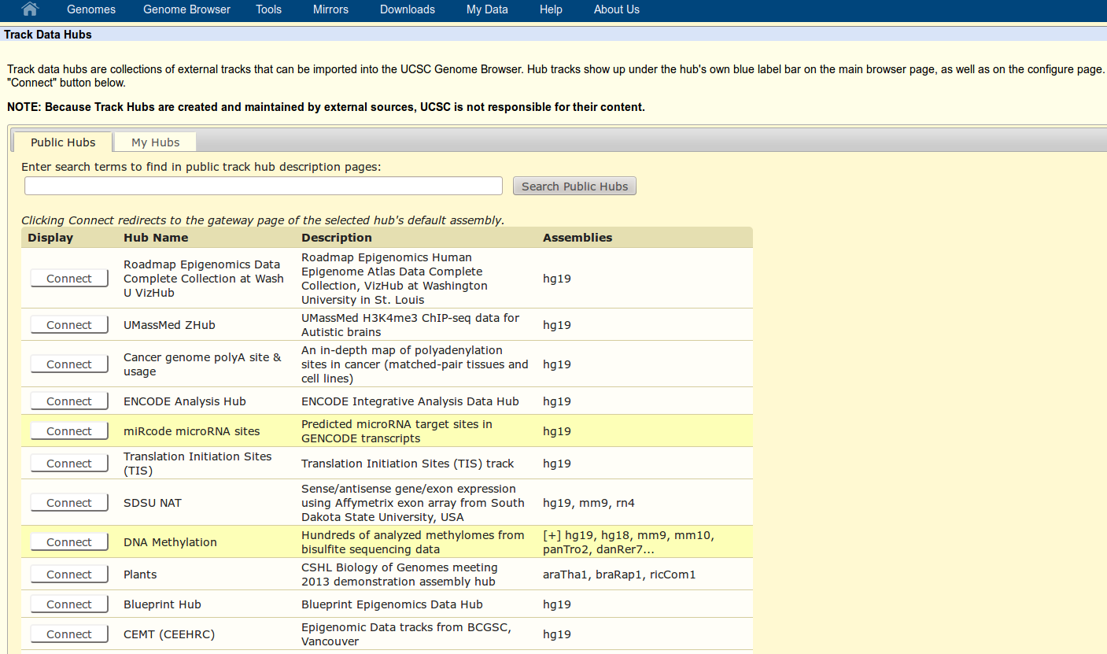
UCSC Portal
Notes:
The Genome Browser provides links to a collection of public track hubs that have been registered with UCSC.

Slide 15
TrackHub Registry
Global collection of publicly available TrackHub servers
  external parties advertise/publish their THs
  users discover interesting data
Services:
  programmatic registration/publication/editing (validation)
  search TrackHubs
  TrackHub still available?

Slide 16
Registry Design
Storage/Search engine
  support format consumable by browsers (JSON, backward compatible)
  scalability not a issue
Web application
  RESTful WS
  min support for storage/search solution

Slide 17
Storage/Search dilemma
JSON-aware
  document store: MongoDB, CouchDB etc.
  postgreSQL >= v9.3
Attach a search engine for efficient search?
Search frameworks as persistence engines?

Slide 18

Solr
XML define schema/indexing/analyses
Lucene/Solr doesn't understand inner objects
Not built for nested data structures
  can be stored, but cannot be indexed
  general rule: flatten the data

Slide 19

Elasticsearch
Every field in the doc is indexable/searchable
Dynamically generates schema, based on what it could guess
When indexing, concatenates all fields into one full-text searchable field
  exploratory phase, when unsure about doc structure
  quickly provide basic search interface

Slide 20
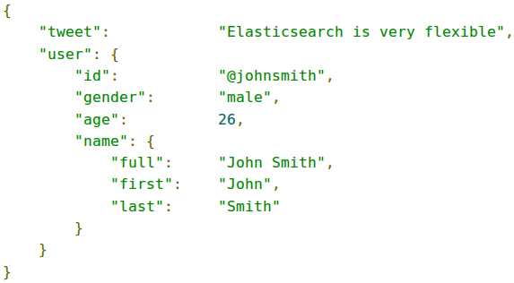
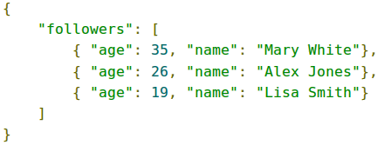
Mapping Complex Field Types
Supports for JSON null, arrays and objects values
Arrays: indexed as 'multi-value' fields
Multi-level objects
  embed one entity inside another
  objects fields dynamically detected
Nested-objects
  embed arrays of inner objects
  nested object indexed as a hidden separate doc

Slide 21

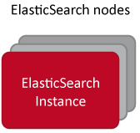
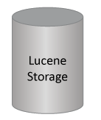
Web Client
WEB UI
RESTful WS
RESTful WS
Authentication
TrackHub
Search
Registration
Provider
Genome Browser
Fetch
Publication/
Editing

Slide 22
Where we are
TrackHub DB: draft 02 JSON schema
  epigenomics metadata, proteomics in progress
Catalyst WebApp demo:
  ES search/storage driver
  ES based ACL component
  basic search interface
  prototype REST WS API for TH providers

Slide 23
