Slide 1
EpiRR
A Registry for Reference Epigenomes
Alessandro Vullo on behalf of
David Richardson
Avik Datta
Laura Clarke
Paul Flicek
EMBL – European Bioinformatics Institute
Wellcome Trust Genome Campus
Hinxton, Cambridge, CB10 1SD, UK
Notes:
I would like to talk about things I've been doing in the recent past concerning the integration of remote genome annotation data using recent genome browser technology

Slide 2
Background
IHEC goal
“produce and archive >1000 reference epigenomes”
Ensure generated data is useful for comparative/integrative analyses by others
Distributed data production
  challenging!
Notes:
We're in the context of the the IHEC, whose goal is to archive >1000 reference epigenomes from normal and disease tissues.
Doing this requires the coordination of data production from various member projects to ensure data generated by one project is directly useful for comparative/integrative analyses by other member projects and also the wider scientific community.
In order to support this, IHEC adopts an approach of distributed data production following the success of similar efforts like ENCODE and 1000 Genomes Project
However, the production of community data resources at this scale and across multiple locations gives rise to substantial challenges in the collation, standardisation and sharing of the data

Slide 3
IHEC Data
Assay type | Required | Optional
DNA methylation | BS-seq | MDB, MeDIP, MRE, RRBS
Histone modification | Input, H3K27me3, H3K36me3, H3K4me3, H3K27ac, H3K9me3 | Any other histone modifications
RNA-seq | mRNA | miRNA, smRNA
Chromatin accessibility |  | FAIRE-seq, DnaseI-seq, ATAC-seq
Notes:
Member projects deposit their raw data to public repos like EGA and Gene Expression Omnibus (GEO). The data must meet the standards and definitions defined by the consortium.
A complete reference epigenome must contain data for the core set of assay types, but member projects can also produce additional data types for some samples.

Slide 4
Problem
Public archives metadata do not facilitate linking different experiments
Biological material used and location of data must be known
Need a tracking system
Notes:
One of the main pb discoved is that these archives metadata structures do not provide effective methods to link the different experiments that comprise a reference epigenome
To facilitate maximal data reuse, the biological material used to assay the reference epigenome and the location of the resulting data must be known and readily available.
In other words, IHEC identified the need of a system for tracking the reference epigenomes produced and where each member project has submitted the corresponding raw data

Slide 5
EpiRR
  http://www.ebi.ac.uk/vg/epirr
Holds public archive accessions
Provides accessions for reference epigenomes
  discrete, coherent units
Notes:
Meet EpiRR, a tool designed to meet these challenges.
In particular, it holds all the public archive accessions for these data and provide accessions for the different members' reference epigenomes.
Accessioning each reference epigenome as a discrete data set gives the community a coherent unit, ready for integrative analysis.

Slide 6
Data Model
A reference epigenome
  belongs to a member project
  receives an accession when created
Assumed will be submitted before completed
  updates are supported
  versioning to ensure precise identification and metadata updates
Notes:
As for the data model, it is assumed that each reference epigenome belongs to one and only one member project and receives an accession when submitted
Furthermore, it is assumed that a reference epigenome can be submitted before it is completed so that incremental updates are supported. There's a versioning scheme in place so that each time an update is submitted the version is incremented to allow precise identification of the dataset.

Slide 7
Submission Workflow
Accepts text/JSON
Validates metadata associated to component data sets
  error if not enough descriptive
  experiment used to assess completeness
Assigns unique identifiers to reference epigenomes
Summarises key experimental characteristics
  e.g. single or pool of samples

Slide 8
Availability
Minimal web interface
  http://www.ebi.ac.uk/vg/epirr
REST API
  /view/all – returns all current datasets
  /view/:id – returns single dataset
  /summary – dataset counts by project

Slide 9
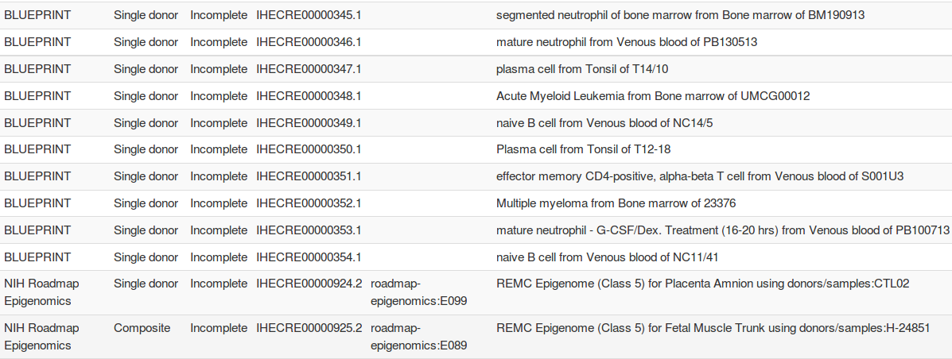
/view/all

Slide 10
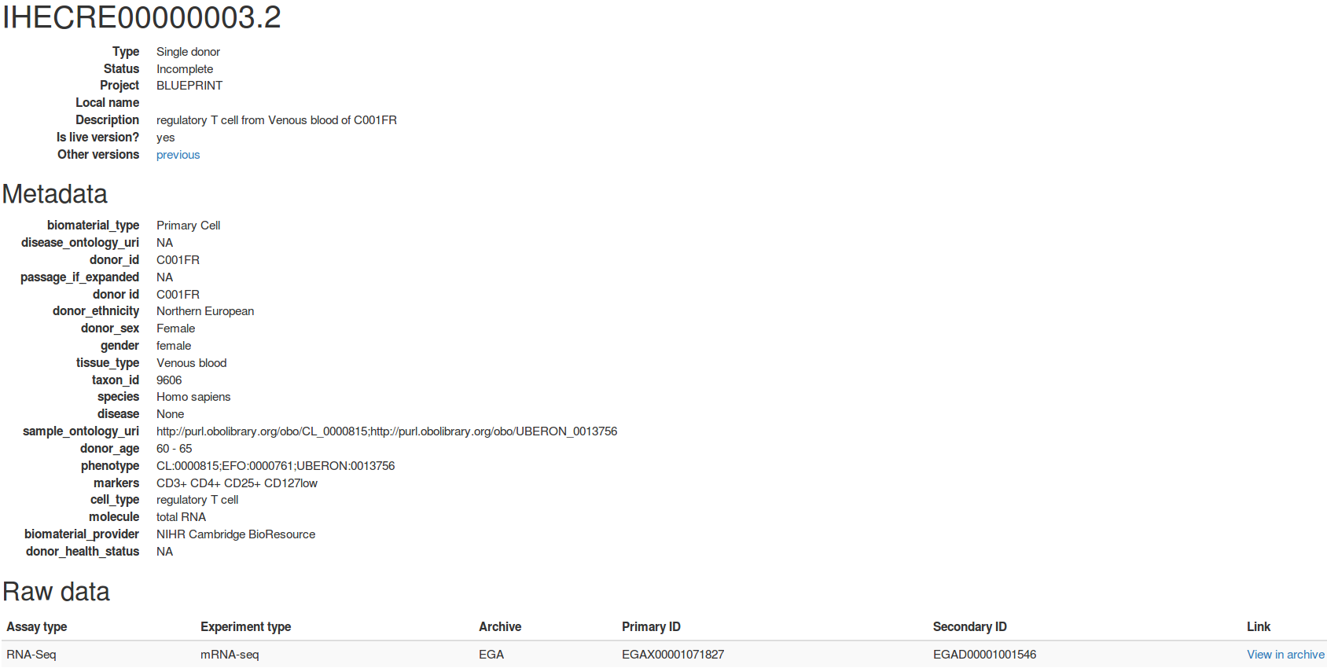
/view/:id

Slide 11
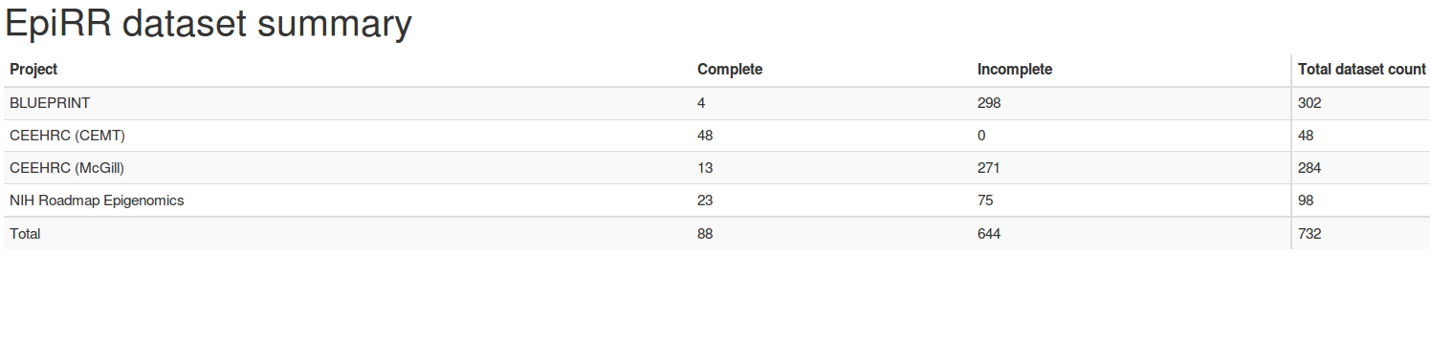
/summary

Slide 12
Present & Future
>1400 registered experiments across >300 accessioned epigenomes
IHEC data portal – full integration
  display only EpiRR registered data sets
  tracks required to have an EpiRR accession
Fall 2016
  >7000 experiments
  1500 reference epigenomes

Slide 13




Acknowledgements
EBI
  David Richardson
  Avik Datta
  Laura Clarke
  Paul Flicek
David Bujold (McGill)
Sita Gakkhar (BCGSC)
European Commission
Framework Programme 7

