Slide 1
Deployment Tools
Ensembl Retreat
Dec 1-2 2016
EMBL – European Bioinformatics Institute
Wellcome Trust Genome Campus
Hinxton, Cambridge, CB10 1SD, UK

Slide 2
Goals
Overview of (some) existing tools
How deployment tools work
How they improve speed/quality of software releases

Slide 3
How this session runs
Short talks
  Andy – CPAN/DarkPAN
  Prem – Docker
  Nick – REX
  Thibaut – Homebrew
Free discussion
  get inspired by topics/ideas
  https://www.ebi.ac.uk/seqdb/confluence/display/ENS/Deployment+tools+2016#Deploymenttools2016-Topics/Ideas

Slide 4
Deployment
“grouping of every activity that makes a program available for use and moving it to the target environment”
Process with several interrelated activities, transitions
  occur at the producer or consumer side
precise processes in activities cannot be defined
  every software system is unique

Slide 5
Deployment Tools
Any software instrument/platform supporting the deployment process
Large ecosystem
Focus: automating the deployment pipeline

Slide 6
Continuous Delivery
“Software production process where software can be released to production at any time with as much automation as possible at each step”
advocates creation of automated deployment pipeline
release software rapidly/reliably

Slide 7
Deployment Pipeline
Build/Deploy/Test/Release cycle
  automated implementation
Enables self-served releases of any application in any environment
Optimise cycle time: avg time between prod releases
  dev cost are lowered
  release failure risk minimised
  faster customer feedback loops

Slide 8
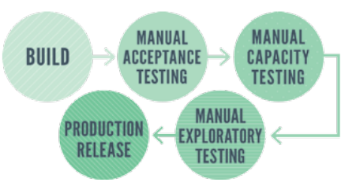
CD: where it’s coming from
Continuous Integration (CI)
  “development process where a (CI) server rebuilds a branch of source code every time code is committed”
  extended to include deployment/installation/testing into prod
focused on development
  benefit fraction of release process
Source: DZone

Slide 9
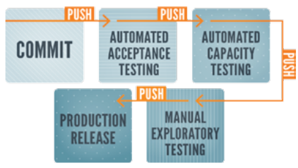
Beyond CI
CD: extension of CI practices into infrastructure mgt and prod env
Infrastructure as code
  version control, automated testing, deploy tools

Slide 10
CD Toolchain
No single tool, automation product or deployment pipeline impl provides CD
CD impossible wo some capabilities the tools provide
Tool categories:
  Orchestration and deployment pipeline visualisation
  Version Control
  CI
  Artifact Management
  Test and Environment Automation
  Server Configuration and Deployment
  Monitoring and Reporting

Slide 11
Orchestration & Visualisation
Backbone of CD
  allow building effective sequence of steps
  provide visualisation utilities
  detect and expose delays at each stage
Can use dedicated deployment pipeline tools or Application Release Automation (ARA) solution

Slide 12
Orchestration and Visualisation
Deployment pipeline tools
Jenkins
Travis CI
Thoughtworks GO
Atlassian Bamboo
...
ARA
ElectricCommander
IBM UrbanCode, XebiaLabsXL
CA Lisa

Slide 13
Version Control
All text-based assets should be stored in a version control system
  easily accessible by anyone
  code changes very easy to review
  configuration files defining build/release system
Git, Subversion, Mercurial, Perforce, TFS

Slide 14
Continuous Integration
Can support orchestration/visualisation
Core functionality
  integrate new code into stable main release
  alert if issues with new code
Team should also connect a code metrics and profiling utility
  stop integration if metrics reach a threshold

Slide 15
CI (continued)
CI tools: Jenkins, TravisCI, ThoughtWorks GO, CircleCI, Jetbrains TeamCity, Atlassian Bamboo
Code Metrics: SonarQube, SLOC, SciTools Undestand

Slide 16
Artifact Management
Artifacts: assembled pieces of an application
  application code and assets
  infrastructure code
  VM images
  configuration data
Packaged artifacts (not source code) are focus of deploy pipelines
Metadata identifies when/how package was tested/deployed in an environment

Slide 17
Artifact Management
Artifacts should be traceable
  Identifiable (unique name)
  Versioned (semantic)
  Immutable
Management is done with Artifact Repository Manager
Art Repositories contains complete usage history with dependency resolution
  Can track exactly what was (or will be) tested/deployed

Slide 18
Artifact Management
OS-level package managers
  APT, RPM, Homebrew
Language-specific package manager
  CPAN, PIP, Ruby Gems, Composer
Repository Managers
  Archiva, Artifactory, Nexus

Slide 19
Test/Environment Automation
All tests should be automated, except:
  Exploratory testing, UI design ispections, UATs
Automated testing tools should be lightweight and operate non interactively
Teams create testing environment on-demand using env automation tools
  provision VM and configure environment template

Slide 20
Test/Environement Automation
Test automation: JMeter, Selenium/WebDriver, Cucumber, RSpec, LoadUI, PageSpeed, Netem, SoapUI, Test Kitchen
Environment automation:
  Vagrant, Docker, Packer

Slide 21
Server Configuration/Deployment
Distribution/Installation of packages
Two main deployment models
  Push: Capistrano (Ruby), Fabric (Python), REX (Perl), ThoughtWorks GO, various CI/build/ARA tools
  Pull: Ansible, Chef, CFEngine, Puppet, Salt

Slide 22
Push Model
Master server manages distribution/installation of packages to multiple remote machines
Pros: (good choice for small systems)
  simplicity: easy to set up and run
  control: everything is synchronous
Cons:
  lack of full automation: server does not boot and configure itself
  not scalable

Slide 23
Pull Model
AKA: configuration management systems
  server acts as master
  clients pull config information from master and figure out what to do
Pros:
  full automation capabilities
  increased scalability: clients contact server independently
Cons:
  proprietary conf mgt language (ex. Chef)
  scalability still an issue, unless deploy several master servers

Slide 24
Monitoring/Reporting

