Slide 1
Track hubs and their Registry
Remote Data Integration made easy?
Alessandro Vullo
avullo@ebi.ac.uk
Ensembl Core Team
EMBL – European Bioinformatics Institute
Wellcome Trust Genome Campus
Hinxton, Cambridge, CB10 1SD, UK
Notes:
I would like to talk about things I've been doing in the recent past concerning the integration of remote genome annotation data using recent genome browser technology

Slide 2
Outline
Prelude: track data hubs
How do we use them in Ensembl?
The Track Hub Registry

Slide 3
Background
High-throughput seq challenges genomic data visualisation tools
UCSC/Ensembl browsers improved
visualise remotely hosted large data sets
support binary indexed data: BigBed, BigWig, BAM, VCF/tabix etc.
UCSC introduced track data hubs (2011)
integrate remote data sets into the browser
Notes:
High throughput seq tech has challenged gen vis tools as the vol and size of genome-wide data sets outpace the capacity of existing browser tech.
In recent years, both the UCSC/Ensembl browsers have been extended to offer increased visualisation of remotely hosted large data sets adding support for binary indexed large data formats
Most notably, in 2011 UCSC introduced support for track data hubs, which is briefly a mechanism to fully and efficiently integrate one or more large data sets into the browser

Slide 4
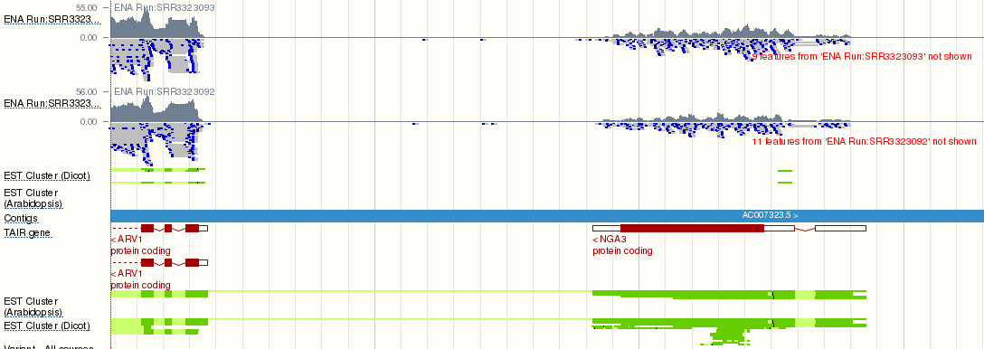
What are Track Hubs?
Internet-accessible collections of genome annotations
Alternative to DAS
no need for special software
WWW/FTP server and some text
Notes:
Ths are remote internet-accessible collections of genome annotations that can be viewed on a genome browser (supporting THs) alongside native annotation tracks
Interestingly, Ths represent a more user-friendly and efficient alternative to DAS which does not need any special software, it just requires a standard HTTP or FTP server plus a bunch of configuration files.

Slide 5
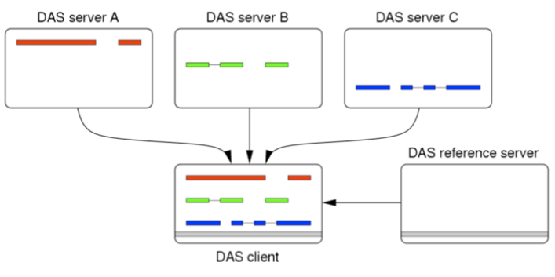
How about DAS?
Workhorse of external data integration (so far)
Can no longer support new features or scale to modern data sets sizes
very high feature densities
query large feature-rich regions
fast zooming
No longer supported (>=e!84)
Notes:
At this stage, you might ask what's the difference with DAS, the prevalent tech used by genome browsers to integrate external data.
Problem is that DAS was not developed to serve data for very high feature densities, querying large feature rich genomic regions, or providing fast zooming functionality.
For these reasons, the e! browser no longer provides support for DAS since last release.

Slide 6
Track Hubs
Collate related data sets (tracks) through a single attachable URL
Annotations in binary indexed file formats
partial downloads
caching
Hosted on HTTP/FTP servers + text files
Notes:
Ths represent a way to compose related data sets via a single attachable URL for presentation as a single entity
These data sets are provided in binary indexed file formats (BigBed, BigWig etc) which supports partial downloads (only the relevant data needed to support the view of the current genomic region is transmitted) and caching (trasmitted data is cached on the genome browser server) to expedite future access
They can be hosted on a simple HTTP or FTP server together with a bunch of text file thus reducing the cost of set up and maintenance

Slide 7
Hub Configuration
hub.txt
hub Blueprint_Hub_20150820
shortLabel Blueprint Hub
longLabel Blueprint Epigenomics Data Hub
genomesFile genomes.txt
email blueprint-info@ebi.ac.uk
descriptionUrl http://www.blueprint-epigenome.eu/index.cfm?p=31AD6D30-9B3C-BB97-E7F81875121FEC41
UCSC
assembly name
genomes.txt
genome hg38
trackDb grch38/tracksDb.txt
Notes:
Hub.txt – information about the hub (name, contact)
Genomes.txt – list of supported assemblies
For any assembly, we report the UCSC alias and the file which contains the configuration for all tracks related to it

Slide 8
track miRNA_new_pre
bigDataUrl https://www.broadinstitute.org/ftp/pub/vgb/dog/trackHub/canFam3/miRNA/cf3_miRNA_novel_precursors.bb
shortLabel miR New Hairpins
longLabel Novel miRNAs - Hairpin Structures
html html/miRNA
priority 5.53
type bigBed 6
visibility pack
useScore 1
track miRNA_new_mat
bigDataUrl https://www.broadinstitute.org/ftp/pub/vgb/dog/trackHub/canFam3/miRNA/cf3_miRNA_novel_mature.bb
shortLabel miR New Mature
longLabel Novel miRNAs - Mature Structures
html html/miRNA
priority 5.54
type bigBed 6
visibility pack
useScore 1
track CTVT_variation
superTrack on
group CTVT
shortLabel CTVT Variation
longLabel CTVT Variations from Germline and Somatic
html html/CTVT
priority 5.8
track CTVT_ind_Som
bigDataUrl https://www.broadinstitute.org/ftp/pub/vgb/dog/trackHub/canFam3/ostrander/CTVT_indels_somatic.vcf.gz
parent CTVT_variation
shortLabel CTVT Indels Somat
longLabel CTVT Indels Somatic
html html/CTVT
priority 5.81
type vcfTabix
visibility dense
track CTVT_ind_Ger
bigDataUrl https://www.broadinstitute.org/ftp/pub/vgb/dog/trackHub/canFam3/ostrander/CTVT_indels_germline.vcf.gz
parent CTVT_variation
shortLabel CTVT Indels Germl
longLabel CTVT Indels Germline
html html/CTVT
priority 5.82
type vcfTabix
visibility dense
hierarchical
Notes:
This is an example of such files where all tracks related to an assembly are listed sequentially.
For each one, we have the URL of the corresponding data file, which can reside on another remote location, plus a bunch of metadata specifying configuration options and appearance to the browser.
Tracks can be also hierarchically organised into supertracks that contain groups of tracks that can share the same configuration settings because it makes sense to show them together or to overlay them.

Slide 9
Attaching a hub (Ensembl)
Via a URL:
/Trackhub?url=https://www.broadinstitute.org/ftp/pub/vgb/dog/trackHub/hub.txt
Via Configuration Panel

Slide 10
Configuring a Hub

Slide 11
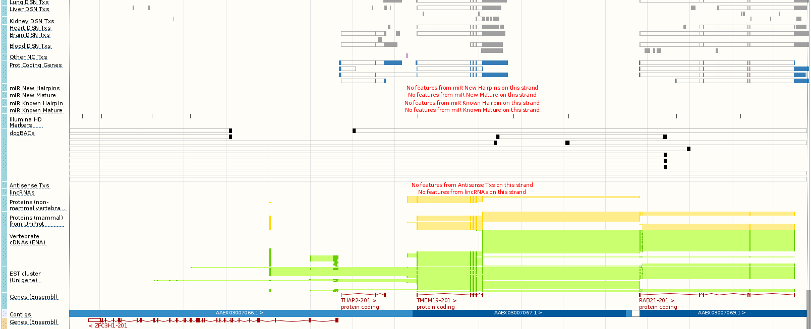

Slide 12
Track Hubs: cons
Browser integration
copy-paste of known URLs
Discovery:
word of mouth
manually curated pages
Notes:
But of course there are some limitations with this technology.
At present, integration of track hubs into Ensembl/UCSC involves the copy and paste of known URLs.
Discovery is based on word-of-mouth or the provision of manually curated portal pages hosted by the genome browser

Slide 13
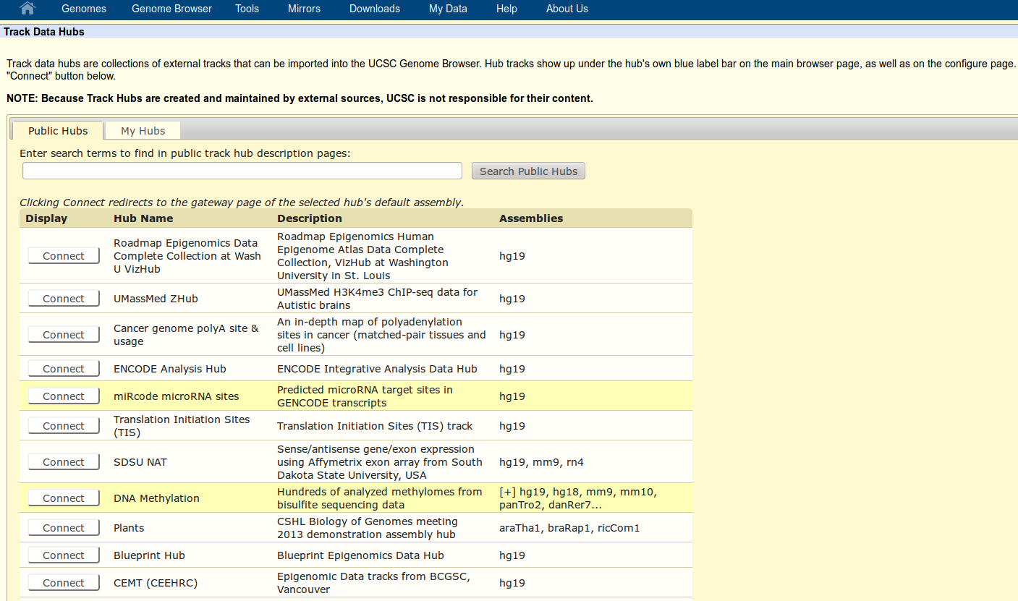
UCSC Portal
Notes:
The Genome Browser provides links to a collection of public track hubs that have been registered with UCSC.
Until now, there was a similar system for Ensembl
We believe this system is unmaintanable especially considering the potentially very large number of track hubs which might be released world wide in the near future

Slide 14
Track Hub Registry
Global collection of publicly available TrackHub servers
external parties advertise/publish THs
users discover interesting data
Services:
hub registration (RESTful API)
search track hubs (WWW/API)
track hub still available

Slide 15
REST API
Hub Registration, 8 endpoints (CRUD)
HTTP SSL-secured/Basic Authentication
token based authorisation
Basic service information, 5 endpoints
e.g. server alive? species/assembly/hub list
Search, 2 endpoints
genome browser support

Slide 16
POST /api/trackhub
Register/update remote public hub
Requirement: INSDC assemblies (GCA)
Body:
Hub URL (required)
(assembly name → GCA accession) map (required if not UCSC native)
data type (optional)

Slide 17
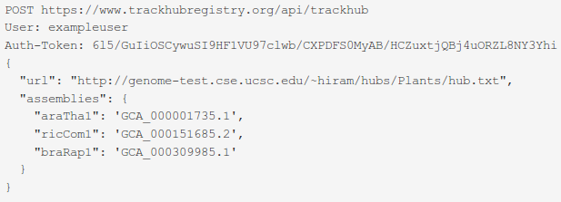
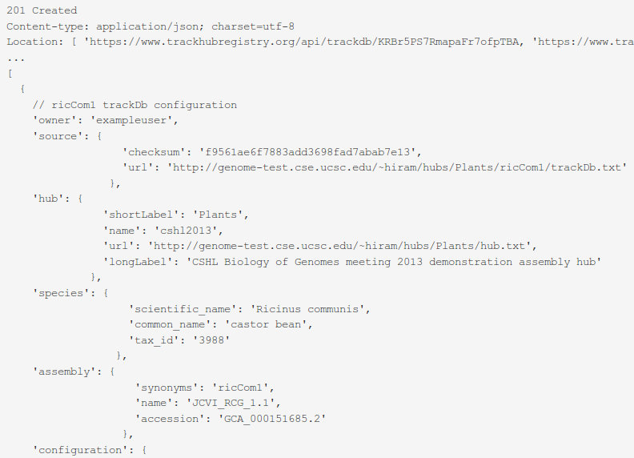

Slide 18
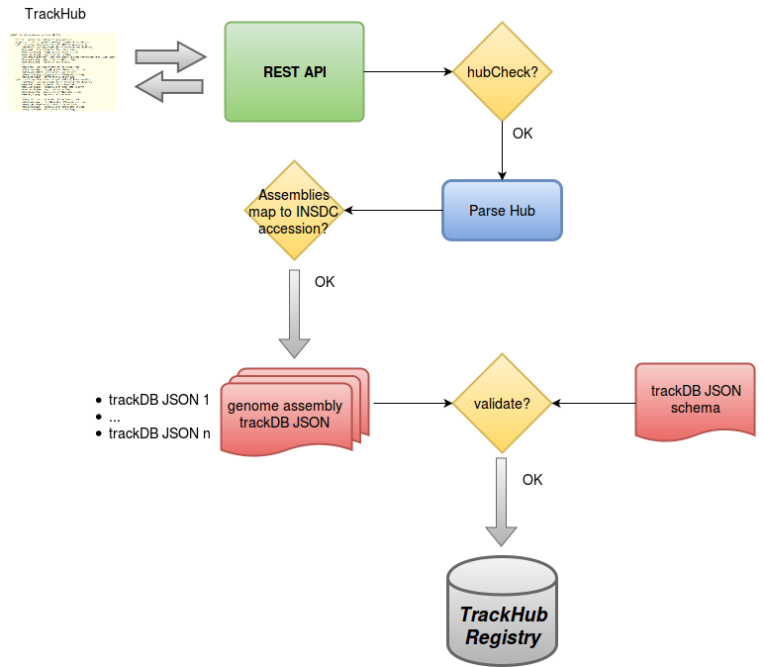

Slide 19

Web Front-end
Track hub aware, intuitive interface for searching interesting tracks
Simple dashboard for track hub providers
Track hub submission instructions and REST API docs
http://beta.trackhubregistry.org

Slide 20
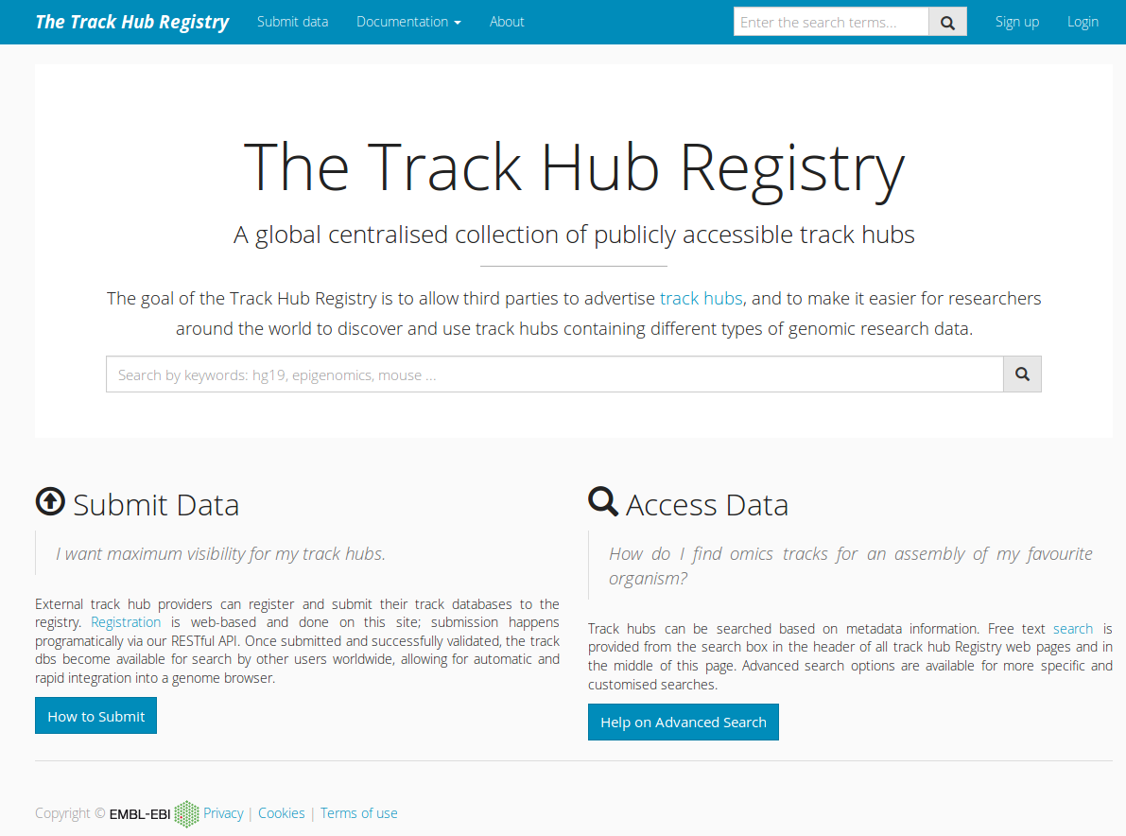

Slide 21
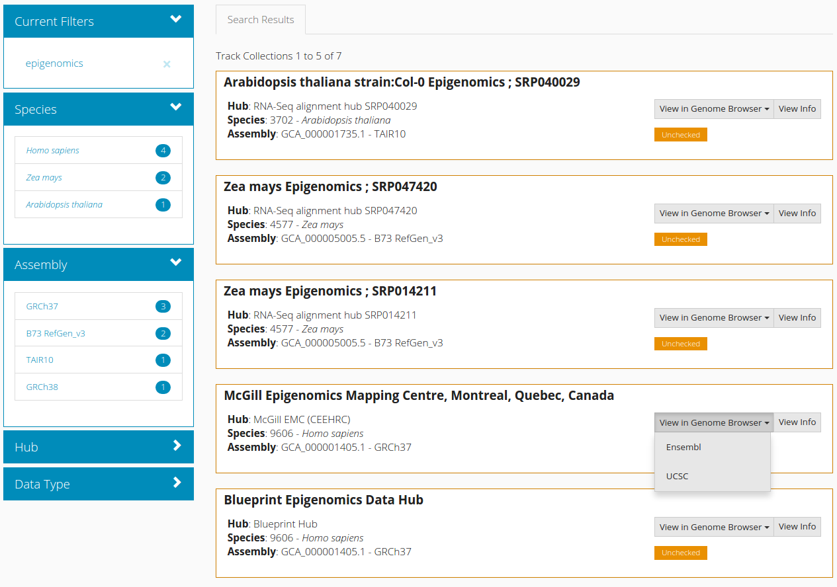

Slide 22
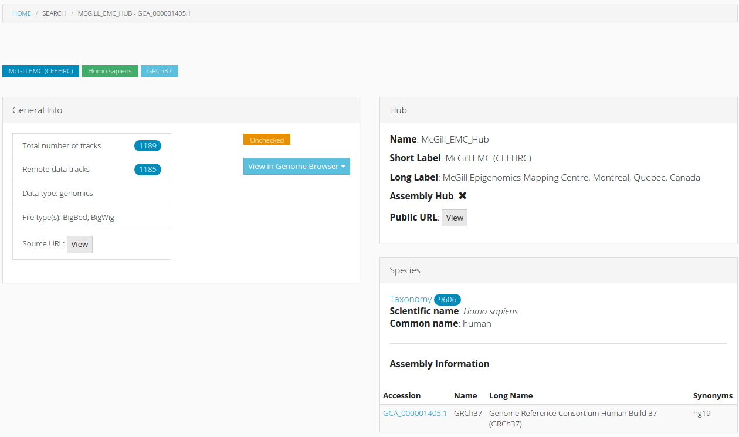

Slide 23
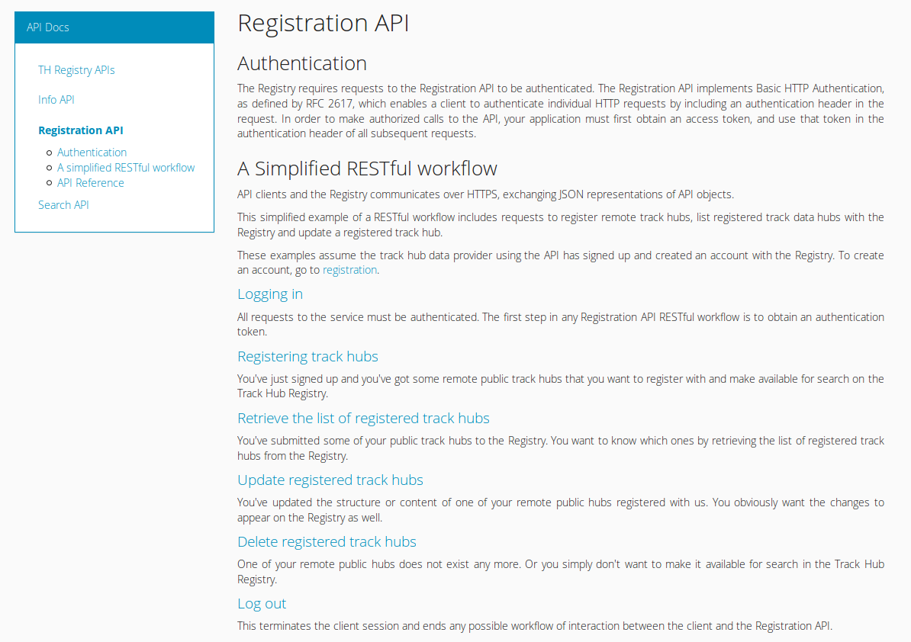
Notes:
There's extensive documentation on how to do searches, from the web interface and programatically , and how to use the REST API.
You can see here a guided walk through the steps you commonly do when using the hub registration API, with examples on how to login/out, register a track hub, and do basic CRUD operations on your set of registered hubs.

Slide 24
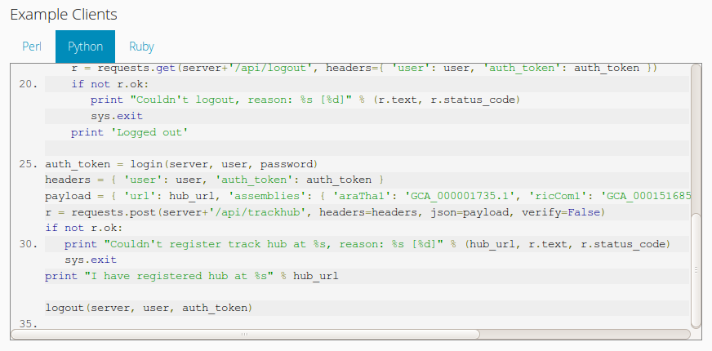
Notes:
Each section contains example clients in different programming languages: we have Perl, Python2 and Ruby and I am currently adding examples in Python3.

Slide 25
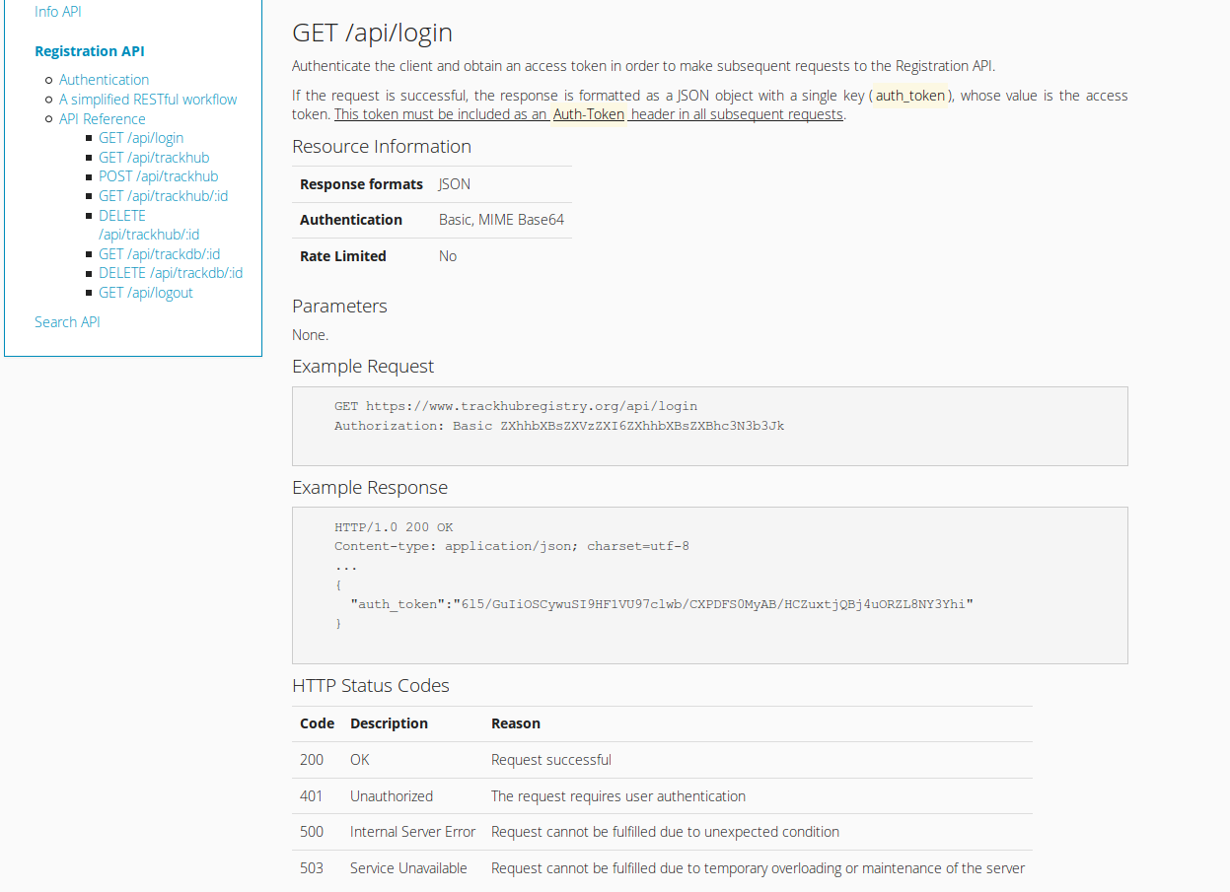
Notes:
There's also reference documentation for each API section, with extensive information on how to use each endpoint.

Slide 26
Ensembl as a Registry Client
Phase 1 – Spring '16
Search interface using Registry API
one-click attachment of chosen hub
text files still retrieved/parsed by web server
Phase 2 – Spring '16
Ensembl consumes registry's hub JSON

Slide 27
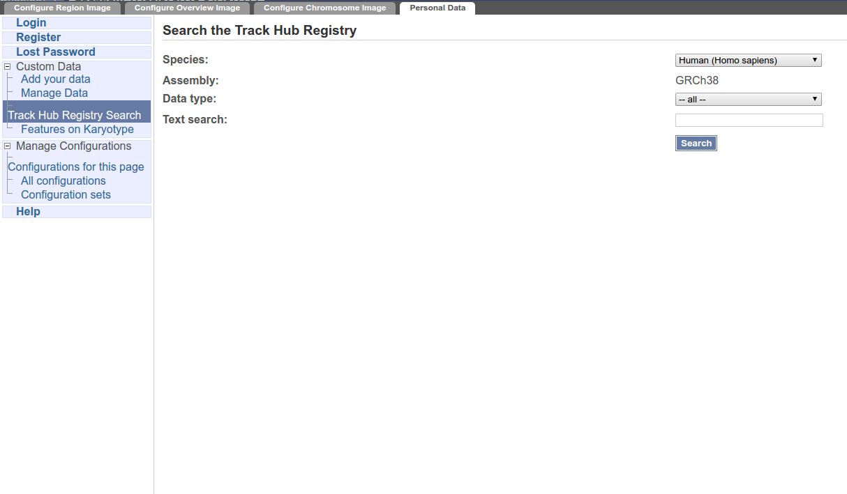

Slide 28
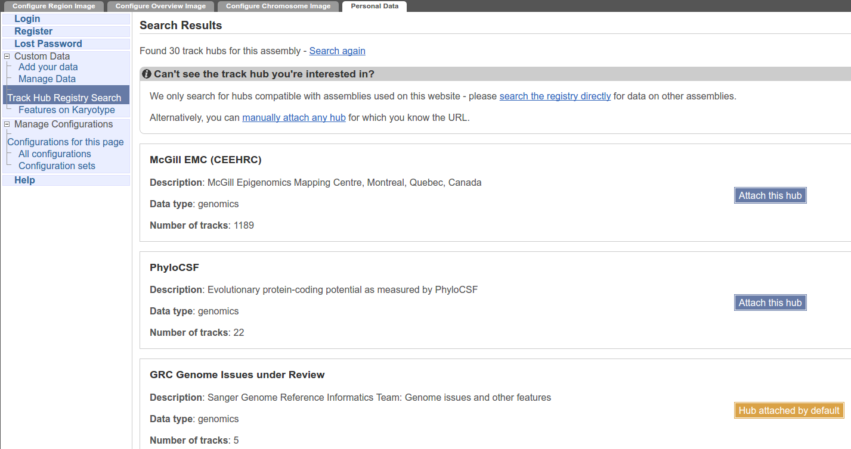

Slide 29
Present/Future Directions
Stats:
track hubs: 1173
species: 78
assemblies: 83
Out of Beta soon!
Embed Biodalliance
Track hub RDF
link hub to other data via ontology mapping
query hubs via SPARQL
Notes:
We’ve explored the possibility of generating an RDF representation from track hub JSON stored in the registry so as to offer users the opportunity to search over increasingly vast amount of connected data, including track hubs, using SPARQL.

Slide 30





Acknowledgements
Ensembl
Anne Lyle, Steve Trevanion
Andy Yates
Magali Ruffier
Paul Flicek and the entire e! Team
UCSC
Kate Rosenbloom
Funding
European Commision FP7

