Slide 1



Track hubs - remote data integration made simple?
Anne Lyle
Ensembl Web Team
12 October 2015

Slide 2
Outline
What are track hubs?
How do we use them in Ensembl?
The track hub registry

Slide 3
What are track hubs?
An easy way to share a set of data and view it in a genome browser
Created by UCSC to make it easier for projects to contribute data
A user-friendly alternative to DAS - no need for special software, just a web/ftp server and some text files
hub.txt - information about the hub (name, contact)
genomes.txt - a list of supported assemblies
trackDb.txt (one per genome) - list of data file URLs with metadata (e.g. track label, configuration options)
Data files are indexed formats, e.g. BigBed, BigWig, BAM/CRAM

Slide 4
hub.txt & genomes.txt
hub.txt
hub Blueprint_Hub_20150820
shortLabel Blueprint Hub
longLabel Blueprint Epigenomics Data Hub
genomesFile genomes.txt
email blueprint-info@ebi.ac.uk
descriptionUrl http://www.blueprint-epigenome.eu/index.cfm?p=31AD6D30-9B3C-BB97-E7F81875121FEC41
UCSC
assembly name
genomes.txt
genome hg38
trackDb grch38/tracksDb.txt

Slide 5
tracksDb.txt
track miRNA_new_pre
bigDataUrl https://www.broadinstitute.org/ftp/pub/vgb/dog/trackHub/canFam3/miRNA/cf3_miRNA_novel_precursors.bb
shortLabel miR New Hairpins
longLabel Novel miRNAs - Hairpin Structures
html html/miRNA
priority 5.53
type bigBed 6
visibility pack
useScore 1
track miRNA_new_mat
bigDataUrl https://www.broadinstitute.org/ftp/pub/vgb/dog/trackHub/canFam3/miRNA/cf3_miRNA_novel_mature.bb
shortLabel miR New Mature
longLabel Novel miRNAs - Mature Structures
html html/miRNA
priority 5.54
type bigBed 6
visibility pack
useScore 1
track CTVT_variation
superTrack on
group CTVT
shortLabel CTVT Variation
longLabel CTVT Variations from Germline and Somatic
html html/CTVT
priority 5.8
track CTVT_ind_Som
bigDataUrl https://www.broadinstitute.org/ftp/pub/vgb/dog/trackHub/canFam3/ostrander/CTVT_indels_somatic.vcf.gz
parent CTVT_variation
shortLabel CTVT Indels Somat
longLabel CTVT Indels Somatic
html html/CTVT
priority 5.81
type vcfTabix
visibility dense
track CTVT_ind_Ger
bigDataUrl https://www.broadinstitute.org/ftp/pub/vgb/dog/trackHub/canFam3/ostrander/CTVT_indels_germline.vcf.gz
parent CTVT_variation
shortLabel CTVT Indels Germl
longLabel CTVT Indels Germline
html html/CTVT
priority 5.82
type vcfTabix
visibility dense
hierarchical

Slide 6
Attaching a hub
Via a URL: /Trackhub?url=http://www.ebi.ac.uk/hub.txt
Via the ‘Add your data’ interface
??

Slide 7
public_trackhubs.html

Slide 8
Configuring a hub

Slide 9
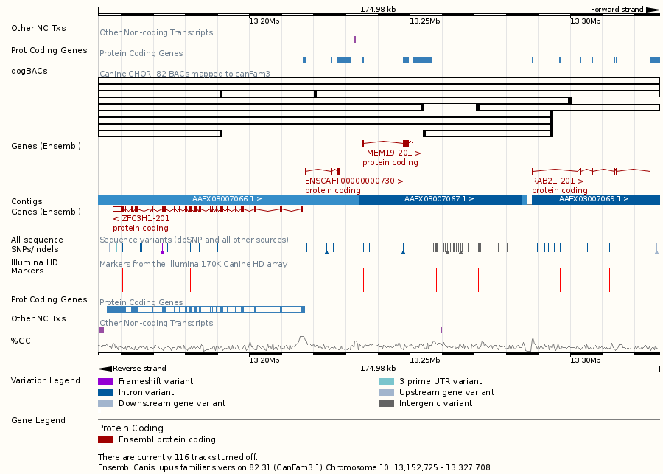
An attached hub

Slide 10
Challenges
Created by UCSC, who define the format of the text files
written for the UCSC code, so doesn’t always fit well into the Ensembl way of doing things
originally no version numbers, so there are hubs of different ages with different versions of the spec and no way to tell which one without parsing the files
Data is often multi-dimensional - difficult to create an automated configuration interface that’s also intuitive
Text files are intended to be human-readable and -writable (via scripts if the hub is large)
difficult to parse
prone to human error
Over 80 configuration options (though around 2/3 are rarely used)
Recommendations such as number of tracks to turn on by default can’t be enforced, requiring defensive programming

Slide 11
Which features do we support?
Essentials - name, file URL, labels
Visibility - we show tracks that are turned on by default, and set the style to the nearest Ensembl equivalent of the UCSC style (e.g. ‘pack’ == ‘stacked’)
Hierarchy (partial) - we group sets of tracks in the configuration interface, so they can be turned on en masse
Colour - we support various colour options, including itemRgb, color, colorByStrand and spectrum (formerly useScore)
Scaling on BigWigs - autoScale, viewLimits, maxHeightPixel

Slide 12
The Track Hub Registry
• Developed by Alessandro Vullo
• Public registry of track hubs
◦ Searchable
◦ One-click loading of hubs into UCSC (and eventually Ensembl)
◦ Stores hub text files parsed into JSON
• Scheduled for public release in spring 2016

Slide 13
Ensembl as a registry client
Phase 1 - Spring 2016
Web interface within Ensembl
remote searching of the registry
one-click attachment of your chosen hub
.txt files will still be retrieved directly and parsed by the website
Phase 2 - Summer 2016
Ensembl will consume the registry’s stored JSON for a hub

Slide 14








Acknowledgements
Ensembl
Alessandro Vullo
Andy Yates
Paul Flicek and the entire Ensembl Team
Funding
European Commission Framework Programme 7
UCSC
Kate Rosenbloom
Notes:
Updated November 2012

