Slide 1
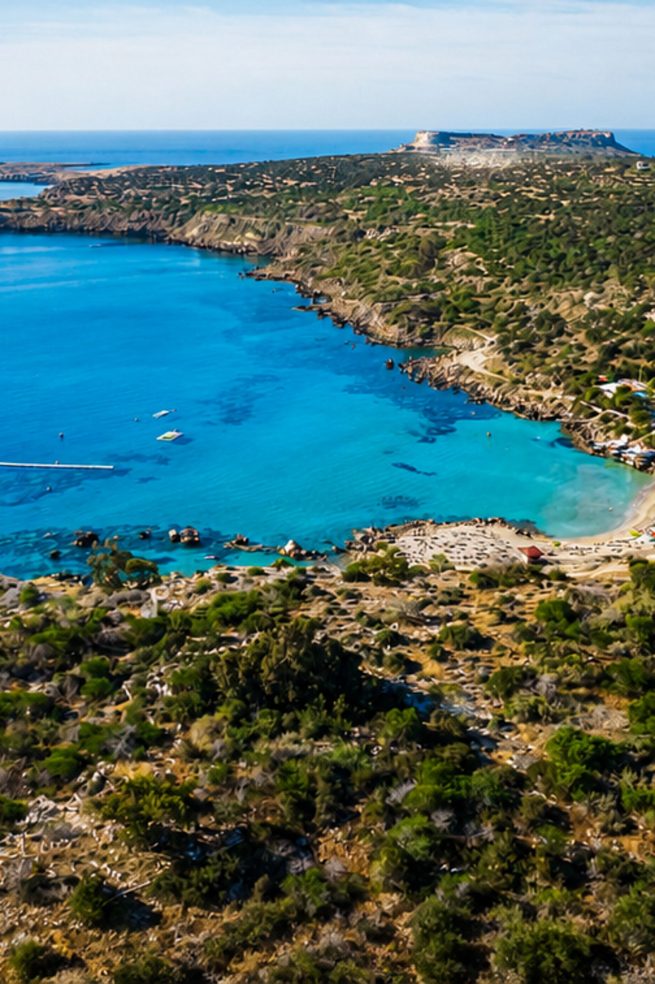
Cyprus Geography: Landforms, Water, Climate, and a Living Divide
Concise visual guide to the island’s physical form, water systems, climate patterns, vegetation, and how these shape human geography today.

Slide 2
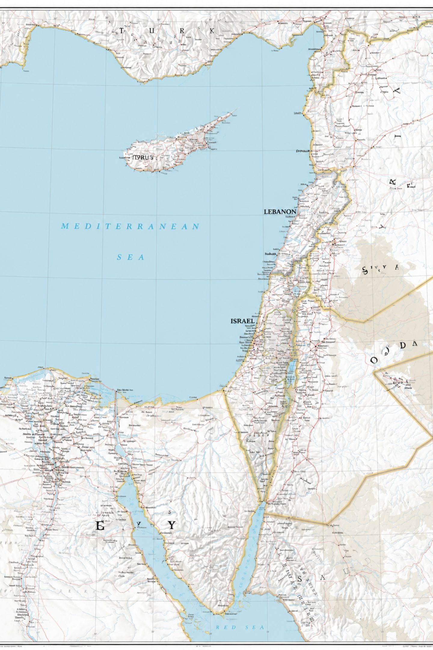

A Crossroads Island in the Eastern Mediterranean
Cyprus sits in the Eastern Basin of the Mediterranean Sea and is the third-largest Mediterranean island (after Sicily and Sardinia). Its position at the junction of Europe, Asia, and Africa made it a historical crossroads—an "end of the Silk Road" island shaped by shifting routes and empires.
Key fact: Strategic location has driven settlement, trade, and cultural exchange for millennia.

Slide 3
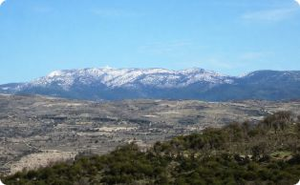
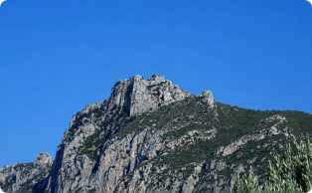
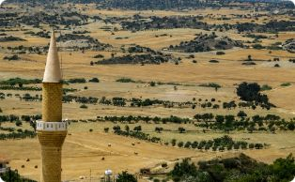
The Island’s Skeleton: Troodos, Kyrenia, and Mesaoria
Troodos Mountains
Kyrenia (Pentadaktylos)
Mesaoria Plain
Low, broad central plain between the ranges; home to Nicosia and the island’s major agricultural zones.
Dominant massif in the south and west, reaching 1,952 m at Mount Olympus and supplying most winter runoff.
Narrow limestone ridge along the north coast—sharp, rocky, locally dramatic and visible from the sea.

Slide 4
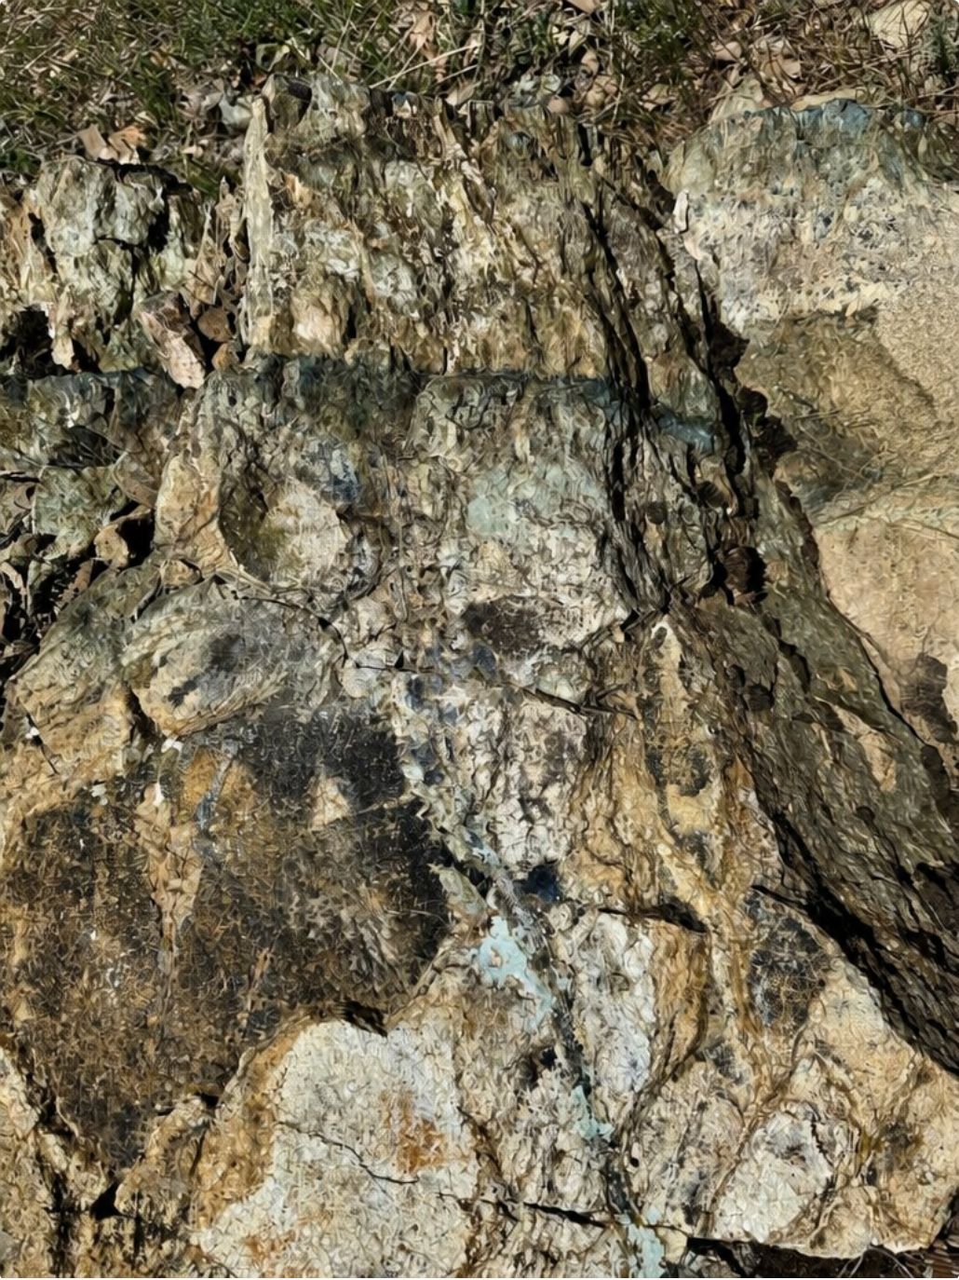
Limestone Cliffs vs Volcanic Massif: The Geology You Can Feel
Troodos is an uplifted ophiolite: a volcanic, basaltic massif whose soils and slopes differ sharply from surrounding limestone. Kyrenia’s Pentadaktylos ridge is primarily limestone—karstic, sharp ridges and caves shaped by dissolution. Around the coasts, narrow lowlands and alluvial fans create fertile pockets for settlements.
Troodos: volcanic, rugged, rich in copper deposits historically
Kyrenia: limestone, cliffs, karst features
Coastal lowlands: sand, alluvium, variable width

Slide 5
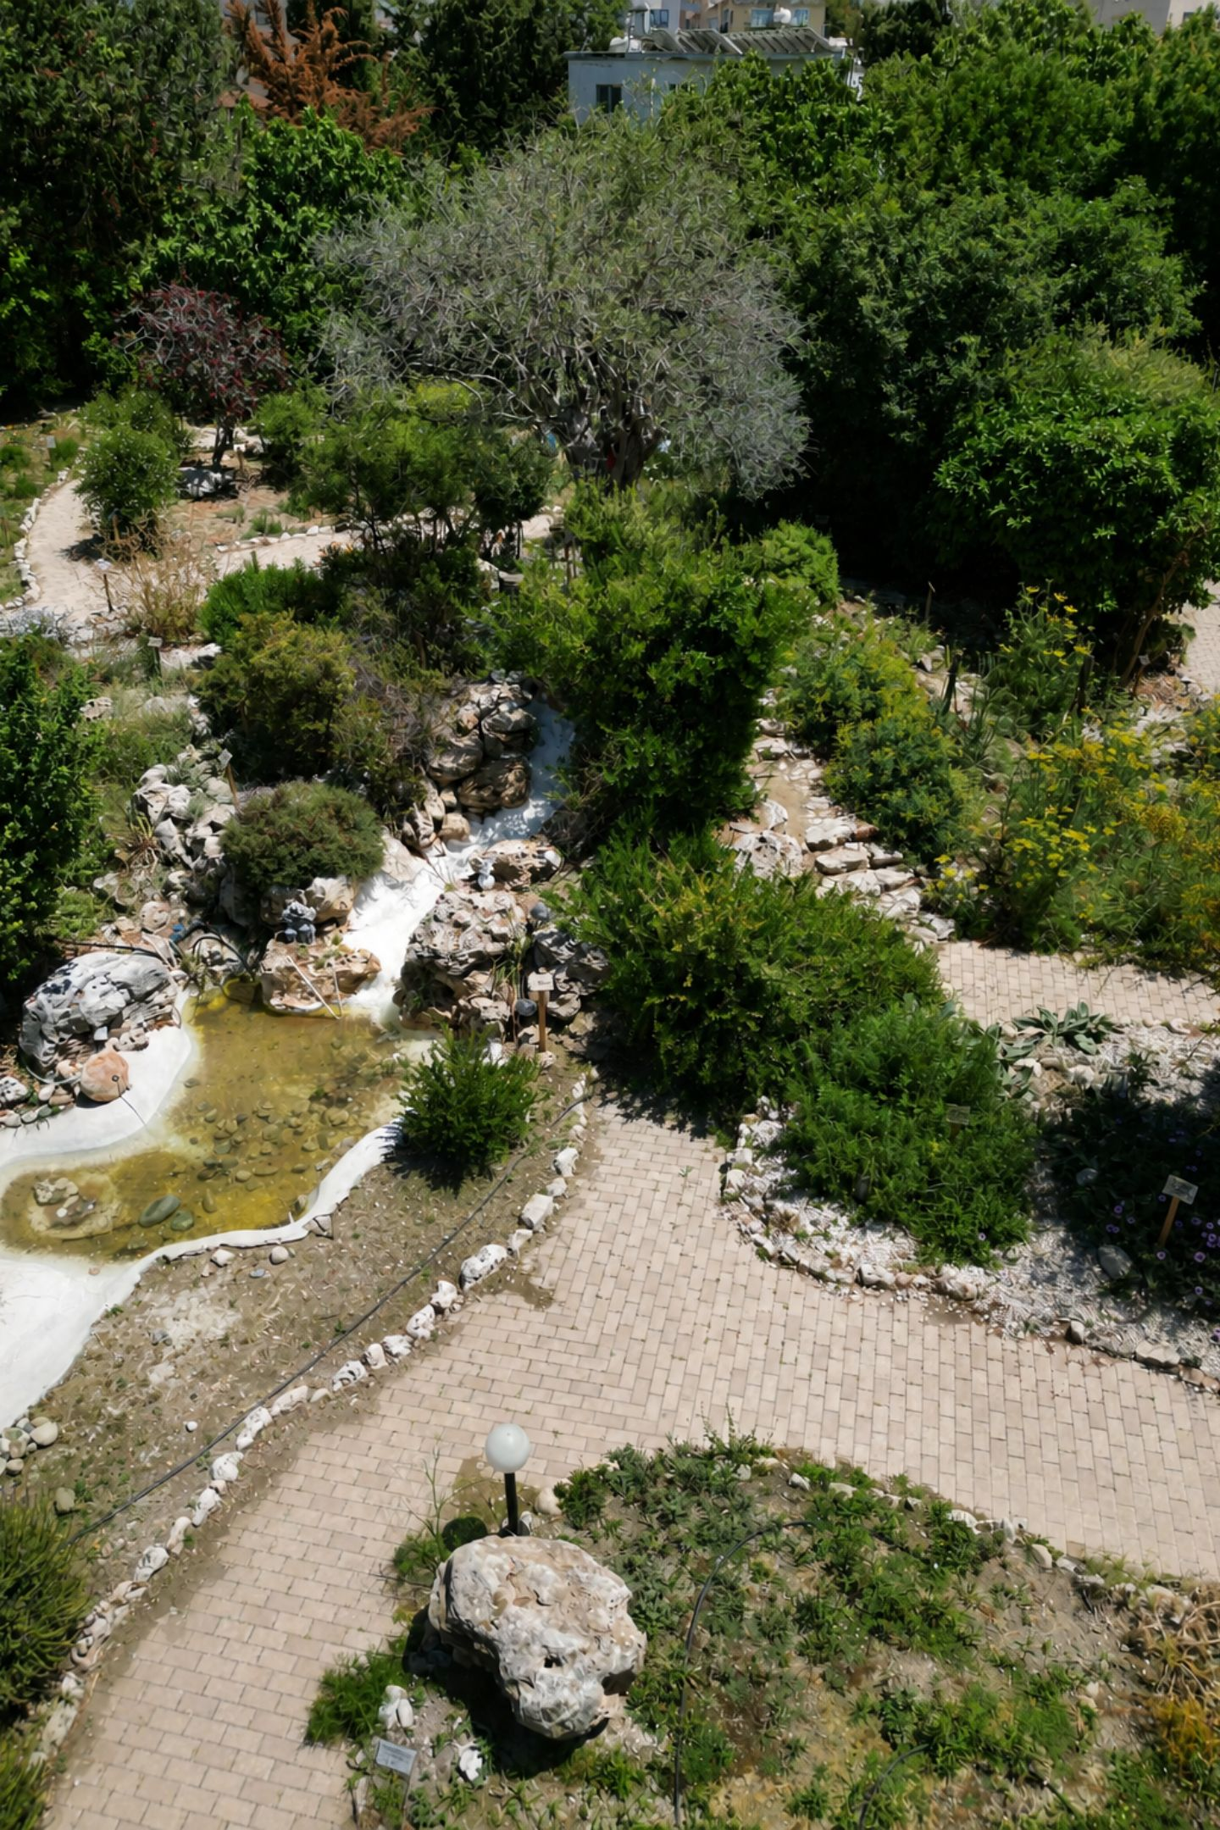

Water That Comes in Seasons: Rivers, Dams, and Agricultural Survival
Permanent rivers are rare; most channels are seasonal torrents fed by winter precipitation. Troodos is the primary source of winter runoff that feeds rivers like the Pedhieos and Yialias. Modern dams and irrigation schemes capture this brief flow to sustain agriculture and towns through the long dry summer.
Infrastructure note: Several large dams and transfer systems are critical to island-wide water security.

Slide 6
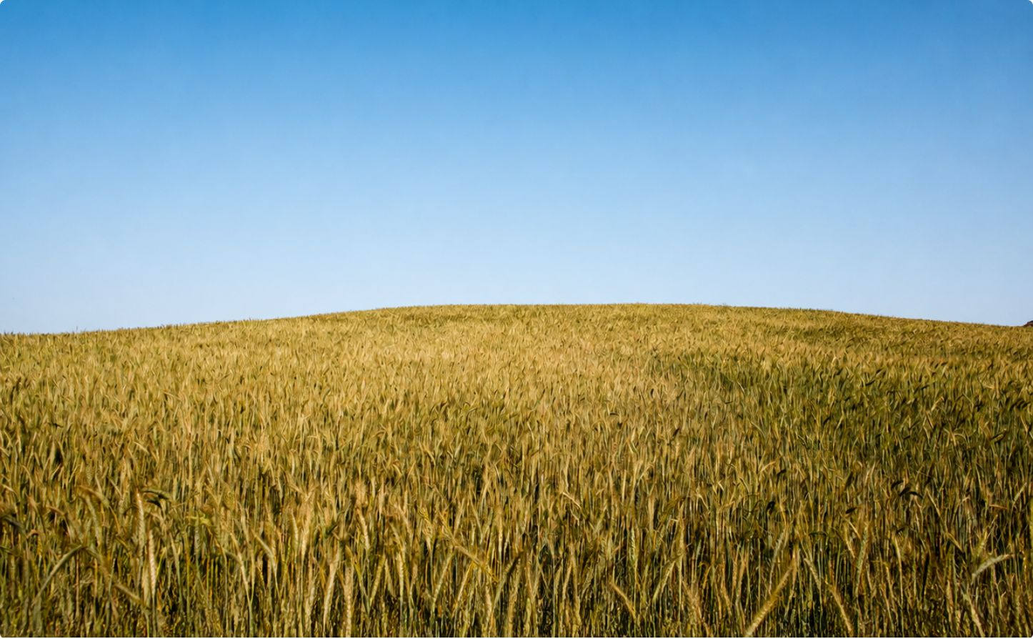
Mesaoria’s Farms: Why Winter Rain Matters
Mesaoria is the agricultural heartland: wheat and barley rely on winter rainfall rather than year-round rivers. Arable land makes up about 46.8% of the island, but productivity is tightly linked to variable precipitation and stored water from dams.
Most rivers act as seasonal torrents—agriculture depends on winter storms and stored runoff.
Irrigation and water transfers allow multiple crops but increase pressure on resources.

Slide 7
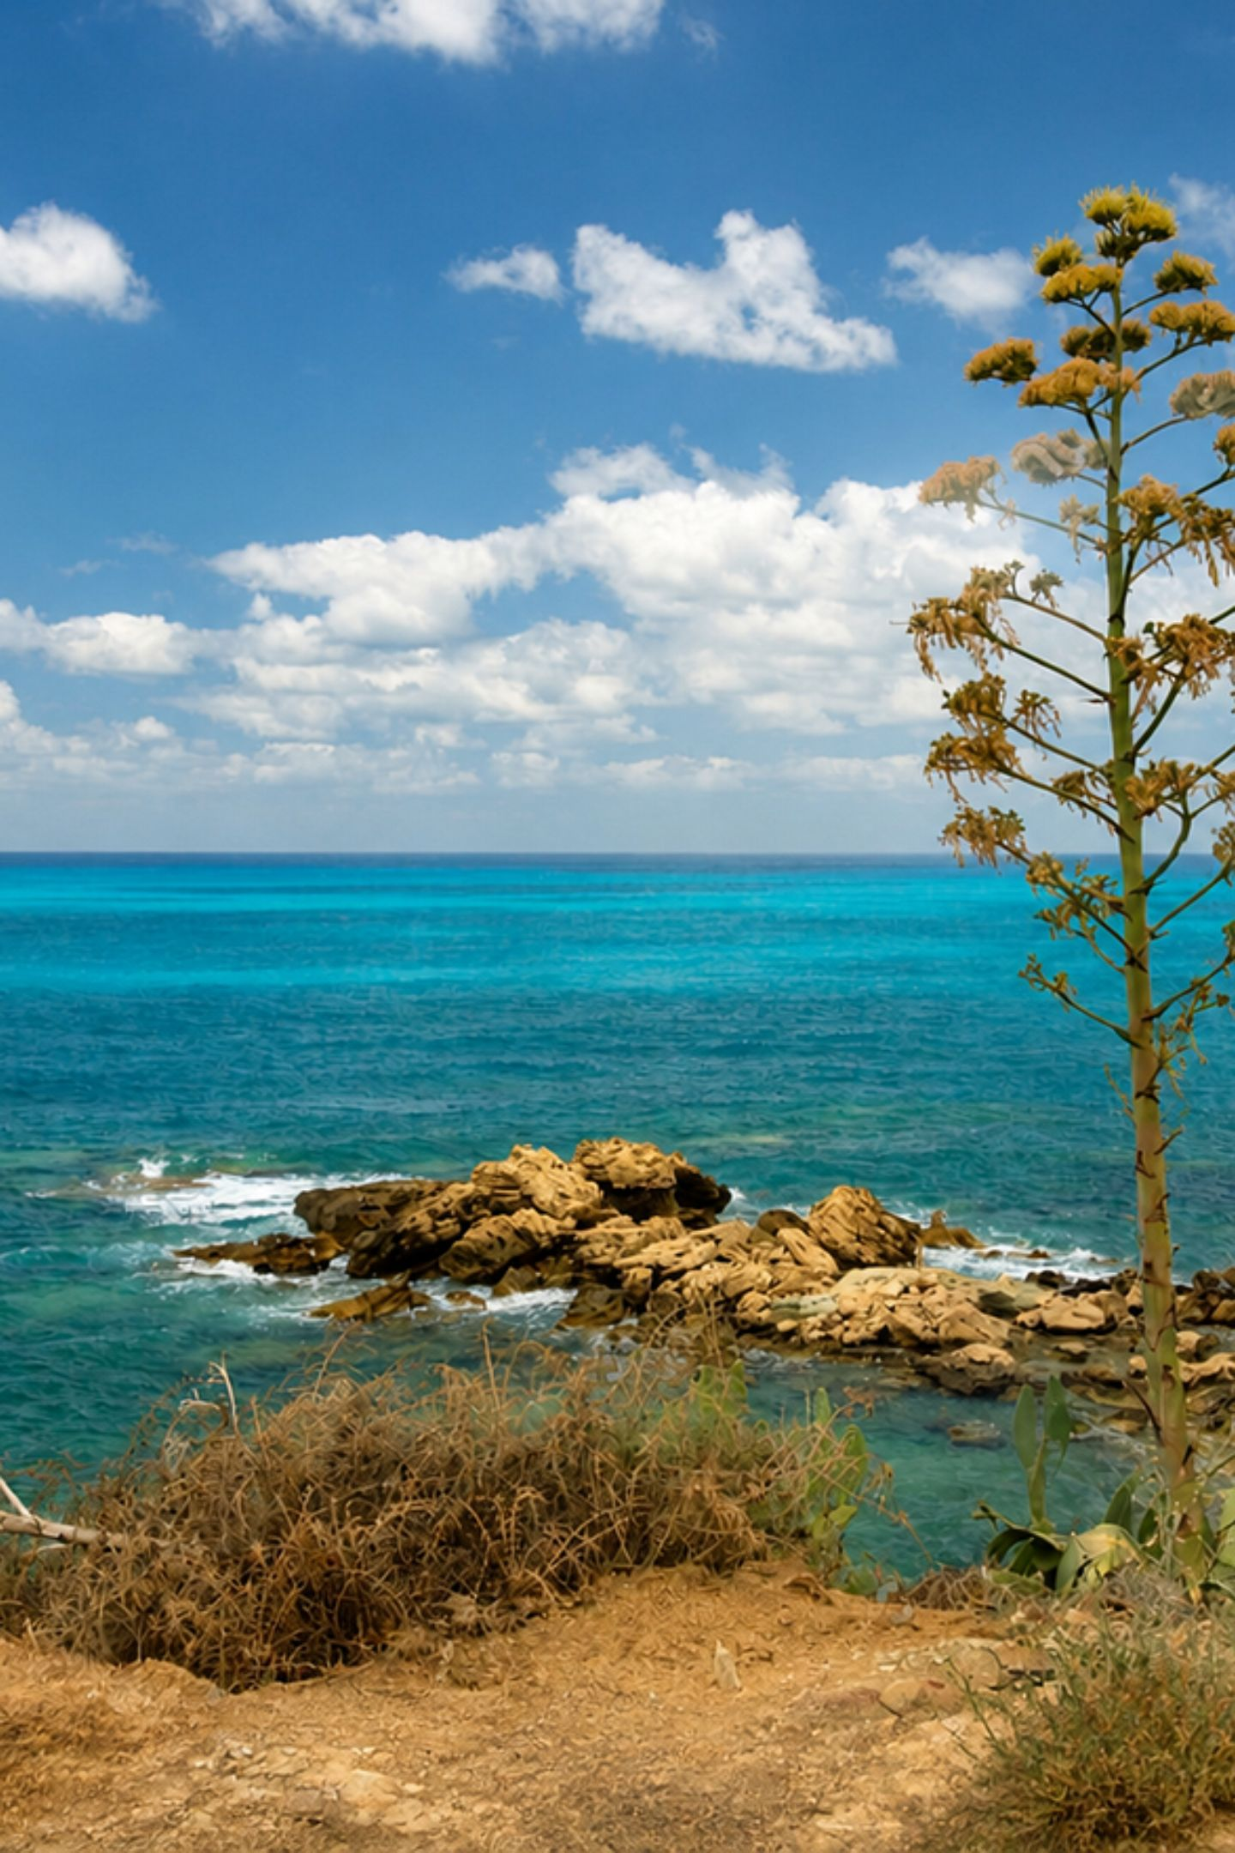
Climate as a Landscape Generator
Cyprus has a pronounced Mediterranean climate: hot, dry summers and mild, wet winters. Rainfall concentrates from November to March; summers are long and drought-prone. Snow falls regularly above ~1,000 m in Troodos, supporting different ecosystems and seasonal water input.
Seasonality
Microclimates
Winter rains supply rivers; summer droughts shape farming and water storage needs.
Higher elevations are cooler and wetter, creating distinct mountain ecology.

Slide 8
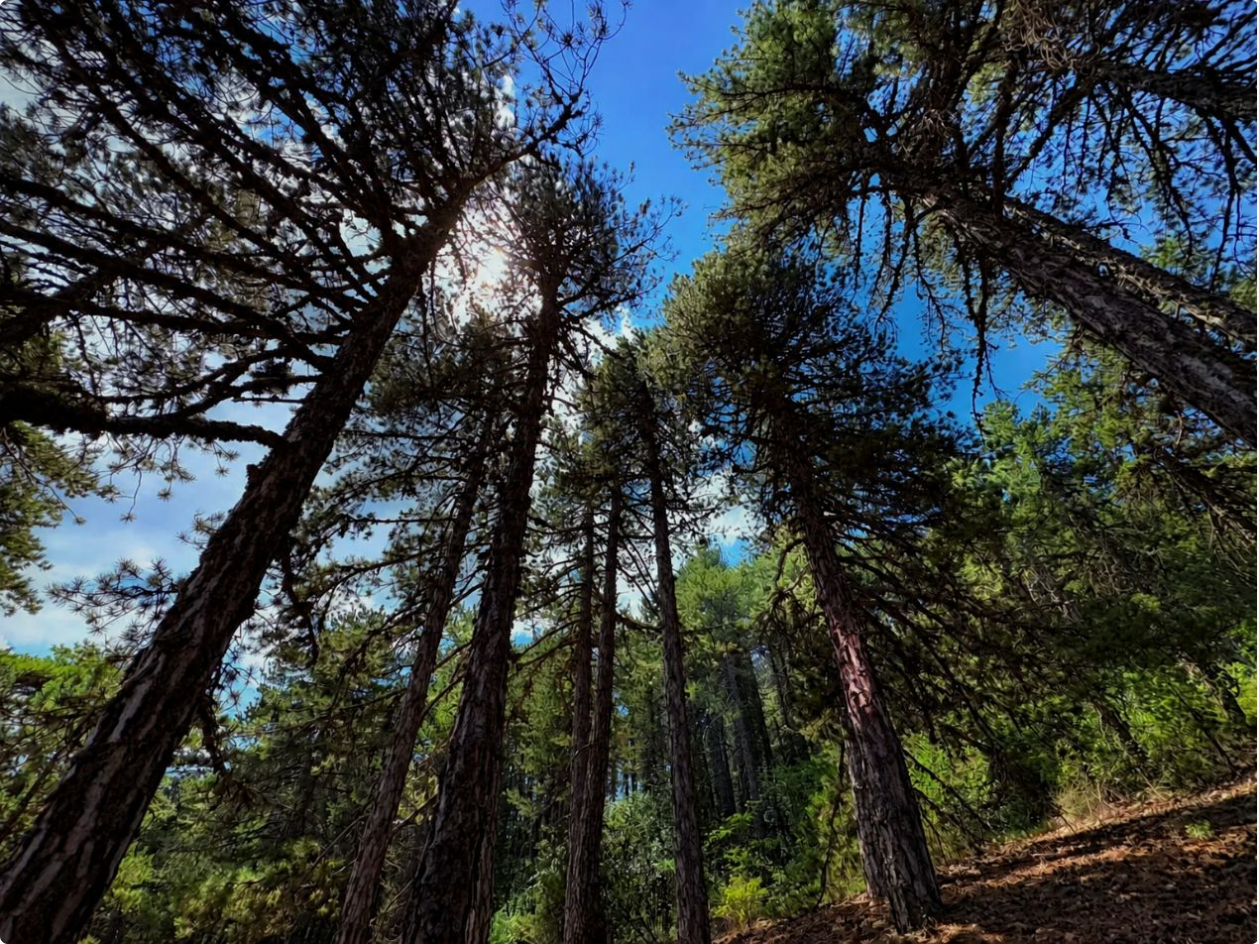
Vegetation Under Pressure: Forests, Maquis, and Woodland Scale
Woodland covers roughly 12% of Cyprus, concentrated on Troodos and parts of Kyrenia. Native species include Pinus brutia (Calabrian pine), cedars, cypresses, and several oak species. Overgrazing and fire have expanded maquis and degraded batha in places where forests have retreated.
Troodos: denser, higher-elevation forests
Lowlands: maquis and scrub, shaped by grazing and cultivation
Conservation challenge: balancing grazing, wildfire risk, and reforestation

Slide 9
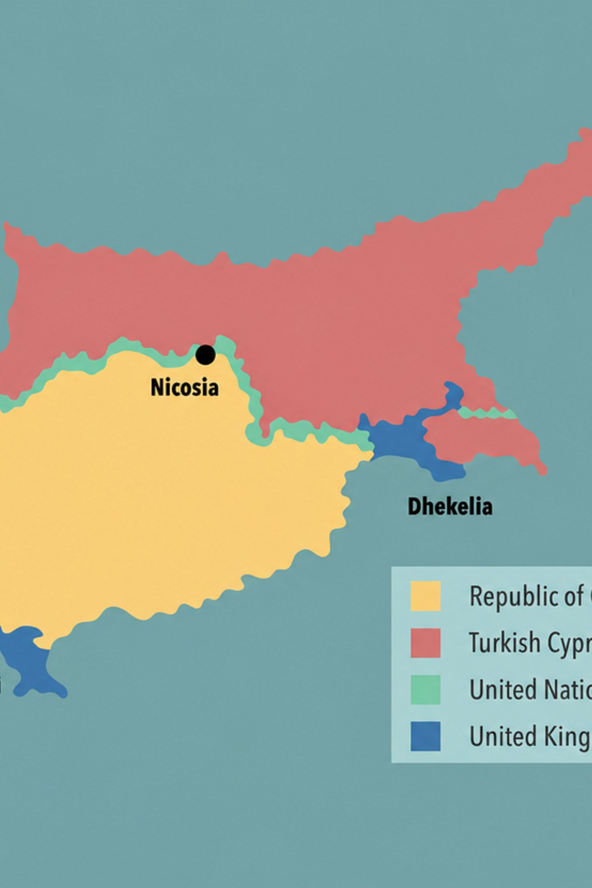
The Geography of Division: Four Segments on One Island
Cyprus’s political map overlays its physical terrain. The Republic of Cyprus controls about 60% in the south; the Turkish Republic of Northern Cyprus occupies roughly 36% in the north; the UN Green Line buffer (about 4%) separates them. Mountains, plains, and transport routes all influence how the island is partitioned and administered.
Important: Physical features like the Kyrenia ridge and Mesaoria corridor affect movement, settlement, and the location of the buffer zone.

Slide 10

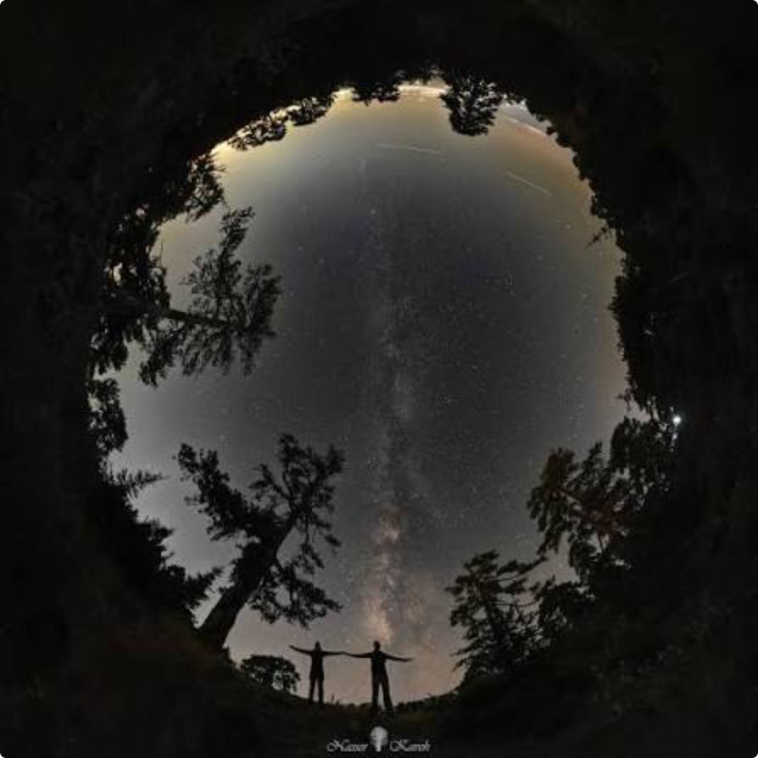
Conclusion: One Island, Many Realities
Troodos, Kyrenia, and Mesaoria shape where water flows, where farms prosper, and where people live. Mediterranean climate seasons govern river life—brief winter rivers, long dry summers—and human infrastructure compensates with dams and irrigation. Today’s political geography maps onto this physical tapestry: terrain and climate help explain the island’s social and economic patterns.
Physical Drivers
Human Adaptation
Mountains, plains, and rock types create diverse land uses.
Dams, irrigation, and land management support agriculture despite seasonality.
Geography & Politics
The island’s physical structure has helped shape its persistent human divisions.

