Slide 1
35°00′N 33°00′E • EASTERN MEDITERRANEAN ATLAS
Cyprus: The Copper Island
Physical geography, relief architecture, premier coastal destinations, and 11,000 years of civilization synthesized from five geographic resources.

Slide 2
01 / GEOGRAPHIC DOSSIER
Cyprus in Numbers
9,251 km²
1,952 m
648 km
107
Mount Olympus peak elevation
Mediterranean coastline length
Water dams across Cyprus
Third-largest Mediterranean island
Etymology of Copper (aes Cyprium → Cuprum): Attested in 15th-century BC Linear B script as ku-pi-ri-jo from ancient Troodos copper ore deposits.

Slide 3
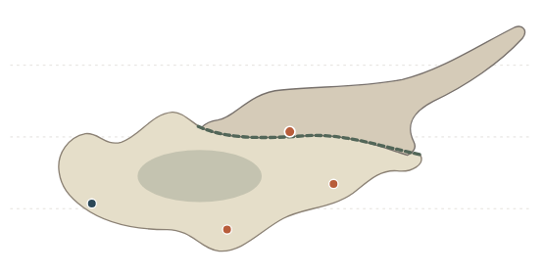
02 / CARTOGRAPHY & GEOPOLITICS
Tri-Continental Crossroads & Administrative Zones
Republic of Cyprus (59%): Southern EU member state since May 2004.
Northern Sector (36%): Covers 3,355 km² following 1974 division.
UN Buffer Zone: Neutral Green Line crossing capital Nicosia.
UK Sovereign Bases (5%): Akrotiri (47.4 km border) and Dhekelia enclaves.
70 km S of Turkey
100 km W of Syria
500 km N of Egypt

Slide 4
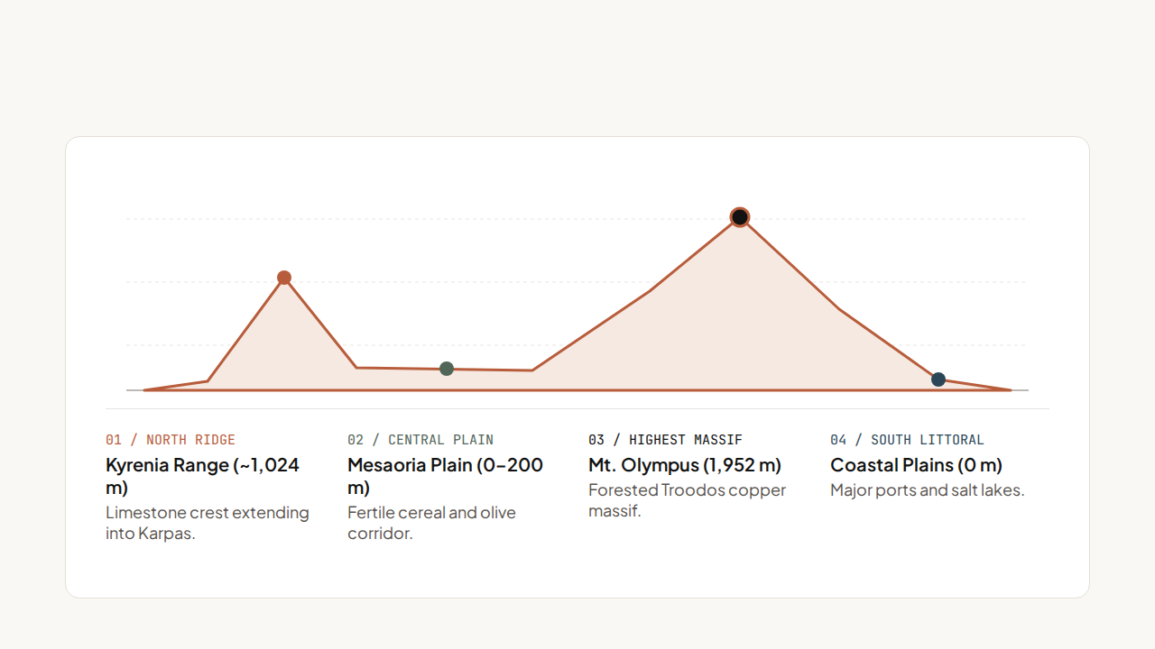
03 / PHYSICAL GEOGRAPHY & RELIEF
North–South Elevation Cross-Section

Slide 5
04 / SUBDIVISIONS & WATER RESOURCES
The 6 Administrative Districts & Hydrography
District | Geographic Position | Key Role | Signature Landmark
Nicosia | Central Mesaoria Plain | Divided National Capital | Venetian Walls & Pedieos
Limassol | Southern Coast | Largest Maritime Port | Molos Palm Promenade
Larnaca | Southeastern Coast | Primary Airport Gateway | Flamingo Salt Lake
Paphos | Southwestern Coast | UNESCO Cultural Hub | Petra tou Romiou
Famagusta | Eastern Coast | Premier Beach Resorts | Ayia Napa & Salamis
Kyrenia | Northern Coast | Historic Northern Harbor | Pentadaktylos & Shipwreck
Hydrography Note: Pedieos (98 km) and Yialias (~100 km) are the only regular winter rivers; 107 dams and desalination plants combat chronic drought.

Slide 6
SECTION 02 • CESTEE & DERTOUR SYNTHESIS
Tourism Destinations, Coastal Resorts & Major Cities

Slide 7
05 / URBAN CENTERS
Four Principal Cities of Cyprus
01 / CAPITAL
02 / MARITIME HUB
03 / AIR GATEWAY
04 / UNESCO CITY
Nicosia
Limassol
Larnaca
Paphos
Inland divided financial capital.
Largest port hosting February Carnival.
Main airport near flamingo lake.
Ancient Greco-Roman mosaic park.

Slide 8

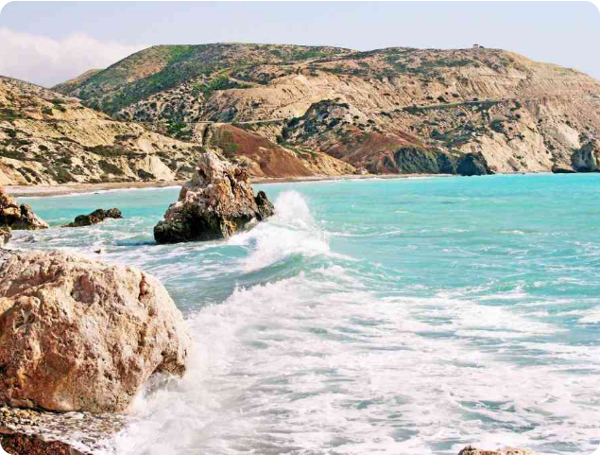
06 / COASTLINE & NATIONAL PARKS
Petra tou Romiou, Eastern Resorts & Wilderness
Petra tou Romiou
Legendary sea-foam birthplace of Greek goddess Aphrodite near Paphos.
Ayia Napa & Protaras
Eastern turquoise beach resorts with golden sand and sea caves.
Akamas National Park
Western peninsula featuring dramatic limestone cliffs and hiking trails.

Slide 9
07 / ARCHAEOLOGICAL TIMELINE
11,000 Years of Iconic Landmarks
10,000 BC
6800 BC
1725 BC
45 AD
Aetokremnos
Khirokitia UNESCO
Alashiya & Nitovikla
Church of Cyprus
Pygmy hippo extinction site.
Neolithic round-house village.
Bronze Age copper trade fortress.
Apostolic church founded by Paul.

Slide 10
08 / NUMISMATICS & IDENTITY
Euro Coin Symbols & Religious Heritage
1c–5c: Mouflon
10c–50c: Kyrenia Ship
€1 & €2: Pomos Idol
5 Metropolises
Endangered wild Troodos sheep.
Chalcolithic fertility cross statue.
Orthodox South; secular Muslim North.
Ancient Greek merchant vessel.

Slide 11
09 / ECONOMY, CLIMATE & INFRASTRUCTURE
Service Economy, Maritime Fleet & Climate
Maritime Fleet: 1,414 commercial vessels across six ports.
75.6%
Road Network: 19,525 km left-hand traffic; zero active railways.
Seasonal Contrasts: 2°C winter Troodos snow; 34°C dry summers.
Services Share of GDP (HDI 0.913)
Joined Eurozone on January 1, 2008 alongside expanding offshore natural gas reserves.
Natural Resources: Copper, pyrite, marble, gypsum, olives, citrus.

Slide 12
KÝPROS • 35°00′N 33°00′E
Thank You & Questions
Synthesized from Wikipedia RO (Geografia Ciprului & Cipru), Cestee.ro, GlobalInfo.ro, and DERTOUR.ro.

Slide 13

Image Sources
https://www.leonardo-hotels-cyprus.com/images/photos/photoGalleries/cityGuides/paphos/beaches/petraTouRomiou/petraTouRomiou_04.jpg
Source: www.leonardo-hotels-cyprus.com

