Slide 1
E-Glass
February 26, 2026 Dr. Mark Gurvich
Anisotropic Stiffness (HW 1)
By Avanthika Vuppala
Aerospace Materials (14:650:449:90)

Slide 2
Content
Slide 1: | Title
Slide 2: | Content
Slide 3: | Problem Statement
Slide 4: | Input Data- Material: E-Glass
Slide 5: | Methods of Analysis
Slide 6-12: | Results of Analysis
Slide 13: | Conclusion
Slide 14: | Excel File Information

Slide 3
Problem Statement
Goal: Determine stresses and strains in global and material coordinates for a unidirectional composite lamina subjected to in-plane stresses at a given orientation θ.

Slide 4
Input data - Material: E-Glass
Material properties from Table 6: Elastic Properties of UD Polymer Matrix Composites
Applied Stresses (Global Coordinates)
Axial Modulus E11: | 45000 MPa
Transverse Modulus E22: | 12000 MPa
In-Plane Shear Modulus G12: | 5500 MPa
Major Poisson’s Ratio v12: Minor Poisson’s Ratio v21: | 0.28 0.07466667
Stress σxx: | 874 MPa
Stress σyy | 814 MPa
Stress τxy: | 420 MPa
Material Orientation Θ: | 72.6 deg

Slide 5
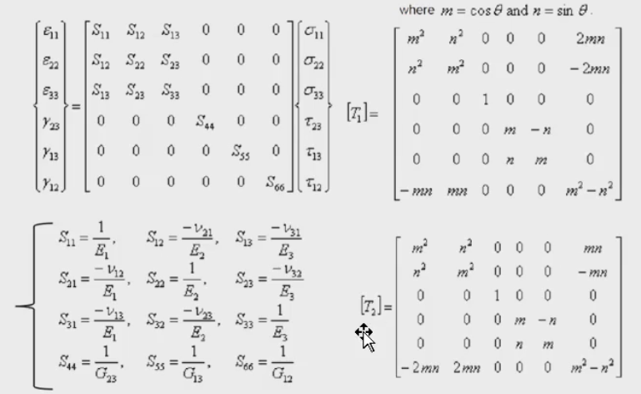
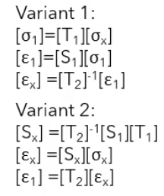
Methods OF Analysis
Using the Matrix definitions shown above with the given
inputs, the stresses and strains can be calculated in two
different ways shown to the right.

Slide 6
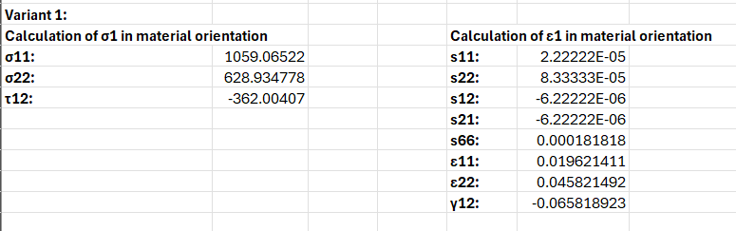
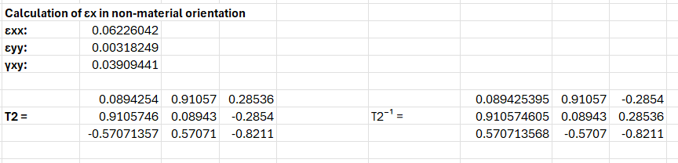
Results of Analysis
Variant 1 results at 72.6 Deg:

Slide 7
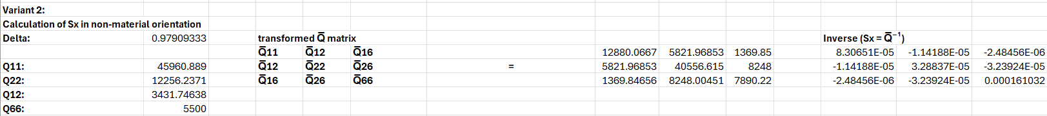


Results of Analysis
Variant 2 results at 72.6 Deg:

Slide 8
Results of analysis
Both Variant 1 and Variant 2 yielded the same results at the specified control angle, demonstrating consistency between the two computational approaches.

Slide 9
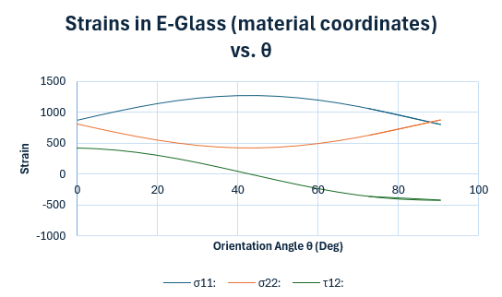

Results of analysis
The stresses in the material coordinate system vary significantly with orientation angle θ.
The longitudinal stress σ₁₁ reaches its maximum near 45° and minimum at 0° and 90°.
The transverse stress σ₂₂ decreases with increasing angle, while the shear stress τ₁₂ changes sign and reaches its largest magnitude near 90°.
This behavior reflects the anisotropic stiffness of E-Glass.

Slide 10
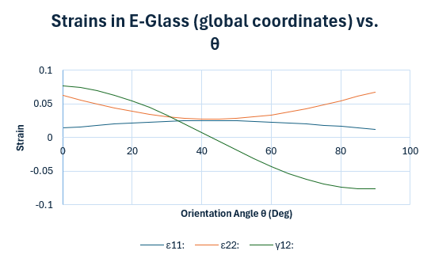

Results of analysis
The global strains εxx, εyy, and γxy vary nonlinearly with orientation angle θ.
The normal strain εxx increases with angle, while εyy shows a decreasing trend.
The shear strain γxy changes sign and reaches its largest magnitude at high angles, indicating strong coupling between normal and shear deformation in anisotropic materials.

Slide 11
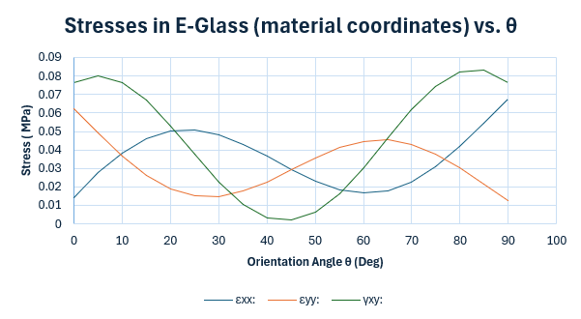

Results of analysis
In the material coordinate system, the strain components depend strongly on orientation.
The longitudinal strain ε11 increases with angle, while the transverse strain ε22 shows a nonlinear variation.
The shear strain γ12 changes sign and magnitude, indicating rotation of the principal strain directions relative to the global axes.

Slide 12
Results of analysis
The stress and strain responses of the E-Glass lamina vary significantly with material orientation due to anisotropic stiffness. Results obtained using Variant 1 and Variant 2 were identical at the control angle (θ = 72.6°), confirming the correctness of both transformation approaches.
The material coordinate stresses and strains exhibit strong directional dependence. The axial (11-direction) response is largest when fibers align closely with the loading direction, while the transverse (22-direction) response dominates when fibers are oriented away from the load. Shear components reach extreme values at intermediate orientations, indicating coupling between normal and shear behavior.
Analysis of the full angular range shows that the optimal orientation depends on the design objective. To minimize normal strain in the fiber direction, orientations near 0° are preferred. To reduce shear effects, orientations closer to 90° are more favorable. These results highlight the importance of selecting fiber orientation to tailor mechanical performance in anisotropic composite materials.

Slide 13
Conclusion
The results demonstrate that E-Glass exhibits significant anisotropic behavior, with mechanical response strongly dependent on orientation angle θ. The agreement between Variant 1 and Variant 2 confirms the validity of the transformation methods used. Different stress and strain components reach their extrema at different angles, indicating that no single orientation simultaneously minimizes all responses. Therefore, the optimal material orientation depends on the specific performance requirements of the structure.

Slide 14
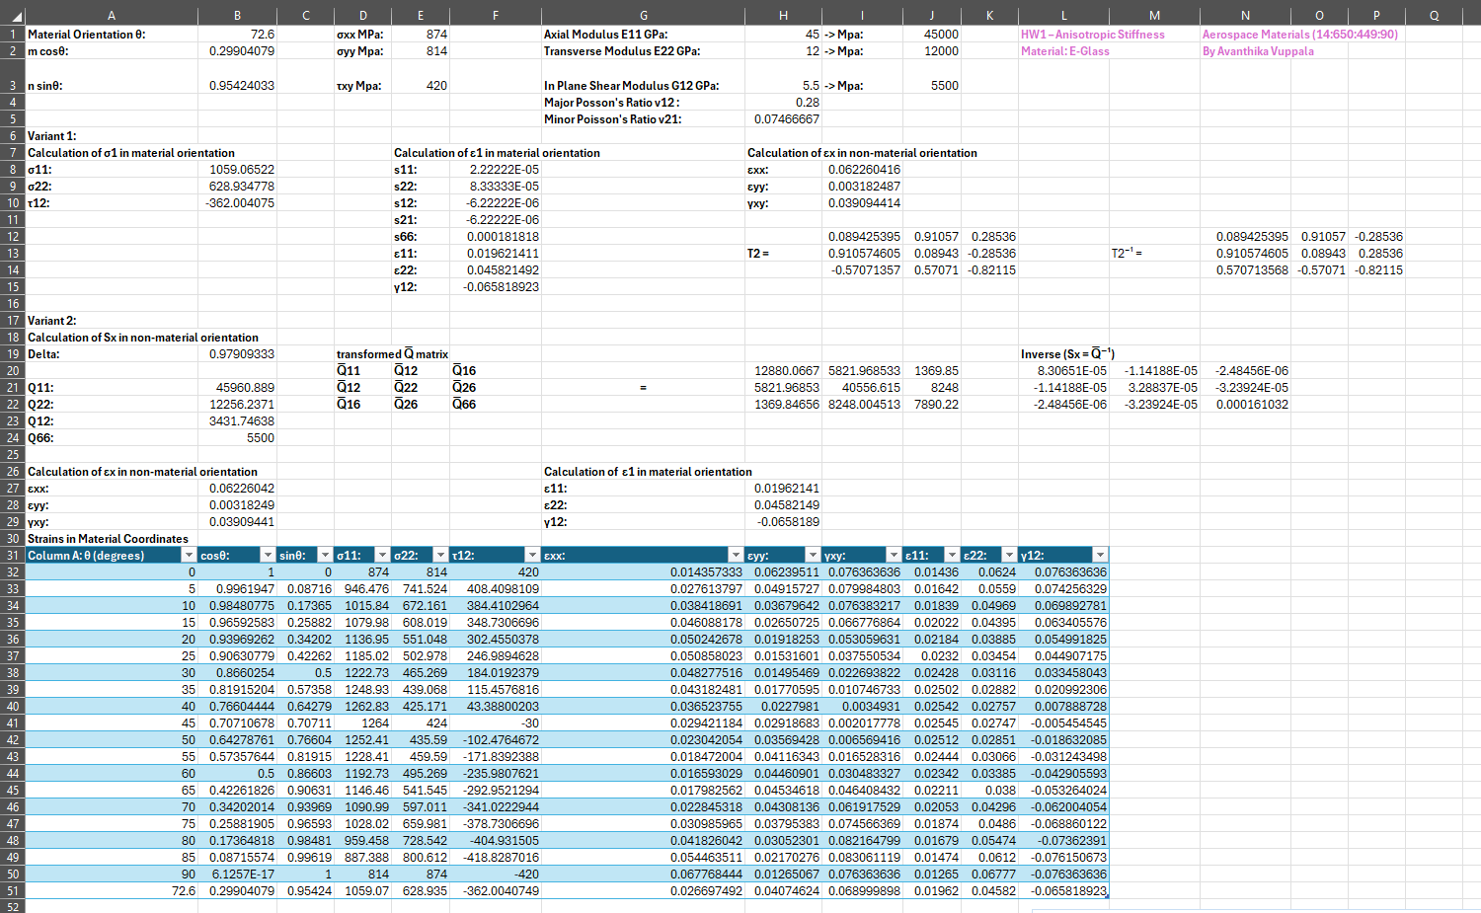
Excel file provided as a separate attachment.

