Slide 1
DAEN 690 – Capstone – Team Autoencoders
Summer 2020 – Section 002

Slide 2
Autoencoders – Full Sprint 3 – analytic/algorithm
July 28, 2020

Slide 3

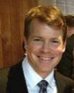

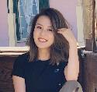

Team autoencoders - Members
Matt Machado
Product Owner
Stephen Schade
SCRUM Master
Yun Li
Developer
Jun Wang
Developer
Gauthami Kuravi
Developer

Slide 4
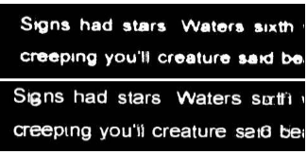
Team autoencoders – problem statement
Problem Context:
Domain of problem: OCR technology is valuable in any instance where documents or images have text, such as healthcare, banking, manufacturing, legal, business, and other industries associated with heave paperwork or documentation.
Importance of problem: Image “noise” is one reason that OCR technology may have trouble reading character text. Removing noise makes OCR more reliable.
Problem Statement: It is difficult to translate text images into text data without some inaccuracies or errors. This project will build a Convolutional Neural Network (CNN) auto-encoder that attempts to reduce image noise during OCR processing. We will evaluate the fidelity of our CNN by conducting OCR text extraction on a dataset before and after the implementation of our method.
Example: Before (top) and after (bottom) OCR denoising

Slide 5
Team autoencoders – Potential Analytics/algorithms - Process
Input Image
OCR
(PyTesseract)
Result
Input Image
Autoencoder
OCR
(PyTesseract)
Result

Slide 6
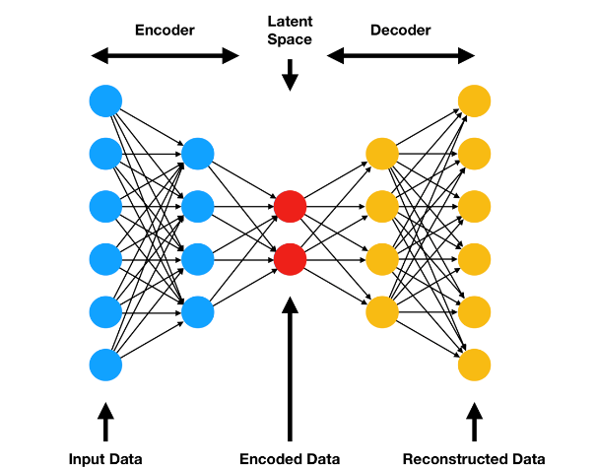
Team autoencoders – Potential Analytics/algorithms
Autoencoder Illustration:

Slide 7
autoencoders – Datasets
Datasets Planned for Project
Dataset Name: Ryerson Vision Lab Complex Document Information Processing (RVL-CDIP):
Dataset Owner: Adam W. Harley, Alex Ufkes, and Konstantinos G. Derpanis, stored by Carnegie Mellon’s computer science department.
Dataset Type: Open source, academic computer vision project database
Dataset Size: 37GB
Dataset License: The authors ask that users cite their paper if using this dataset.
A. W. Harley, A. Ufkes, K. G. Derpanis, "Evaluation of Deep Convolutional Nets for Document Image Classification and Retrieval," in ICDAR, 2015
Dataset Location: Web-accessible
Dataset Access: Publicly available.
Dataset Restrictions: None.
Dataset Collection Process: This dataset is a subset of the IIT-CDIP Test Collection, which was used for a 2006 conference paper on complete document information processing. The IIT-CDIP dataset is itself a subset of the Legacy Tobacco Document Library (TLDL), an archive of 14 million documents related to tobacco industry advertising, manufacturing, marketing, scientific research, and political activities.
Analytic/Algorithm that will use dataset: tesseract optical character recognition; convolutional neural network.

Slide 8
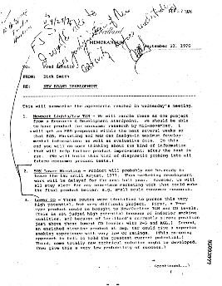
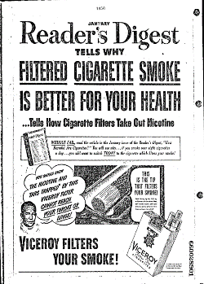
autoencoders – Dataset Example
Three Different Document Types
News
Memo
Ads

Slide 9
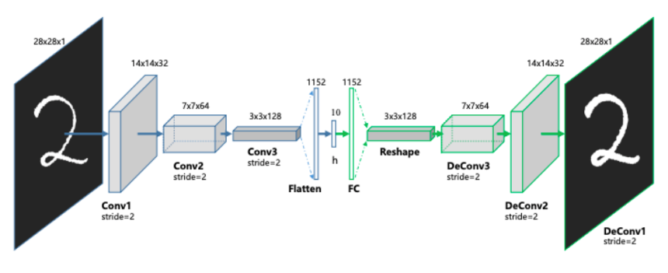
Team autoencoders –Analytics/algorithms
Birds’ Eye View of the Autoencoder Structure
Source:
https://towardsdatascience.com/convolutional-autoencoders-for-image-noise-reduction-32fce9fc1763
Notes:
Source:
https://www.youtube.com/watch?v=jajksuQW4mc

Slide 10
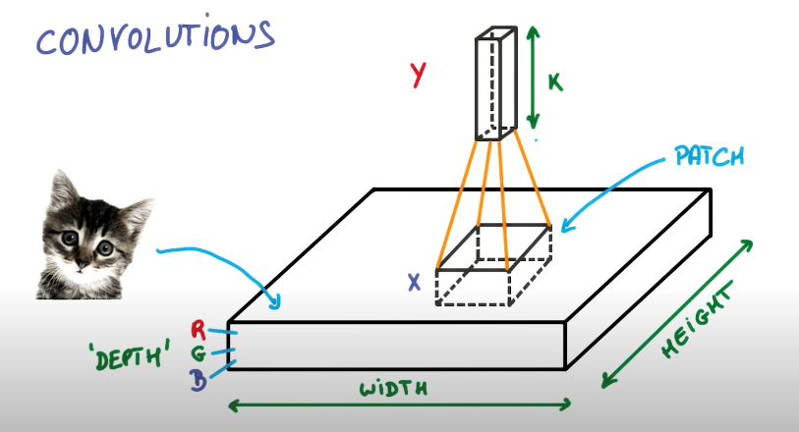
Team autoencoders –Analytics/algorithms
Using filter/kernel for convolution:
Source:
https://www.youtube.com/watch?v=jajksuQW4mc

Slide 11
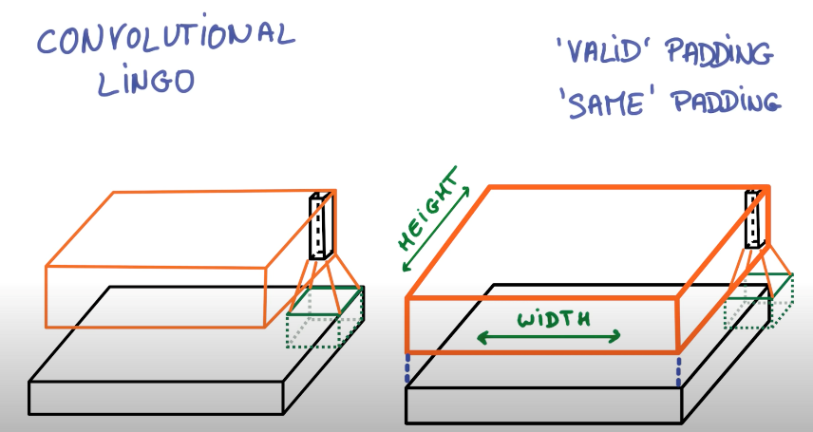
Team autoencoders –Analytics/algorithms
Padding:
Source:
https://www.youtube.com/watch?v=jajksuQW4mc

Slide 12
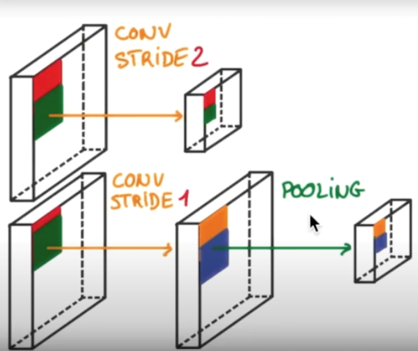
Team autoencoders –Analytics/algorithms
Pooling:
Source:
https://www.youtube.com/watch?v=jajksuQW4mc

Slide 13
Team Autoencoders – analytic/algorithm Specification
Name: Convolutional Autoencoder
How it works: Unsupervised machine learning algorithm that takes an image as input and tries to reconstruct it back using a fewer number of bits from the latent space representation.
Encoder: Conv2D and Max pooling Layers.
Decoder:Conv2D and Upsampling 2D layers
Libraries : Numpy, Tensorflow, Keras, OpenCV
Parameters: Width, height. Depth, Filter, LatentDim(Default =16)
Data Inputs: Image data in .Tiff format are converted to JPEG in Python using PIL
Hyperparameters: loss(sparse_categorical_crossentropy )
Model Tuning: Code Size, No.of Layers, Loss function(Adding penality to weight size) , holdout to validation data
Model Training Resources Required: GoogleColab (GPU)
Model Deployment: Trained model is used to improve the text quality extracted from the image.

Slide 14
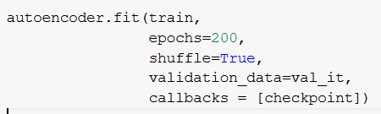
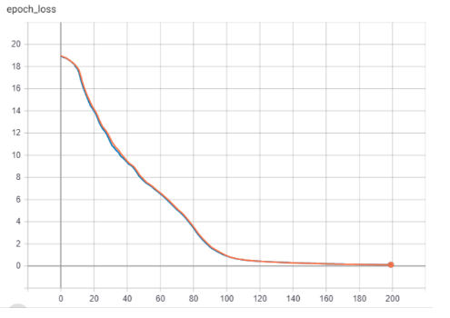
Team autoencoders– analytics/algorithms - Demonstrations

Slide 15
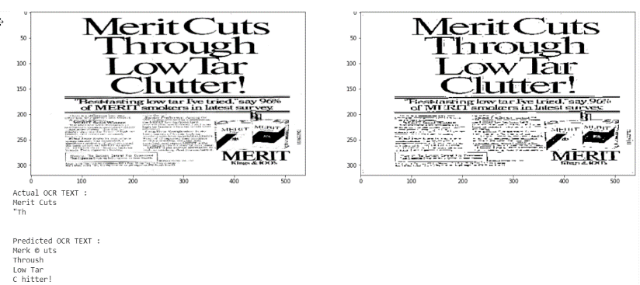
Team autoencoders- Visualizations

Slide 16
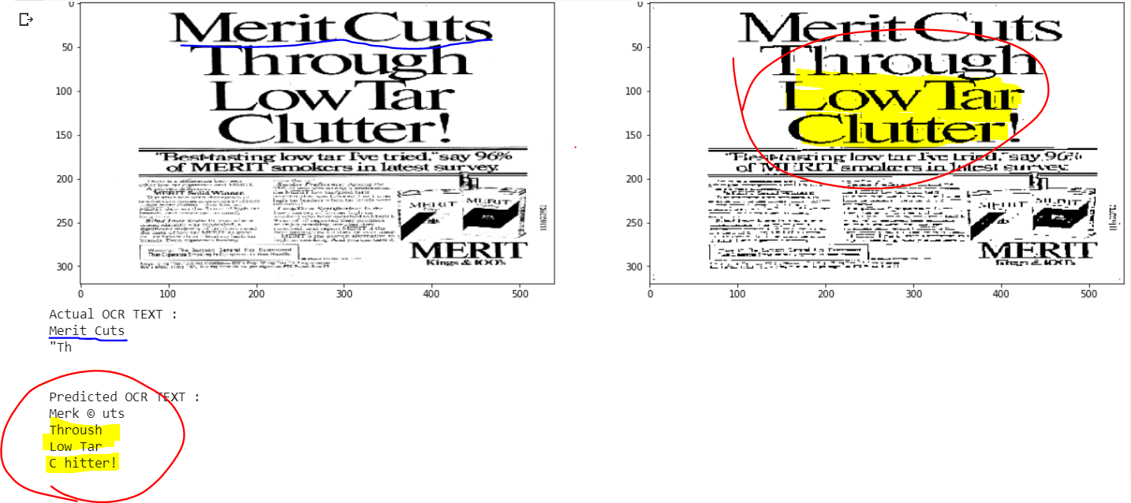
AutoEncoders - Visualizations

Slide 17
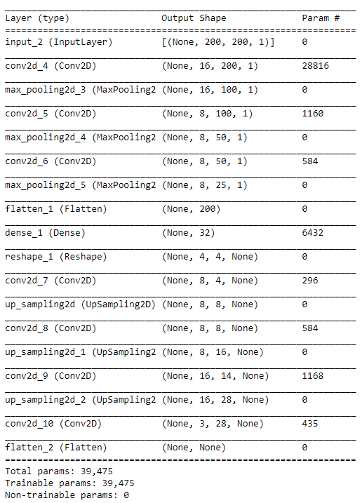


Team autoencoders– analytics/algorithms - Demonstrations
Image preprocessing
Model Construction
Model Training
Model deployment
OCR analysis
ISSUE: Tuning – Symmetry
ISSUE: deployment – Dimension
Next Steps: Achieve Symmetry
Next Steps: Analysis, Findings

Slide 18
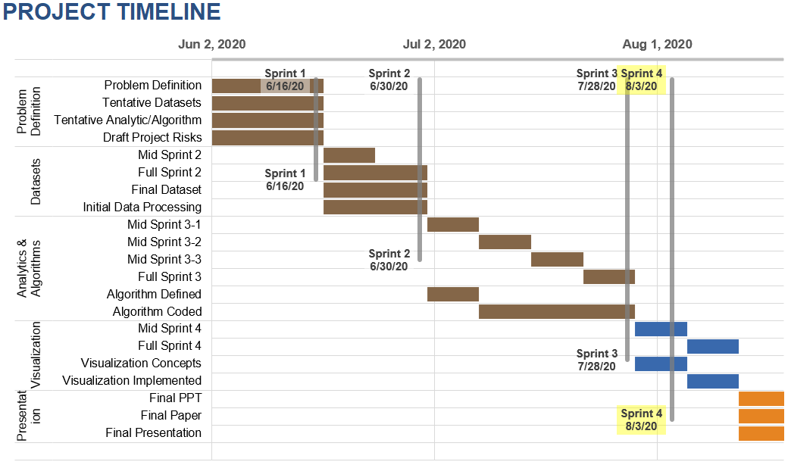
Team autoencoders– Project Schedule

Slide 19
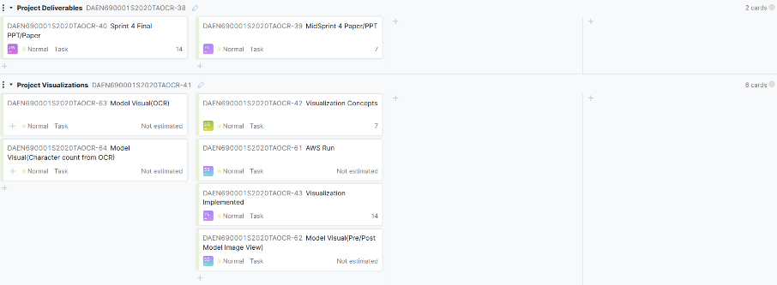
Team autoencoders – youtrack

Slide 20

Autoencoders – Risks and Planned Mitigations
Risk Name | Description | Probability | Impact | Mitigation
Inadequate data for project goal | A lack of images “noisy” enough to adequately test CNN-OCR project goal | Low | High | Promising datasets identified, composite dataset options available.
Unavailable computer resources | A lack of compute resources will leave us unable to conduct CNN training | Low | high | Alternative resources available through university and commercial means.
Inadequate internet access | Unable to access compute or communications channels | Low | High | Persistent internet outage unlikely, will seek alternate access points.
Inadequate team communications | Inability to communicate with team during work effort | Low | Low | Multiple communications channels; BB, Slack, email, phone, YouTrack
Inadequate stakeholder communications | Inability to get feedback / requirements from sponsors | Low | Low | Multiple communications channels, BB, email, phone, YouTrack.

Slide 21
APPENDIX

Slide 22
Team autoencoders – Potential Analytics/algorithms
Denoising Process for OCR:
Using PyTesseract to conduct OCR analysis on the chosen dataset and note the according result (such as Accuracy and performance, etc.)
Create the denoising autoencoder by developing CNN algorithms. Train, validate, and test the model until the model satisfies expectations.
Using PyTesseract to conduct OCR analysis with denoising autoencoder created in 2. on the same dataset. Note the according result.
Compare result from 1. and 4. to evaluate how effective the denoising autoencoder is.

