Slide 1
DAEN 690 – Capstone – Team autoencoders
Summer 2020 – Section 002

Slide 2
Team Autoencoders - Sprint-1: Problem Statement
June 9, 2020

Slide 3
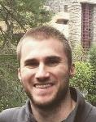
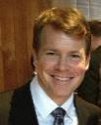
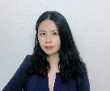


Team autoencoders - Members
Matt Machado
Product Owner
Stephen Schade
SCRUM Master
Yun Li
Developer
Jun Wang
Developer
Gauthami Kuravi
Developer

Slide 4
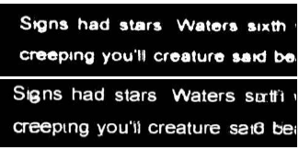
Team autoencoders – problem statement
Problem Context:
Domain of problem: OCR technology is valuable in any instance where documents or images have text, such as healthcare, banking, manufacturing, legal, business, and other industries associated with heave paperwork or documentation.
Importance of problem: Image “noise” is one reason that OCR technology may have trouble reading character text. Removing noise makes OCR more reliable.
Problem Statement: It is difficult to translate text images into text data without some inaccuracies or errors. This project will build a Convolutional Neural Network (CNN) auto-encoder that attempts to reduce image noise during OCR processing. We will evaluate the fidelity of our CNN by conducting OCR text extraction on a dataset before and after the implementation of our method.
Example: Before (top) and after (bottom) OCR denoising

Slide 5
Team autoencoders – Datasets
Proposed Datasets for Project
The University of California, Irvine Machine Learning Repository hosts multiple OCR-related datasets, including handwritten digits and others. https://archive.ics.uci.edu/ml/datasets.php
Kaggle hosts datasets associated with a competition on OCR denoising. https://www.kaggle.com/c/denoising-dirty-documents/data
The National Institute of Standards and Technology (NIST) hosts a dataset titled “Structured Forms Reference of Binary Images (SFRS).”https://www.comet.ml/site/app/uploads/2020/01/deeperase.pdf This dataset consists of:
- The database has the following features:
- 900 simulated tax submissions
- 5,590 images of completed structured form faces
- 5,590 text files containing entry field answers
- 20 tables of entry field types and contexts

Slide 6
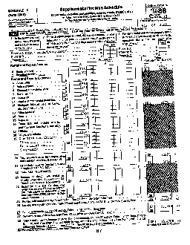
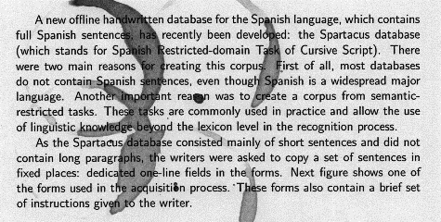
Team autoencoders – Datasets Example
UCI NoisyOffice Dataset
NIST Special Database 2

Slide 7
Team autoencoders – Potential Analytics/algorithms
Analytic/Algorithm Name: Convolutional Neural Network; pyTesseract library for optical character recognition, Keras Machine Learning library.
Datasets: images of documents; preferably templated (professional forms, invoices, records.) and relatively noisy.
Computer Resources Required: Google Colab, GUI processing, web access.
Training: approx. 70% of identified data
Testing: approx. 15%
Validation: approx. 15%

Slide 8
Team autoencoders – Potential Analytics/algorithms
Denoising Process for OCR:
Using PyTesseract to conduct OCR analysis on the chosen dataset and note the according result (such as Accuracy and performance, etc.)
Create the denoising autoencoder by developing CNN algorithms. Train, validate, and test the model until the model satisfies expectations.
Using PyTesseract to conduct OCR analysis with denoising autoencoder created in 2. on the same dataset. Note the according result.
Compare result from 1. and 4. to evaluate how effective the denoising autoencoder is.

Slide 9
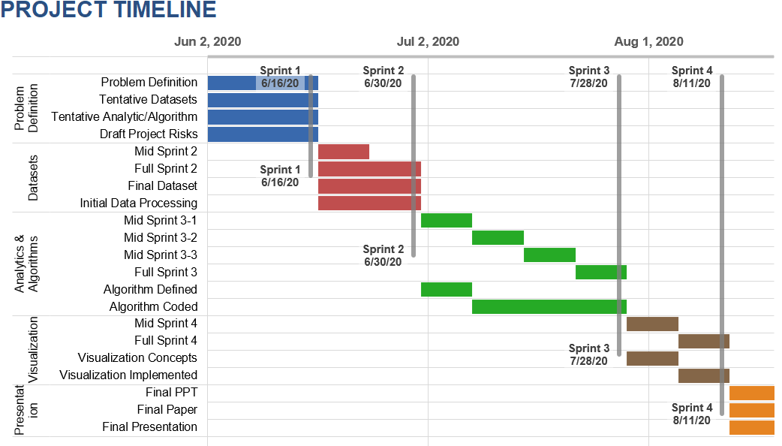
Team autoencoders– Project Schedule

Slide 10
Team autoencoders – youtrack
CATEGORY | TASK | START | END
Problem Definition | Problem Definition | 6/2/20 | 6/16/20
 | Tentative Datasets | 6/2/20 | 6/16/20
 | Tentative Analytic/Algorithm | 6/2/20 | 6/16/20
 | Draft Project Risks | 6/2/20 | 6/16/20
Datasets | Mid Sprint 2 | 6/17/20 | 6/23/20
 | Full Sprint 2 | 6/17/20 | 6/30/20
 | Final Dataset | 6/17/20 | 6/30/20
 | Initial Data Processing | 6/17/20 | 6/30/20
Analytics & Algorithms | Mid Sprint 3-1 | 7/1/20 | 7/7/20
 | Mid Sprint 3-2 | 7/8/20 | 7/14/20
 | Mid Sprint 3-3 | 7/15/20 | 7/21/20
 | Full Sprint 3 | 7/22/20 | 7/28/20
 | Algorithm Defined | 7/1/20 | 7/7/20
 | Algorithm Coded | 7/8/20 | 7/28/20
Visualization | Mid Sprint 4 | 7/29/20 | 8/4/20
 | Full Sprint 4 | 8/5/20 | 8/11/20
 | Visualization Concepts | 7/29/20 | 8/4/20
 | Visualization Implemented | 8/5/20 | 8/11/20
Presentation | Final PPT | 8/12/20 | 8/20/20
 | Final Paper | 8/12/20 | 8/20/20
 | Final Presentation | 8/12/20 | 8/20/20

Slide 11
Team autoencoders – Risks and Planned Mitigations
Risk Name | Description | Probability | Impact | Mitigation
Unavailable Compute resource | A lack of compute resources will leave us unable to conduct our CCN construction | Low | High | Alternative resources available through university and commercial means.
Unavailable internet access | Unable to access compute or communications channels | Low | High | Persistent internet outages unlikely, will seek alternative access points.
Inadequate team communication | Inability to communicate with team during work effort | Low | Low | Multiple communications channels, BB, Slack, email, phone, YouTrack
Inadequate stakeholder communication | Inability to get feedback and requirements from sponsors | Low | Low | Multiple communications channels, BB, email, phone, YouTrack.

