Slide 1
What is Software Testing?
Testing is the process which includes the set of activities to make sure software application/product is working as per clients requirements.
Why is Software Testing Important?
Testing is important because software bugs could be expensive or even dangerous. Software bugs can potentially cause monetary and human loss, history is full of such examples.
In April 2015, Bloomberg terminal in London crashed due to software glitch affected more than 300,000 traders on financial markets. It forced the government to postpone a 3bn pound debt sale.
Nissan cars have to recall over 1 million cars from the market due to software failure in the airbag sensory detectors. There has been reported two accident due to this software failure.
Starbucks was forced to close about 60 percent of stores in the U.S and Canada due to software failure in its POS system. At one point store served coffee for free as they unable to process the transaction.
Some of the Amazon’s third party retailers saw their product price is reduced to 1p due to a software glitch. They were left with heavy losses.
Vulnerability in window 10. This bug enables users to escape from security sandboxes through a flaw in the win32k system.
In 2015 fighter plane F-35 fell victim to a software bug, making it unable to detect targets correctly.
China Airlines Airbus A300 crashed due to a software bug on April 26, 1994, killing 264 innocent live
In 1985, Canada's Therac-25 radiation therapy machine malfunctioned due to software bug and delivered lethal radiation doses to patients, leaving 3 people dead and critically injuring 3 others.
In April of 1999, a software bug caused the failure of a $1.2 billion military satellite launch, the costliest accident in history
In may of 1996, a software bug caused the bank accounts of 823 customers of a major U.S. bank to be credited with 920 million US dollars.

Slide 2
What is Manual Testing?
Manual Testing is a type of Software Testing where Testers manually execute test cases without using any automation tools.
Manual testing is the most primitive of all testing types and helps find bugs in the software system.
Any new application must be manually tested before its testing can be automated. Manual testing requires more effort, but is necessary to check automation feasibility.
Manual Testing does not require knowledge of any testing tool.

Slide 3

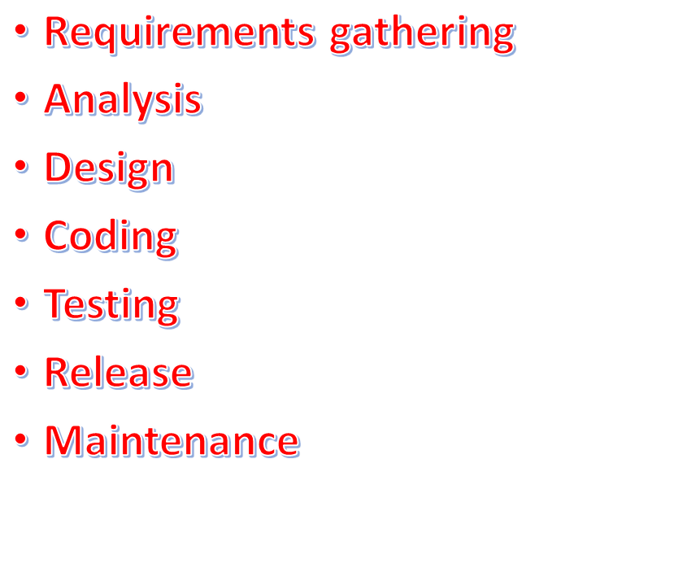
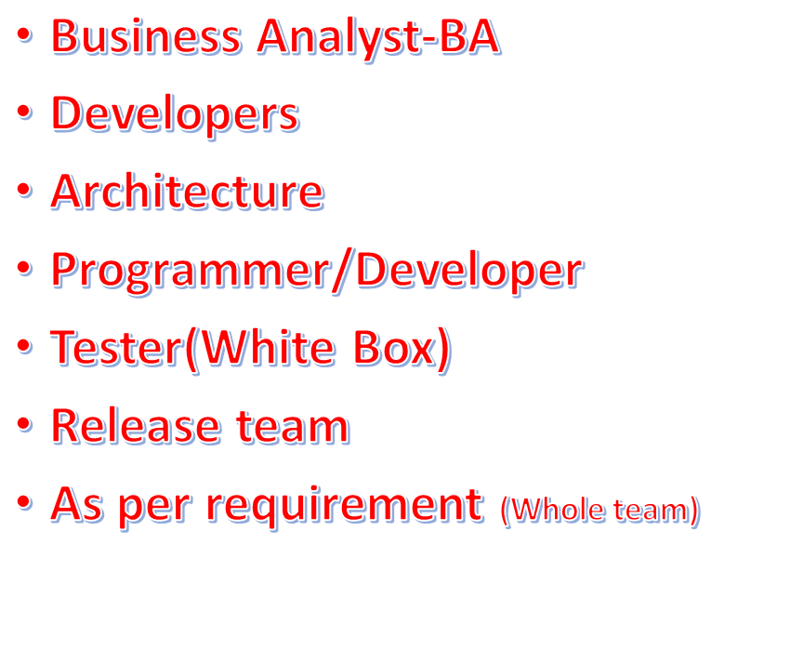

Slide 4


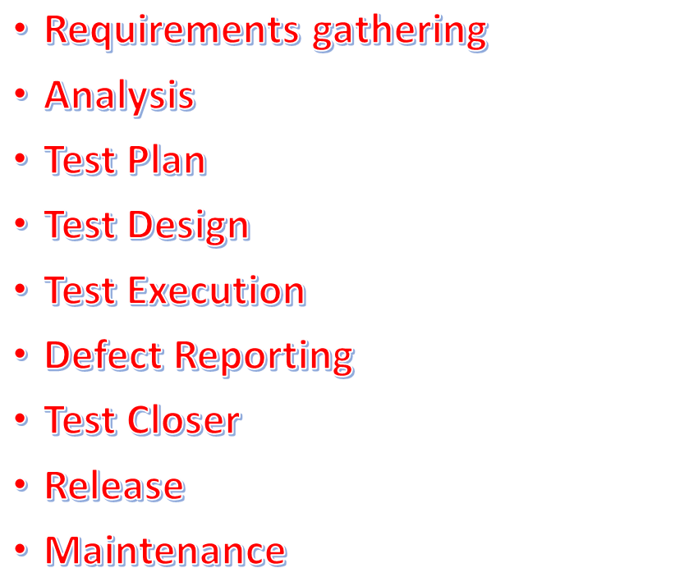
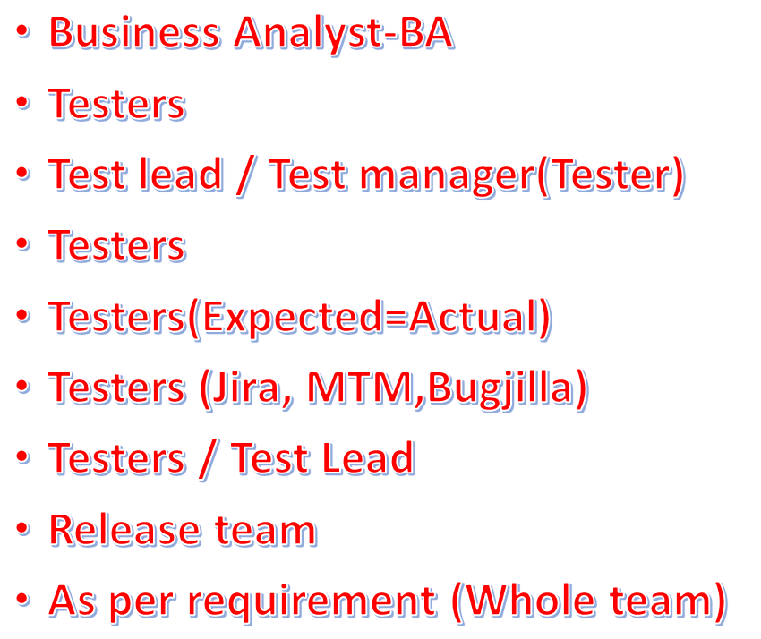

Slide 5

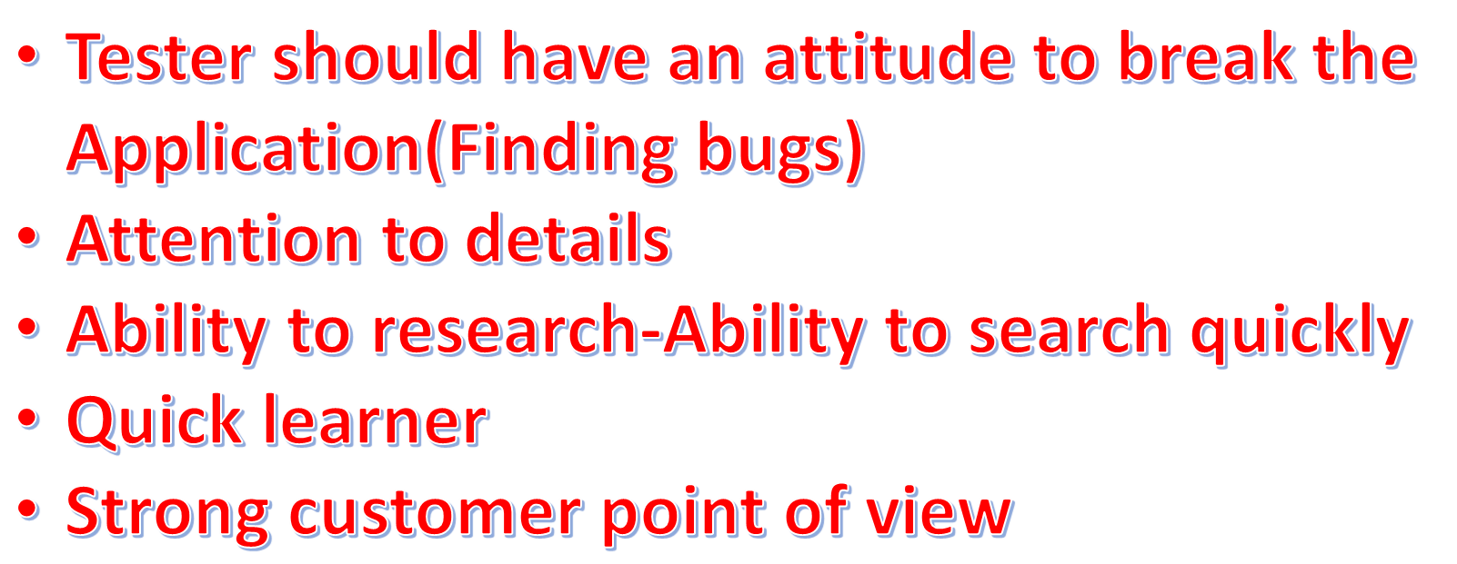

Slide 6

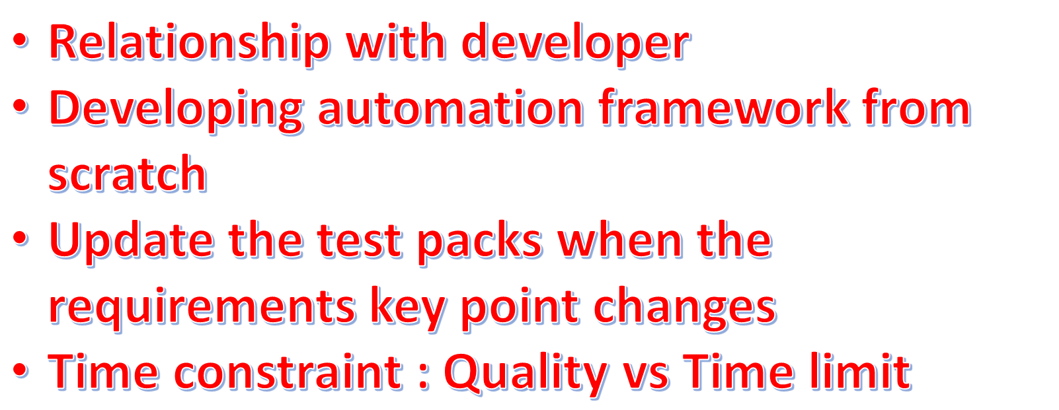

Slide 7
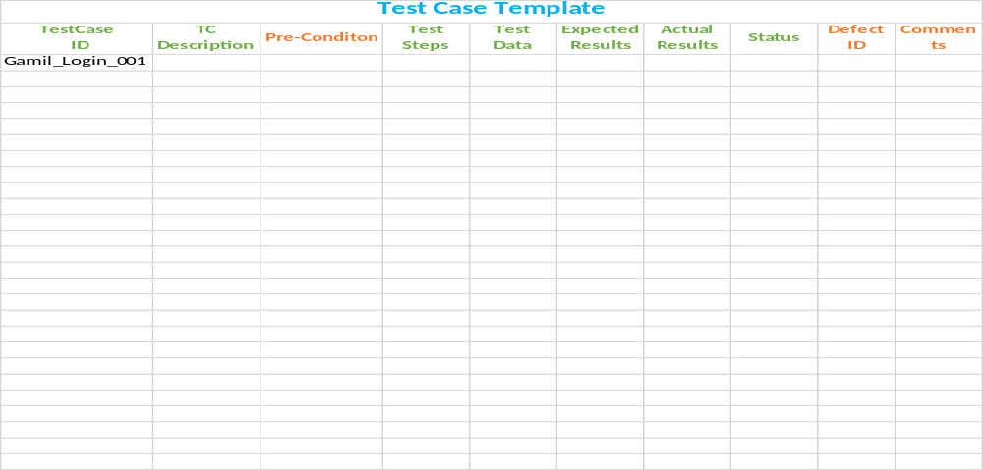

Slide 8
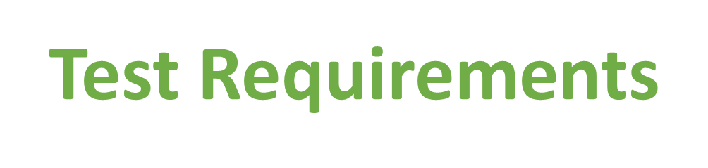
As we don’t have the official Google requirements for the login screen. We’ll come up with our own requirement set for the login screen. We’ll write the scenario based on these requirements.
User should be logged in with valid credential.
User should NOT be logged in with INVALID credential.
Username should contain letter, number and period.
Username should not be left blank.
Username should not be more than 40 characters.
Username should not start with or contain any symbols.
Password should be at least 6 characters.
Password should contain combination of letter, numbers and symbols.
Password should not contain spaces and period.
Password should not be more than 40 characters.

