Slide 1

Test plan is the high level document, which explains the roadmap of the project, which is describing the scope, approach, resources and schedule of intended test activities.
Test Plan is a dynamic document. Test Plan is more or less like a blue print of how the testing activity is going to take place in a project.
A document which will give you 4 answers:
  Who ? - who will test it ?
  When ? - when to start and finish testing?
  How ? - how to test?
  What? - what needs to be tested? - what is the scope? - what is timeline?
Who will make it? - Test Manager or QA (sometimes)

Slide 2
ELEMENTS OF TEST PLAN
Test Plan ID:
Scope and Objective: what can be tested and what can’t ?
Test Items: How many functionalities/features in total we gonna test ? e.g.. 10
Features to be tested: 6
Features not to be tested: 4
Test Approach: Manual, Automation, Toolset
Test Schedule: Task Estimation
Entry Criteria: When to start testing?
Exit Criteria: When to stop testing?
Roles and Responsibilities: who will do what ?
Staff and Training: If any training is required ? plan ahead
Risk Assumptions and Management: What are the risk associated and how to resolve them. Risk identification—> Risk impact analysis —>Risk Mitigation

Slide 3


Slide 4
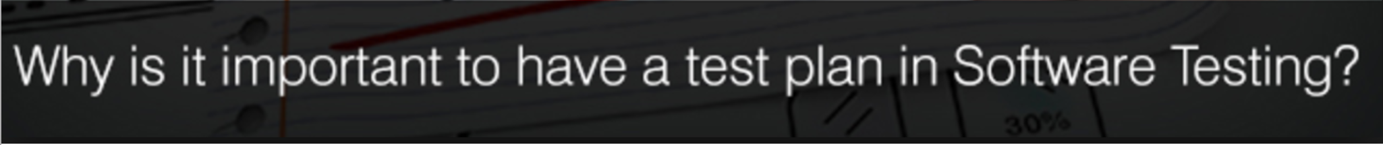
Planning makes a task execution in a systematic manner: No matter which situation we are dealing with, we can make it simpler by proper planning (as it gives an ideal path for the execution process).
Test plan for finding a suitable way to execute the testing process: Test plan give an inside look of the project and hence helping in developing a better testing approach.
We can avoid loopholes: With test plan we can presume and assume most of the upcoming uncertain risks/issues of the application.
Efficient testing can be achieved with test plan: by eliminating unnecessary tasks, processes from the application
Effort will be minimised and productivity will be maximised: by avoiding unnecessary iterative processes which in turn reduce the effort and time

Slide 5
Sprint:
A sprint is a set period of time during which specific work has to be completed and made ready for client.
Here is a summary what’s going on during
What does the product owner do during a sprint planning meeting
Product owner go on each of the user story, define its scope.
Explain the team what to be done.
Team asked question to verify their understating and concepts.
Once user story is understood, team start to the effort estimation, which mean estimating how long it will take to complete.
Some team use “planning poker” to spark the discussion, but its optional.
Team members can choose story points or hours to estimate the story (though story points are recommended).
Task breakdown is done separate out of sprint planning to better utilize the Product Owner and other team members.

Slide 6
Meetings in Aglie
Sprint Planning (2-6Hrs)
  Agreed and verified about the User Stories that will be delivered in the Sprint.
  Add all the team members' capacity, days off.
  Assigned the User Stories to team members.
  Planning individual tasks for all team members that respect the capacity for the Sprint (Green).
Daily Stand-up (every day 15 min in morning)
  What they did yesterday that can help the team to successfully deliver items from the Sprint Planning.
  What they are going to do today that will help the team to finish the Sprint.
  Are there any blocking points or impediments in their way?
Backlog Grooming/Refinement (0.5- 2 hrs, 1-2 Times per Week)
  Remove obsolete items (User Stories) that are no longer needed.
  Add new items, if this is necessary to deliver the Sprint.
  Refinement of the description or title.
  Add initial or additional acceptance criteria.
  Estimate the items.
  Prioritize the items.

Slide 7
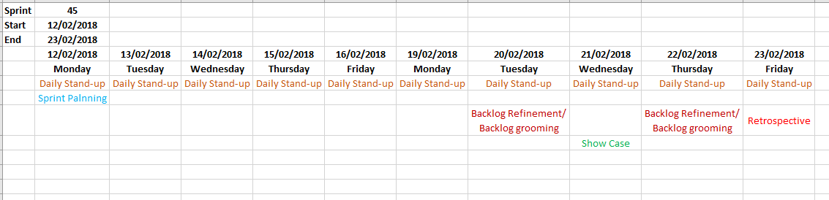
Sprint Review/Showcase Meeting at the End of the Sprint (2-4 Hours)
  has been done
  has not been done
  work that has been added
  And work removed from the sprint
Retrospective Meeting at the End of the Sprint (1 Hour)
  Explain what items have been "Done" and what has not been "Done."
  Discuss what went well during the Sprint, what problems the team ran into, and how those problems were solved.
  Demonstration of the functionality built during the Sprint.

Slide 8
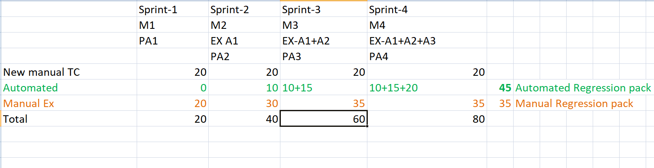
Sprint Regression Testing

Slide 9
Here are some of the best practices for agile sprint planning meeting in agile methodology
Create a recursive calendar invitation include all team members including development and QA.
Meeting invitation for agile sprint planning should be from the Product Owner.
Include agenda in the invitation, add the user stories link which should be included in the sprint
Always included more User stories to be included in the sprint then the team’ capacity. What it mean is go with the bigger chunk of backlog, as it might be possible that some of the user stories you might thing is ready for implementation is rejected by the team. So in that case, you will always have extra user stories to be included in the sprint.
Make sure the User story you are proposing from the sprint should be really defined well, all the use cases, functional requirements and condition of satisfaction are in detailed level and, at least, grooming once with some senior team members.
Order a tea/Coffee with something sweet, sometimes a coffee bribe does work or, at least, it keep the developers or QA not to fell a sleep.
Sprint Planning Meeting Rules In Agile Methodology
All team member product owner and scrum master need to be present
Understand the chick and pig rule in the scrum team.
Remember the sprint planning meeting is run by scrum master and he has the highest authority.
PO owner role in sprint planning meeting is only as a contributor, (s)he make active contributor in answering the question if the team have and explaining the user stories to the team.
Scrum master is the timekeeper, leader, facilitator, and coordinator of the agile sprint planning meeting
Scrum Sprint Planning Checklist In Agile Methodology

Slide 10
Practical checklist for sprint planning
Product Owner
Define sprint scope
Define each user story items in detail
Prepare notes or include them in the agenda the thing concern, the question for a particular user story so the team can come prepare and have those answers before the before.
Make sure backlog is in priority order
Describe definition of done for each user story and for sprint
Scrum Master
Practicalities are taken care of, since scrum master is the facilitator, make sure that all the merchandising are available for the meeting
Making sure video, audio conference is reserved and working
Pre-order coffee and light refreshment, “no coffee no code”
Enough post-it notes and markers, whiteboard etc.
Available capacity for the team (team members holidays, public holidays, etc)
Keep tracking the teams’ velocity vs the amount of work committed by the team
Development Team
Ask questions to clear any ambiguity or else “speak now or hold your … “
Do not commit more than you can not deliver
Remember to think of your personal availability for the coming sprint.
Taking part in technical discussion during estimation or planning poker

Slide 11
Gherkin
Cucumber executes your .feature files, and those files contain executable specifications written in a language called Gher kin. Gherkin is plain-text English (or one of 60+ other languages) with a little extra structure. Gherkin is designed to be ea sy to learn by non-programmers, yet structured enough to allow concise description of examples to illustrate business rul es in most real-world domains.
Here is a sample Gherkin document:
Feature: Refund item
Sales assistants should be to refund customers' purchases. This is required by the law, and is also essential in order to keep customers happy.
Rules: - Customer must present proof of purchase
- Purchase must be less than 30 days ago
Scenario: Jeff returns a faulty microwave
Given Jeff has bought a microwave for $100
And he has a receipt
When he returns the microwave
Then Jeff should be refunded $100
Feature
Scenario
Given, When, Then, And, But (Steps)
Background
Scenario Outline
Examples
“ ” ” (Doc Strings)
| (Data Tables)
@ (Tags)
# (Comments)

Slide 12
Feature: Keyword
  Each Gherkin file begins with a Feature keyword. Feature defines the logical test functionality you will test in this feature file. For e.g. if you are testing a payment gateway your Feature will become Payment Gateway
Background: Keyword
  Background keyword is used to define steps which are common to all the tests in the feature file.
Scenario: Keyword
  Each Feature will contain some number of tests to test the feature. Each test is called a Scenario and is described using the Scenario: keyword.
Given Keyword
  Given defines a precondition to the test. For e.g. In shopping website, assume that the Login page link is only present on the Home Page, so the precondition for clicking the Login link is that the user is at the Home Page.
When Keyword
  When keyword defines the test action that will be executed. By test action we mean the user input action.
Then Keyword
  Then keyword defines the Outcome of previous steps.
And Keyword
  And keyword is used to add conditions to your steps.
But Keyword
  But keyword is used to add negative type comments. It is not a hard & fast rule to use but only for negative conditions.
Scenario Outline: Keyword
  Scenario Outline keyword is used to remove repeated given steps from different scenario(s) in same feature.

Slide 13
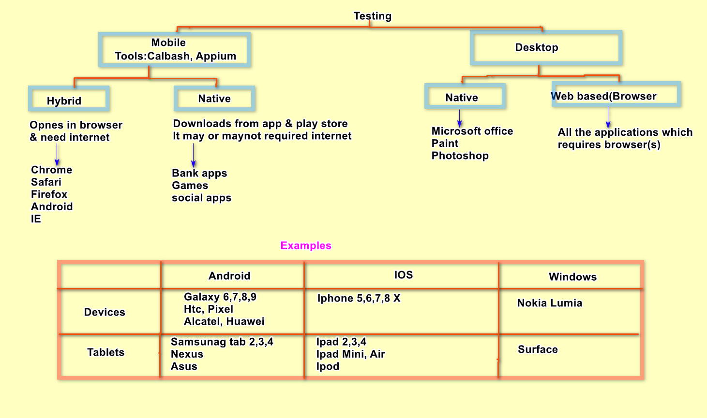
Mobile testing Basic Test cases scenario

