Slide 1
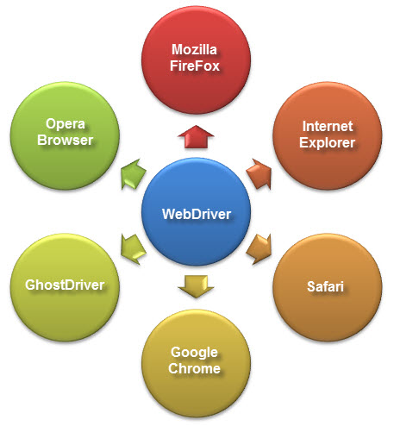
What is WebDriver?
WebDriver is a web automation framework that allows you to execute your tests against different browsers, not just Firefox (unlike Selenium IDE).

Slide 2

WebDriver also enables you to use a programming language in creating your test scripts (not possible in Selenium IDE).
You can now use conditional operations like if-then-else or switch-case
You can also perform looping like do-while.
Following programming languages are supported by WebDriver
Java
.Net
PHP
Python
Perl
Ruby
You do not have to know all of them. You just need to be knowledgeable in one. However, in this tutorial,
WebDriver interacts with page elements in a more realistic way. For example, if you have a disabled text box on a page you were testing, WebDriver really cannot enter any value in it just as how a real person cannot.
WebDriver can support the headless HtmlUnit browser
HtmlUnit is termed as "headless" because it is an invisible browser - it is GUI-less.
It is a very fast browser because no time is spent in waiting for page elements to load. This accelerates your test execution cycles.
Since it is invisible to the user, it can only be controlled through automated means.
Selenium RC cannot support the headless HtmlUnit browser. It needs a real, visible browser to operate on.
Limitations of WebDriver
WebDriver Cannot Readily Support New Browsers
Remember that WebDriver operates on the OS level. Also, remember that different browsers communicate with the OS in different ways. If a new browser comes out, it may have a different process of communicating with the OS as compared to other browsers. So, you have to give the WebDriver team quite some time to figure that new process out before they can implement it on the next WebDriver release.
However, it is up to the WebDriver's team of developers to decide if they should support the new browser or not.

Slide 3
Summary
WebDriver is a tool for testing web applications across different browsers using different programming languages.
You are now able to make powerful tests because WebDriver allows you to use a programming language of your choice in designing your tests.
WebDriver is faster than Selenium RC because of its simpler architecture.
WebDriver directly talks to the browser while Selenium RC needs the help of the RC Server in order to do so.
WebDriver's API is more concise than Selenium RC's.
WebDriver can support HtmlUnit while Selenium RC cannot.
The only drawbacks of WebDriver are:
It cannot readily support new browsers, but Selenium RC can.
It does not have a built-in command for automatic generation of test results.

Slide 4
Different Drivers
HTMLUnit and Firefox are two browsers that WebDriver can directly automate - meaning that no other separate component is needed to install or run while the test is being executed. For other browsers, a separate program is needed. That program is called as the Driver Server.
Browser | Name of Driver Server | Remarks
HTMLUnit | (none) | WebDriver can drive HTMLUnit without the need of a driver server
Firefox | (none) | WebDriver can drive Firefox without the need of a driver server
Internet Explorer | Internet Explorer Driver Server | Available in 32 and 64-bit versions. Use the version that corresponds to the architecture of your IE
Chrome | ChromeDriver | Though its name is just "ChromeDriver", it is in fact a Driver Server, not just a driver. The current version can support versions higher than Chrome v.21
Opera | OperaDriver | Though its name is just "OperaDriver", it is in fact a Driver Server, not just a driver.
PhantomJS | GhostDriver | PhantomJS is another headless browser just like HTMLUnit.
Safari | SafariDriver | Though its name is just "SafariDriver", it is in fact a Driver Server, not just a driver.

