Slide 1
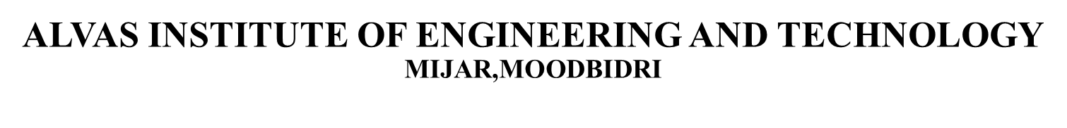
Phase 2 Presentation ON
LoRa and IoT based smart irrigation system
Guide:
Dr. Guruprasad B
Assistant Professor ,AIET
TEAM MEMBERS:
4AL19EC001 - A V VEDANTH
4AL19EC008 - ABHISHEK P
4AL19EC027 - DARSHAN S N
4AL19EC037 - JAISON V J

Slide 2
CONTENT
1. Introduction
2. Block diagram
3. Hardware description
4. Software description
5. Circuit diagram
6. Implementation and Result
7. Literature Survey
8. Conclusion
9. Road map
10. Reference

Slide 3
INTRODUCTION
Water resource one of the most important natural resource problem to be paid more attention in the world in 21st Century.
Irrigation method in traditional agriculture has low utilization of water resource with the development of IoT in this system.
In our project irrigation node sends data to cloud through LoRa gateways via wireless transmission. The system can be controlled manually and remotely by mobile applications.

Slide 4
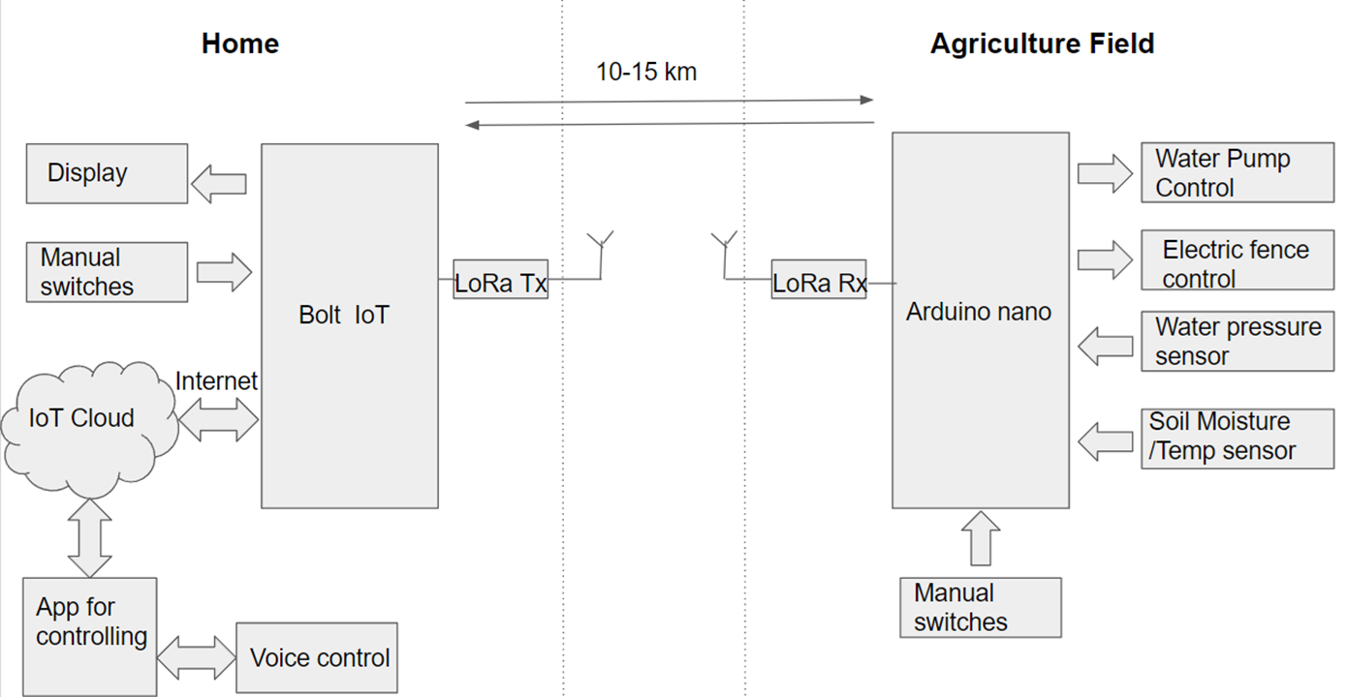
BLOCK DIAGRAM

Slide 5
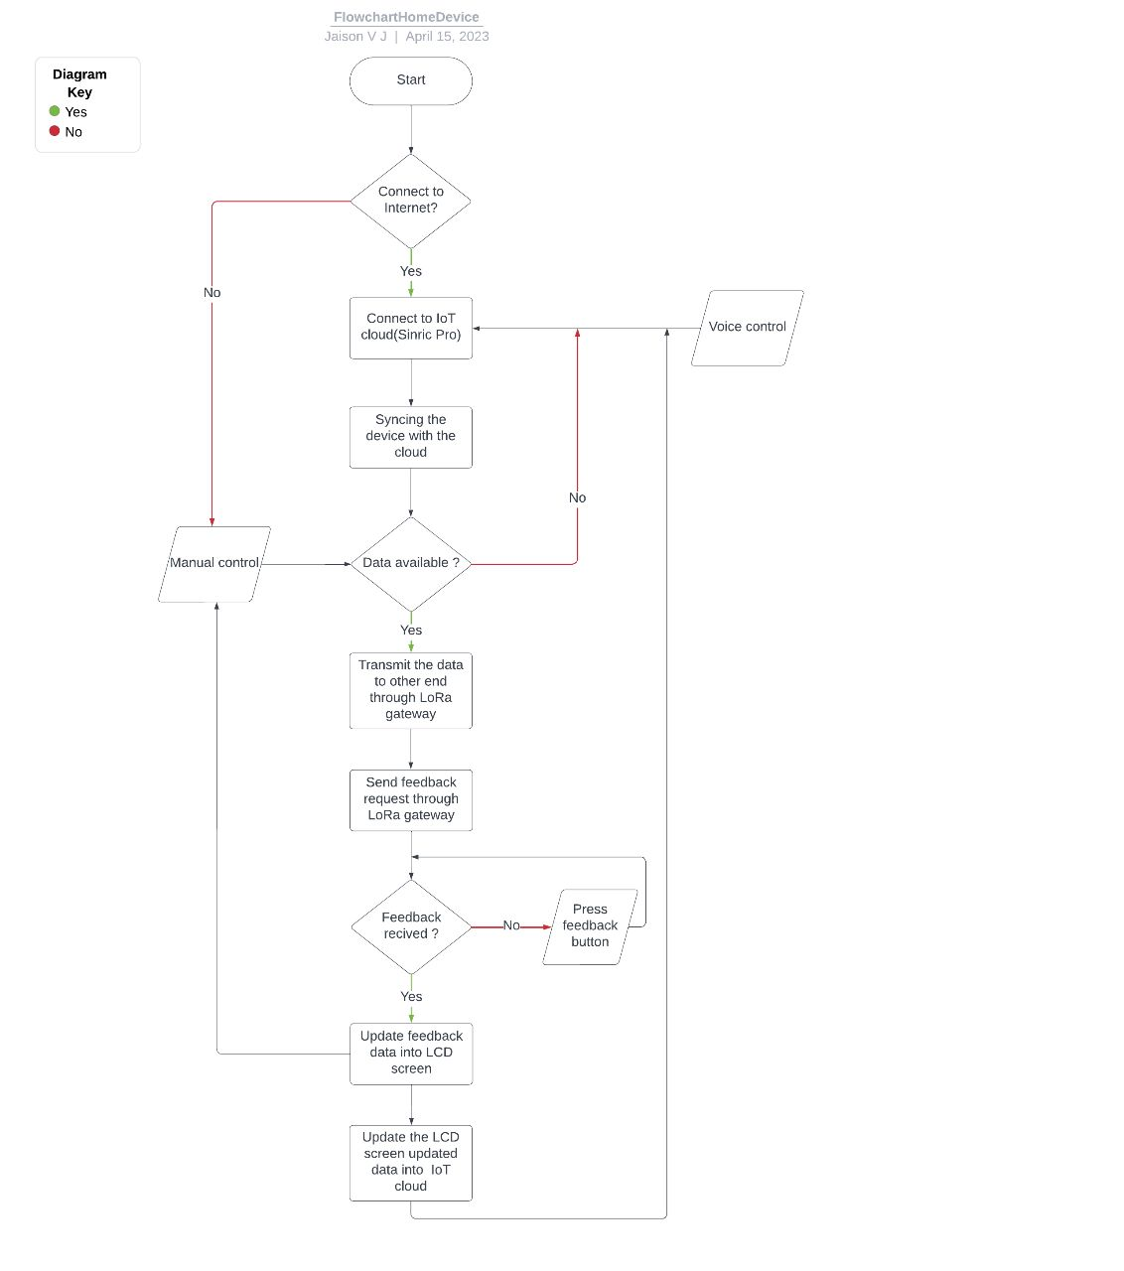
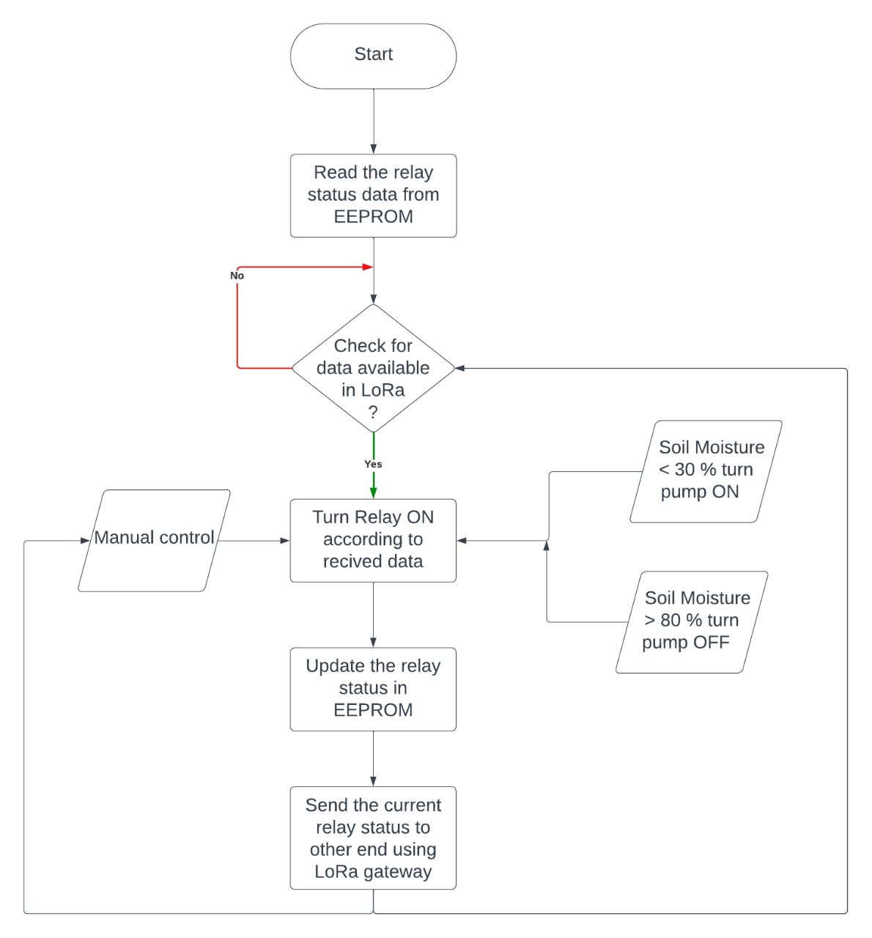
WORKING PRINCIPLE

Slide 6


HARDWARE DESCRIPTION
Lora Module REYAX RYLR998 - 1
ESP8266 NodeMCU - 1
1k Resistors - 2
4.7k Resistor - 1
10k Resistor - 1
5-mm LED - 2
0.96" OLED Display - 1
Push button - 5
Lora Module REYAX RYLR998 - 1
Arduino UNO - 1
5v 4-channel Relay Module - 1
2k Resistor - 1
4.7k Resistor - 1
5-mm LED - 1
Push Buttons or Switch - 4

Slide 7
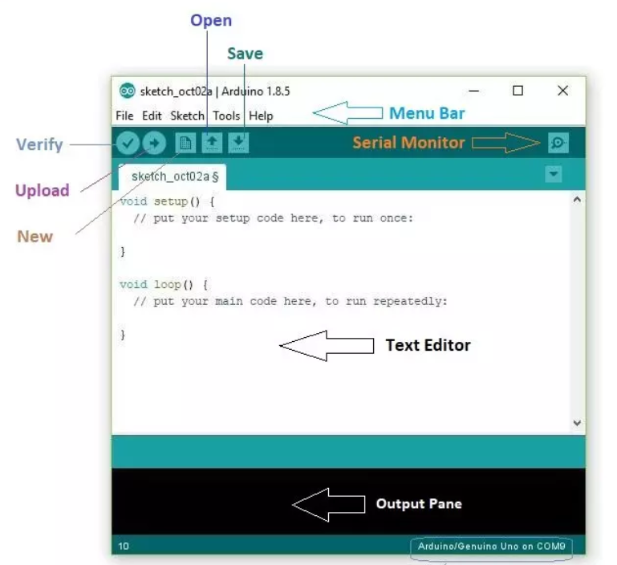
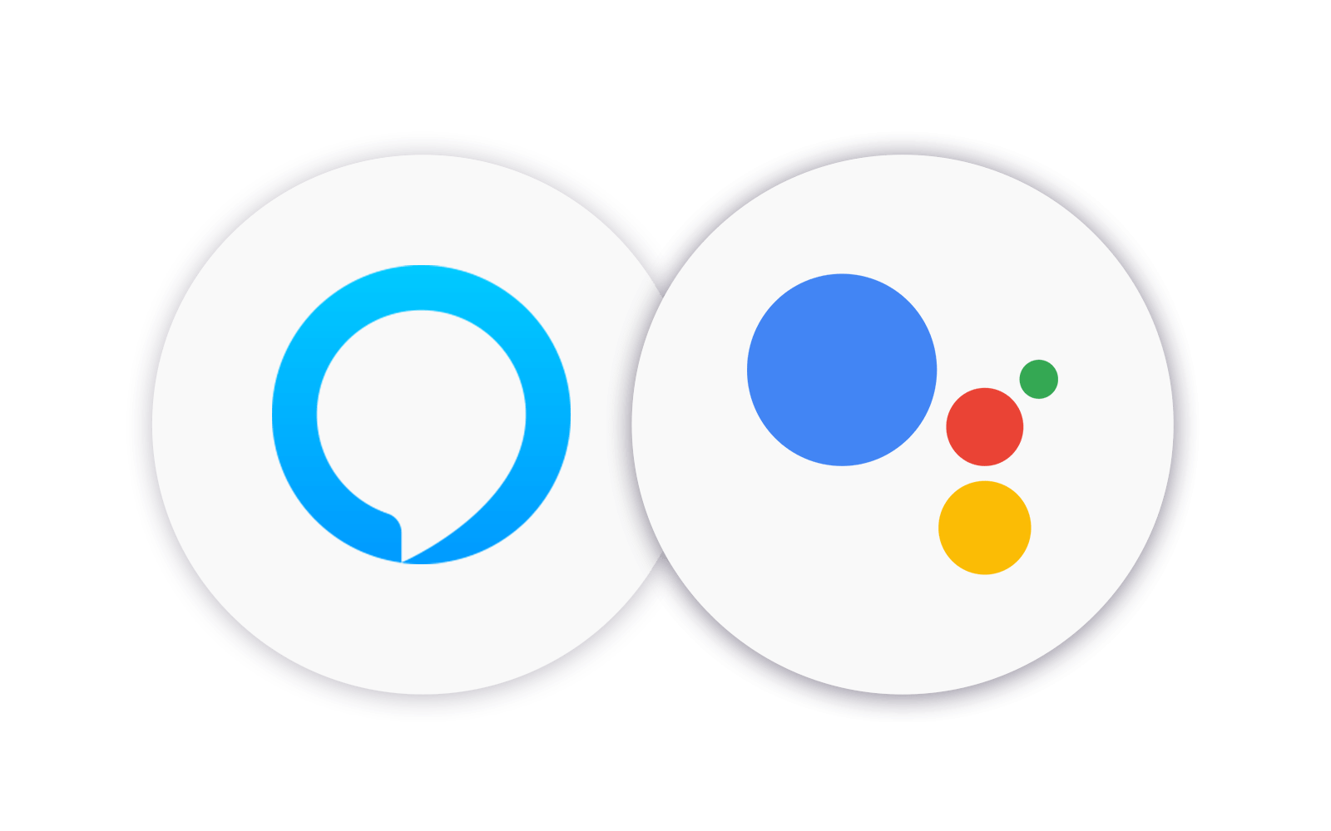
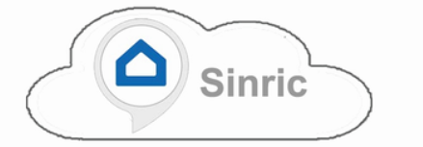
SOFTWARE DESCRIPTION
Arduino IDE (Integrated Development Environment) is an open-source software used for programming Arduino boards.
Sinric Cloud is a platform that enables the development of smart home applications, allowing users to control their smart devices.
Google Assistant and Alexa are popular voice assistants developed by Google and Amazon, respectively.

Slide 8
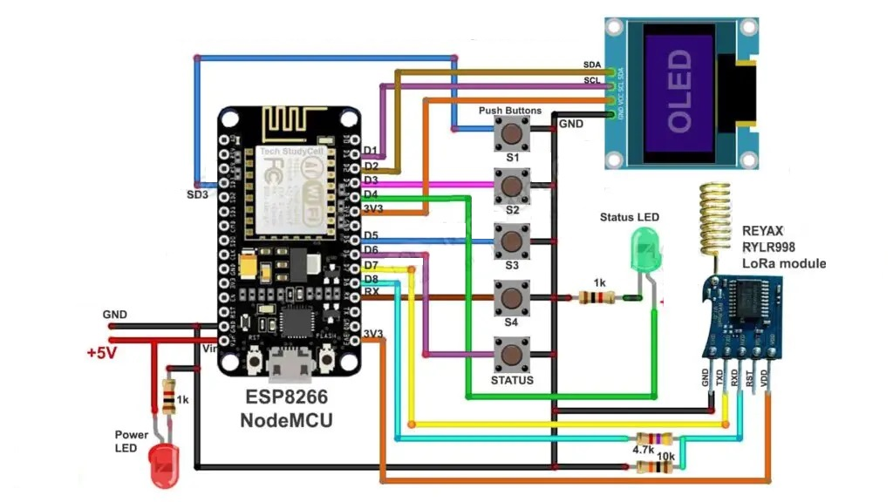
CIRCUIT DIAGRAM (HOME)

Slide 9
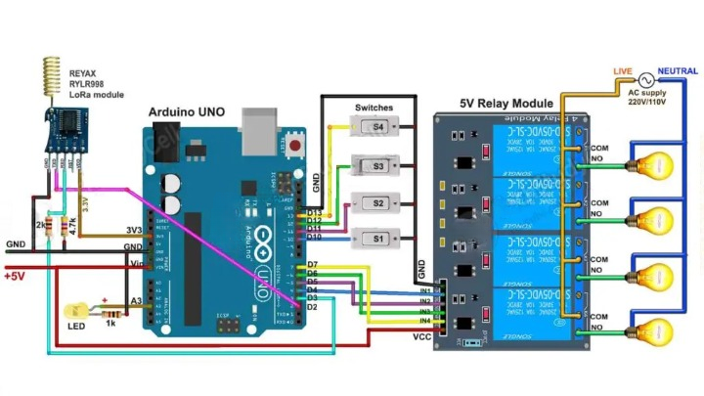
CIRCUIT DIAGRAM (FIELD)

Slide 10
BLOCK DIAGRAM
IMPLEMENTATION AND RESULT
ABSTRACT: The use of Internet of Things (IoT) and LoRa technologies to the implementation of smart farming practices with the purpose of improving agriculture. The goal is to enhance yield by reducing human participation in agricultural operations while keeping high accuracy and using minimum electricity. To do this, we developed a method to manage the flow of water into the fields depending on soil moisture levels, which are critical for crops. Temperature and humidity sensors are utilized to decide what the farmer needs to do. Using LoRa technology, which can reach up to 20 km in rural regions and up to 8 km in urban areas, the detected data is transferred over vast distances.
Department of Electronics and Communication Engineering
PROJECT OUTLOOK
TEAM MEMBERS:
1. A V VEDANTH - 4AL19EC001
2. ABHISHEK P - 4AL19EC008
3. DARSHAN S N - 4AL19EC027
4. JAISON V J - 4AL19EC037
PROJECT GUIDE:
Dr. Guruprasad B
Assistant Professor ,AIET

Slide 11
LITERATURE SURVEY
Daveev [1],This paper shows the useful methods that can be used in smart agriculture system with the help of LoRa technology. The sensor nodes are connected with LoRa modules in order to transfer the sensor data to the processing system, in order to upload it on cloud platform.
C. Bouras [2], Wi-Fi & LoRa as wireless technologies have been compared initially, however the end devices require high power consumption for processing and thus there is requirement of low power network technologies. Experiments carried out on real time basis indicate that LoRa could be an ideal option for building smart rescue monitoring

Slide 12

3. C. S. Gaddam [3], This paper shows the WAN technology i.e LPWAN is popular and leading technology created for IoT networks. LPWAN is wireless based WAN technology that enables Low power consumption, long range, lower bandwidth with low bit rates.
4. A. Lavric [4], Long-range transfer of information is enabled by LoRa modules, with a low transfer rate. Considering the requirements this paper presents the evaluation of the LoRa technology in the field of IoT and Architecture requirements of LoRa WAN communication protocol have been discussed along with the evaluation of LoRa modulation performance.

Slide 13
CONCLUTION
In conclusion, a LoRa and IoT-based smart irrigation system can offer many benefits for farmers and other stakeholders in the agriculture industry.
By using this model labour cost reduced, increases the crop yield, increase the efficiency, improves the plant health and improves the monitoring and controlling.
The benefits of long-range, low-power wireless communication make LoRa technology to use at many cases.

Slide 14
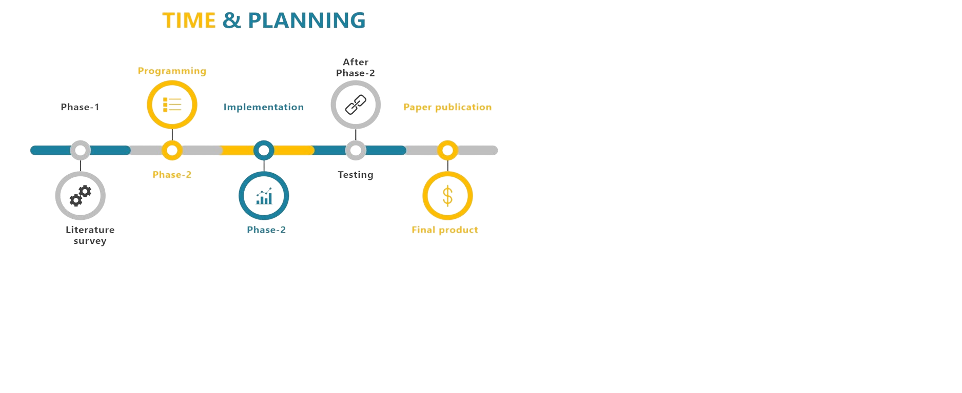

Slide 15
REFERENCES
Daveev, K. Mitreski, S. Trajkovic, V. Nikolovski and N. Koteli, “IoT agriculture system based on LoRa WAN," 2018 14th IEEE International Workshop on Factory Communication Systems (WFCS), Imperia, 2018.
C. Bouras, A. Gkamas, V. Kokkinos and N. Papachristos, "Using LoRa Technology for IoT Monitoring Systems," 2019 10th International Conference on Networks of the Future (NoF), Rome, Italy, 2019.
C. S. Gaddam and M K. Rai, "A Comparative Study on Various LPWAN and Cellular Communication Technologies for IoT Based Smart Applications," 2018 International Conference on Emerging Trends and Innovations In Engineering And Technological Research (ICETIETR), Ernakulam, 2018,
A. Lavric and V Popa, "Internet of Things and LoRa™ Low-Power Wide-Area Networks: A survey," 2017 International Symposium on Signals, Circuits and Systems (ISSCS), Iasi, 2017

Slide 16
THANK YOU

