Slide 1

SMART INDIA HACKATHON 2026
Vayoo
A Unified Gerontological Care Platform for
Independent, Safe and Connected Elderly Living
Problem Statement ID – SIH1778
Innovative Gerontological Care Solutions: Designing the Future of Elderly Care Products
Theme – «confirm on portal»
PS Category – Software
Team – Unmatrix
Team ID – «confirm on portal»
Working prototype — 15 database migrations, 162 tests passing

Slide 2
IDEA TITLE
Unmatrix
Proposed Solution
Built and working: two paired mobile apps + one care-team console.
PROBLEM — an elderly parent lives alone; the family is in another city.
SOLUTION — Vayoo connects them: emergency, health record, and consent, in one place.
Four pillars: Emergency SOS · Health & medicines · Care marketplace · Social wellbeing.
How It Addresses the Problem
Emergency — SOS reaches family instantly, even on a locked, force-killed phone.
Remote care — family can order & pay for medicines without holding the account.
Fragmentation — vitals, medicines, reports and appointments live in one record.
Innovation & Uniqueness
Consent is the core design: senior grants access per category, revokes instantly.
Security lives in the database, not the app — unbypassable by any client.
Not a concept: 15 database migrations, 162 automated security tests — already passing.

Slide 3
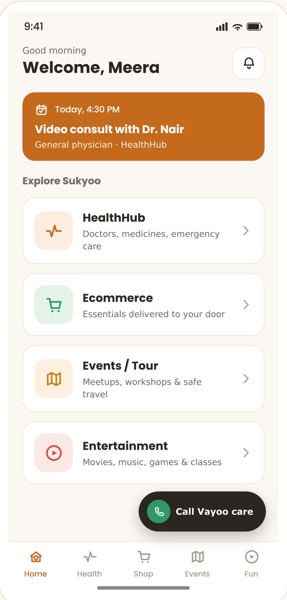
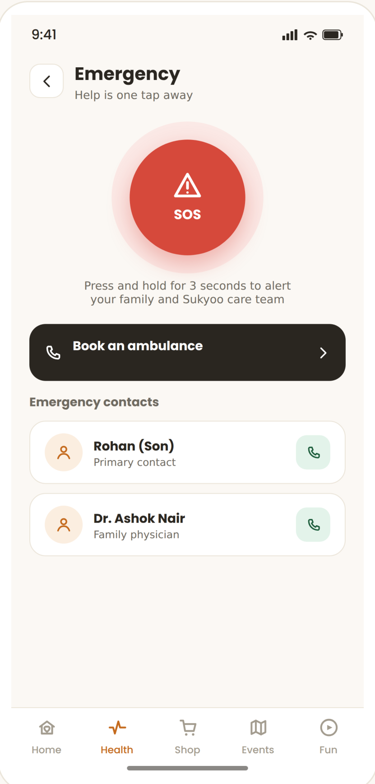
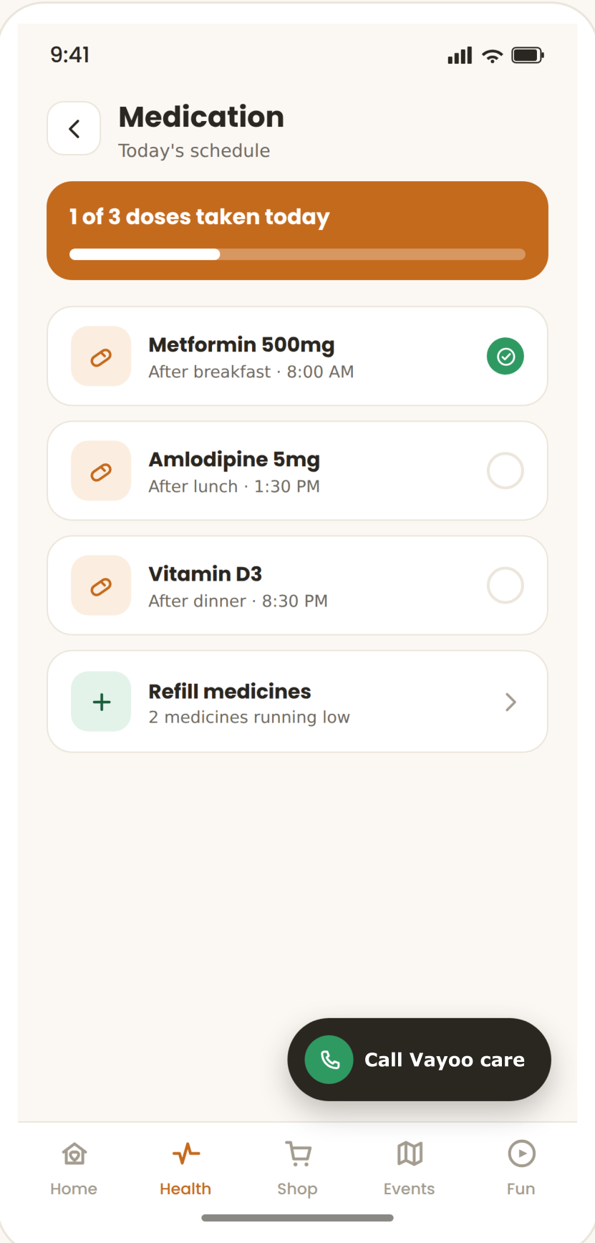
TECHNICAL APPROACH
Unmatrix
Technologies Used
React Native (Expo) — one codebase, Android + iOS
Next.js — the care-team console
Supabase (PostgreSQL) — row-level security on every table
Serverless functions — SOS dispatch, escalation, payments
FCM + Apple Push — the alert, on both platforms
Agora · Razorpay · MSG91 — calls, payments, SMS fallback
How It Works — The SOS Flow
Senior presses SOS
↓ location captured, alert raised
↓ push sent to every family device
↓ full-screen alert — wakes a locked phone
↓ no response? auto SMS / WhatsApp
An ordinary notification cannot do this — ours does.
Built on real security, not a demo shortcut: 162 tests attack it in CI.
Working prototype — senior app
Home hub · Emergency SOS · Medication adherence

Slide 4
FEASIBILITY AND VIABILITY
Unmatrix
Feasibility
Already built: 15 migrations, 162 tests passing, both apps compile clean.
Zero-cost pilot — free-tier infrastructure; real spend starts only at scale.
Rollout through hospitals, clinics, NGOs and senior associations, city by city.
Revenue: subscriptions + marketplace commission + partner tie-ups.
Risks → Our Strategy
Silent alert failure → delivery is tracked; console flags it, SMS auto-fires.
Elderly onboarding → big buttons, plain language, three text sizes.
Data breach → database-enforced access, encrypted storage, 162 tests.
Insider misuse → every staff health-read needs a logged reason.

Slide 5
IMPACT AND BENEFITS
Unmatrix
Impact
Seniors — help that reaches them, and privacy that stays theirs.
Families — no more guessing; act on real information, from any city.
Health system — earlier intervention, one record instead of a plastic bag.
Benefits
Social — dignity and independence, not institutional care.
Economic — fewer hospitalisations; local pharmacies & labs gain demand.
Environmental — fewer repeat trips; digital records, not paper.
Policy Alignment
Built around the DPDP Act 2023 and Telemedicine Guidelines 2020.
Future scope: Elderline 14567, 108, and ABDM integration.

Slide 6
RESEARCH AND REFERENCES
Unmatrix
References
UNFPA India Ageing Report 2023 — elderly population & 2050 projection.
Census of India 2011 — internal migration data.
LASI (IIPS) — elderly living arrangements & health needs.
Digital Personal Data Protection Act, 2023.
Telemedicine Practice Guidelines, 2020 (MoHFW).
National Policy on Older Persons — MoSJE.
Elderline 14567 · 108 · ABDM / ABHA.
Add the exact page / link for each source above before you submit.

