Slide 1
Traffic Potential

Slide 2
How do we increase our traffic?
Avvo’s organic traffic growth has slowed down and historically high traffic growth is unlikely to return.
We need to develop traffic growth strategies for specific geographic regions and practice areas.
This project identifies markets that have growth potential in terms of visits and value delivered to advertisers

Slide 3
Methodology
Data sources: Census demographics and internal traffic.
Analysis: Group counties by similarity, based on demographic metrics related to practice area.
Estimation: In each county cluster, assign a target market as the one that is at the 70th percentile of visits per capita.
Since all counties in the cluster are expected to be demographically similar, potential sessions are calculated by setting visits/capita to the target.
ACV is assumed to increase with visits, but with diminishing returns.

Slide 4
Opportunity

Slide 5
Findings
Average ACV increase is 21%, from an increase in visits of 24%.
Largest absolute potential is in PAs that are already large, but in terms of growth rates, immigration is high and criminal defense is lower.
More detail on Tableau
Notes:
Criminal defense has a relatively small percent increase, but is the largest in absolute ACV.
San Bernardino, CA has the largest ACV potential ($16,000). Followed by Riverside, CA ($13,000) and St. Louis, MO ($11,000).
For Divorce, Los Angeles, CA has the most potential - $10,000
For DUI & DWI, St. Louis, MO ($8,400) and Bernalillo, NM ($7,800)
For Immigration, Maricopa, AZ - $4200
For Real Estate, Los Angeles ($4,000) and Riverside, CA ($3,900)

Slide 6
Findings: Top Counties
Criminal defense has a relatively small percent increase, but is the largest in absolute ACV.
Marion, IN, Erie NY
For Divorce, Los Angeles, CA and Wayne, MI
For DUI & DWI Wayne, IN and Bernalillo, NM and Clark NV
For Immigration, Maricopa, AZ - $4200
For Real Estate, Dallas, TX

Slide 7
Findings: Pops
Most efficient (ACV/session) is DUI Bernalillo, NM at $92 and DUI Cumberland NC at $66
Areas that pop out
Los Angeles, CA and Baltimore,MD for Divorce
Harris, TX and Maricopa, AZ for Real Estate
Cook, IL for Immigration
Clark, NV and St. Louis, MO for DUI and Criminal Defense
San Bernardino, CA for Criminal Defense

Slide 8
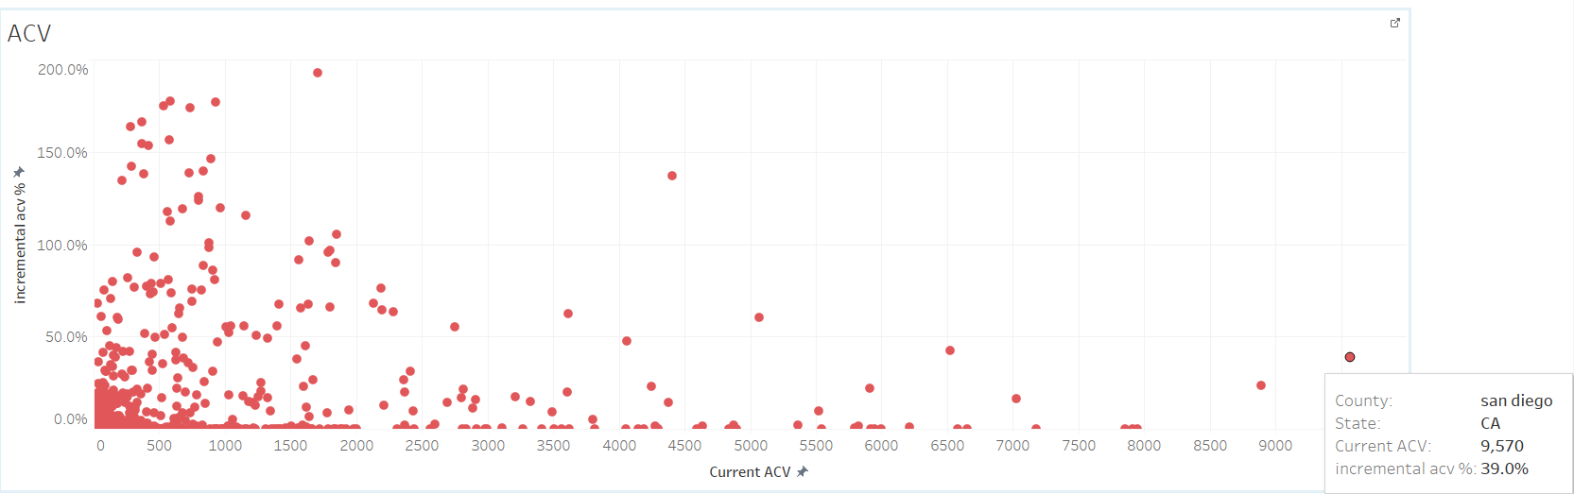
Applying this data, Example 1
San Diego county has large potential in Divorce & Separation
Look at “San Diego divorce attorney”
And compare to “La Jolla divorce attorney”
La Jolla’s median income is $97K, compared to $67K for San Diego, so we should enhance our SEO efforts for La Jolla.

Slide 9
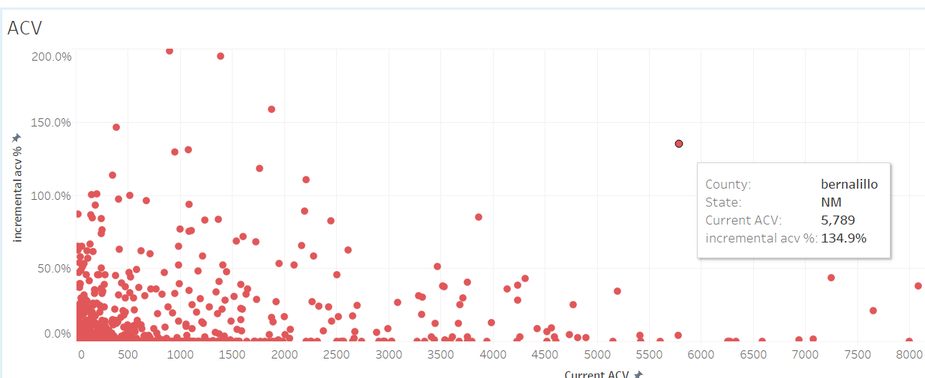
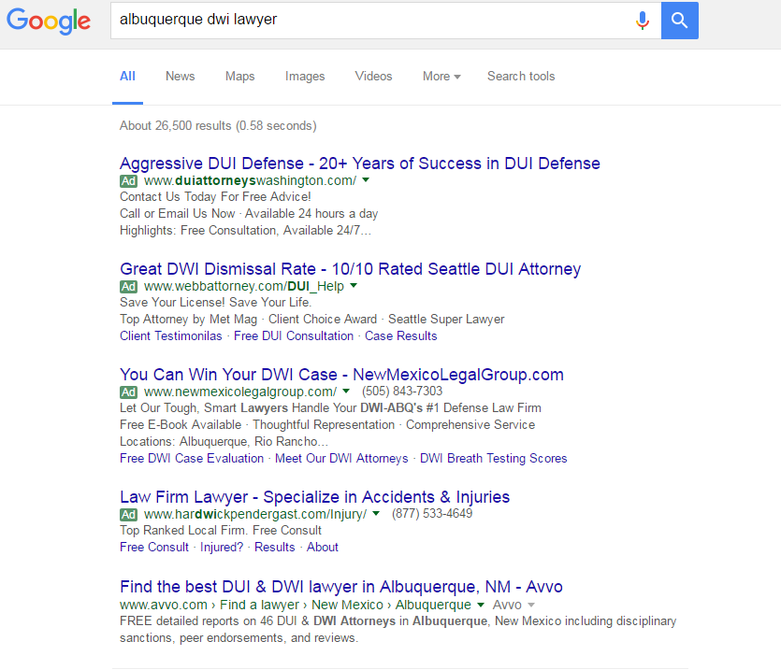
Applying this data, Example 2

Slide 10
Applying this data, Example 2
Why is there so much potential in Bernalillo County if we’re already doing great in SEO?
Bernalillo differs from higher ranking counties in the cluster in that the number of advertisers on Avvo is smaller. This could indicate lower awareness generally in the county.
Corroboration of potential by demographic trends:
Population growth is expected to be high over the next five years, especially West of the Rio Grande.
Job growth is expected to be 33% over the next ten years.
Crime rates are well above the US average.
NHTSA ranked Bernalillo 2nd worst in the country for DUI in 2014 (up from 19 in 2013 and 29 in 2012).
We are currently very efficient in generating ACV in DUI Bernalillo, with ACV/session = $92. Modest increases in traffic should result in good ACV gains.

Slide 11
Not So Fine Print
This is version 1 of a methodology that is still under improvement.
The confidence interval around the estimates could be +/- 5%.
Additional demographic data will make the estimates more accurate for some counties.
Estimates are based on current performance (current conversion efficiency, current market penetration in healthy markets).
They can be thought of as a lower bound.

Slide 12
Enhancements
Get more data – refine estimates by including additional data, not limited to: quality of traffic, non-census county statistics, Avvo SEO rankings.
Expand to all practice areas.
Use this data to identify prime markets.
Smarter diagnosis to identify factors that are holding growth back.

