Slide 1
Final Project Title
Delivering an ML/AI Strategy, AI for Business Leaders, Udacity
Athari Alshehhi, December - 2024
© 2024 Udacity.

Slide 2
Executive Summary
Purpose of Project
The project aims to leverage Machine Learning (ML) and Artificial Intelligence (AI) technologies to enhance business processes, optimize operations, and achieve a competitive advantage for TeknoVe.
Methodology
Over 10 potential use cases were evaluated for feasibility and impact.
Narrowed down to 4 initial use cases using 5V analysis.
Further refined to 2 high-priority use cases through prioritization grids, resource constraints analysis, and operational considerations.
Path Forward
Identified two actionable use cases: "Predictive Maintenance" and "Customer Churn Prediction.“
Outlined implementation requirements and next steps, including data preparation, model development, and pilot testing.

Slide 3
I Began with Four Use Case Ideas
Use Case 1: Predictive Maintenance
Sensors monitor machinery to reduce downtime and maintenance costs through anomaly detection.
Use Case 4 : Fraud Detection
Real-time transaction analysis to identify and prevent fraudulent activities.
Use Case 2 : Customer Churn Prediction
Predict customer churn using historical data and trigger interventions to improve retention.
Use Case 3 : Supply Chain Optimization
Optimize inventory and supplier performance using data-driven algorithms.

Slide 4
I Assessed Feasibility vs. Impact for All Cases
UC 3
UC 1
UC 1
UC1: <Predictive Maintenance>
UC 2
UC2: <Customer Churn Prediction>
UC 3
UC3: <Supply Chain Optimization>
UC 4
UC 2
Impact
UC 4
UC4: <Fraud Detection>
low
low
Feasibility
high

Slide 5
Transforming Our Business Using ML/A with These Top Two Use Cases
Use Case 1 : Predictive Maintenance
By leveraging ML-based anomaly detection, we aim to reduce downtime and extend machinery lifespan, leading to cost efficiency.
Use Case 2 : Customer Churn Prediction
Improving customer retention through predictive insights enables personalized interventions and enhances customer satisfaction.
By executing on these two projects I believe we can drive growth and innovation for our business byleveraging cutting-edge technology and improving operational efficiency and become a(n) market-leading and sustainable business.

Slide 6
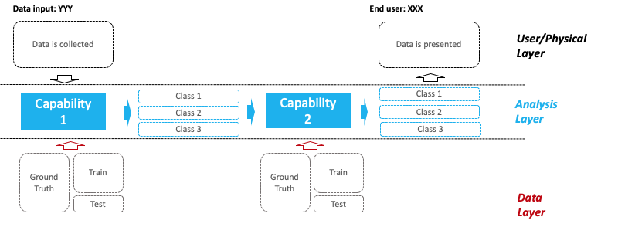
Use Case 1: Predictive Maintenance Deep Dive
Process Today
Manual maintenance scheduling
Downtime due to unplanned failures.
Example Architecture
Process Tomorrow
Sensors collect real-time data.
ML models predict potential failures.
Automated alerts trigger preemptive maintenance.
The impact of automation will be transformational thanks to innovative technology and streamlined processes!

Slide 7
Use Case 2 Customer Churn Prediction Deep Dive
Process Today
Reactive strategies for customer retention.
Limited insight into customer behavior.
Example Architecture
Process Tomorrow
ML models analyze customer data to predict churn.
Personalized offers or customer support is automatically triggered.
The impact of personalized marketing strategies will be significant thanks to data-driven insights and advanced analytics!

Slide 8
Risks / Mitigations
 | Use Case 1 : Predictive Maintenance | Use Case 2 : Customer Churn Prediction
Accuracy Definition | Concerns: Predictive accuracy may be low due to insufficient data or data quality. Plan: Conduct periodic tests of the model using fresh data to ensure accuracy. | Concerns: Unweighted analyses can lead to inaccurate results. Plan:Improve data quality by updating it regularly.
Underfitting/Overfitting Definition | Concerns: Overfitting may occur if the model relies heavily on training data. Plan: Use cross-validation techniques to fine-tune models. | Concerns: Underfitting may lead to inaccurate prediction of leakage risk. Plan:Use regularization techniques.
Ethical Concerns Definition | Concerns: Use sensitive data from sensors without ensuring privacy. Plan: Implement strict controls on data collection and use. | Concerns: Violation of customer privacy when using their personal data. Plan: Apply encryption and anonymization to sensitive data.

