Slide 1
AI For Business Leaders Course
Project Slides: Delivering an ML/AI Strategy
Athari Alshehhi, December - 2024
© 2024 Udacity.

Slide 2
AI for Business Leaders
Project Step 2C
First Prioritization Grid

Slide 3
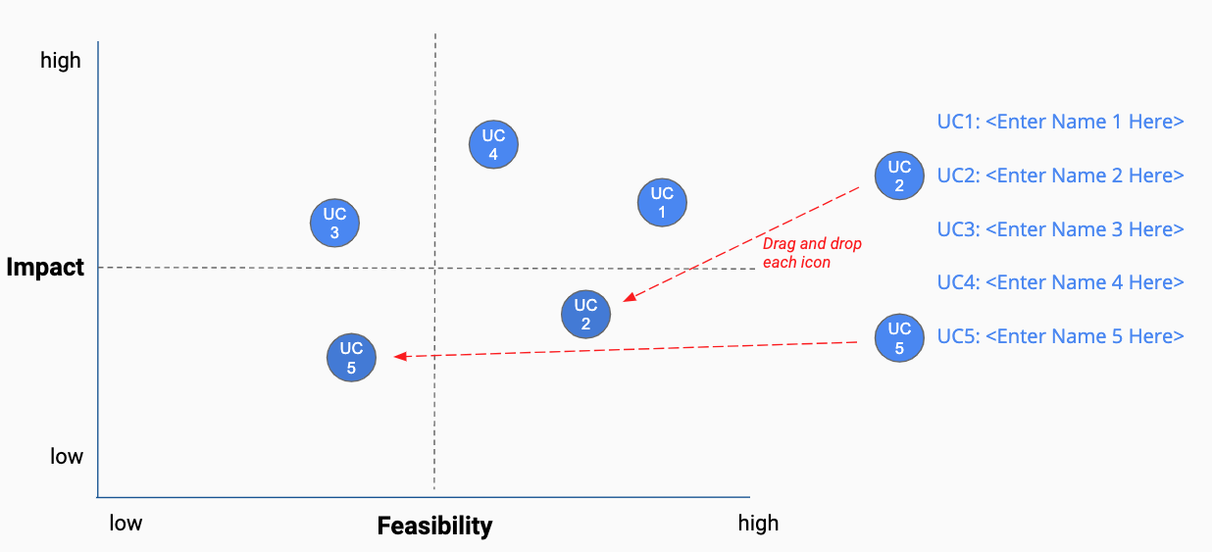
First Prioritization Grid
DIRECTIONS: For each of your use cases, review your answers to the 5V questions in Step 2A, and the operations you chose in Step 2B.
Then on the grid on the next slide, not this slide, move each blue use case icon to a place indicating how you see this use case’s impact and feasibility.
(Recall that the upper right quadrant is usually the most desirable, as it indicates we expect higher feasibility and greater impact.)
UC 2
Drag and drop icons for each use case
Remember to think about both axes!

Slide 4
First Prioritization Grid
(Follow directions on previous slide)
high
UC 3
UC 1
UC 1
UC1: <Predictive Maintenance>
UC 2
UC2: <Customer Churn Prediction>
UC 4
UC 2
UC 3
UC3: <Supply Chain Optimization>
Impact
UC 4
UC4: <Fraud Detection>
low
low
Feasibility
high

Slide 5
Now Prioritize and Eliminate Three Use Cases
1) Review the locations of your use cases on the grid on the previous slide. Remember we want to prioritize use cases for AI and ML that offer the greatest impact for the least difficulty.
2) Now in the grid on the previous slide change the color from blue to grey for one use case circle you want to de-prioritize.
3) This leaves your top three use cases in blue that you want to move forward with in the rest of the project.
UC 3
UC 3

Slide 6
Excellent, you’ve completed this step of the project!

Slide 7
AI for Business Leaders
Project Step 3
Architectures for Top 3 Use Cases

Slide 8
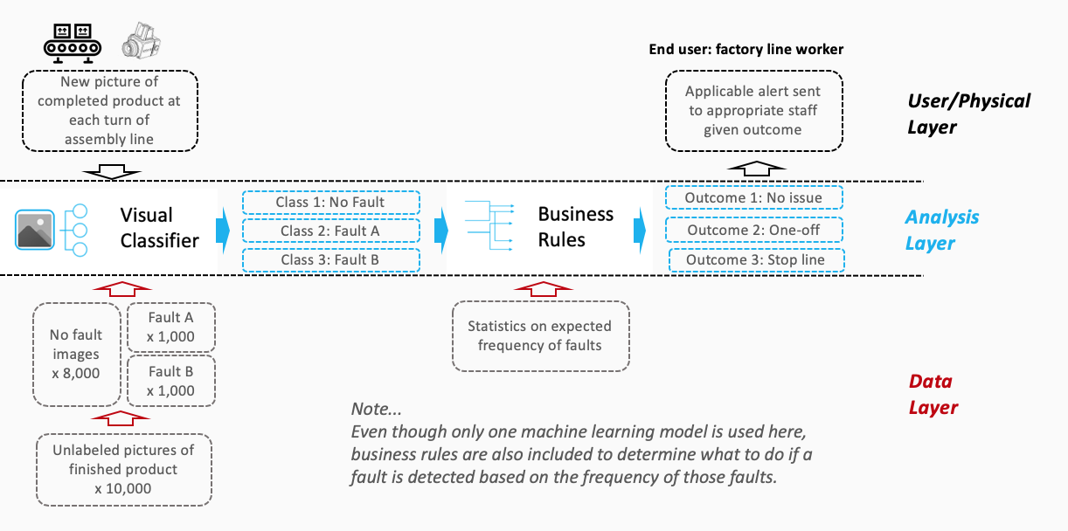

Sample Completed Architecture
Creating High Level Architectures
For the top three use cases you prioritized in Project Step 2C, you’ll now create a high level architecture for each, on slides 10-12.
For this step, be sure to review Lesson 3 but also recognize that this process allows significant creative freedom.
Keep a focus on… - Data flow/direction - Clear view on inputs/outputs - Simplicity
Write the use case name at the top of each slide.
Do all work on slides 10-12:
Copy and paste capabilities from slide 9 into Analysis Layer
Identify relevant User/Physical and Data Layer attributes
Copy and paste arrows from slide 9 to show data flow, input/output
Use annotations to help explain difficult concepts

Slide 9

















AI / ML Toolkit - List of Capabilities
Generic ML Capabilities
Natural Language Processing
Voice/Speech Processing
Computer Vision
Other Capabilities
Drawing Tools
User/Physical Layer
Analysis Layer
Data Layer

Slide 10
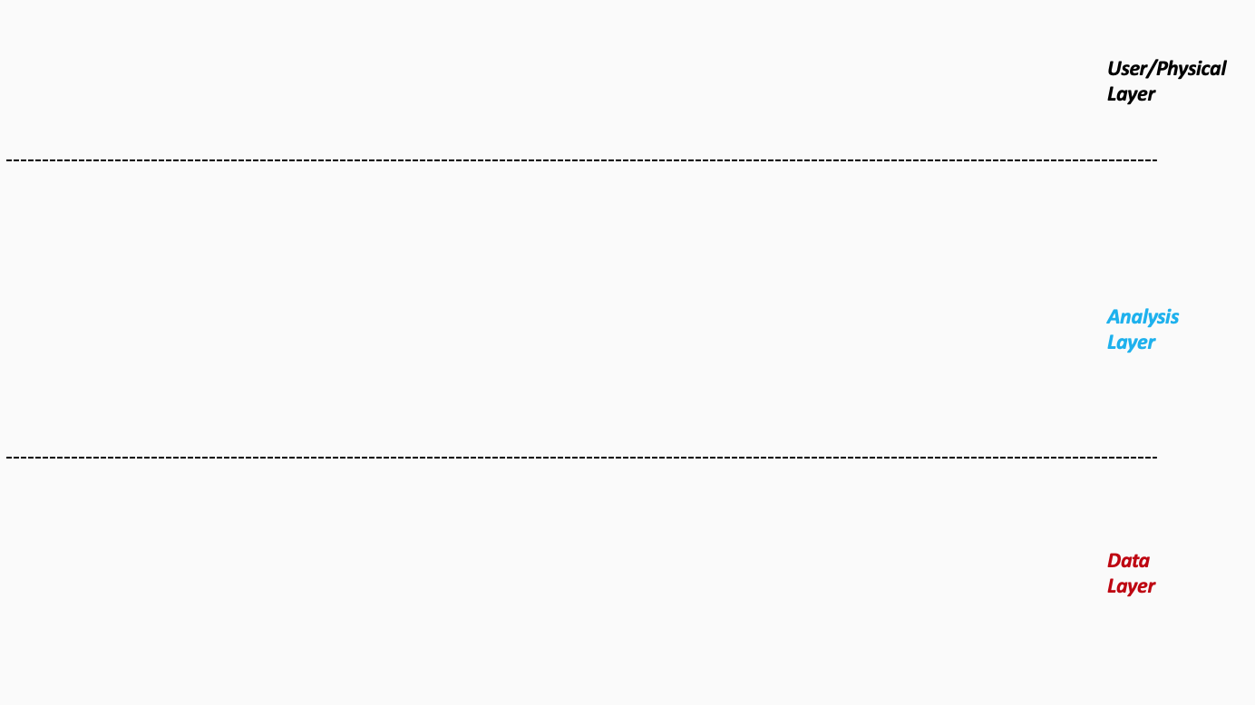
Architecture 1/3 - <Predictive Maintenance>
Real-time sensor data (vibrations, temperature).
Anomaly detection algorithms (TensorFlow).
Maintenance teams receive alerts for proactive action.
Notes:
Please follow the directions on slide 8. Copy and paste the desired icons provided you on slide 9 onto this page.

Slide 11
Architecture 2/3 - <Customer Churn Prediction>
Historical customer data (transactions, interactions, surveys).
Classification models (Keras, AutoML).
Marketing and customer service teams use insights for outreach.
Notes:
Please follow the directions on slide 8. Copy and paste the desired icons provided you on slide 9 onto this page.

Slide 12
Architecture 3/3 - <Use Case Name>
Supplier performance, inventory levels, demand forecasts.
Optimization algorithms (OR-Tools).
Supply chain managers dynamically adjust logistics.
Notes:
Please follow the directions on slide 8. Copy and paste the desired icons provided you on slide 9 onto this page.

Slide 13
Excellent, you’ve completed this step of the project!

Slide 14
AI for Business Leaders
Project Step 4C
Second Prioritization Grid

Slide 15
Second Prioritization Grid
Based on new information from your further analyses of your use cases in step 4A and 4B, you’ll engage in the same exercise as you did before in Step 2C to update your prioritization.
Move onto the grid the three use cases that you have been working with in steps 4A and 4B.
You MAY choose different use cases and shift your focus, if you feel these exercises have caused you to significantly revise your prior evaluations.
Drag and drop icons for each use case
Remember to think about both axes!
UC 2

Slide 16
Second Prioritization Grid
(Follow directions on previous slide)
high
UC 3
UC 1
UC 1
UC1: < Predictive Maintenance >
UC 2
UC2: < Customer Churn Prediction >
UC 2
UC 3
UC3: < Supply Chain Optimization >
Impact
low
low
Feasibility
high

Slide 17
Now Prioritize and Eliminate One More Use Case
1) Review the locations of your use cases on the grid on the previous slide. Remember we want to prioritize use cases for AI and ML that offer the greatest impact for the least difficulty.
2) Now in the grid on the previous slide change the color from blue to grey for one use case circle you want to de-prioritize.
3) This leaves your top two use cases in blue that you want to move forward with in the rest of the project.
UC 3
UC 3

Slide 18
Excellent, you’ve completed this step of the project!

Slide 19
AI for Business Leaders
Project Step 5
Operational Considerations:
Accuracy, Bias, and Ethics

Slide 20
Accuracy, Bias, and Ethics Concerns
For each of your two remaining use cases, on the next two slides please write 2-3 paragraphs discussing how success will be measured and monitored.
Start by focusing on how model effectiveness would be measured, and speak to what success would look like.
Comment on any other operational concerns, including bias in the data, or ethical limitations, that could influence success.
For each concern you raise, comment on how you would measure or monitor this concern on an ongoing basis.

Slide 21
Case 1 : Predictive Maintenance
Accuracy Concerns: Inaccurate predictions may occur due to insufficient data.
Plan: Clean data and regularly update the model.
Underfitting/Overfitting Concerns:
- Underfitting: Missing critical patterns.
- Overfitting: Model relies too heavily on training data.
Plan: Cross-validation and regularization techniques.
Ethical Concerns: Privacy issues from sensitive sensor data.
Plan: Encrypt data and adhere to privacy policies.

Slide 22
Case 2 : Customer Churn Prediction
Accuracy Concerns: Outdated or incomplete data may reduce accuracy.
Plan: Continuously update and validate data.
Underfitting/Overfitting Concerns:
- Underfitting: Poor recognition of churn patterns.
- Overfitting: Over-reliance on historical data.
Plan: Diverse datasets and regularization.
Ethical Concerns: Privacy risks from customer data usage.
Plan: Anonymize data and comply with regulations

Slide 23
Excellent, you’ve completed this step of the project!

Slide 24
AI for Business Leaders
Project Step 6B

Slide 25
Final Prioritization Grid
Based on all of the previous information for each use case, you’ll now engage in the same prioritizing exercise as you have twice before.
You MAY choose to re-prioritize use cases and shift your focus if you feel these exercises have caused you to significantly revise your prior evaluations.
At the end of this exercise, you should have a final point of view on the use cases you’ll advocate in your ML/AI strategy!
UC 2
Drag and drop icons for each use case
Remember to think about both axes!

Slide 26
Final Prioritization Grid
(Follow directions on previous slide)
high
UC 3
UC 1
UC 1
UC1: <Predictive Maintenance>
UC 2
UC2: <Customer Churn Prediction>
UC 3
UC3: <Supply Chain Optimization>
UC 4
UC 2
UC 4
UC4: <Fraud Detection>
Impact
Note: You only need to locate two of these onto the grid.
low
low
Feasibility
high

Slide 27
Excellent, you’ve completed this step of the project!

