Slide 1
CPS3525
By Daniel Lordelo, Iramir Neto, Amir Zaman

Slide 2
Our Project
Character guessing game!
Simple and easy.
Teaches us combining C headers and file linking when compiling
Strong understanding of Linux/Unix file systems

Slide 3
Challenges
Confusion on variable names
(Remedied by using getter methods from header files!)
Meeting and communication
Solved by having frequent meetings on campus/online
Confusion on file location and destinations
Decided on one generic php file with pre defined directories for testing

Slide 4
Workload
Daniel
Count method
Comparison
Vince
Set directory & file standards
Php design
Project Lead
Github Guru
Iramir
Main method
Final page output
Web Design

Slide 5
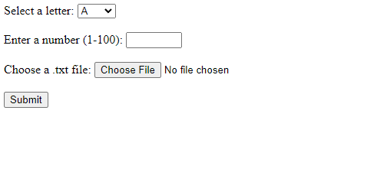
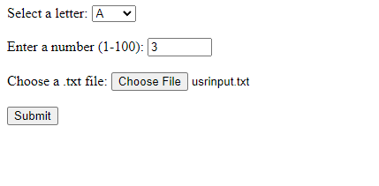
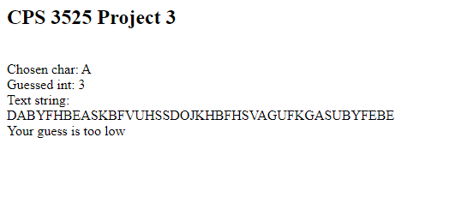
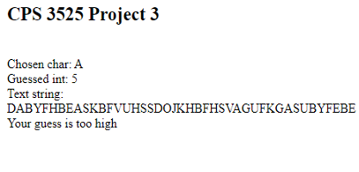
Final product

Slide 6
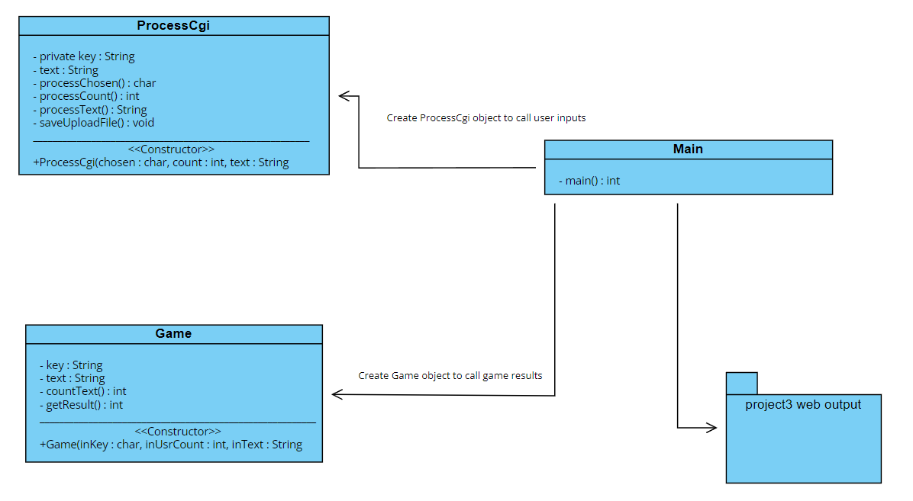
UML

Slide 7

Thank you
Questions?

