Slide 1
Project Meeting 04/04/24

Slide 2
Current Progress – Interim Report
Remains my strongest contribution at the moment
Background is 80% complete
Lacking in technical discussion

Slide 3
Current Progress – Interim Report
Previous project quality acts as reference
Would value a moment to address any comments in the current draft
With minor corrections from yourself (no comments from second marker)

Slide 4
Current Progress - Project
Lack of significant progress over lecture time
nnU-Net studied and output is generating
Scope of project is fully understood

Slide 5
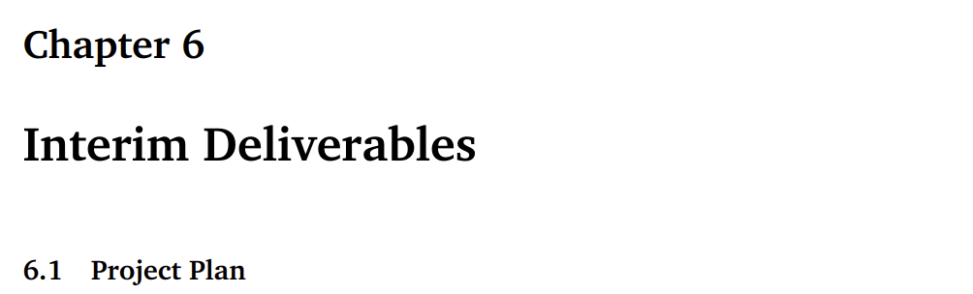
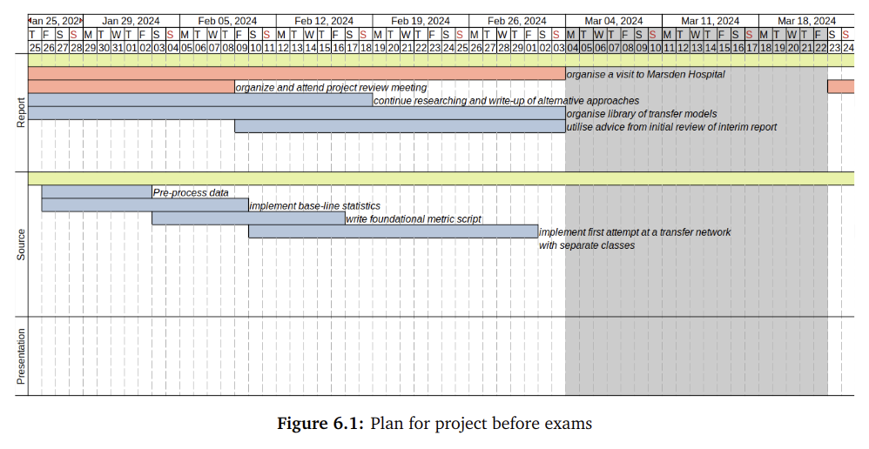
Current Progress - Interim Deliverable Plan
Accomplished half of desired achievements with severe inaction to first attempt
Metric system trivial to implement

Slide 6
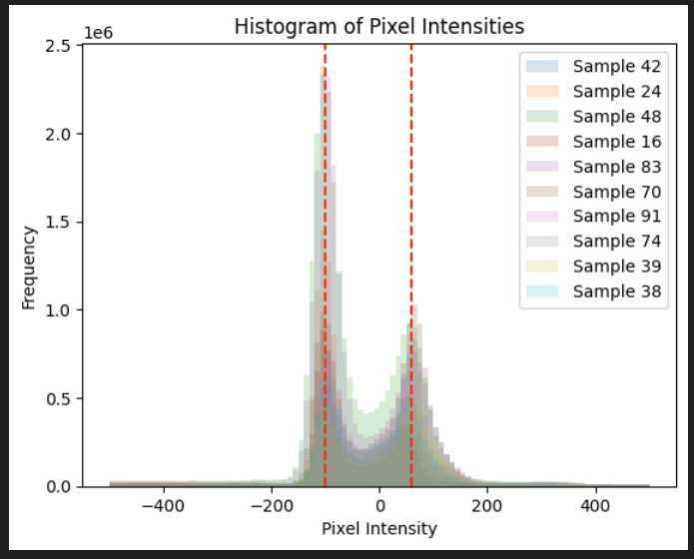
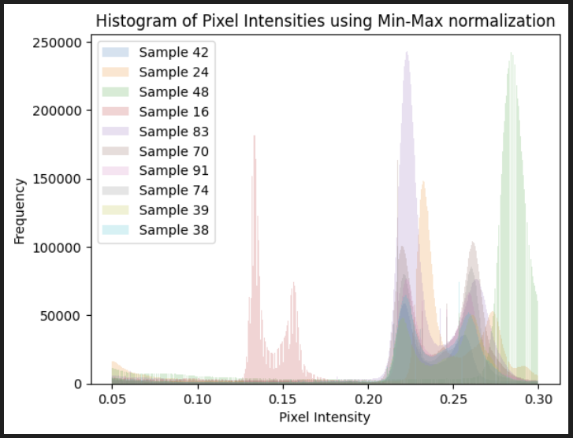
Current Progress - Pre-processing
Independent pre-processing not effective
Current plan is to utilize the nnU-Nets dynamic pre-processing pipeline to process images with minor adaptations

Slide 7
Plans for the future – Near Future
Recently discovered paperswithcode website
In the next week I will find and implement a collection of pre-trained models (e.g. TotalSegmentator, Univeral-seg., SAM-medical)

Slide 8
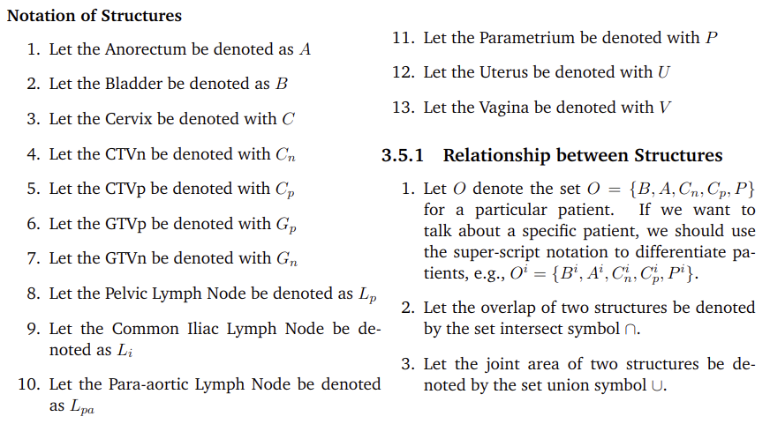
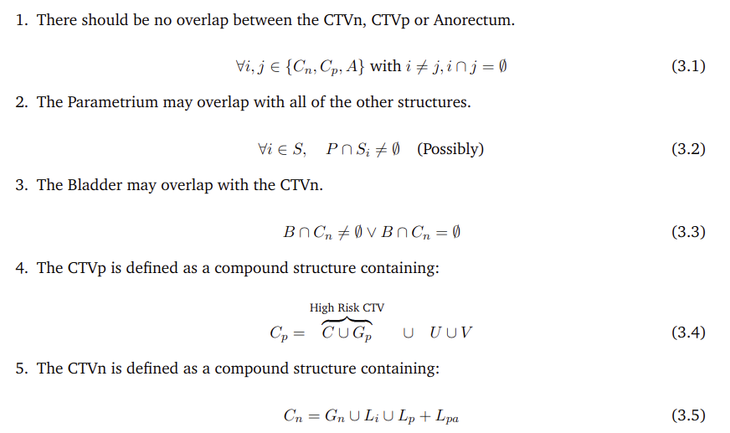
Plans for Mid Future (following month)
I’d like to reach out to Marsden by email to clarify target volume logic

Slide 9
Plans for Mid Future (following month)
Experiment With Individual segmentations or one-shot segmentation for the 5 classes

Slide 10
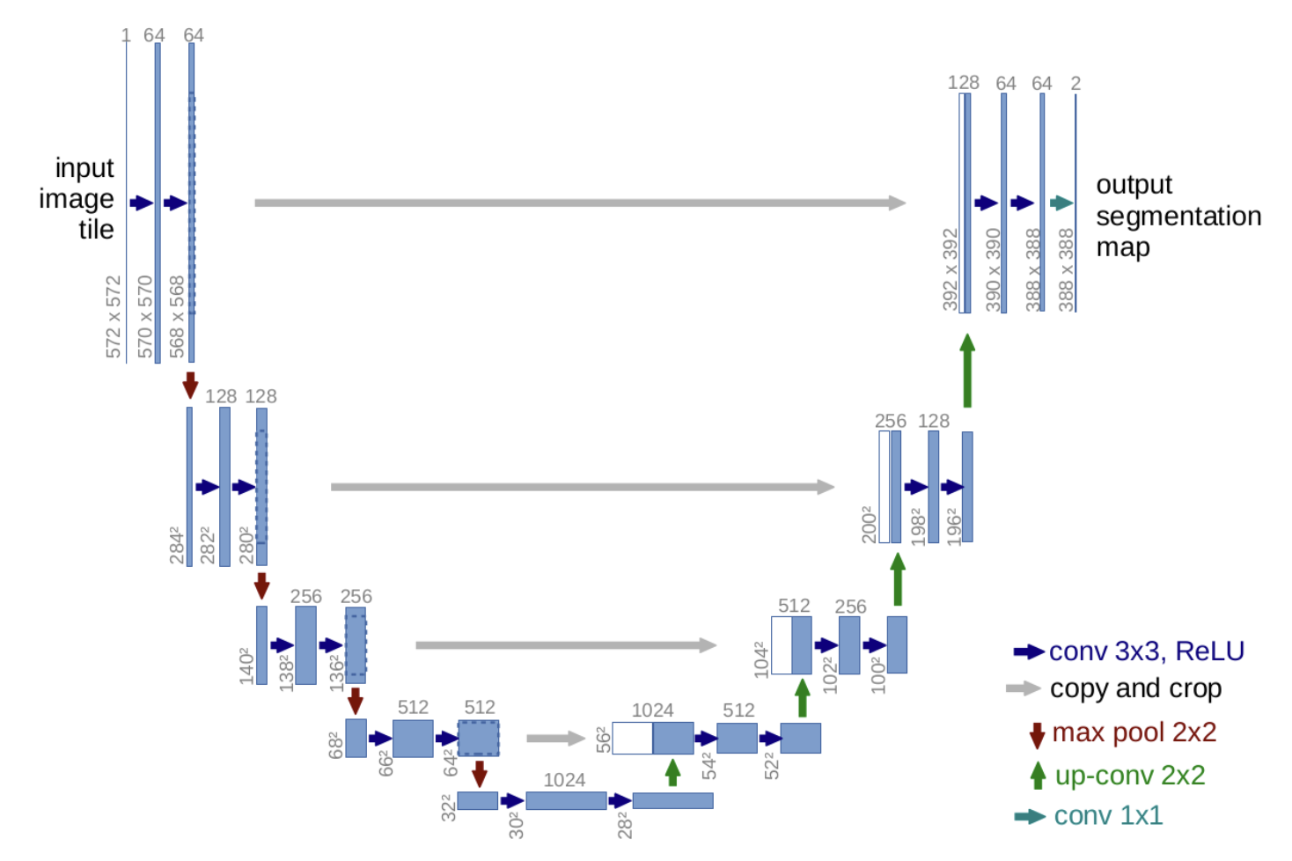
Plans for Far Future (mid-end of project)
`

Slide 11
Plans for Far Future (mid-end of project)
Extra layers for managing margin of error for radiation planning – thoughts on “Nonrigid Image Registration Using Multi-scale 3D CNNs”
`
transferred

Slide 12
Plans for Far Future (mid-end of project)
Transfer learning boosting like TrAdaBoost because we break the ‘identical distribution assumption’
Incorporate a variation of atlas learning where we average the predictions of multiple pre-trained networks
`

Slide 13
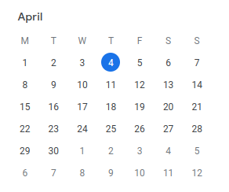
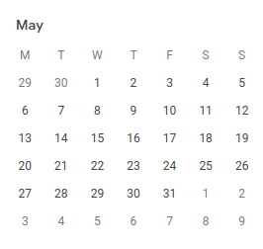
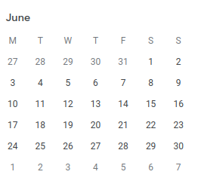
Conclusion
Stage 1 – Running pre-trained models relevant to the task of medical organ segmentation

Slide 14
Conclusion
Stage 1 – Running pre-trained models relevant to the task of medical organ segmentation
Stage 2 – Implementing pipeline for classifying each class separately using a selected architecture for a proof of concept. Also, clarify target volume logic with Royal Marsden

Slide 15
Conclusion
Stage 1 – Running pre-trained models relevant to the task of medical organ segmentation
Stage 2 – Implementing pipeline for classifying each class separately using a selected architecture for a proof of concept. Also, clarify target volume logic with Royal Marsden
Stage 3 – Experiment with one-shot PTV area planning and also other pipelines. (Non-rigid image transformation?)

Slide 16
Conclusion
Stage 1 – Running pre-trained models relevant to the task of medical organ segmentation
Stage 2 – Implementing pipeline for classifying each class separately using a selected architecture for a proof of concept. Also, clarify target volume logic with Royal Marsden
Stage 3 – Experiment with one-shot PTV area planning and also other pipelines. (Non-rigid image transformation?)
Stage 4 – Leftover time for interim report and implementation catchup/Boosting Algorithms?

Slide 17
Conclusion
Stage 1 – Running pre-trained models relevant to the task of medical organ segmentation
Stage 2 – Implementing pipeline for classifying each class separately using a selected architecture for a proof of concept. Also, clarify target volume logic with Royal Marsden
Stage 3 – Experiment with one-shot PTV area planning and also other pipelines. (Non-rigid image transformation?)
Stage 4 – Leftover time for interim report and implementation catchup/Boosting Algorithms?
Stage 5 – Presentation and administrative pieces for submission

