Slide 1
Should I get a Masters?
Anthony Wong, Allen Tung, Matthew Lew

Slide 2
Higher Education
More and more people are seeking higher education to improve their chances of getting well paying jobs.
The question then becomes, when is it reasonable to go to Graduate School?
Information is spread out across the Web and makes it difficult to come to a decision.

Slide 3
Target Audience
Anyone deciding whether or not to go Graduate School.
Anyone wondering if it is a good idea to go into Industry right after undergrad.
Anyone who is curious about different Majors or Schools.
Undergrad students who are curious about future possibilities.
Workers in the Industry interested in going back to School

Slide 4
Our Product
Mastersorjob.ga
A one-stop-shop for getting the important facts, fast.
The website analyzes over 50 Majors, over 800 occupations, and 4000 schools nationwide.
Enter as little or as much information as you want - we’ll do all the heavy lifting.

Slide 5
Why use our product?
We provide immense amounts of useful information, and we do it fast.
Users can get exactly what they need without having to think too much about it.
The convenience and power of our product is the main selling point - make things as complicated as you want
With just a little more information, we’ll answer that big question for you...to be or not to be? (a Graduate student that is)

Slide 6
Specifications
Basic Search - Learn more about your potential Masters Degree by simply giving us your undergrad major and the State you went to College.
Advanced Options - Customize your basic search with a plethora of options to get the right information for you
Compare Majors - Given 2 Majors, learn more about their differences
Compare Schools - Given 2 Schools, get information regarding their graduate school.

Slide 7
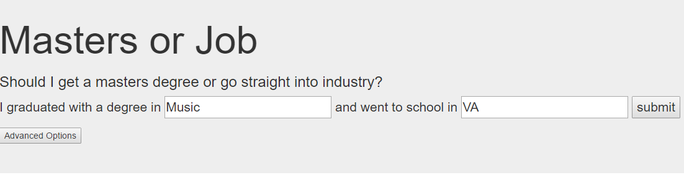
I know where I live, and I know what degree I have…
But otherwise, I’m completely lost!
Enter that information into our website, and we’ll guide you!
With just two pieces of information, we can gather data from various reputable databases like the Census, and show you useful statistics!

Slide 8
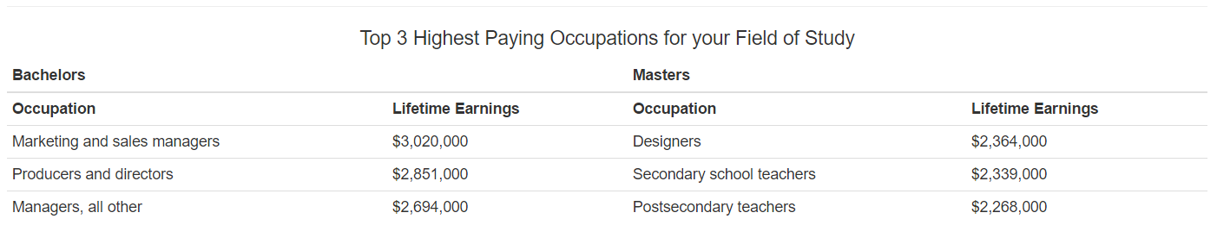
What you can find out
The information we can provide with just two fields is limited, so we make assumptions based on averages.
Estimates based on national data are computed and displayed in a user-friendly display, with useful quick facts at the top, followed by more in depth tables and graphs.

Slide 9
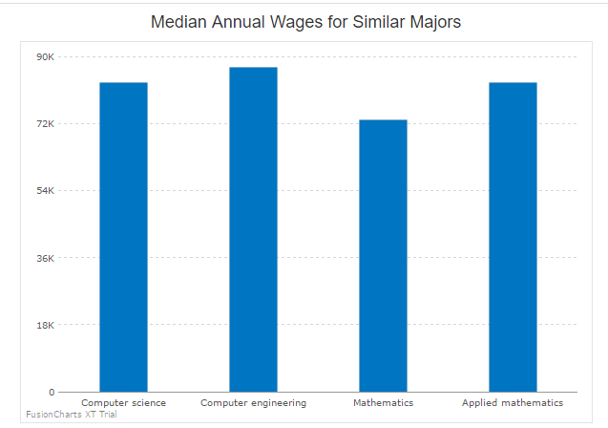
The Charts
This chart provides a quick look at majors similar to your own to get a picture on what others are earning

Slide 10
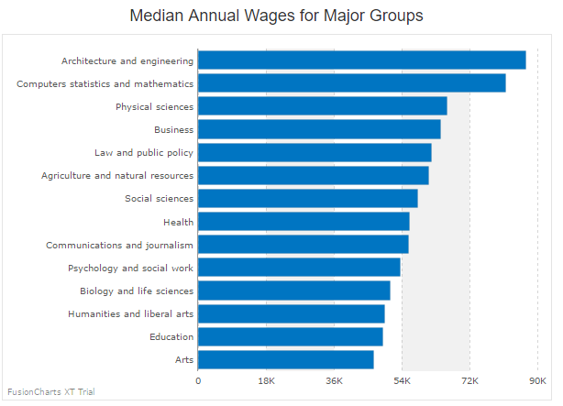
The Charts
This chart lists average median salary nationwide for majors grouped by a general group of study.

Slide 11
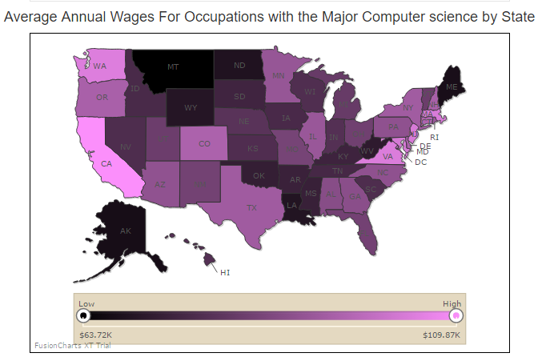
State Gradient Map
This heat map presents the average earnings of occupations per state that use require your major

Slide 12


I know where I want to go, and what I want, but I’m bad at math. Is it worth it?
We’ll let you know!
Just open up the advanced options tab, and fill in as many or as few fields as you want!
Each entry helps us help you to come to a more accurate decision!
From your input, we can tell you simply, either 「 Yes 」, or「 No 」

Slide 13
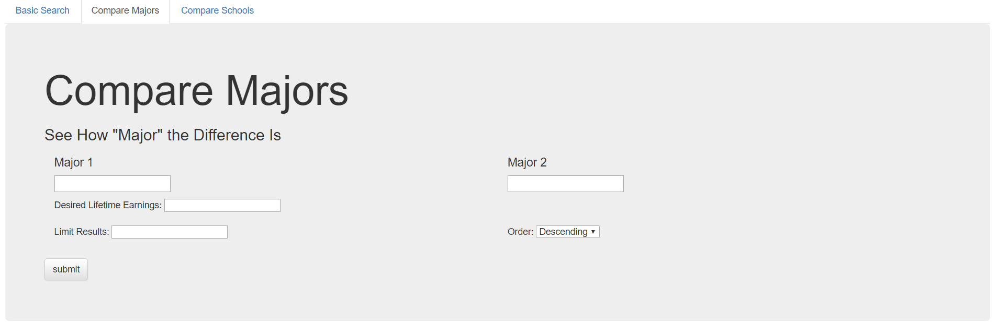
I Want to Know more About Possible Grad Majors
We have a comparison feature for that!
Just enter in 2 desired Majors and we’ll get you the facts
Filter results to get exactly what you need

Slide 14
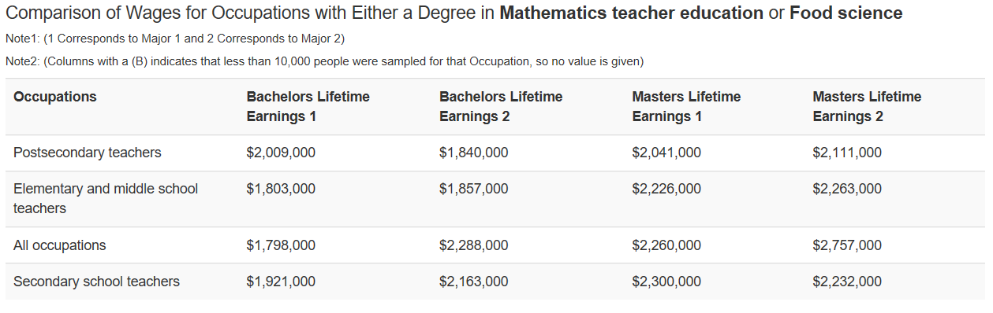
Major Comparisons - See the Difference
In addition to basic comparisons between the Majors, we provide information on Earning Differences based on Occupations. See which Occupation is right for you!

Slide 15
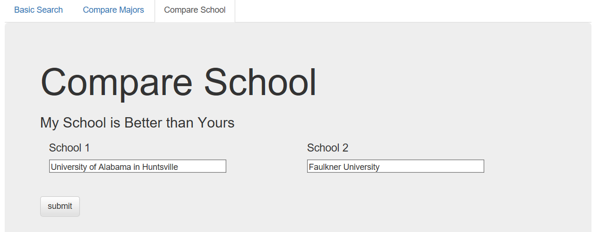
Finding the Right School
I know I want to go to Grad School...Now what?
Our website provides a School Comparison feature to help you find exactly what you need. Just provide us with 2 different schools!

Slide 16
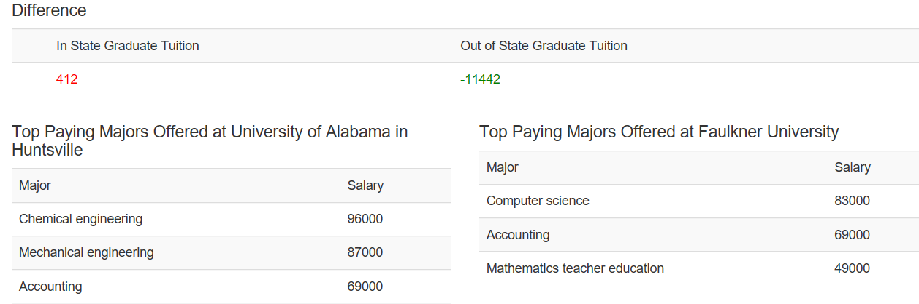
Giving You the Good Stuff
We provide quick, useful facts and easy-to-read tables so you can what you need right away.
Take a look through the data; you might be surprised by what you find!

Slide 17
This is too good to be true!
It may seem that way, yes. If you don’t believe us, check out our sources. All are online and accessible to the public:
https://nces.ed.gov/ipeds/datacenter/DataFiles.aspx
https://www.census.gov/library/visualizations/2012/comm/pathways-series.html
http://www.bls.gov/oes/current/oessrcst.htm
https://collegescorecard.ed.gov/data/
https://cew.georgetown.edu/wp-content/uploads/The-Economic-Value-of-College-Majors-Full-Report-web-FINAL.pdf

Slide 18
Fin

