Slide 1







AI-Powered Smart Light System
6th - 8th Grade AI Activity
AI
Coding
Sensors
Automation
Duration: 50 Minutes

Slide 2







What Makes a Device Smart?
Discussion Prompt
Phones Adjusting Brightness
Automatically adapts screen brightness based on ambient light
Automatic Lights
Turn on when it gets dark or when motion is detected
Smart Thermostats
Learn your preferences and adjust temperature automatically
Voice Assistants
Respond to voice commands and control other devices

Slide 3







AI Systems and Sensors
AI systems
mimic human decision-making
by collecting data
from sensors and using that information to control devices
automatically.
INPUT
PROCESS
Sensors
Decision-Making
OUTPUT
Control Devices
Example:
A light sensor detects darkness (input), the system
decides it's too dark (process), and turns on the lights (output).

Slide 4



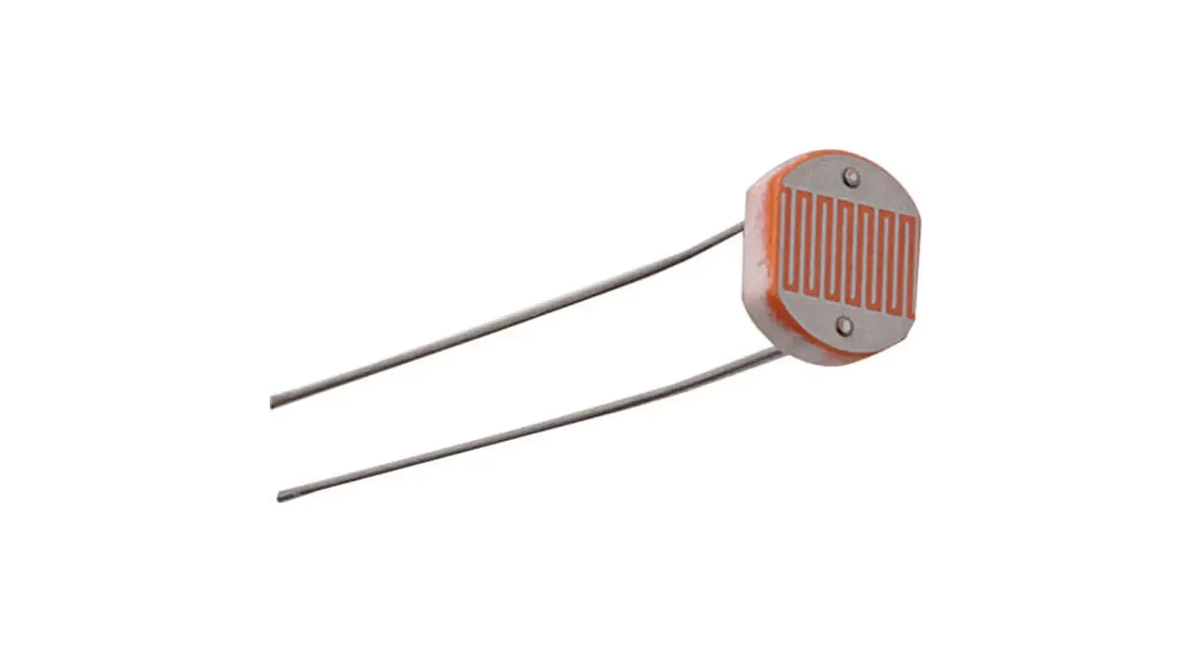
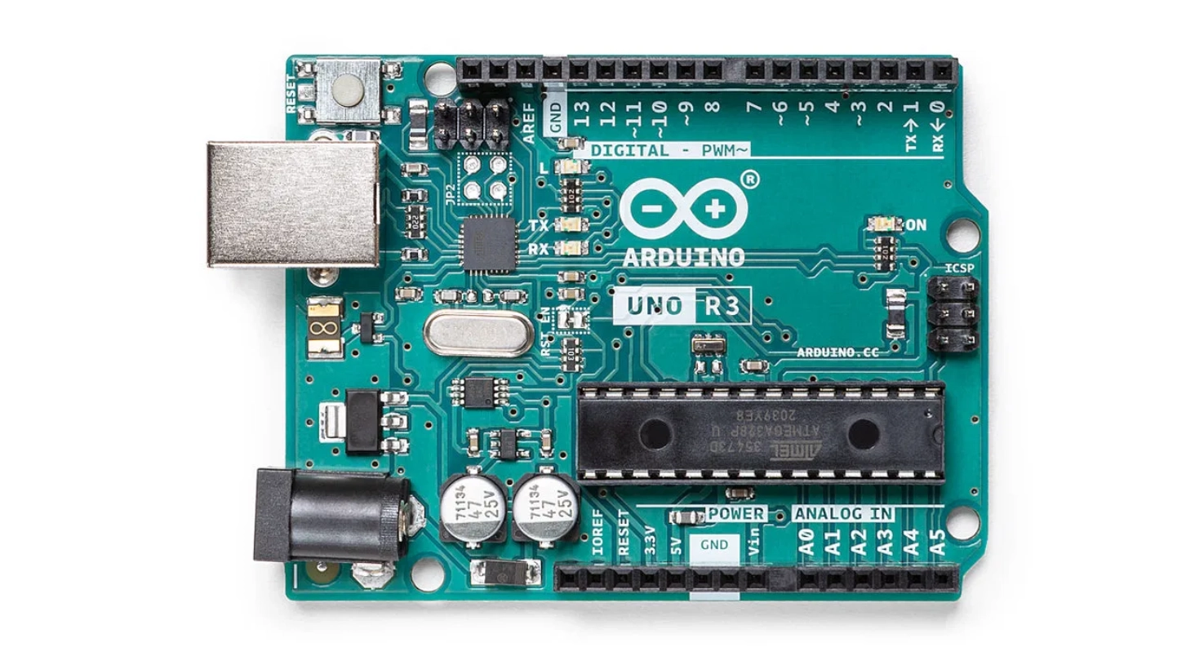



Our Smart Light Components
Our smart light system uses three key components that work together, just like an AI system:
INPUT
PROCESS
OUTPUT
LDR (Light Sensor)
Arduino (Processor)
LED (Light Bulb)
Detects the amount of light in the environment. The resistance changes based on light intensity, providing data to the Arduino.
Acts as the "brain" that reads sensor data, makes decisions based on programmed rules, and controls the output.
Turns on or off based on the Arduino's decision. Simulates a smart light that responds to environmental conditions.
Together, these components create an AI-inspired system that automatically responds to light levels

Slide 5

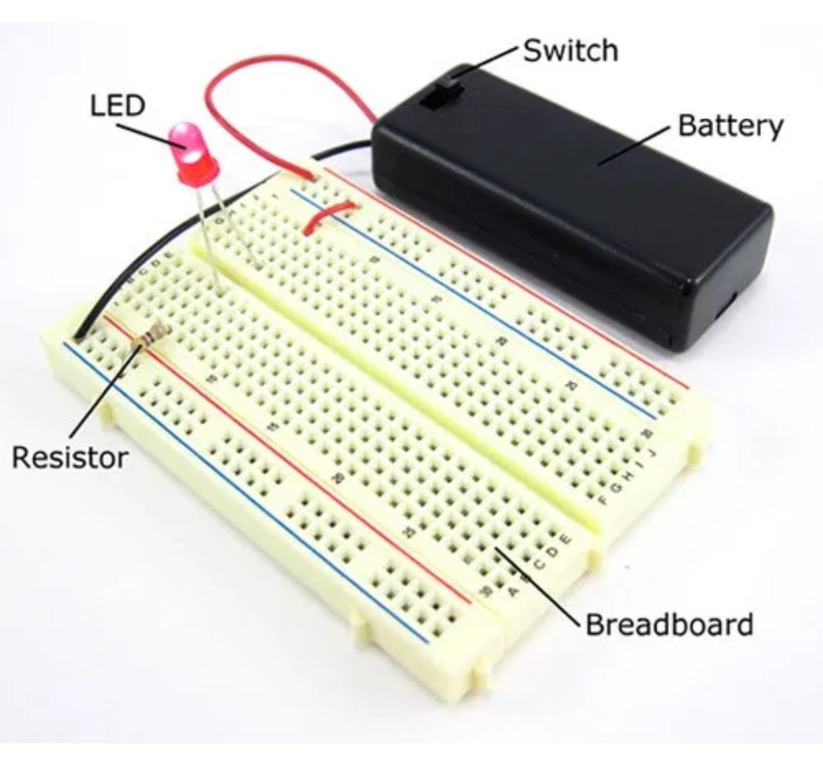

Materials Needed
Per Group of 2–3 Students
Qty
Component
Description
1×
Arduino Uno board
Microcontroller platform
1×
USB cable
For programming and power
1×
Breadboard
Solderless circuit building
1×
LDR (Light Sensor)
Light Dependent Resistor
1×
10kΩ resistor
For LDR circuit
1×
LED (any color)
Light output indicator
1×
220Ω resistor
For LED protection
5–7
Jumper wires
Male-to-male connections
1×
With Arduino IDE or web editor
Laptop

Slide 6

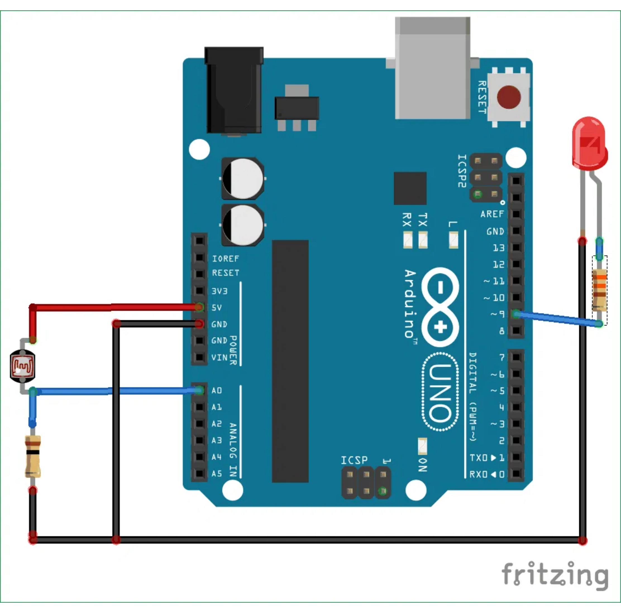


Building the Circuit
Step-by-Step Instructions
1
Place the
LDR
on the breadboard
2
Connect one leg of the LDR →
5V
on Arduino
3
Connect the other leg of the LDR →
A0
(analog input)
4
Connect a
10kΩ resistor
between the LDR and
GND
5
Connect LED positive leg (anode) →
Pin 13
(digital output)
6
Connect LED negative leg (cathode) →
220Ω resistor
GND
through a
This circuit "senses" brightness and makes a decision to turn
the light ON when it's dark.

Slide 7




Coding the AI Logic
Goal:
Write and upload code to the Arduino to make the smart light functional
VARIABLES
// Define pins and threshold
int
ldrPin =
A0
;
// LDR sensor pin
int
ledPin =
13
;
// LED
output pin
int
threshold =
500
;
// Decision point
void
setup
() {
pinMode
(ledPin,
ldrPin:
Where we read light data (A0)
OUTPUT); Serial.
begin
(
9600
); }
void
loop
() {
// Read sensor data
int
ldrValue =
analogRead
(ldrPin); Serial.
print
(
"LDR Value: "
); Serial.
println
(ldrValue);
// Make
ledPin:
Where we control the LED (Pin 13)
decision based on threshold
if
(ldrValue < threshold) {
digitalWrite
(ledPin, HIGH);
//
threshold:
The "decision rule" for our AI (500)
Dark
}
else
{
digitalWrite
(ledPin, LOW);
// Bright
}
delay
(
100
); }
SETUP FUNCTION
Runs once when Arduino starts. Sets up the LED pin as output and starts serial communication for monitoring.
LOOP FUNCTION
Runs continuously, reading the sensor and making decisions:
Read light level from LDR sensor
Compare value to threshold
Turn LED on (dark) or off (bright)
Discussion:
How does the threshold act like a decision-making rule for
our AI?

Slide 8









How the Code Works
The
threshold
acts as a
decision-making rule
for our AI system. It determines when the light should turn on or off based on the sensor
reading.
Step 1: Read Sensor
Step 2: Compare to Threshold
Step 3: Control LED
analogRead(ldrPin)
reads the light
The code compares the sensor value to the threshold (default: 500)
Based on the comparison, turn the LED ON or OFF
level from the LDR sensor
Returns a value from 0 (dark) to 1023 (bright)
This is the "decision point" of our AI
This is the "action" or output
If LDR Value < Threshold (Dark)
If LDR Value ≥ Threshold (Bright)
digitalWrite(ledPin, HIGH)
digitalWrite(ledPin, LOW)
LED turns
ON
LED turns
OFF
When the environment is dark (low light reading), the smart light activates automatically
When there is enough ambient light, the system conserves energy by keeping the light off
Connection to AI Training:
Just like adjusting the threshold fine-tunes our smart light, training an AI involves adjusting parameters to improve
decision-making accuracy.

Slide 9







Testing and Iteration
Step 1: Upload Code
Step 2: Test the Sensor
Step 3: Adjust Threshold
Upload the Arduino code to your board using the USB cable and Arduino IDE
Cover the LDR with your hand to simulate darkness and observe the LED turning on
Fine-tune the threshold value in the code to change the sensitivity of your smart light
Threshold Values and Their Effects
Threshold Value
Sensitivity
Behavior
200
Very Low
LED turns on only in very dark conditions (e.g., complete darkness)
500
Medium (Default)
LED turns on when moderately dark (e.g., room with lights off)
700
High
LED turns on even in dim lighting (e.g., cloudy day indoors)
900
Very High
LED stays on in most conditions except very bright light
Discussion Question
Key Insight
What happens if we change the threshold? How does this relate to training an AI?
Adjusting the threshold is like training an AI—we fine-tune parameters to get the desired behavior and accuracy.

Slide 10










Conclusion and Next Steps
How Our Circuit Mimics an AI System
Sensors (LDR)
Gather data from the environment
Processor (Arduino)
Actuators (LED)
Makes decisions based on rules
Perform actions based on decisions
Extension Ideas
Add More LEDs
Add Different Sensors
Create different lighting patterns or brightness levels based on multiple light thresholds
Incorporate temperature, motion, or sound sensors to create more complex smart systems
Implement Lighting Patterns
Real-World Applications
Program the LED to blink, fade, or change colors based on different sensor readings
Research how smart lighting is used in homes, cities, and businesses to save energy
You've just built your first AI-inspired system! Keep exploring, experimenting, and creating.

