Slide 1

CBSE Science Exhibition Project 2025-26
Voice-Based Early Stress Detection for Student Mental Wellness in Schools
Rushil Sunder [X E] | Arav Vijayvergia [X E]
Euro School, Whitefield [Bangalore, Karnataka]

Slide 2
Why This Matters for academic zones
A Strategic Need for Early Mental-Wellness Support
Student stress is now a national priority, with early emotional struggles often going unnoticed because students don't openly express them.
Self-Reporting
Counsellor Intervention
Many students avoid expressing their struggles openly.
Often happens after visible signs emerge.
High-Cost Tools
While schools are the first line of support, early warning signs of stress can be subtle and hard to detect without the right tools.
Not feasible for school-wide deployment.
Our school already does a lot for well-being. AWAAZ adds a proactive layer: early, gentle, objective signals that help us reach students before stress escalates.
Notes:
The Supreme Court (2025), Ministry of Education, and NCERT highlight schools as the most important environment for early identification and prevention.

Slide 3




AWAAZ
Audio Wellness Analytics for Academic Zones
Helping Students Speak Without Speaking
Voice Samples
AI Analysis
Short samples during normal classroom routines.
Analyses natural vocal cues like micro-tension, pitch shifts, breathing irregularities.
Privacy First
Secure Sharing
No voice recordings saved , only numerical indicators.
Insights shared privately with authorised wellness staff only.
AWAAZ merges voice-based biomarkers, AI analytics, and school counseling systems to proactively enhance student mental wellness.
AWAAZ acts as a digital biomarker for stress, giving educators objective, continuous insights, while respecting privacy, cultural context, and student comfort.

Slide 4
Strategic Benefits for the School
Enhancing Our Well-Being Ecosystem Without Increasing Workload
Aligned with National Frameworks
UMMEED School Mental-Health Framework
NCERT & MANODARPAN priorities
NEP 2020's emphasis on emotional safety
Supreme Court 2025 directions
Early, Objective Wellness Signals
Identifies emerging distress so the school can initiate support at the right time.
Low Effort, High Impact
Uses existing devices, short routines, minimal training.
Designed for Dignity & Privacy
No labelling, no storing voices, no interference with academics.
AWAAZ deepens our school's commitment to well-being with minimal operational burden.

Slide 5
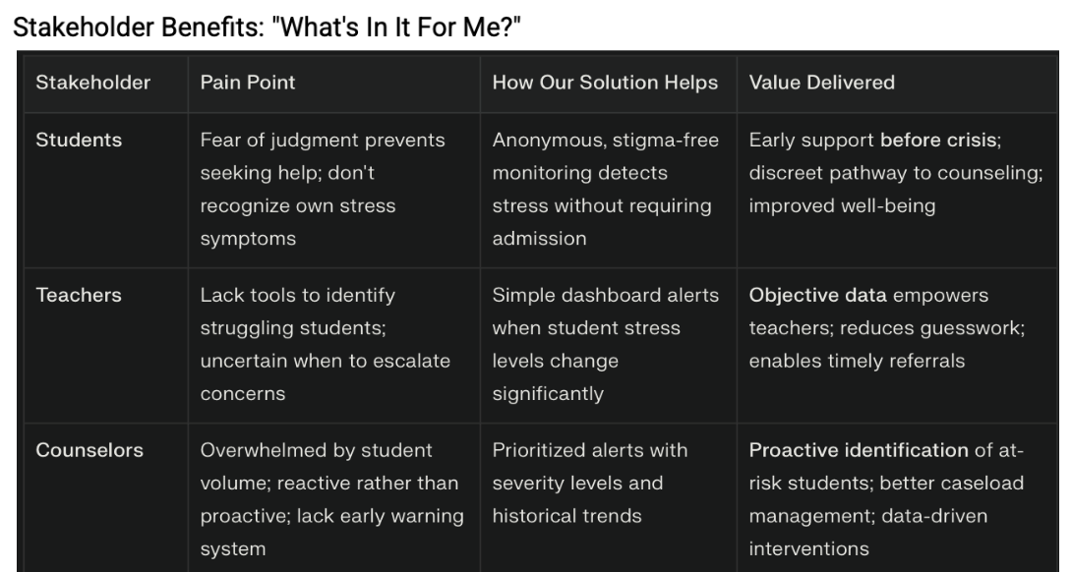
What’s in it for me?
Strategic benefits for every stakeholder

Slide 6
What makes awaaz unique
Students' identity kept anonymous, only revealed to counselor during high-risk cases
Instant chat with the counselor
Works on any device
Early warning alerts for high-risk cases

Slide 7
Future upgrades
Teacher /staff check-in
SMS to the counselor mobile device for high-risk students
Optimization for mobile devices
Dashboard for counsellor to update the 360-degree analysis based on the discussion with parents and teachers.
Analytics based on age group

Slide 8
Request for Additional support
Technical & Digital Support
Provide access to better computing resources, cloud storage, or school servers to process larger datasets.
Support refinement of AI/voice-analysis models, including algorithm tuning, testing, and validation with more student voice samples.
Facilitate integration with secure apps or platforms for national-level demo (so POC works seamlessly).
Mentorship & Guidance
Connect us with IT / AI / experts for technical validation and project improvement.
Offer advice on structuring presentation & storytelling for judges at national events.
Help prepare for Q&A with scenario-based practice and anticipated judge questions.

Slide 9
THANK YOU

