Slide 1
Predicting the FIFA World Cup 2018 Winner
By: Awab Idris

Slide 2
Outline:
Introduction.
Problem Statement.
Methods & Models.
Results from the Predictions.
Next steps.

Slide 3

Introduction:
The first World Cup was held in 1993 in Uruguay.
The world cup is hosted every 4 years except in 1942 & 1946 due to the Second World War.
17 countries have hosted the World Cup in 21 tournaments.

Slide 4
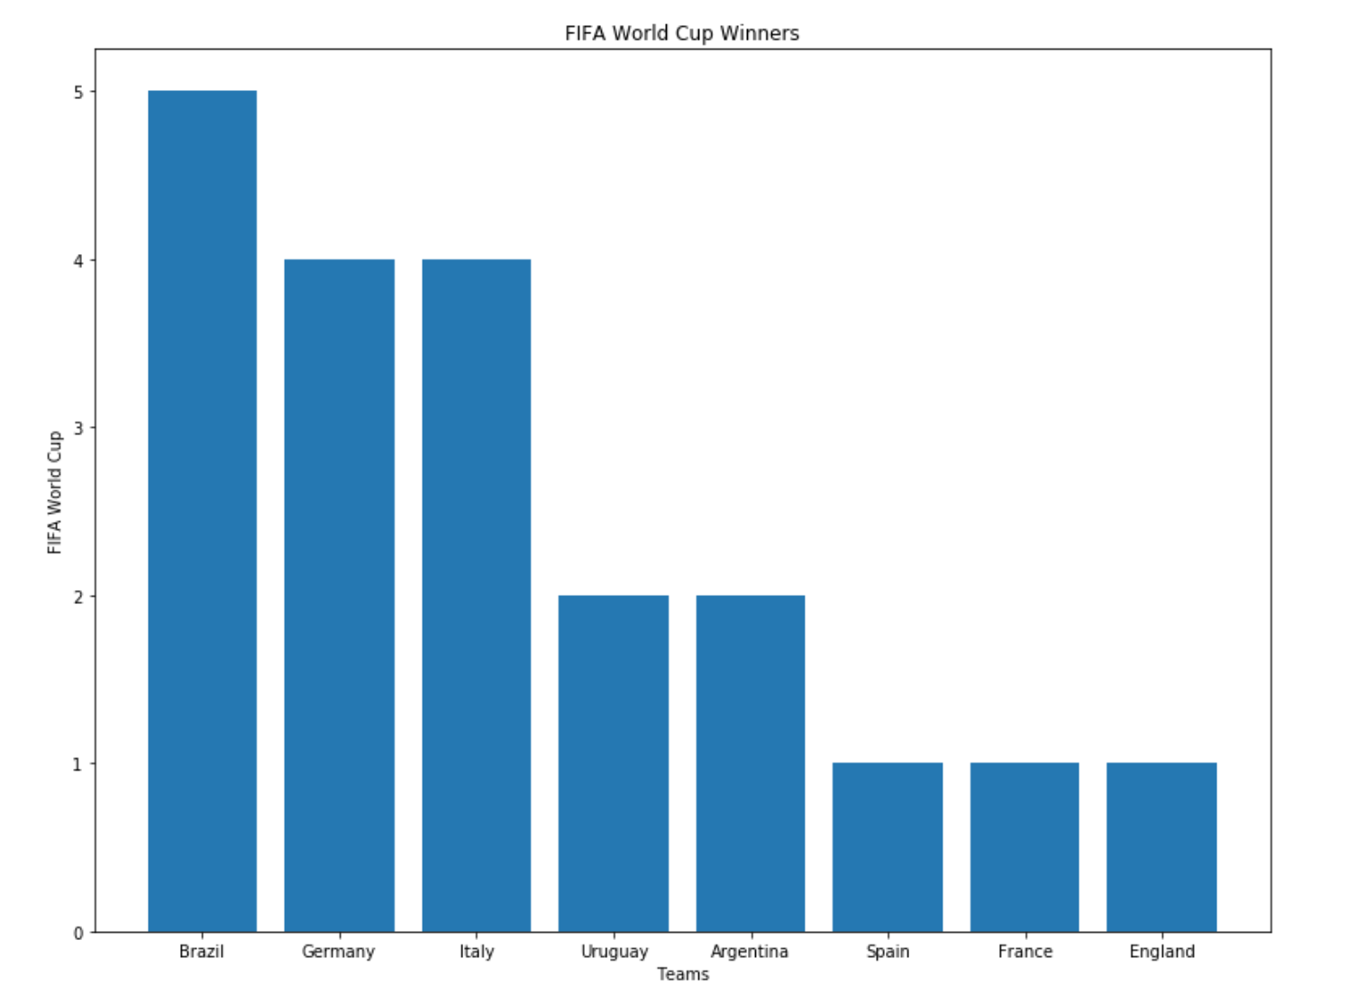
Introduction(cont):

Slide 5
Problem Statement:
Predicting the FIFA World Cup 2018 winner based on the previous matches for the world cup?

Slide 6
Datasets:
Previous World Cup Matches from Kaggle.
FIFA World Cup 2018 fixtures from Kaggle.

Slide 7
Methods:
I broke the predictions section into six parts:
Group stages matches.
Round of 16 matches.
Quarter final matches.
Semi-final matches.
Third place match.
Final match

Slide 8
Modeling:
Main Features for prediction:
Home team.
Away team.
Focused mainly on the match results for each team.

Slide 9
Modeling(cont):
Applied different types of multi-classification models to predict which team is going to win or it’s a draw.
The best multi-classification model:
AdaBoostClassifier 56%
LogisticRegression 55%
XGBClassifier 53%

Slide 10
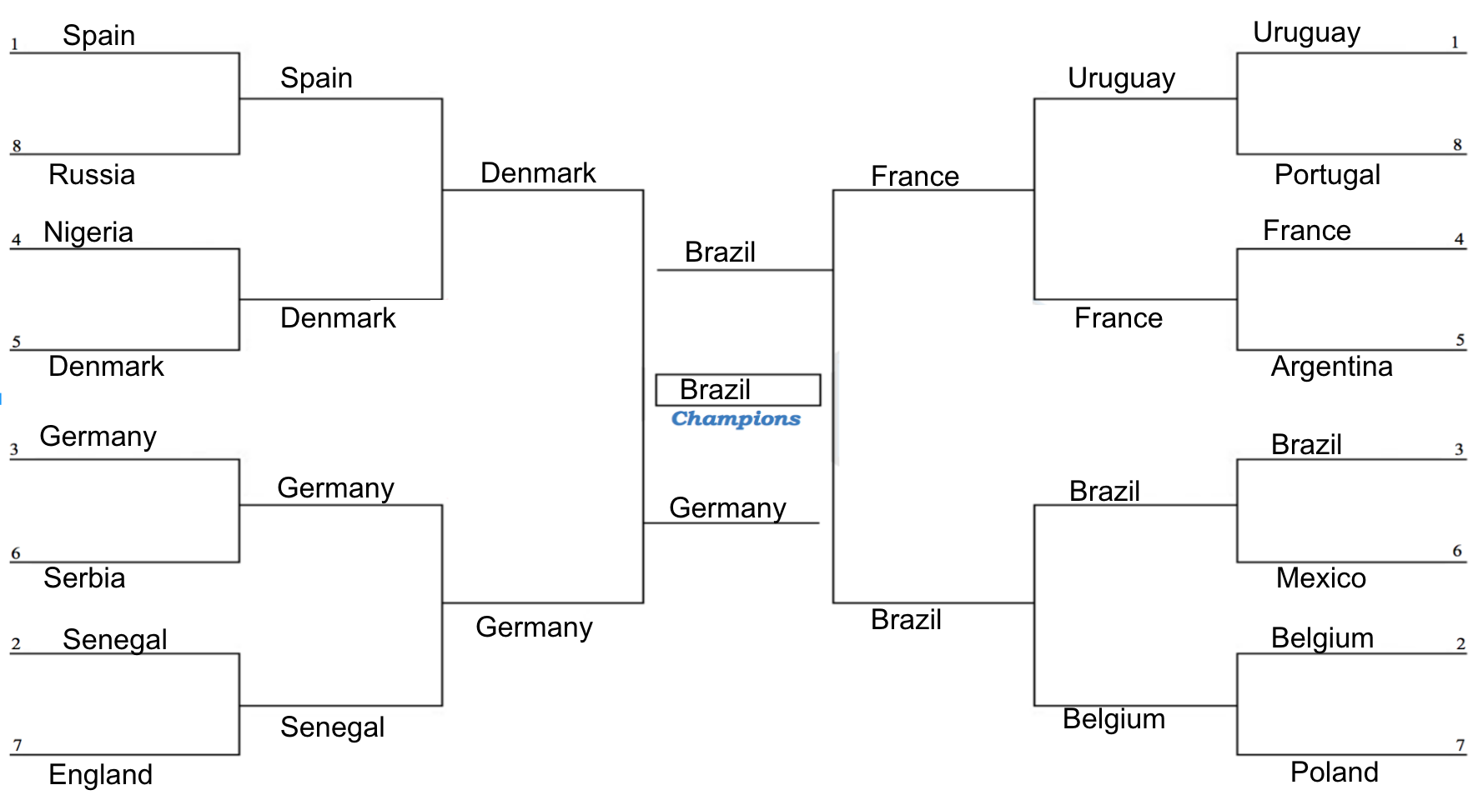
Results:
Results:

Slide 11
Results Summary:
1- Brazil won the FIFA World Cup 2018.
2- Germany won the second place.
3- Denmark won the third place.
4- France came on the fourth place.

Slide 12
Next Steps:
More feature engineering.
Construct a whole knockout simulation model.
Gather more data like rank, team squad, weather, etc.
Predicting the best player, top scorer, etc.

Slide 13
Thank you!

