Slide 1
SOFTWARE ENGINEERING FAMILY TRACKING APP
GROUP # 4
BSCS14035 – FIZZA TAUQEER
BSCS14059 – MAMOONA RIAZ
BSCS14072 – SIDDIQUA NAYYER
BSCS14004 – AWAB AQIB

Slide 2
TECHNIQUES
Interviews: Open ended and close ended. system demands constant communication and correlation of family members’ location direct us to adding features of location alerts, perimeter/threshold preferences of the intended market of the system will ensure its better success e.g. opt more for alerts through SMS or through Email

Slide 3
TECHNIQUES
Scenarios: system application crashing unpredictably, or skipping an entire module/phase We cannot account for every possible reaction or activity to such events
anyone with your metadata from the system application could end up tracking you -- > to ensure that two-way verification
Scenarios can also help us in devising the system flow better and handle errors

Slide 4
TECHNIQUES
Use Cases: not as useful as the other techniques in eliciting requirements
If feature of supporting multiple sub-families is added, then Use Cases will become essential - for identifying requirements that depend on multiple interactions of system

Slide 5
TECHNIQUES
Ethnography: eliciting requirements of our system
can help in identifying the real need of a user rather than the one he is presumably communicating correctly but not sufficiently that user satisfaction from the system is maintained till the very end of the app the requirement of pinpoint location of a member through our system will regardless require location tracking of that member

Slide 6
Game Developer Aspects
Not Covered Under Our System Domain

Slide 7
HARDWARE and software REQUIREMENTS
Any android phone with an os better than 4.2.2
Minimum ram of 1gb
Preferred processor is a 1.2 GHz Dual Core processor
Minimum storage of 1gb to keep backup of the tracked positions
WiFi/3G connectivity.
Global Positioning System (GPS)services and permissions to access instant/track of location.
Global System for Mobile (GSM) connections that are preferably local e.g. Warid, Telenor, etc.

Slide 8
HARDWARE and software REQUIREMENTS
8. Updated Android Studio software for building.
9. Testing tools like JTest, JUnit and Litmus.
10. Cookies and Javascript must be enabled when using outsourced and aiding applications, like Google Maps.
11. Broadcast Receiver and service functionalities for outsourced and aiding applications, like Google Maps.
12. Android devices that have Intel or NVIDIA Graphics card in their models.

Slide 9
Grouping Functional req.
Reliable location tracking of registered family members.
Exact and a pinpointed location of the member to be tracked.
Emergency buttons for alerting family members in matters of danger.
Entire location track of the member to be tracked, given time constraints * details in document
SMS Alerts - that are sent when the emergency button is clicked/pressed - to family members that are accompanied by embedded links of your current location or last known Location
Concept of alarms upon entering restricted locations, violating set perimeters or upon receiving alerts.
Multiple family members tracking.
Push notifications of the application – for prompting user to turn on GPS, WiFi, Mobile Data, any alerts, etc.

Slide 10
Grouping NON-Functional req.
Entire location track of the member to be tracked, given time constraints (for example, the entire location track of the member since the past hour or two). * please find the details in the document
Authentication before tracking.
Two-way verification/authentication approach (Family members must verify other ‘watcher’ members for tracking).
Thresholds for distances – location tracking of even a minute difference in location and location tracking of generalized or expansive differences in location.
Multiple watchers – those who can track you.

Slide 11
Grouping NON-Functional TYPES
NF REQ#1. Product Requirements -> Usability Requirements Product Requirements -> Efficiency Requirements -> Performance Requirements
NF REQ #2. Product Requirements -> Dependability Requirements, Security Requirements Product Requirements -> Security Requirements
NF REQ #3. Product Requirements -> Dependability Requirements

Slide 12
Grouping NON-Functional TYPES
NF REQ#4. Product Requirements -> Dependability Requirements Product Requirements -> Efficiency Requirements -> Performance Requirements
NF REQ#5. Usability Requirements, Dependability Requirements, Security Requirements

Slide 13
NON-Functional metrics NON-FUNCTIONAL REQUIREMENT #1
Speed –will be essential in correlating speedy location tracks to its intended users while ensuring that user/event response time can be easily quantified
Reliability – will ensure that the location track being provided is unfailing and correct.
Portability – will ensure that each of the target systems receives the location track efficiently and in due time.

Slide 14
NON-Functional metrics NON-FUNCTIONAL REQUIREMENT #2
Speed – will ensure that the user/event response time is swift for authentication correspondence.
Reliability – The authentication process of enabling users to track you (also an intended user) requires dependability on providing that tracking right and access to the correct users.

Slide 15
NON-Functional metrics NON-FUNCTIONAL REQUIREMENT #3
Speed – will ensure that the user/event response time is swift for authentication and verification correspondence.
Reliability – The authentication process of enabling users to track you (also an intended user) requires dependability on providing that tracking right and access to the correct users.
Portability – This metric will ensure that each of the target systems receives the authentication and verification correspondence efficiently and in due time

Slide 16
NON-Functional metrics NON-FUNCTIONAL REQUIREMENT #4
Speed –will be essential in correlating speedy location tracks to its intended users. Screen refresh time will enable constant updates in the location track to be relayed to the user.
Size –will ensure that the constantly updating and expanding location tracks are saved and tallied to its users in near-constant time.
Reliability – The process of enabling users to track you constantly and keep track of each minute change in location requires dependability on providing that tracking correctly in the first place.

Slide 17
NON-Functional metrics NON-FUNCTIONAL REQUIREMENT #5
Speed –will ensure that the user/event response time is swift for such hierarchical correspondence between multiple watchers and the user to be tracked.
Reliability –will ensure that the location track being provided to the multiple watchers is unfailing and correct.
Portability – will ensure that each of the target systems (for example, in the case of multiple family ‘watchers’ requiring location track of the same family member) receives the location track efficiently and in due time.

Slide 18
CONFLICTS B/W REQS
Android-based Java - demand some limitation of tracking time in their modules. Such a mechanism would drain the computing power and battery of the device the system
We limit this reliable location tracking to a time constraint because constant tracking won’t be feasible
If location-providing services like GPS or WiFi, the embedded location links that get sent as SMS alerts upon clicking the ‘Emergency’ button will not be able to get the location of the proposed user at all. store the last known location of the user indefinitely (when his location providing services were activated)

Slide 19
Build all requirements?
all our requirements seem feasible enough to be established and achieved
Our initial aim is to develop and launch it in Android Studio using Java Language including built-in functions
location providing services through cellular networks and GPS may make it easier for all requirements to be fulfilled

Slide 20
modifying requirements WE cannot build
24/7 tracking of location is not an intended requirement of our system
This is neither feasible nor possible; with limited storage and easily drainable batteries
we would have to scale the feature back to enable as much time constraints as can possibly be handled efficiently by these targeted devices and systems
tracking of location that is physically possible by the system can be achieved and yet will still have flavors of the ‘idealistic’ expectation

Slide 21
Verifiability - requirement review
Make sure whether each requirement is realistically testable, whether each requirement has been properly understood by all interested stakeholders of the system
requirement’s origin is clearly stated and/or whether each requirement is in harmony with the other requirements
Each requirement of our proposed system has a heavy impact and influence on the overall system
this process would provide the system a more efficient curve of growth comparatively

Slide 22
Verifiability - prototyping
a system that can track an entire family, we must implement a successful system that can at least track a singular user or provide his pin-pointed location.
modeling the tracking of a singular user and a single ‘watcher’ would massively help

Slide 23
Verifiability - TEST-CASE GENERATION
checking whether each system requirement is being met or not
It can also help in finding dubious bugs and patterns that builders of the system could not otherwise have found
Mathematical verification of correctness of the system can also be achieved

Slide 24
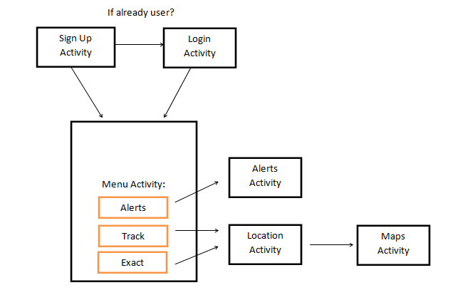
Modeling
A High-level overview of the system and a rudimentary UML diagram for reference

Slide 25
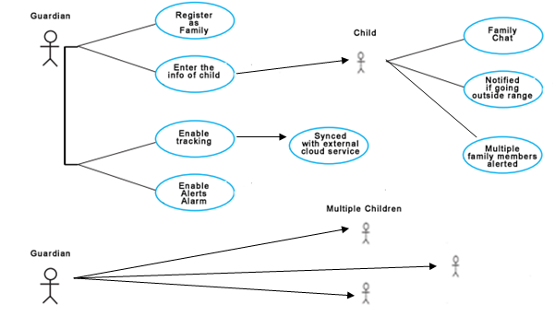
Interactions between the Users and the System

Slide 26
THANK YOU ☺

