Slide 1

Name: Daideepya Awadhiya
Email: awadhiyadaideepya@gmail.com

Slide 2
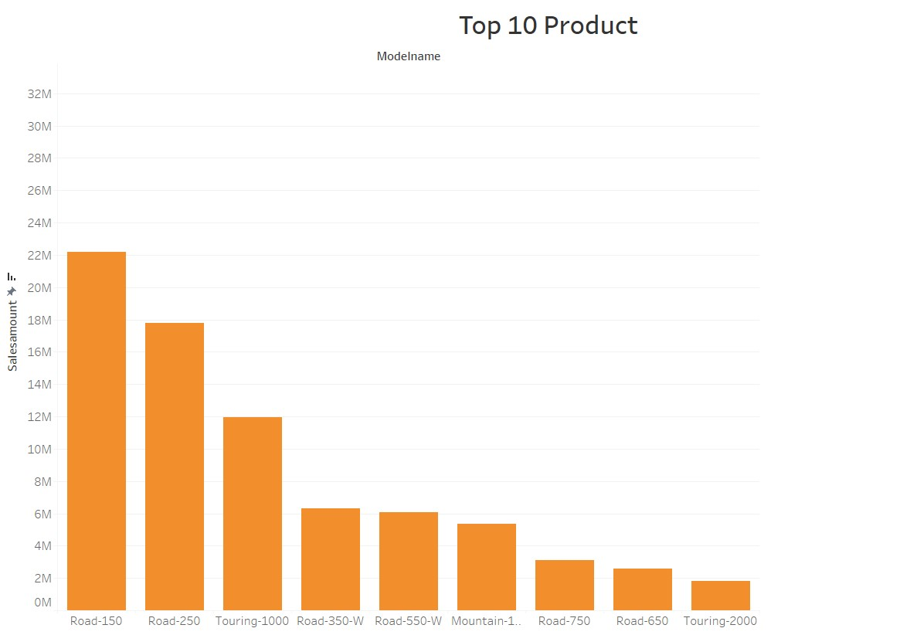
Top 10 product
by sales amount

Slide 3
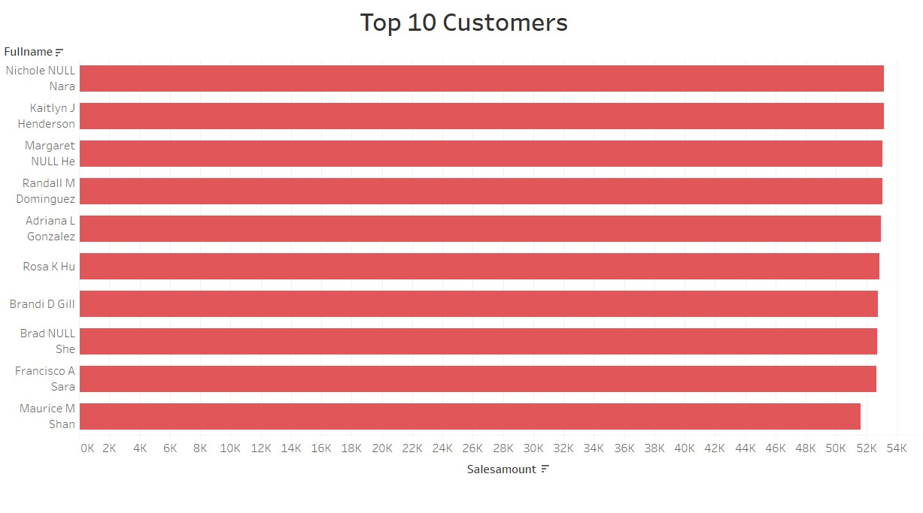
Top 10 Customer by Sales amount

Slide 4
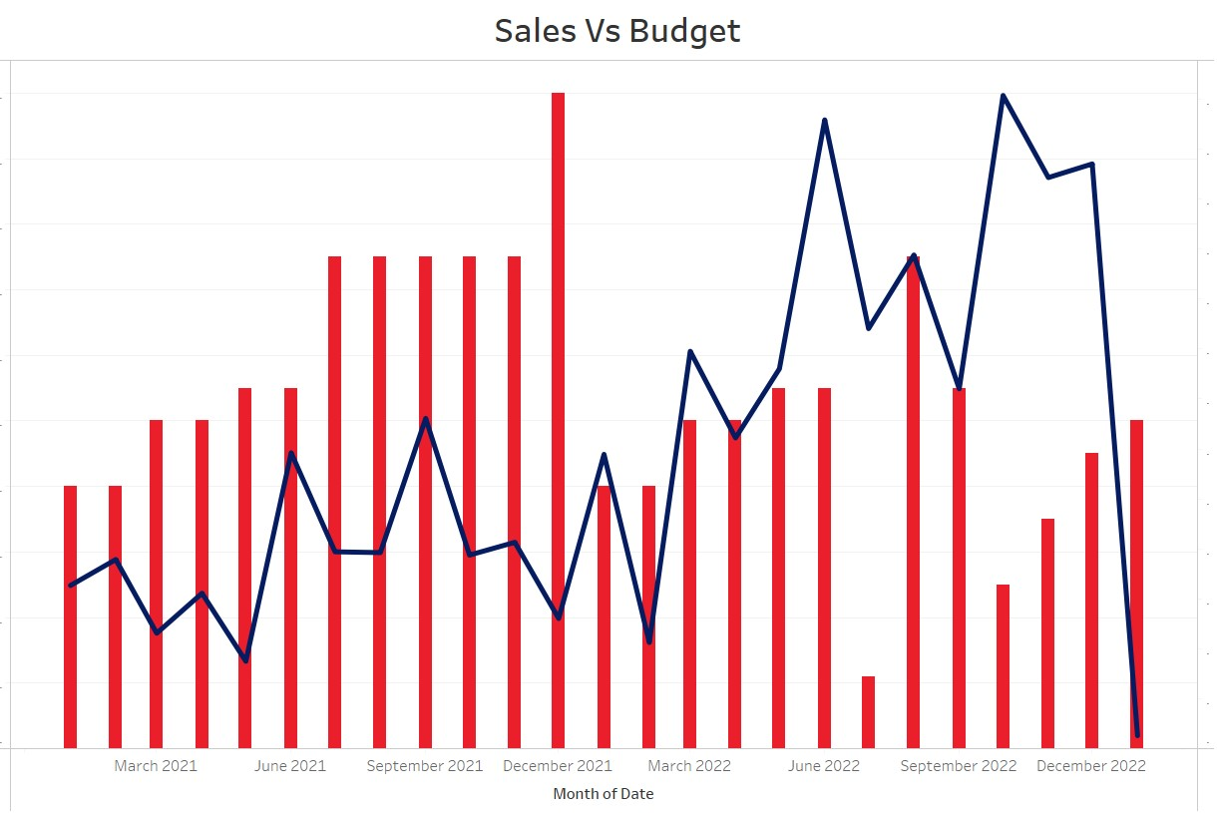

Slide 5
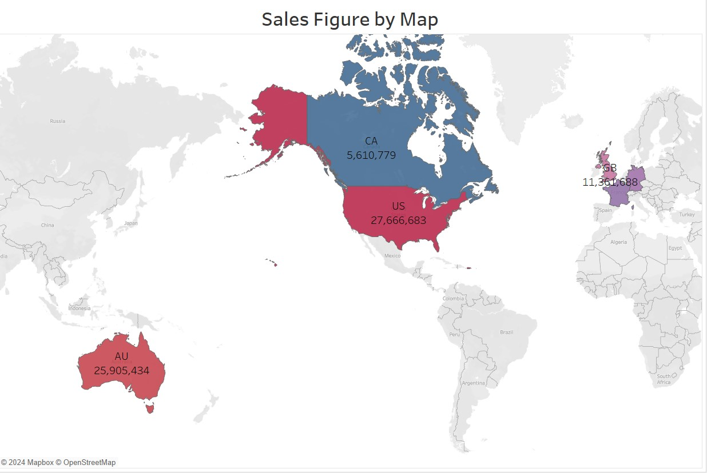

Slide 6
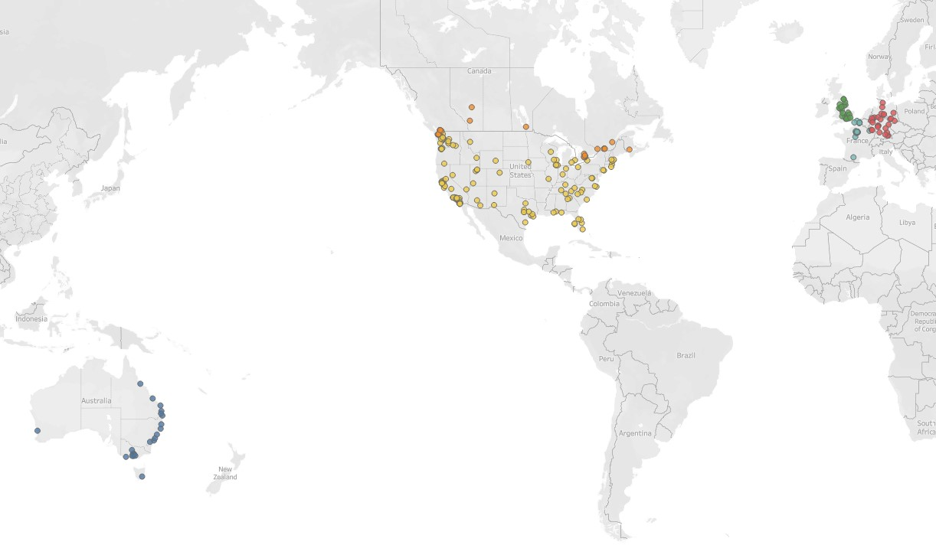
Sales figures by region/city

Slide 7
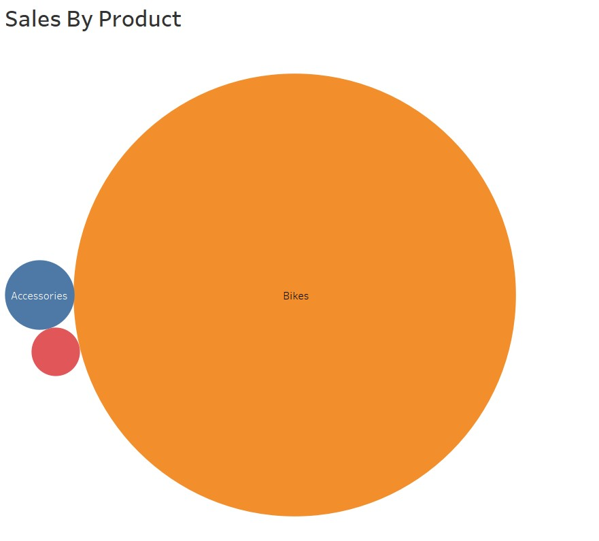

Slide 8
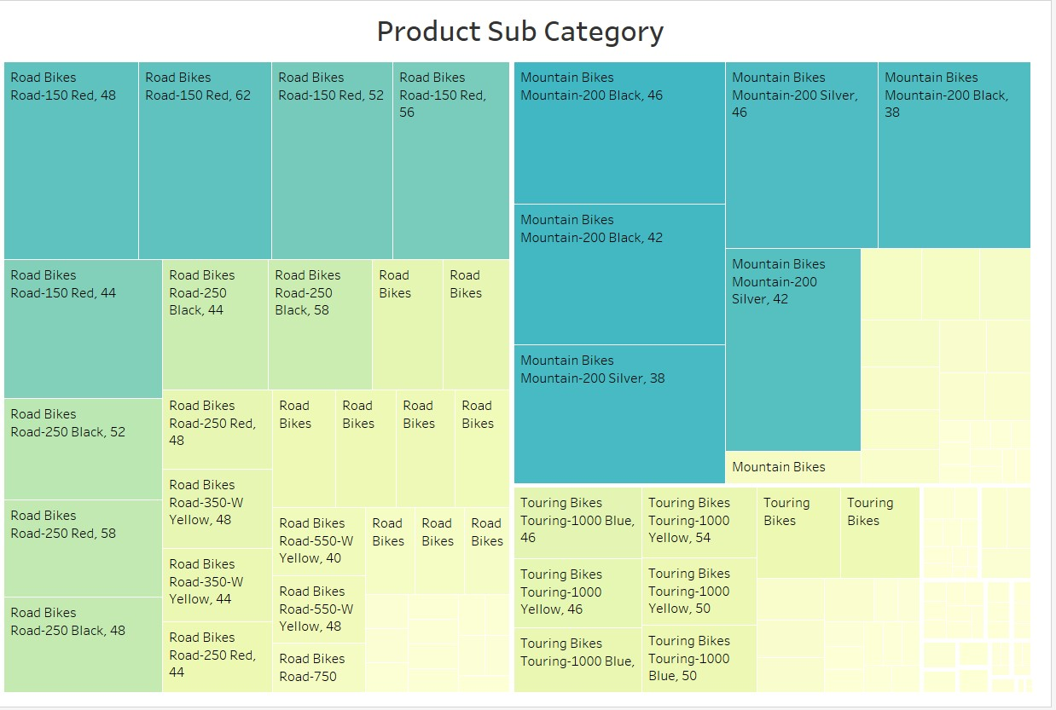

Slide 9
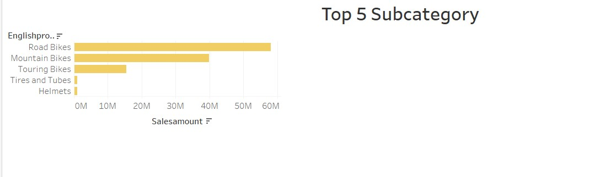
Top 5 Subcategory by sales amount

Slide 10
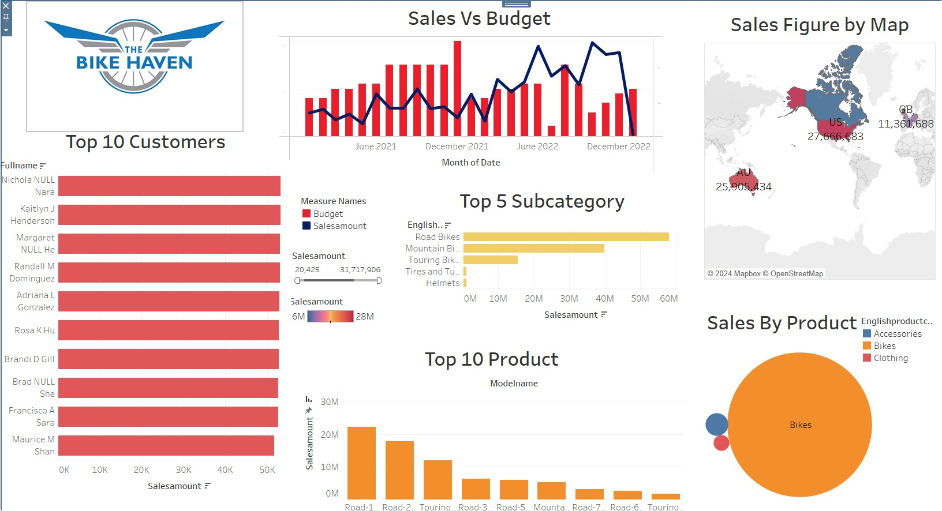

Slide 11
Thank you

