Slide 1
Embedded Project
Project option 2: ECG Heart Monitor
Ahmed Fahmy 900160127

Slide 2
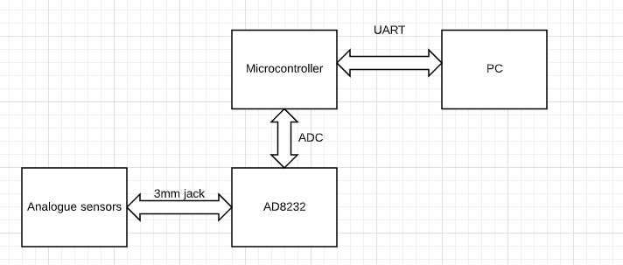
Block diagram

Slide 3
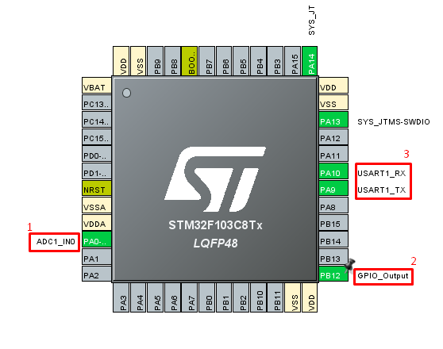
CubeMX setup

Slide 4

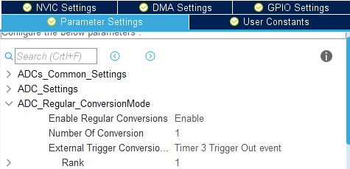
CubeMX setup (1: ADC settings)
NVIC global interrupts enabled as they are needed
Regular (not continuous) conversion
External trigger is TIM 3

Slide 5
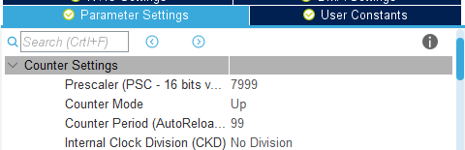
CubeMX setup (2 : GPIO and Timer)
GPIO used for validating, blinks with every sent sample
Channel 4 used
Initially, ARR is 100, changed according to user input
Prescaler scales down the 8MHz clock to 1000Hz

Slide 6
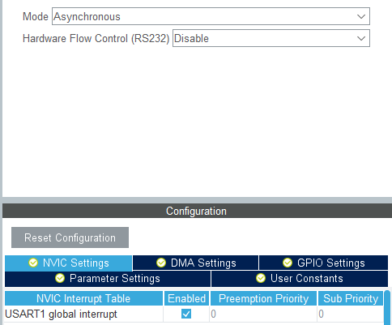
CubeMX setup (3 : UART)
UART 1 used
Interrupts enabled as the logic requires user generated interrupt when sampling rate is set

Slide 7
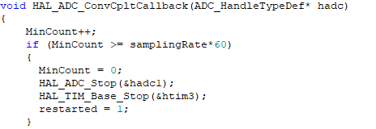
Keil MDK code (ADC callback)
Counts till one minute then stops the sampling (as one minute only is required)
Samples again via the HAL_ADC_GetValue() method
Calls the dec_to_string function
Transmits via the UART
Toggles pin to indicate message sent

Slide 8
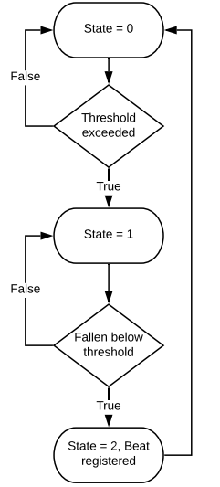
Keil MDK BPM Flow chart
To calculate the bpm, a threshold of 2500 was chosen after testing the output range of the ECG.
Transitioning above and below the threshold (not necessarily consecutively) registers a beat.
This is then divided by the time to calculate BPM.

Slide 9
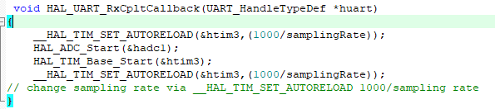
Keil MDK code (UART receive callback)
Sets the ARR according to the received sampling rate from the user.
According to the prescaler, this corresponds to ARR = 1000/User input
Starts the ADC as it might be disabled (not first usage)

Slide 10
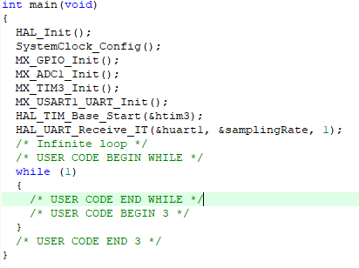
Keil MDK code (main loop)
Main loop empty as all logic is handled in interrupts

Slide 11
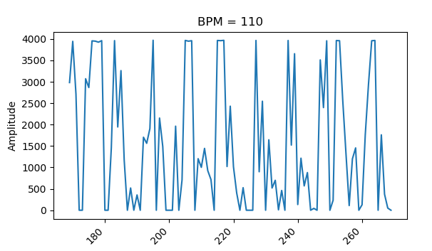
Python code
The user runs the script with the following arguments:
Sampling rate
Close/hold
Hold freezes the chart after the minute has passed, close does not.
COM port
Baud rate
Example:

Slide 12
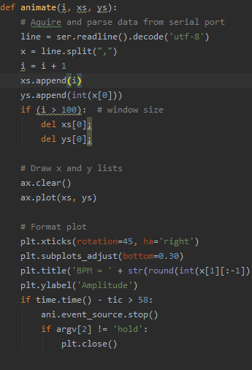
Animation (FuncAnimate):
This Function takes the current amplitude as well as the BPM from the serial link and continuously draws the graph seen above live (both BPM and ECG). The function lasts 60 seconds before terminating the program.
Is called through the matplotlib’s FuncAnimation method, which continuously plots the graph

Slide 13
Sample output

Slide 14
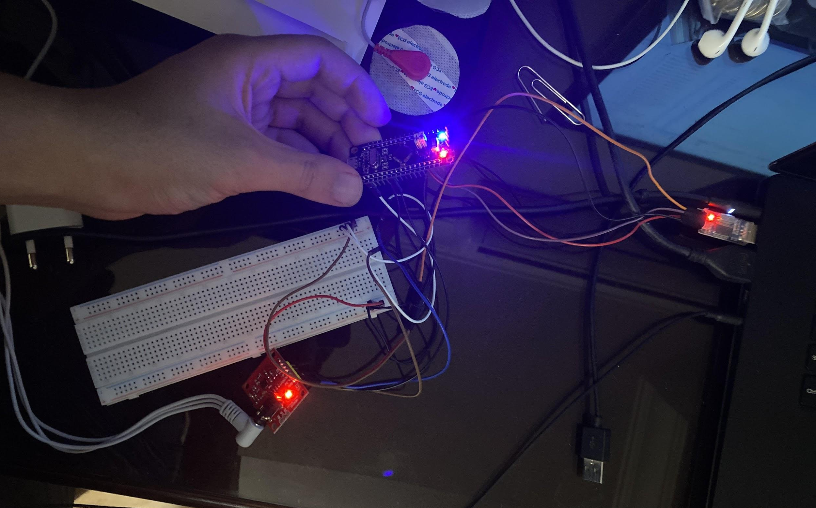
Physical connection

Slide 15
Issues
High Samples per second cause issues even with high baud rate due to the unreliability of the serial connection.
Refresh rate of the graph at high SPS lags behind as it cannot draw as fast as the selected SPS. Blitting was attempted yet was not successful in lowering the delay.

