Slide 1
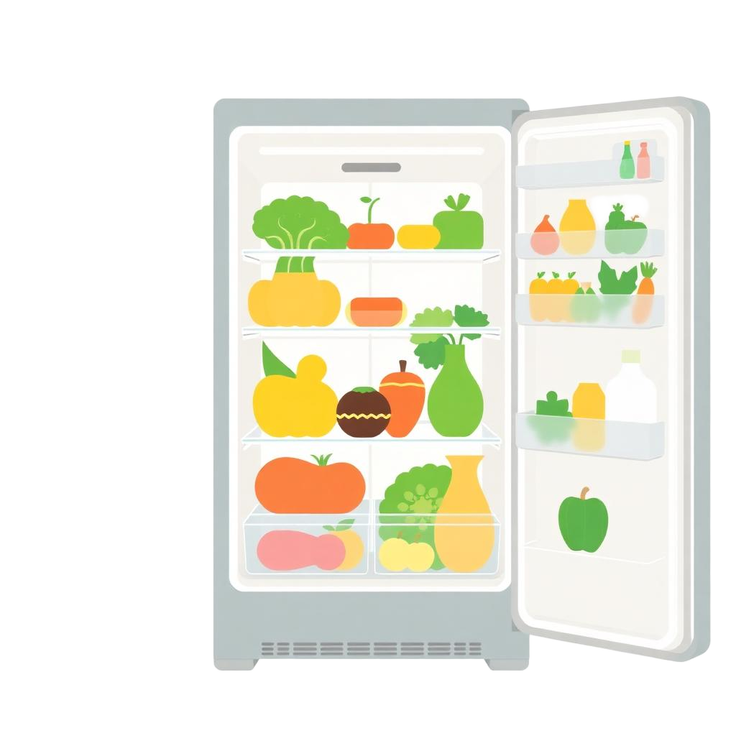

FridgeHero
Reducing Food Waste,
One Household at a Time
A smart food tracking app that helps families
save money, reduce waste, and eat better.
Food Waste Tracker Team
Fridgehero App
Notes:
1

Slide 2


FridgeHero
The Problem
The
Problem
$728
wasted per person per year
30–40% of all food in the U.S. is wasted — costing families thousands each year while filling landfills.
$2,913
wasted per family of four
30–40%
$240B+
of U.S. food supply is wasted
lost annually in the U.S.
Source: EPA Food Waste Research
Notes:
2

Slide 3



FridgeHero
Market Opportunity
Market
Opportunity
Limited Competition
Very few competitors in the U.S. are addressing food waste at the household level.
A massive, untapped consumer problem — difficult to solve because it requires behavior change and lacks aligned incentives.
$134B+
127M
The food waste management market is projected to be 2034 up from 80B this year
U.S. households — families with kids
waste the most food per capita
Notes:
3

Slide 4

Target User
FridgeHero
Target User
Persona
How we identified her:
  10 in-depth user interviews
  Proto-persona mapping across 3 archetypes
  Highest food waste per capita among families
  Strong financial incentive to change behavior
Jessica, 34
Mother of two, works full-time.
Primary grocery shopper.
Buys bulk, shops weekly.
Why she's our target user:
  Frequent grocery purchases (1-2x/week)
  Manages entire household food lifecycle
  Wasting $2,900+/year motivates action
~80% of mothers are the primary
grocery shoppers in households
Source: Pew Research
Notes:
4

Slide 5





Customer Journey
The current food lifecycle for families like Jessica’s
1
2
3
4
5
Plan & Shop
Bring Home
The Week
Check Fridge
Toss & Repeat
Shops with a loose plan, driven by kids’ preferences
Adds items to an overcrowded fridge with unknown timelines
Life gets busy — work,
kids, errands pile up
Opens fridge, unsure what she has
Throws out expired food, feels guilty, and the cycle repeats
"I'll forget about having a food item, so it might be hidden in the fridge, and I just don't see it."
-User Interview 1
Notes:
5

Slide 6
Customer Journey
The current food lifecycle for families like Jessica’s
1
2
3
4
5
Plan & Shop
Bring Home
The Week
Check Fridge
Toss & Repeat
Shops with a loose plan, driven by kids’ preferences
Adds items to an overcrowded fridge with unknown timelines
Life gets busy — work,
kids, errands pile up
Opens fridge, unsure what she has
Throws out expired food, feels guilty, and the cycle repeats
Over-purchasing
No Visibility
  Buys 'just in case'
  Swayed by bulk deals & promotions
  No visibility into current stock
  Forgets fridge items
  Buys duplicates unknowingly
  No expiration tracking
⚠ Key pain points FridgeHero solves
Notes:
6

Slide 7
FridgeHero
The Product
Product Demo
Built with Figma Make + Lovable
Notes:
7

Slide 8

FridgeHero
New User Flow
Jessica’s New User Flow
Active Preservation
Adaptive Cooking
Learn Page gives storage tips to keep food fresh longer.
Turn expiring ingredients into meals with custom AI Recipes.
Smart Shopping
Zero-Effort Tracking
Impact Tracking
Stop overbuying using our Food Tracker before she shops.
Receipt Scanner tracks groceries + sends expiry reminders for busy lifestyles.
Visualize her financial and environmental wins on the Stats Page.

Slide 9

FridgeHero
Metrics & KPIs
Metrics & KPIs
North Star Metric
Target: 70%+
% Food Saved / User
Weekly Active Users
10K
Receipts Scanned / Week
1.5
Month 6
Per user avg
D7 Retention
40%
Money Saved / User
$40
Target
Per month
Notes:
9

Slide 10

FridgeHero
GTM
Go-to-Market
Strategy
Acquisition Channels
1
Awareness
Facebook & Instagram parent groups
Content: "How families waste $1,500/yr"
Mom/parent influencer partnerships
2
Activation
Coupon & meal planning communities
Receipt scan → instant grocery log
Grocery-adjacent touchpoints
3
Retention
Expiration reminders + weekly reports
Monetization
4
Growth
Freemium model — free core tracking.
Premium: advanced analytics, meal planning,
family sharing, and grocery integrations.
Word of mouth + family sharing
Notes:
10
- reach users like Jessica, we focus on where she’s already making decisions: parent groups on Facebook and Instagram, influencer partnerships, and meal-planning or coupon communities.
- a freemium model—free tracking gets users in, and we monetize through premium features like meal planning, analytics, and family sharing.
- a simple funnel—awareness through content around food waste, activation with instant receipt scanning, retention through reminders and reports, and growth driven by word of mouth within families.
-Overall, we’re meeting Jessica where she is, delivering immediate value, and building habits that keep her coming back.

Slide 11

Q & A
Thank you for your time.
We'd love to hear your questions.
FridgeHero
Food Waste Tracker Team
fridgehero App
Notes:
11

