Slide 1




Agenda
Understanding Flux Architecture
Application Development using Alt.js
Front End Rendering with React.js
Test with Jest.js Framework

Slide 2
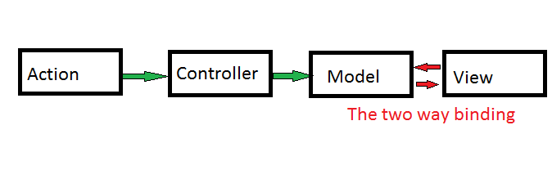
Problem with MVC

Slide 3
Problem with MVC
Model watches to views and views watches the model. Too many Watches

Slide 4
Problem with MVC
Model watches to views and views watches the model. Too many Watches
Views re rendering too much

Slide 5
Problem with MVC
Model watches to views and views watches the model. Too many Watches
Views re rendering too much
Makes a page of real time data heavy to render

Slide 6
Problem with MVC
Model watches to views and views watches the model. Too many Watches
Views re rendering too much
Makes a page of real time data heavy to render
Two way data flow make it difficult to debug a problem

Slide 7
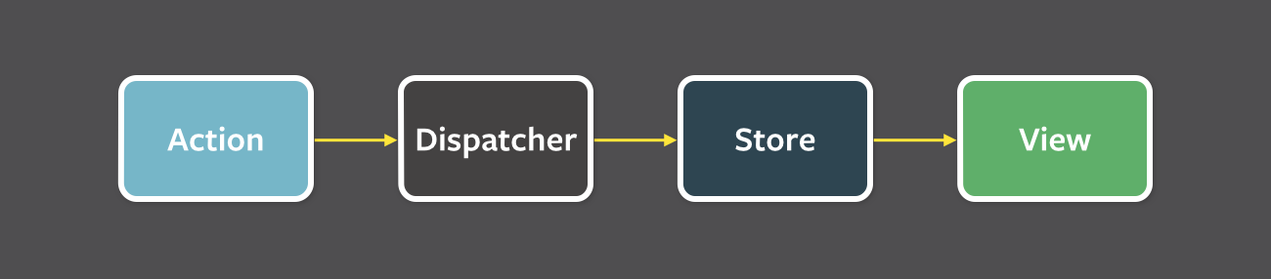
Introducing the Flux Architecture
Flux is simply a design pattern that proposes the idea of one way data flow to the view.

Slide 8
Introducing the Flux Architecture
Actions are the triggers that are initiated by the view or some other components of an application.

Slide 9
Introducing the Flux Architecture
Actions are the triggers that are initiated by the view or some other components of an application.
Dispatcher catches the action and dispatch it to its respective stores where the corresponding actions was registered.

Slide 10
Introducing the Flux Architecture
Actions are the triggers that are initiated by the view or some other components of an application.
Dispatcher catches the action and dispatch it to its respective stores where the corresponding actions was registered.
Stores are the data layer of flux that holds the application state data. It also holds the callbacks of actions coming from the dispatcher where the data can be manipulated to its new state. Once the state of data is changed it re renders its respective view.

Slide 11
Introducing the Flux Architecture
Actions are the triggers that are initiated by the view or some other components of an application.
Dispatcher catches the action and dispatch it to its respective stores where the corresponding actions was registered.
Stores are the data layer of flux that holds the application state data. It also holds the callbacks of actions coming from the dispatcher where the data can be manipulated to its new state. Once the state of data is changed it re renders its respective view.
Views are the front end components to render the data coming from the stores. Views than again initiate some action to the dispatcher.

Slide 12
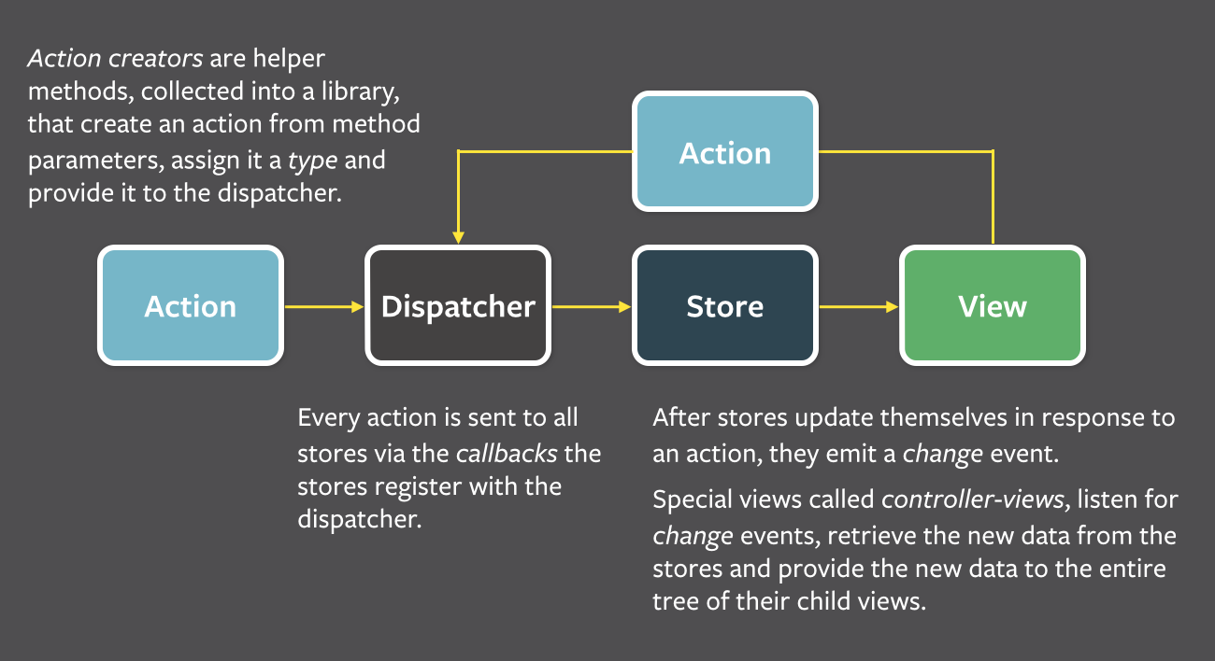
Introducing the Flux Architecture

Slide 13

4
A Javascript Framework

Slide 14
Introduction
JUST THE UI
Lots of people use React as the V in MVC. Since React makes no assumptions about the rest of your technology stack, it's easy to try it out on a small feature in an existing project.
VIRTUAL DOM
React abstracts away the DOM from you, giving a simpler programming model and better performance
DATA FLOW
React implements one-way reactive data flow which reduces boilerplate and is easier to reason about than traditional data binding.

Slide 15
Installation
<script src="build/react.js"></script>
<script src="build/react-dom.js"></script>
<script src="https://cdnjs.cloudflare.com/ajax/libs/babel-core/5.8.23/browser.min.js"></script>
OR
npm install --save react react-dom babelify babel-preset-react
//Then use with require.js
var React = require('react');
var ReactDOM = require('react-dom');

Slide 16
The JSX
React provides us a more convenient way to write Html markup in javascript code. We call it the XMLish syntax and can refer the files as .jsx extension
function() {
return (
<div>Put markup inside the <span>Javascript</span></div>
);
}

Slide 17
Hello World
var HelloMessage = React.createClass({
render: function() {
return <div>Hello {this.props.name}</div>;
}
});
mountNode = document.getElementById(‘mainDiv’);
ReactDOM.render(<HelloMessage name="John" />, mountNode);

Slide 18
Component
In React we refer the all the piece of code as component.
A component can maintain internal state data (accessed via this.props or this.state) When a component's state data changes, the rendered markup will be updated by re-invoking render() this is known as stateful component.
Components can be nested i.e. One component can use the other component inside its render method()

Slide 19
Stateful Component
var Counter = React.createClass({
getInitialState: function() {
return {counter: 0};
},
onClick: function() {
this.setState({counter: this.state.counter + 1}); //this will re render the the DOM
},
render: function() {
return (
<h3 onClick={this.onClick}> Counter using state property: {this.state.counter}</h3>
);
}
});

Slide 20
Html Attributes
React provides full support to all html attributes to us in its markup as a prop.
But prop names should be in camelCase.
Also there are some reserve keywords in Javascript like ‘class’ and ‘for’. So use them as props react provides ‘className’ and ‘htmlFor’ respectively.

Slide 21

Alt.Js
Alt.js provides us an easy and convenient way to implement flux architecture into project using react.js
http://alt.js.org/

Slide 22

Unit tests
To Test the code in our stores and action dispatcher we found a good testing framework which is officially use by facebook.
http://facebook.github.io/jest/

Slide 23
Our Target
To make some simple component using react.js
Then Implement Flux architecture in the app
To find how we can call api and get data from it.
How can we use cookies in react
How can we use local storage in react
How can we implement hash routing to make SPA
How to test the app with unit tests.
Find some good Js bundling framework.

Slide 24
Our RnD
To make some simple component using react.js (Done)
Then Implement Flux architecture in the app (Alt.js)
To find how we can call api and get data from it. (Jquery)
How can we use cookies in react (react-cookie)
How can we use local storage in react (react-localstorage)
How can we implement hash routing to make SPA (react-router)
How to test the app with unit tests. (Jest Framework)
Find some good Js bundling framework.(Require,Reactify,Browserify)

Slide 25
Demo

