Slide 1

Web Training Session
Audience:
Tech Leads and developers @VentureDive.
Presented By:
Mr Abdul Wahab
Mr Tahir Masood

Slide 2





Agenda
Understanding Flux Architecture
Application Development using Alt.js
Front End Rendering with React.js
Test with Jest.js Framework

Slide 3
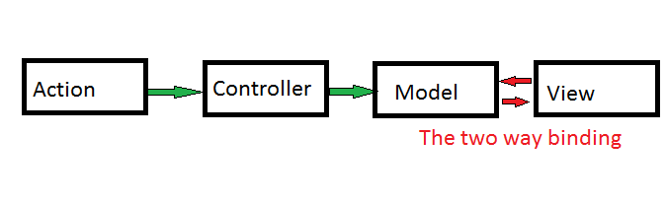
Introducing Flux Architecture
A Typical MVC Flow
Notes:
Model watches to views and views watches the model. Too many Watches.
Views re rendering too much.
Makes a page of real time data heavy to render.
Two way data flow make it difficult to debug a problem.
MVC did not scale well for Facebook’s huge codebase. The main problem for them was the bidirectional
communication, where one change can loop back and have cascading effects across the codebase
(making things very complicated to debug and understand).

Slide 4
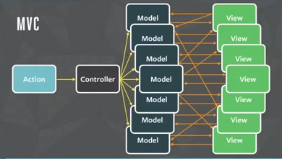
Problem with Two-way binding
Notes:
It creates mash between model and views

Slide 5
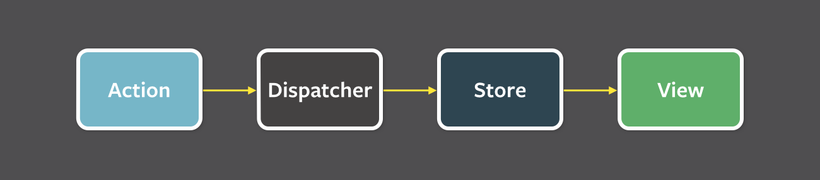
Understanding the Flux Architecture
Flux is simply a design pattern that proposes the idea of one way data flow to the view.

Slide 6
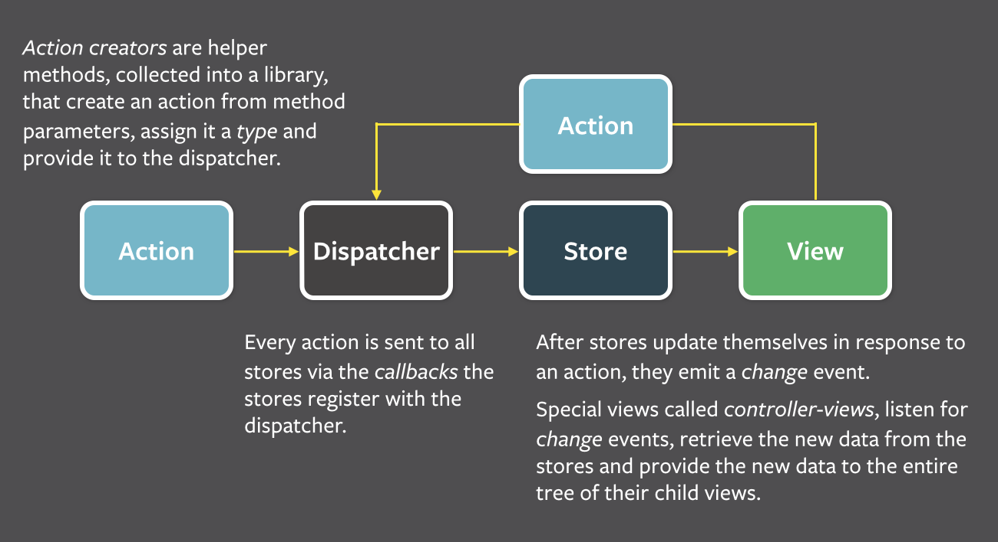
Understanding the Flux Architecture
Notes:
Actions are the triggers that are initiated by the view or some other components of an application.
Dispatcher catches the action and dispatch it to its respective stores where the corresponding actions was registered.
Stores are the data layer of flux that holds the application state data. It also holds the callbacks of actions coming from the dispatcher where the data can be manipulated to its new state. Once the state of data is changed it re renders its respective view.
Views are the front end components to render the data coming from the stores. Views can then again initiate some action to the dispatcher.

Slide 7
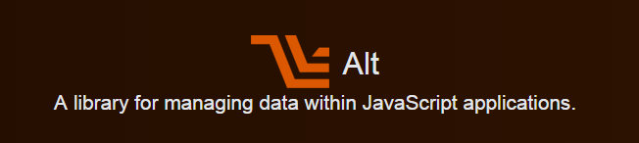
Introducing Alt.Js
Alt.js provides us an easy and convenient way to implement flux architecture into project.
http://alt.js.org/

Slide 8
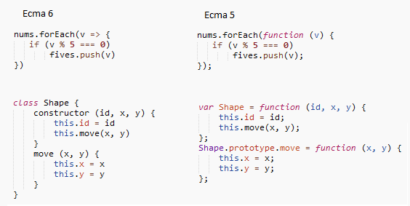
Alt is meant to use ES6
Notes:
Alt.js is meant to use the new features of Ecmascript 6.
We will use classes of ES6 in our sample application.
Therefore some transformer is needed to make the ES6 code compatible to the browsers that only know ES5
Will discuss it later

Slide 9
What Alt provides us?
Dispatcher
Stores
Actions
Views
Unit Testing
Routing
Flexible Directory Structure
Yes (Abstract)
Yes
Yes
No (we will use react)
No (we will use jest)
No (we will use react-router)
Yes

Slide 10
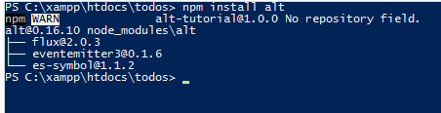
Learn Alt with an example
Create an empty folder named “todos”.
npm install alt
Notes:
Using npm we can run the following command at the root of the directory
This will install the require node modules of alt to the project directory

Slide 11
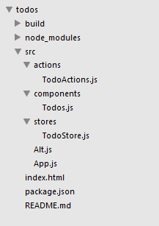
Alt Directory Structure
Notes:
We have now setup an alt app in todos folder.
In which all our Js code resides in the src directory
We added the require files in the their respective folders
Also The Index.html page added at the root which will be starting view
And a package.json file for project’s npm configuration

Slide 12

Initiating Alt application
src/Alt.js
Notes:
Open up tha Alt.js and use the following code that will initiate the alt object.

Slide 13
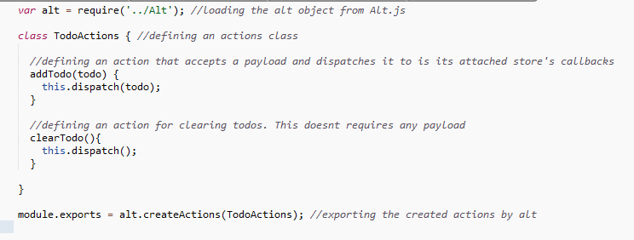
Alt Actions
actions/TodoActions.js
Notes:
Put the following code in TodoActions.js

Slide 14
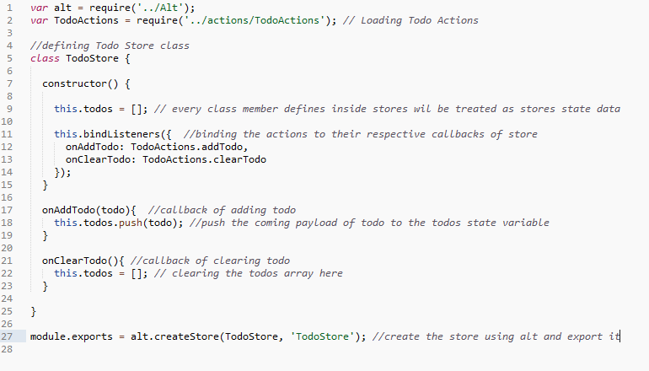
Alt Stores
stores/TodoStore.js
Notes:
Put the following code in TodoStore.js

Slide 15
Alt Views
To render the stores state variables data to the view we are targeting React.Js
Lets understand the react first then we will move back to our Alt Todo app.

Slide 16

Introducing React Js
A Javascript framework for front end rendering

Slide 17
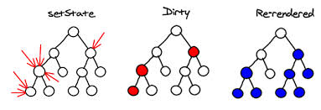
Introducing React Js
JUST THE UI
Lots of people use React as the V in MVC. Since React makes no assumptions about the rest of your technology stack, it's easy to try it out on a small feature in an existing project.
VIRTUAL DOM
React abstracts away the DOM from you, giving a simpler programming model and better performance
DATA FLOW
React implements one-way reactive data flow which reduces boilerplate and is easier to reason about than traditional data binding.
Notes:
Virtual dom will make the new dom tree whenever there is a change in array
And matches it with previous dom structure and calculate the difference
So only the differenced dom would be flush to ui

Slide 18
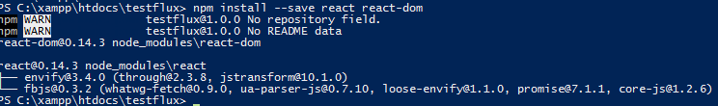
React Installation
OR
npm install --save react react-dom

Slide 19
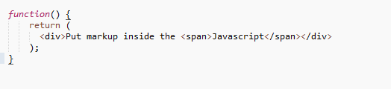
The JSX syntax
React provides us a more convenient way to write Html markup in javascript code. We call it the XMLish syntax and can refer the files as .jsx extension

Slide 20
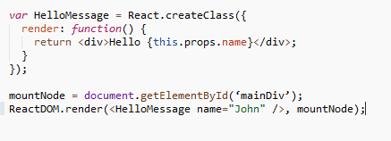
Hello World Component
Notes:
In React we refer all the piece of code as component.
A component can maintain internal state data (accessed via this.props or this.state) When a component's state data changes, the rendered markup will be updated by re-invoking render() method this is known as stateful component.
Components can be nested i.e. One component can use the other component inside its render method()

Slide 21
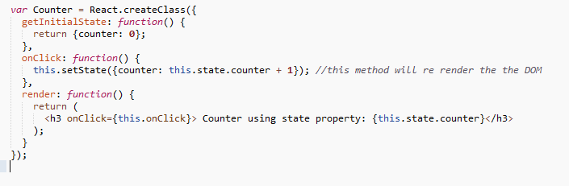
Stateful Component

Slide 22
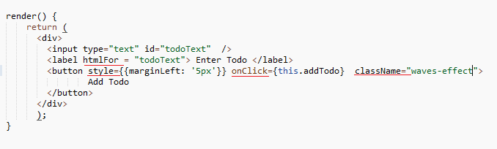
Html Attributes in React
Notes:
React provides full support to all html attributes to us in its markup as a prop.
But prop names should be in camelCase.
Also there are some reserve keywords in Javascript like ‘class’ and ‘for’. So use them as props react provides ‘className’ and ‘htmlFor’ respectively.
Similarly defining any inline style should also use the camelCase syntax like: style={{marginLeft: '5px'}}

Slide 23
Moving back to our Todo App
Notes:
We have learned the React rendering enough so far.
Lets use a react view in our app to render the todos

Slide 24

Using React Component as Alt View
Notes:
We need to pass the alt store’s state data to the view.
Alt provides a built-in components that binds an specific store to the specific view. This is known as Component Container
This will actually pass the state data from the store to the view as a prop. Hence the Customer component can now access the state data from Customer Store i.e customers from its prop.

Slide 25
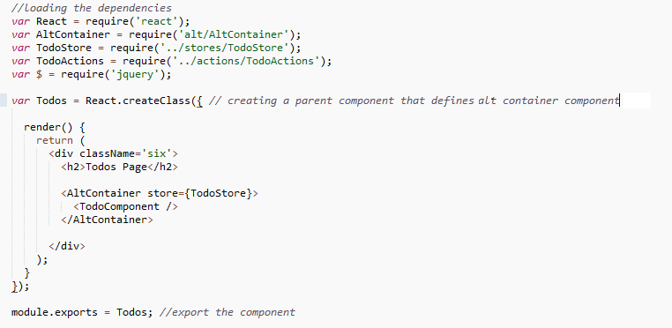
Alt Component
components/Todos.js
Notes:
Use the following code in Todos.js of component directory

Slide 26
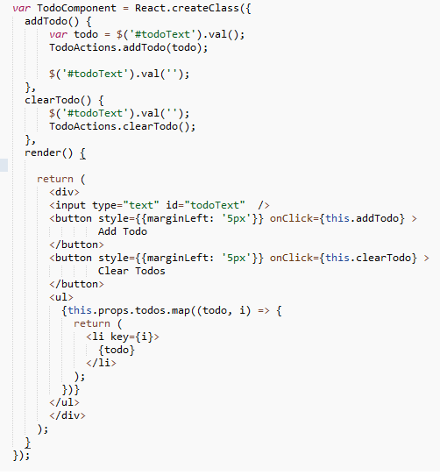
Alt Component
components/Todos.js
Notes:
Use the following code in Todos.js of component directory

Slide 27
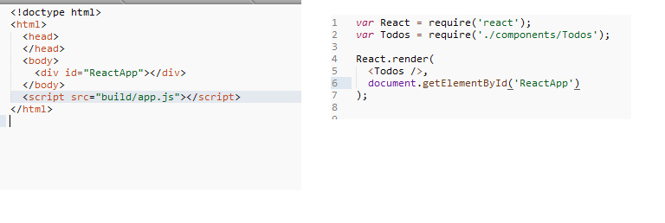
Rendering Component
Index.html
App.js
Notes:
Use the code in index.html
And in app.js

Slide 28
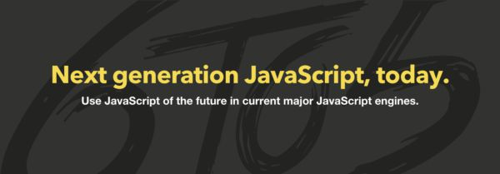
Jsx Compilation and ES6 to 5 Transformation
https://babeljs.io/
Notes:
So far we use just the jsx syntax in our component and also used the ES6 features in the stores.
Browser don’t knows the jsx syntax in javascript so we need some transformer utility that transform this syntax to plain script for browser to digest.
Babel.js done this job pretty well this can be use directly by linking its script file or using npm.

Slide 29
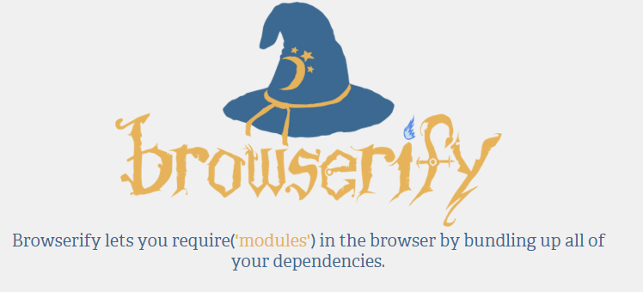
Bundling up the node style code
http://browserify.org/
Notes:
So far we use just the require method of Node but we are actually making the client app
Browserify will let us able to use the node style code and bundles it up into on js file
So we can use the npm packages and modular approach for client code designing as well

Slide 30
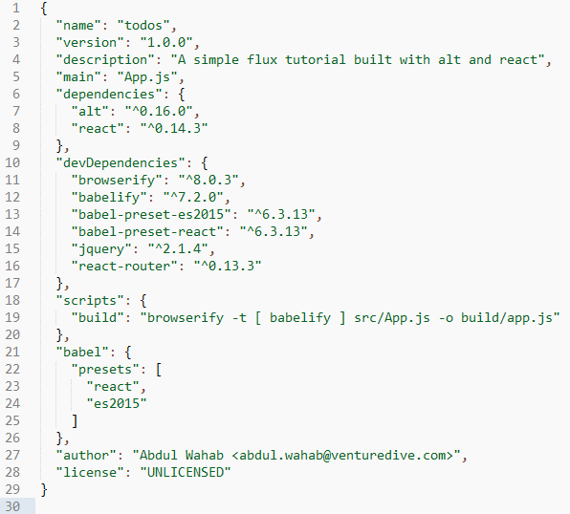
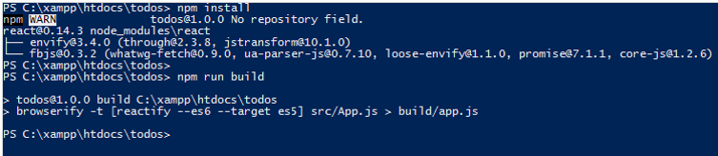
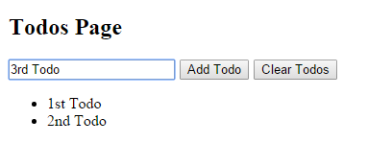
Build and Run
Notes:
Put the following configuration in package.json which contains all the required dependencies.
Then use the commands “npm install” and “npm run build” to install the required dependencies and build the code

Slide 31
Demo

Slide 32
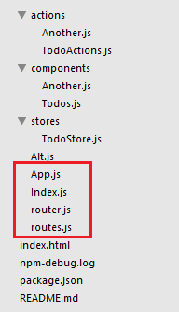

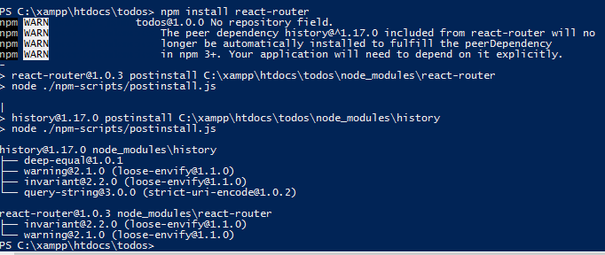
Introducing hash routes
Notes:
To make the app SPA using hash routes we will use react-router component
https://github.com/rackt/react-router
Add react-router dependency and run “npm install” command

Slide 33
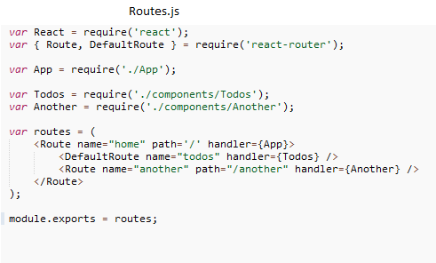
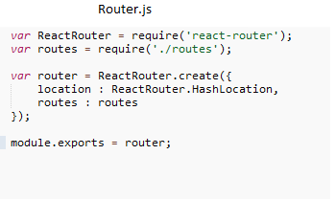
Introducing hash routes
Notes:
To make the app SPA using hash routes we will use react-router component
https://github.com/rackt/react-router
Add react-router dependency and run “npm install” command

Slide 34
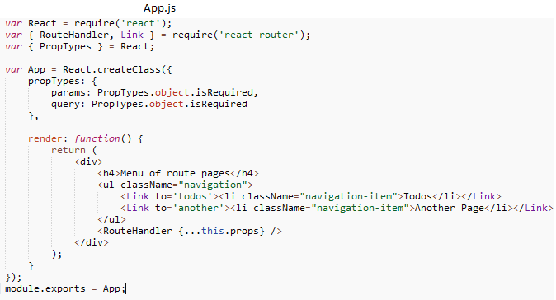
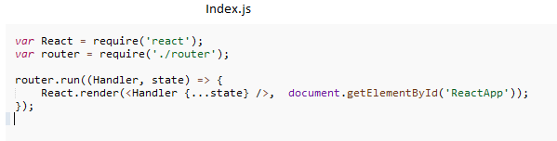
Introducing hash routes
Notes:
To make the app SPA using hash routes we will use react-router component
https://github.com/rackt/react-router
Add react-router dependency and run “npm install” command

Slide 35

Unit tests
To Test the code in our stores and action dispatcher we found a good testing framework which is officially use by facebook.
http://facebook.github.io/jest/

Slide 36
Using Jest
Jest provides you:
Automatically finds tests to execute in your repository.
Automatically mocks dependencies for you when running your tests
Allows you to test asynchronous code synchronously
Runs your tests with a fake DOM implementation (via jsdom) so that your tests can run on the command line
Runs tests in parallel processes so that they finish sooner

Slide 37
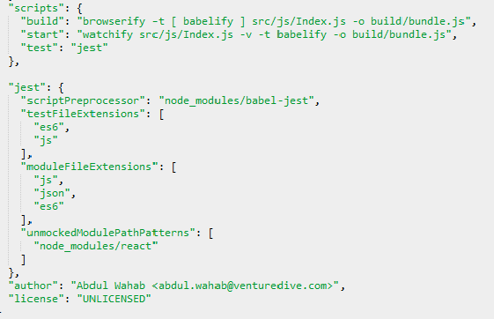

Jest Installation
OR
npm install jest-cli --save-dev

Slide 38
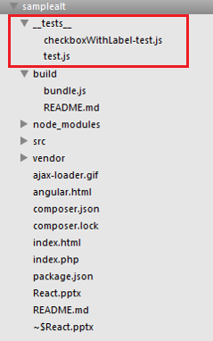
Jest Directory Structure
You can follow the structure as provided by Jest Examples as it creates a folder ‘__tests__’ at top and place all test cases inside it.

Slide 39
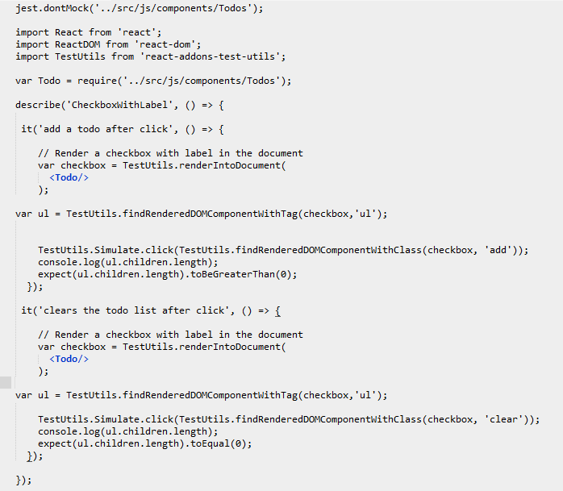
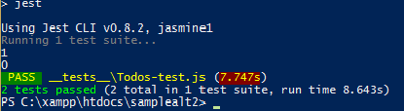
Test And Result

Slide 40
More Learning Resources
https://github.com/awahab29/samplealt (Presentation Code)
https://github.com/goatslacker/alt
https://github.com/substack/browserify-handbook
https://github.com/rackt/react-router
https://github.com/schempy/react-flux-routing-seo
https://github.com/eXon/react-cookie
https://github.com/STRML/react-localstorage
https://facebook.github.io/react/blog/2014/09/24/testing-flux-applications.html
Notes:
We can refer the given links for further learning

Slide 41

Thank You
Any questions from the audience please!!!

