Slide 1




Agenda
Understanding Flux Architecture
Application Development using Alt.js
Front End Rendering with React.js
Test with Jest.js Framework

Slide 2
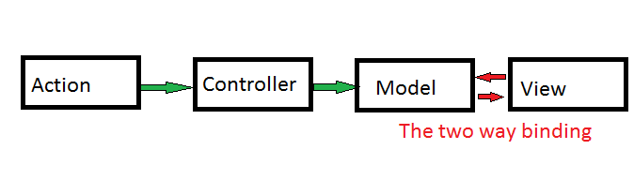
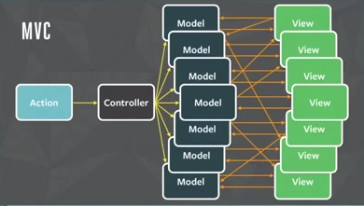
Problem with MVC

Slide 3
Problem with MVC
Model watches to views and views watches the model. Too many Watches

Slide 4
Problem with MVC
Model watches to views and views watches the model. Too many Watches
Views re rendering too much due to cascading update

Slide 5
Problem with MVC
Model watches to views and views watches the model. Too many Watches
Views re rendering too much due to cascading update
Makes a page of real time data heavy to render

Slide 6
Problem with MVC
Model watches to views and views watches the model. Too many Watches
Views re rendering too much due to cascading update
Makes a page of real time data heavy to render
Two way data flow make it difficult to debug a problem

Slide 7
Problem with MVC
Model watches to views and views watches the model. Too many Watches
Views re rendering too much
Makes a page of real time data heavy to render
Two way data flow make it difficult to debug a problem.
MVC did not scale well for Facebook’s huge codebase. The main problem for them was the bidirectional
communication, where one change can loop back and have cascading effects across the codebase
(making things very complicated to debug and understand).

Slide 8
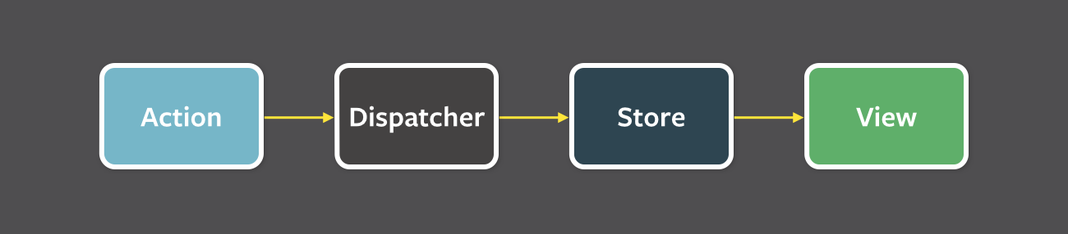
Introducing the Flux Architecture
Flux is simply a design pattern that proposes the idea of one way data flow to the view.

Slide 9
Introducing the Flux Architecture
Actions are the triggers that are initiated by the view or some other components of an application.

Slide 10
Introducing the Flux Architecture
Actions are the triggers that are initiated by the view or some other components of an application.
Dispatcher catches the action and dispatch it to its respective stores where the corresponding actions was registered.

Slide 11
Introducing the Flux Architecture
Actions are the triggers that are initiated by the view or some other components of an application.
Dispatcher catches the action and dispatch it to its respective stores where the corresponding actions was registered.
Stores are the data layer of flux that holds the application state data. It also holds the callbacks of actions coming from the dispatcher where the data can be manipulated to its new state. Once the state of data is changed it re renders its respective view.

Slide 12
Introducing the Flux Architecture
Actions are the triggers that are initiated by the view or some other components of an application.
Dispatcher catches the action and dispatch it to its respective stores where the corresponding actions was registered.
Stores are the data layer of flux that holds the application state data. It also holds the callbacks of actions coming from the dispatcher where the data can be manipulated to its new state. Once the state of data is changed it re renders its respective view.
Views are the front end components to render the data coming from the stores. Views than again initiate some action to the dispatcher.

Slide 13
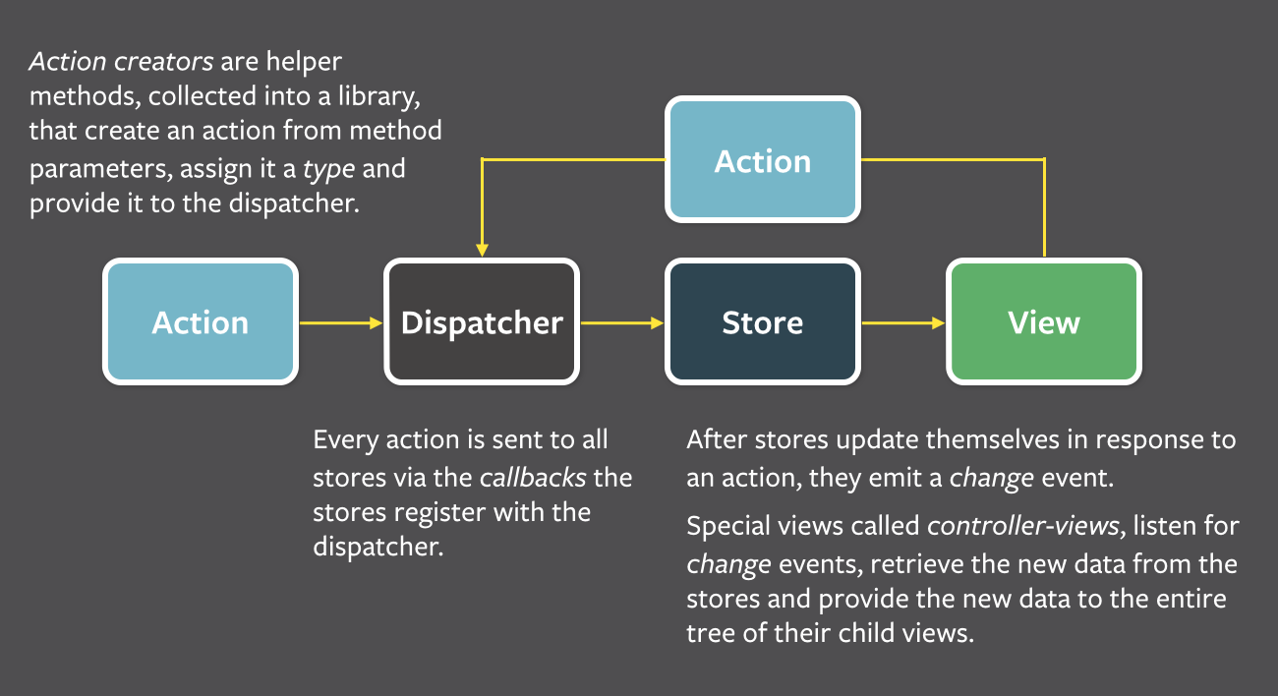
Introducing the Flux Architecture

Slide 14

Introducing Alt.Js
Alt.js provides us an easy and convenient way to implement flux architecture into project using react.js
http://alt.js.org/

Slide 15
Installing Alt
Using npm we can run the following command at the root directory of our project.
npm install alt
This will install the require node modules of alt to the project directory.

Slide 16
Alt Directory Structure
A typical directory structure of alt look like:
my_project
|--actions/
| |--MyActions.js // contains the actions that needs to dispatch to the controllers
|--stores/
| |--MyStore.js // the data store
|--components/
| |--MyComponent.js // view components to render the data coming from stores
|--alt.js // contains the code of initializing alt object
|--app.js // The main starting point of the app that uses alt object

Slide 17
Alt Actions
var alt = require('../alt');
class CustomerActions {
updateCustomers(customers) { //an action getting the customers payload
return customers; //or we can use this.dispatch(customers) to dispatch this action
}
}
module.exports = alt.createActions(CustomerActions); //this will create the actions and export it as module
NOTE: Alt is meant to use the ES6 syntax of class and constructors . But we can convert it to ES5 syntax using a javascript utitilty.

Slide 18
Alt Stores
var alt = require('../alt');
var CustomerActions = require('../actions/CustomerActions'); //Loading the created customer actions
class CustomerStore { //defining store class
constructor() {
this.customers = []; //any class member defines inside the store constructors will be treated as store’s state variables
this.bindListeners({
handleUpdateCustomers: LocationActions.updateCustomers // binding the stores callback to the action. So whenever the action is dispatched it will be handle by the callback
});
}
handleUpdateCustomers(customers) { //the callback of updateCustomers action
this. customers = customers;
}
}
module.exports = alt.createStore(CustomerStore, ‘CustomerStore'); //creating the class as alt store and export it

Slide 19
Alt Views
To render the stores state variables data to the view we are targeting React.Js
Lets understand the react then we will move back to Alt.

Slide 20

Introducing React Js
A Javascript framework for front end rendering

Slide 21
Introducing React Js
JUST THE UI
Lots of people use React as the V in MVC. Since React makes no assumptions about the rest of your technology stack, it's easy to try it out on a small feature in an existing project.

Slide 22
Introducing React Js
JUST THE UI
Lots of people use React as the V in MVC. Since React makes no assumptions about the rest of your technology stack, it's easy to try it out on a small feature in an existing project.
VIRTUAL DOM
React abstracts away the DOM from you, giving a simpler programming model and better performance

Slide 23
Introducing React Js
JUST THE UI
Lots of people use React as the V in MVC. Since React makes no assumptions about the rest of your technology stack, it's easy to try it out on a small feature in an existing project.
VIRTUAL DOM
React abstracts away the DOM from you, giving a simpler programming model and better performance
DATA FLOW
React implements one-way reactive data flow which reduces boilerplate and is easier to reason about than traditional data binding.

Slide 24
React Installation
<script src="build/react.js"></script>
<script src="build/react-dom.js"></script>
<script src="https://cdnjs.cloudflare.com/ajax/libs/babel-core/5.8.23/browser.min.js"></script>
OR
npm install --save react react-dom babelify babel-preset-react
//Then use with require.js
var React = require('react');
var ReactDOM = require('react-dom');

Slide 25
The JSX syntax
React provides us a more convenient way to write Html markup in javascript code. We call it the XMLish syntax and can refer the files as .jsx extension
function() {
return (
<div>Put markup inside the <span>Javascript</span></div>
);
}

Slide 26
Hello World
var HelloMessage = React.createClass({
render: function() {
return <div>Hello {this.props.name}</div>;
}
});
mountNode = document.getElementById(‘mainDiv’);
ReactDOM.render(<HelloMessage name="John" />, mountNode);

Slide 27
React Component
In React we refer all the piece of code as component.

Slide 28
React Component
In React we refer all the piece of code as component.
A component can maintain internal state data (accessed via this.props or this.state) When a component's state data changes, the rendered markup will be updated by re-invoking render() method this is known as stateful component.

Slide 29
React Component
In React we refer all the piece of code as component.
A component can maintain internal state data (accessed via this.props or this.state) When a component's state data changes, the rendered markup will be updated by re-invoking render() method this is known as stateful component.
Components can be nested i.e. One component can use the other component inside its render method()

Slide 30
Stateful Component
var Counter = React.createClass({
getInitialState: function() {
return {counter: 0};
},
onClick: function() {
this.setState({counter: this.state.counter + 1}); //this method will re render the the DOM
},
render: function() {
return (
<h3 onClick={this.onClick}> Counter using state property: {this.state.counter}</h3>
);
}
});

Slide 31
Html Attributes in React
React provides full support to all html attributes to us in its markup as a prop.

Slide 32
Html Attributes in React
React provides full support to all html attributes to us in its markup as a prop.
But prop names should be in camelCase.

Slide 33
Html Attributes in React
React provides full support to all html attributes to us in its markup as a prop.
But prop names should be in camelCase.
Also there are some reserve keywords in Javascript like ‘class’ and ‘for’. So use them as props react provides ‘className’ and ‘htmlFor’ respectively.

Slide 34
Using React Component as Alt View
We need to pass the alt store’s state data to the view.

Slide 35
Using React Component as Alt View
We need to pass the alt store’s state data to the view.
Alt provides a built-in components that binds an specific store to the specific view. This is known as Component Container
<AltContainer store={CustomerStore}>
<Customers/>
</AltContainer>

Slide 36
Using React Component as Alt View
We need to pass the alt store’s state data to the view.
Alt provides a built-in components that binds an specific store to the specific view. This is known as Component Container
<AltContainer store={CustomerStore}>
<Customers/>
</AltContainer>
This will actually pass the state data from the store to the view as a prop. Hence the Customer component can now access the state data from Customer Store i.e customers from its prop.

Slide 37
Using React Component as Alt View
var Customers= React.createClass({
render() {
return (
<ul>
{this.props.customers.map((location, i) => { //getting customers data of store from the props
return (
<li key={i}>
{location.name}
</li>
);
})}
</ul>
);
}
});

Slide 38
Jsx Compilation and ES6 Transformation
So far we use just the jsx syntax in our component and also used the ES6 features in the stores.

Slide 39
Jsx Compilation and ES6 Transformation
So far we use just the jsx syntax in our component and also used the ES6 features in the stores.
Browser don’t knows the jsx in javascript so we need some transformer utility that transform this syntax to plain script for browser to digest.

Slide 40
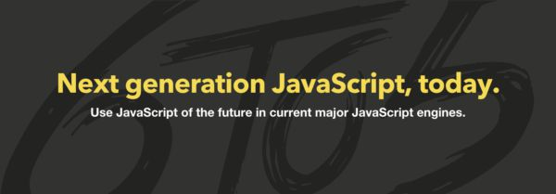
Jsx Compilation and ES6 to 5 Transformation
So far we use just the jsx syntax in our component and also used the ES6 features in the stores.
Browser don’t knows the jsx in javascript so we need some transformer utility that transform this syntax to plain script for browser to digest.
Babel.js done this job pretty well this can be use directly by linking its script file or using npm.
https://babeljs.io/

Slide 41

Unit tests
To Test the code in our stores and action dispatcher we found a good testing framework which is officially use by facebook.
http://facebook.github.io/jest/

Slide 42
Using Jest
Jest provides you:
Automatically finds tests to execute in your repository.

Slide 43
Using Jest
Jest provides you:
Automatically finds tests to execute in your repository.
Automatically mocks dependencies for you when running your tests

Slide 44
Using Jest
Jest provides you:
Automatically finds tests to execute in your repository.
Automatically mocks dependencies for you when running your tests
Allows you to test asynchronous code synchronously

Slide 45
Using Jest
Jest provides you:
Automatically finds tests to execute in your repository.
Automatically mocks dependencies for you when running your tests
Allows you to test asynchronous code synchronously
Runs your tests with a fake DOM implementation (via jsdom) so that your tests can run on the command line

Slide 46
Using Jest
Jest provides you:
Automatically finds tests to execute in your repository.
Automatically mocks dependencies for you when running your tests
Allows you to test asynchronous code synchronously
Runs your tests with a fake DOM implementation (via jsdom) so that your tests can run on the command line
Runs tests in parallel processes so that they finish sooner

Slide 47
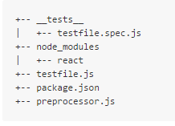
Setting Up Jest
Directory Structure

Slide 48
Demo
Let see a sample single page app developed using Alt and React.
In the app, user has a list of Available Locations from which the user can mark any location to its favorite list.
This app has the following features:
Flux implemented using Alt
Calling some server REST API
Cookies usage
Local storage usage
Hash routing implemented
Using Babelify to tranforms the ES6 and Jsx sytax to vanilla javascript
Js files building and bundeling using Browserify
Unit test with Jest

