Slide 1
Final Project
Predicting Best players in Fifa 2018 world cup

Slide 2
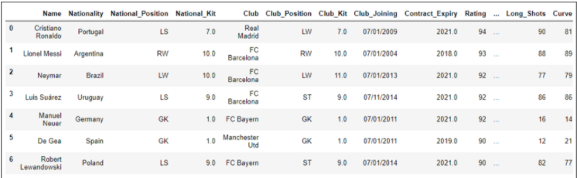
What does the dataset look like?
We have 53 columns in our dataset
We need to remove unused columns

Slide 3
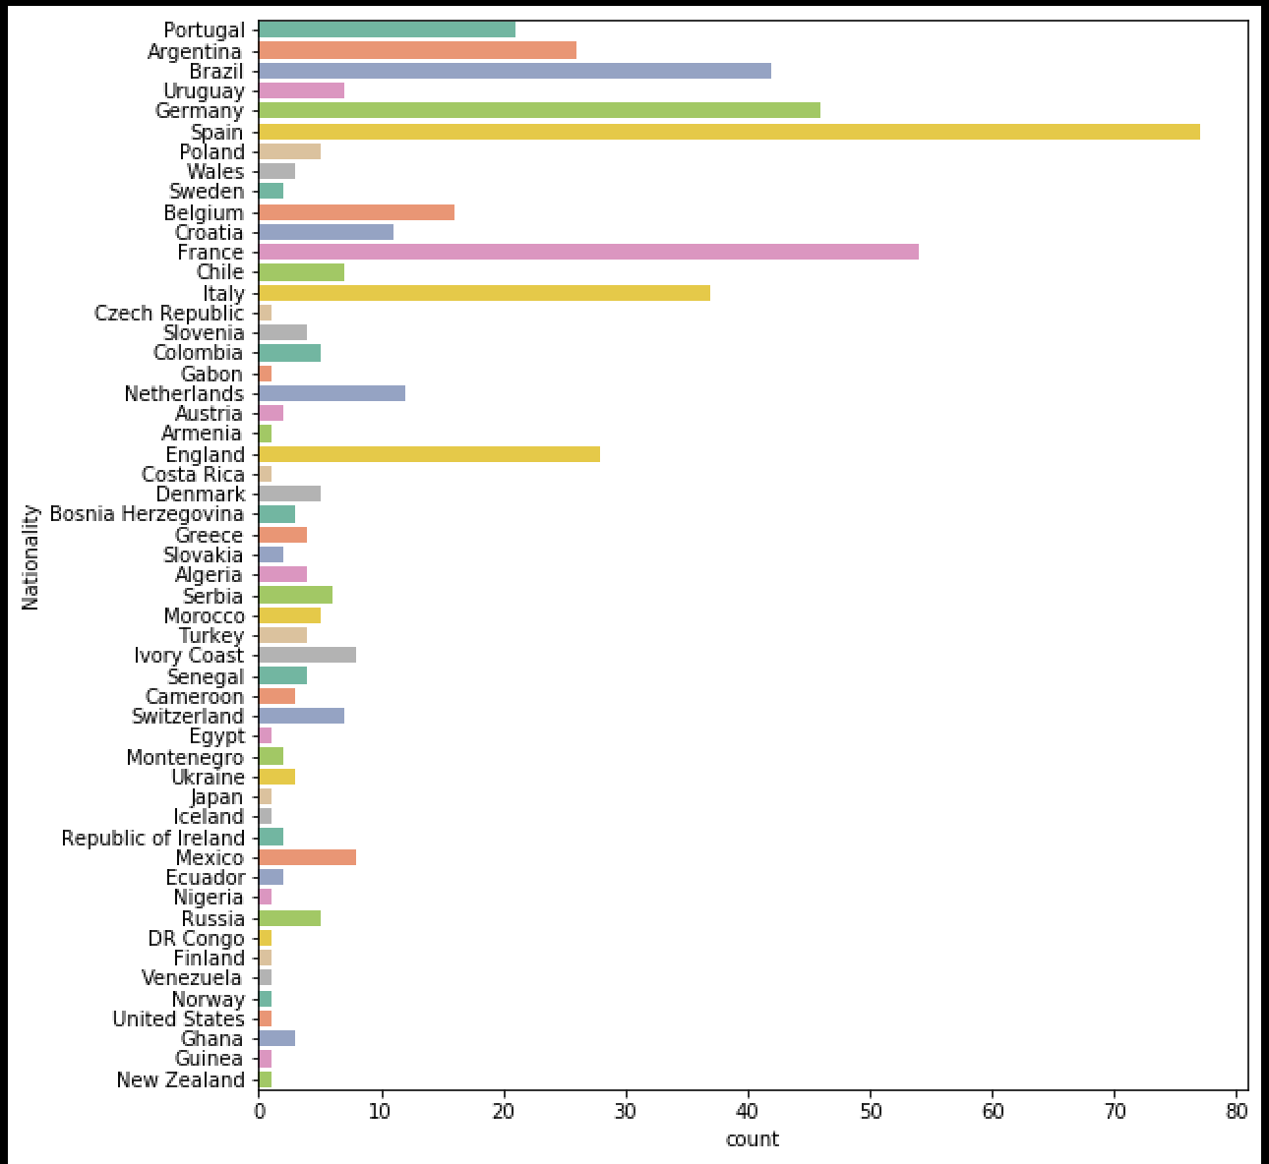
Show the number of players representing a particular country.
This graph shows the number of players representing each country
Based on the results from the graph, we conclude that most of the players are from England, Argentina, Spain, France and Brazil.

Slide 4


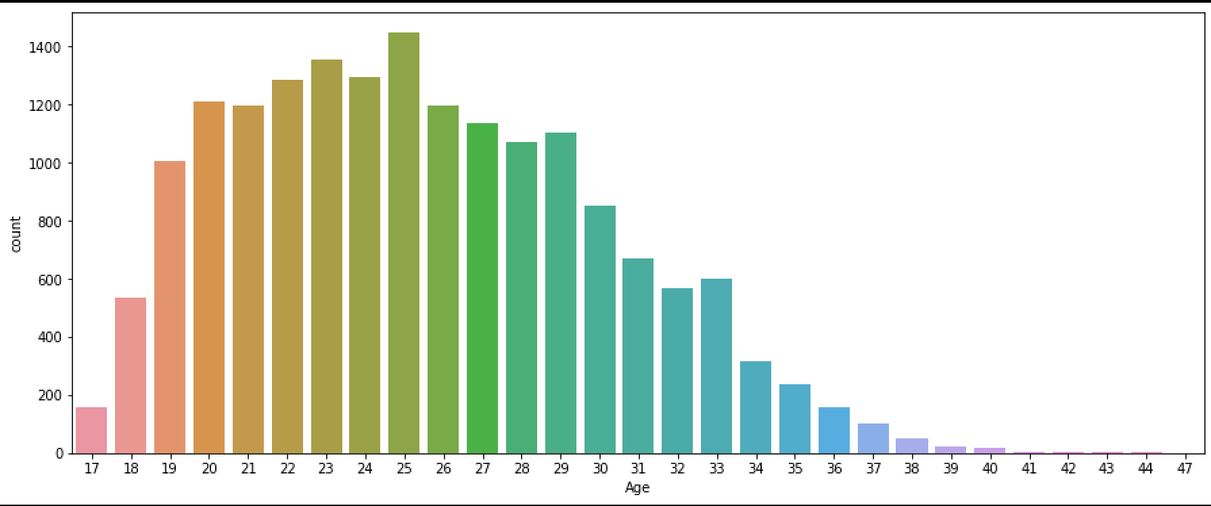



Capture the Age of the soccer players

Slide 5
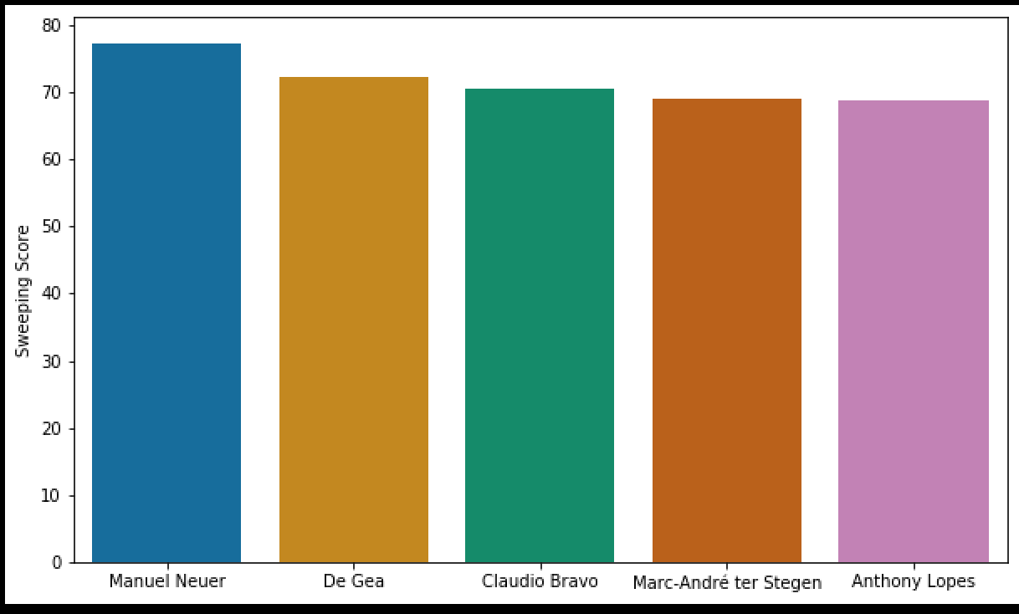
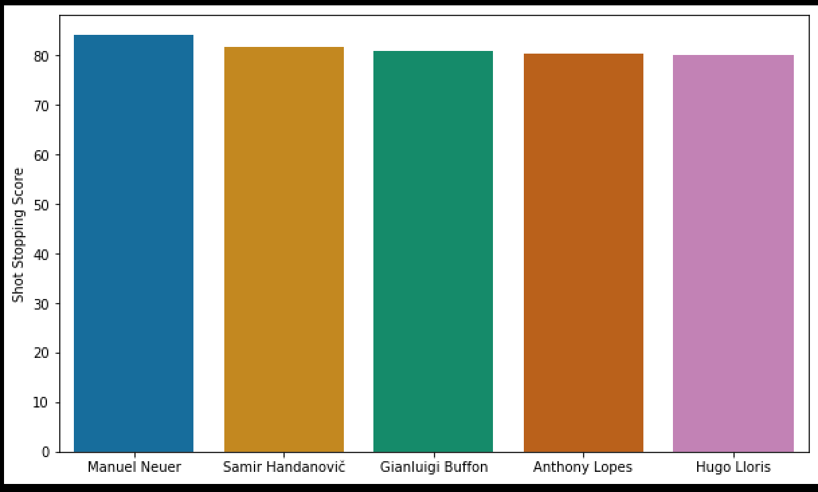
Predicting best GoalKeeper
Manuel Neuer would be the best choice goalkeeper
We used the sweeper and shot stopper features

Slide 6
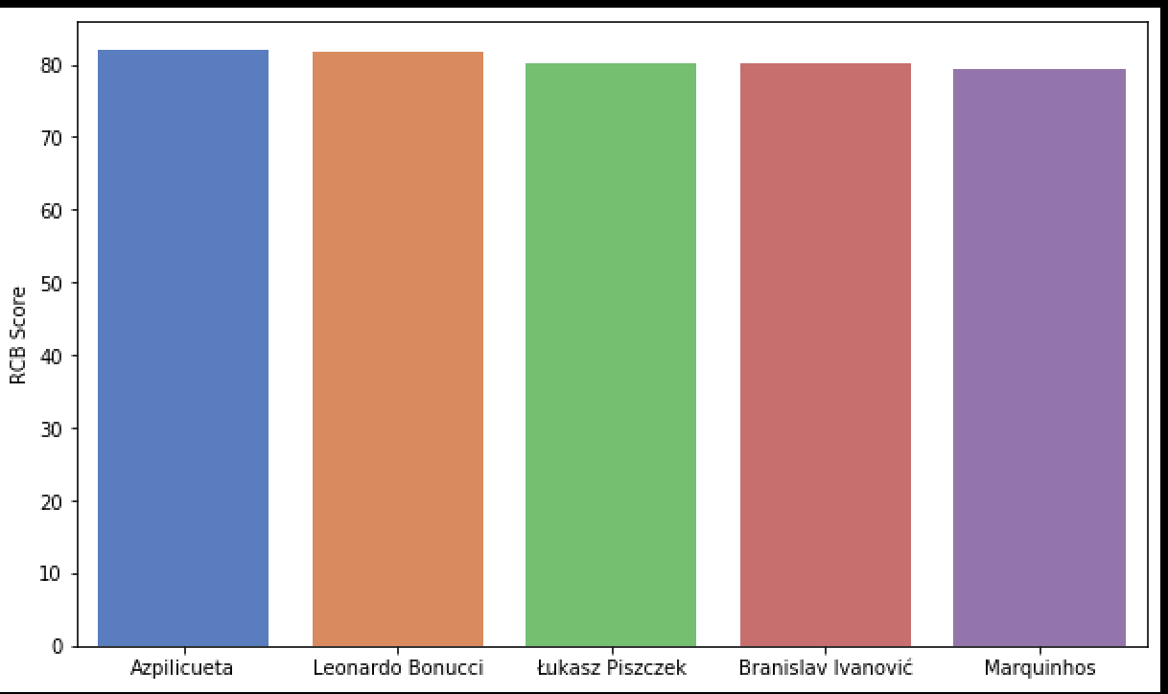
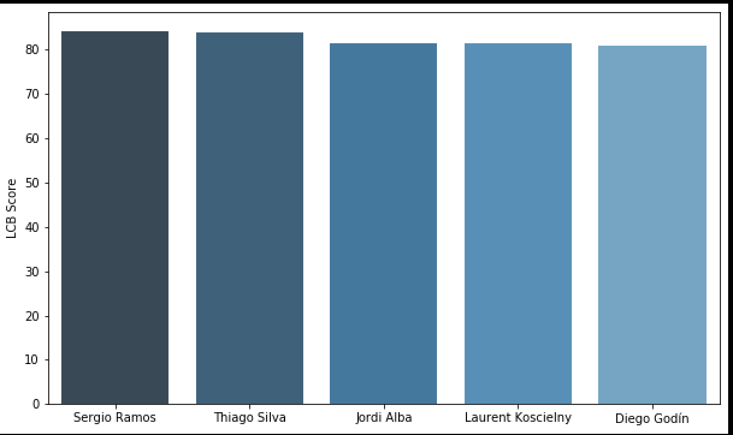
Predict the best Central Defenders
Sergio Ramos is the Best Left Central Defender.
Azpilicueta is the Best Right Central Defender.

Slide 7
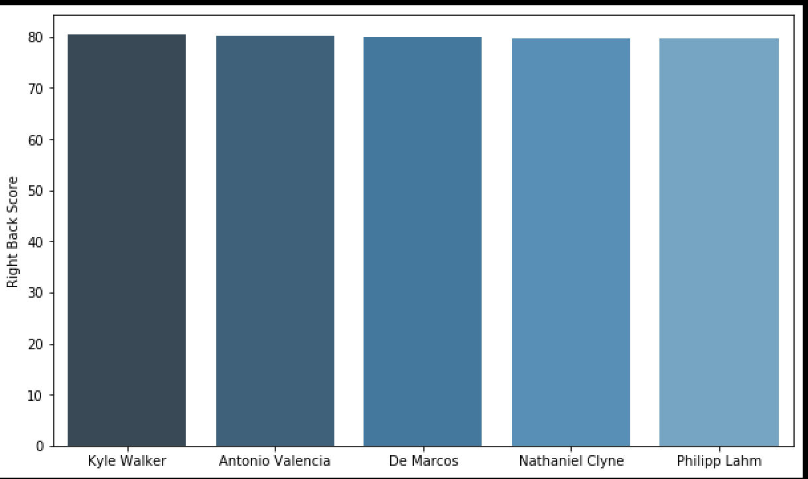
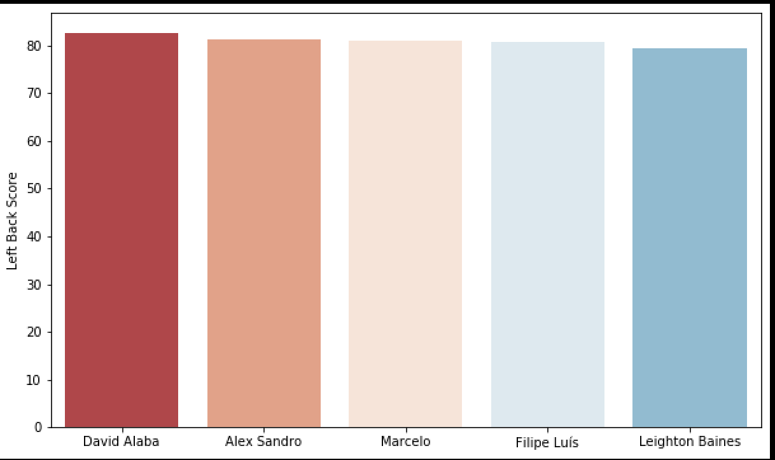
Predict the best wing Backs Defenders
Kyle Walker is the best RWB/RB
David Alaba as the best LWB/LB defender.

Slide 8
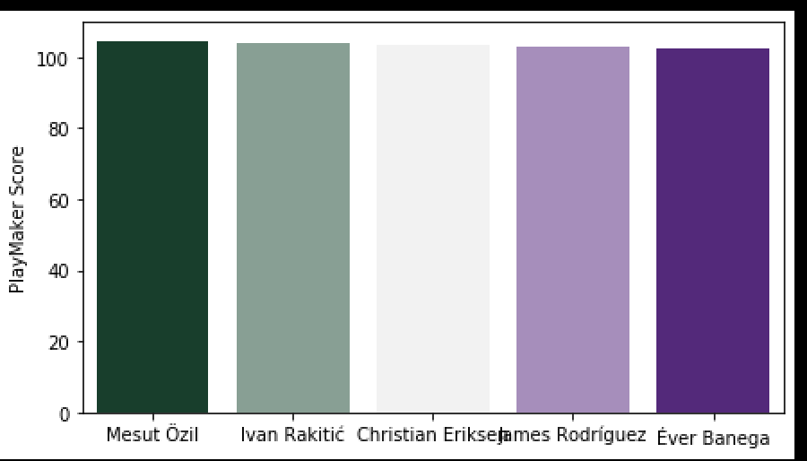
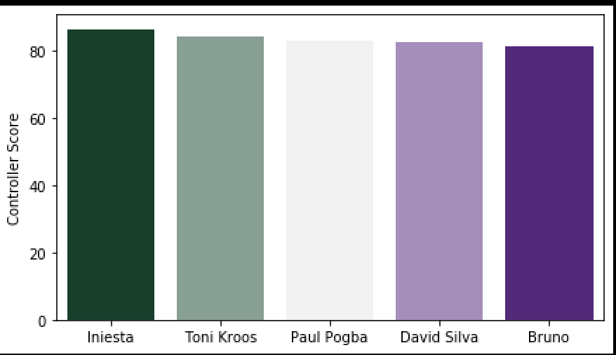
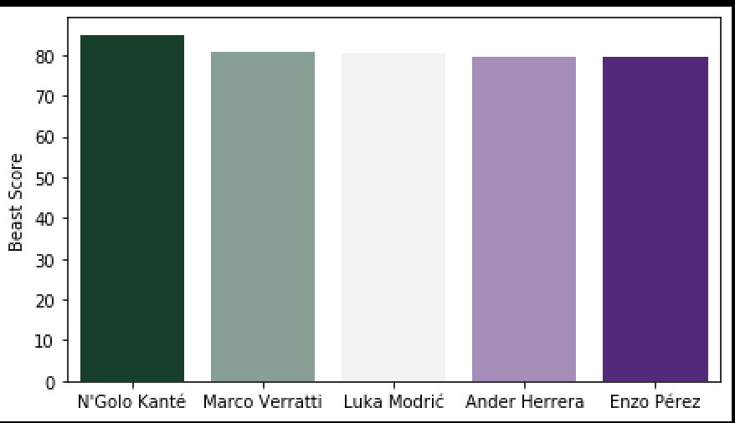
Best Mid-Fielders

Slide 9
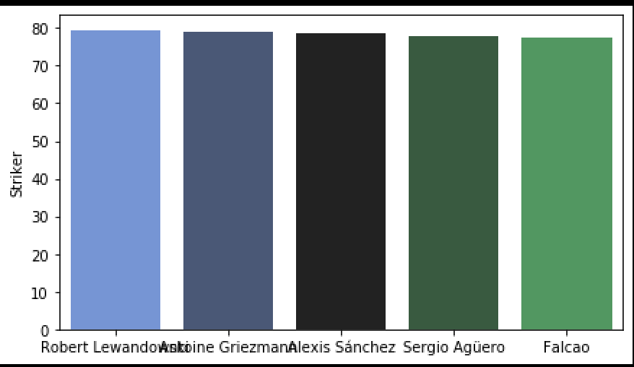
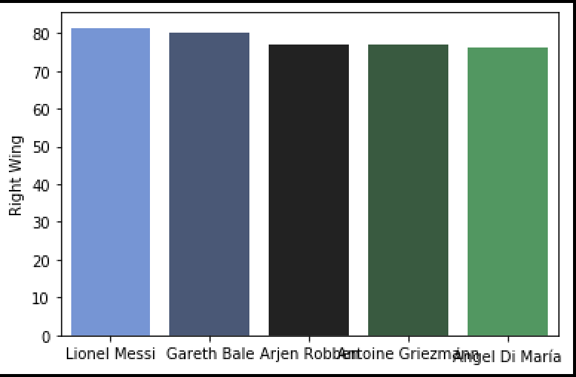
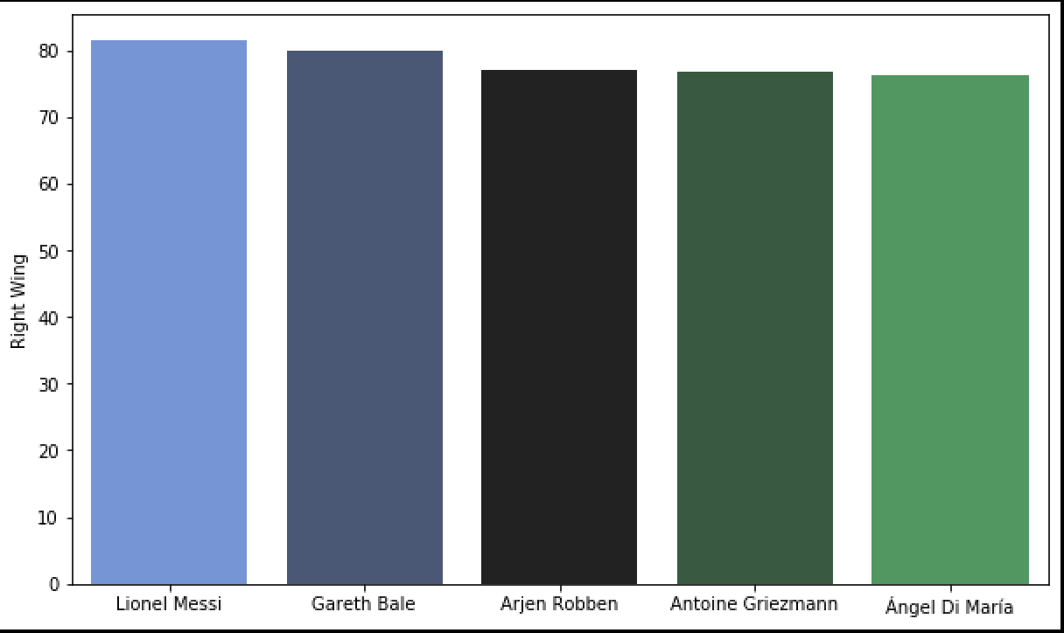
The Best Attackers
Ronaldo is the best Left Wing Attacker
Lionel Messi as the right wing attacker
Robert Lewandowski is the best striker

